Slide 1
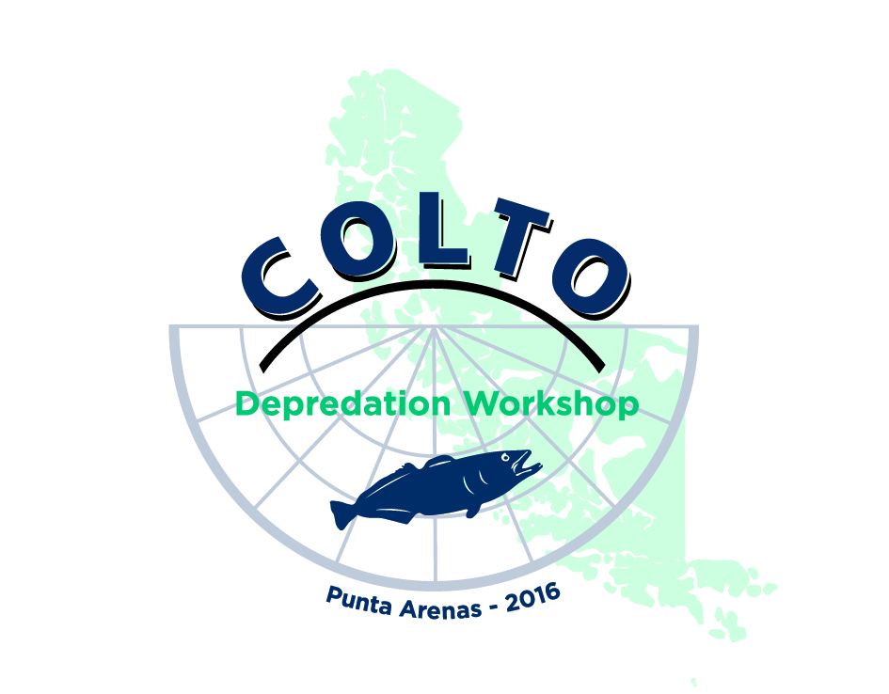
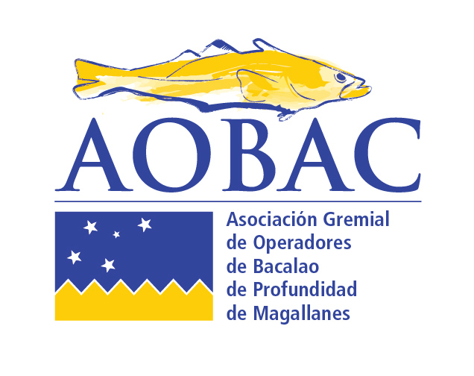
SESSION 1
Levels of depredation and trends in Toothfish fisheries.
Eduardo Infante, AOBAC, Chile

Slide 2
History of the Fishery
The Chilean toothfish fishery goes back to the late 80´s, but it was on the 90´s that a commercial fishery was developed.
The decrease on the quotas of Austral Hake make the longliner fleet to look for alternative species.
Markets should be developed to sell the production. In the earlier years Japan was the main buyer shortly thereafter followed by the USA. The fish was marketed, and still is, as Chilean Seabass.
In the mid 90´s the industrial fleet started to move to international waters looking for better fishing yields starting by South Georgia and moving to more remote locations as far as the Indian Ocean.
Only Fishing Method allowed by Law is longline
Industrial Vessels used traditional Spanish system until 2006- 2007 when we switched to the trotline system with Cachaloteras as a way to avoid the interaction with marine mammals.

Slide 4
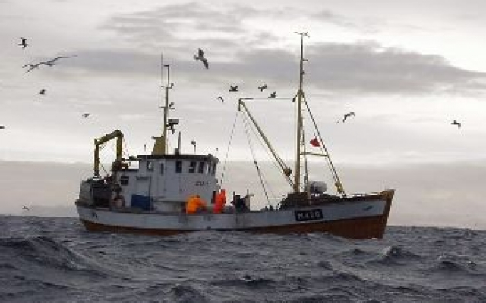
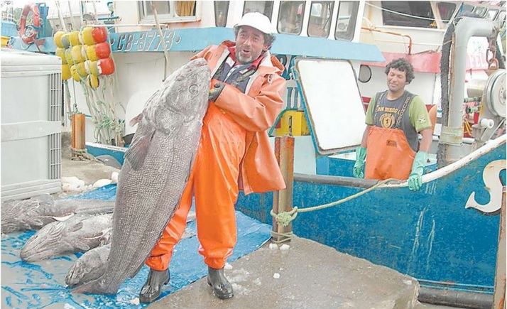
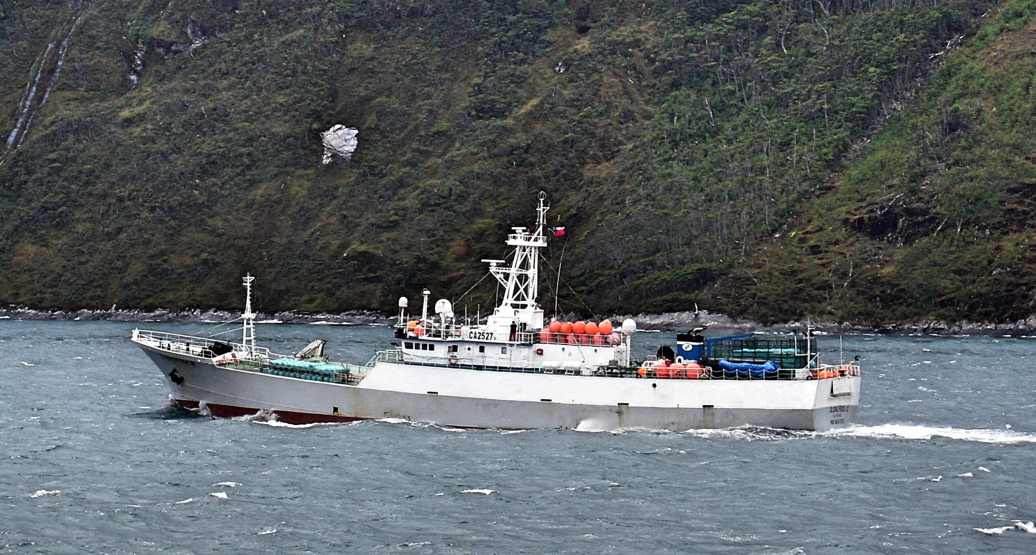
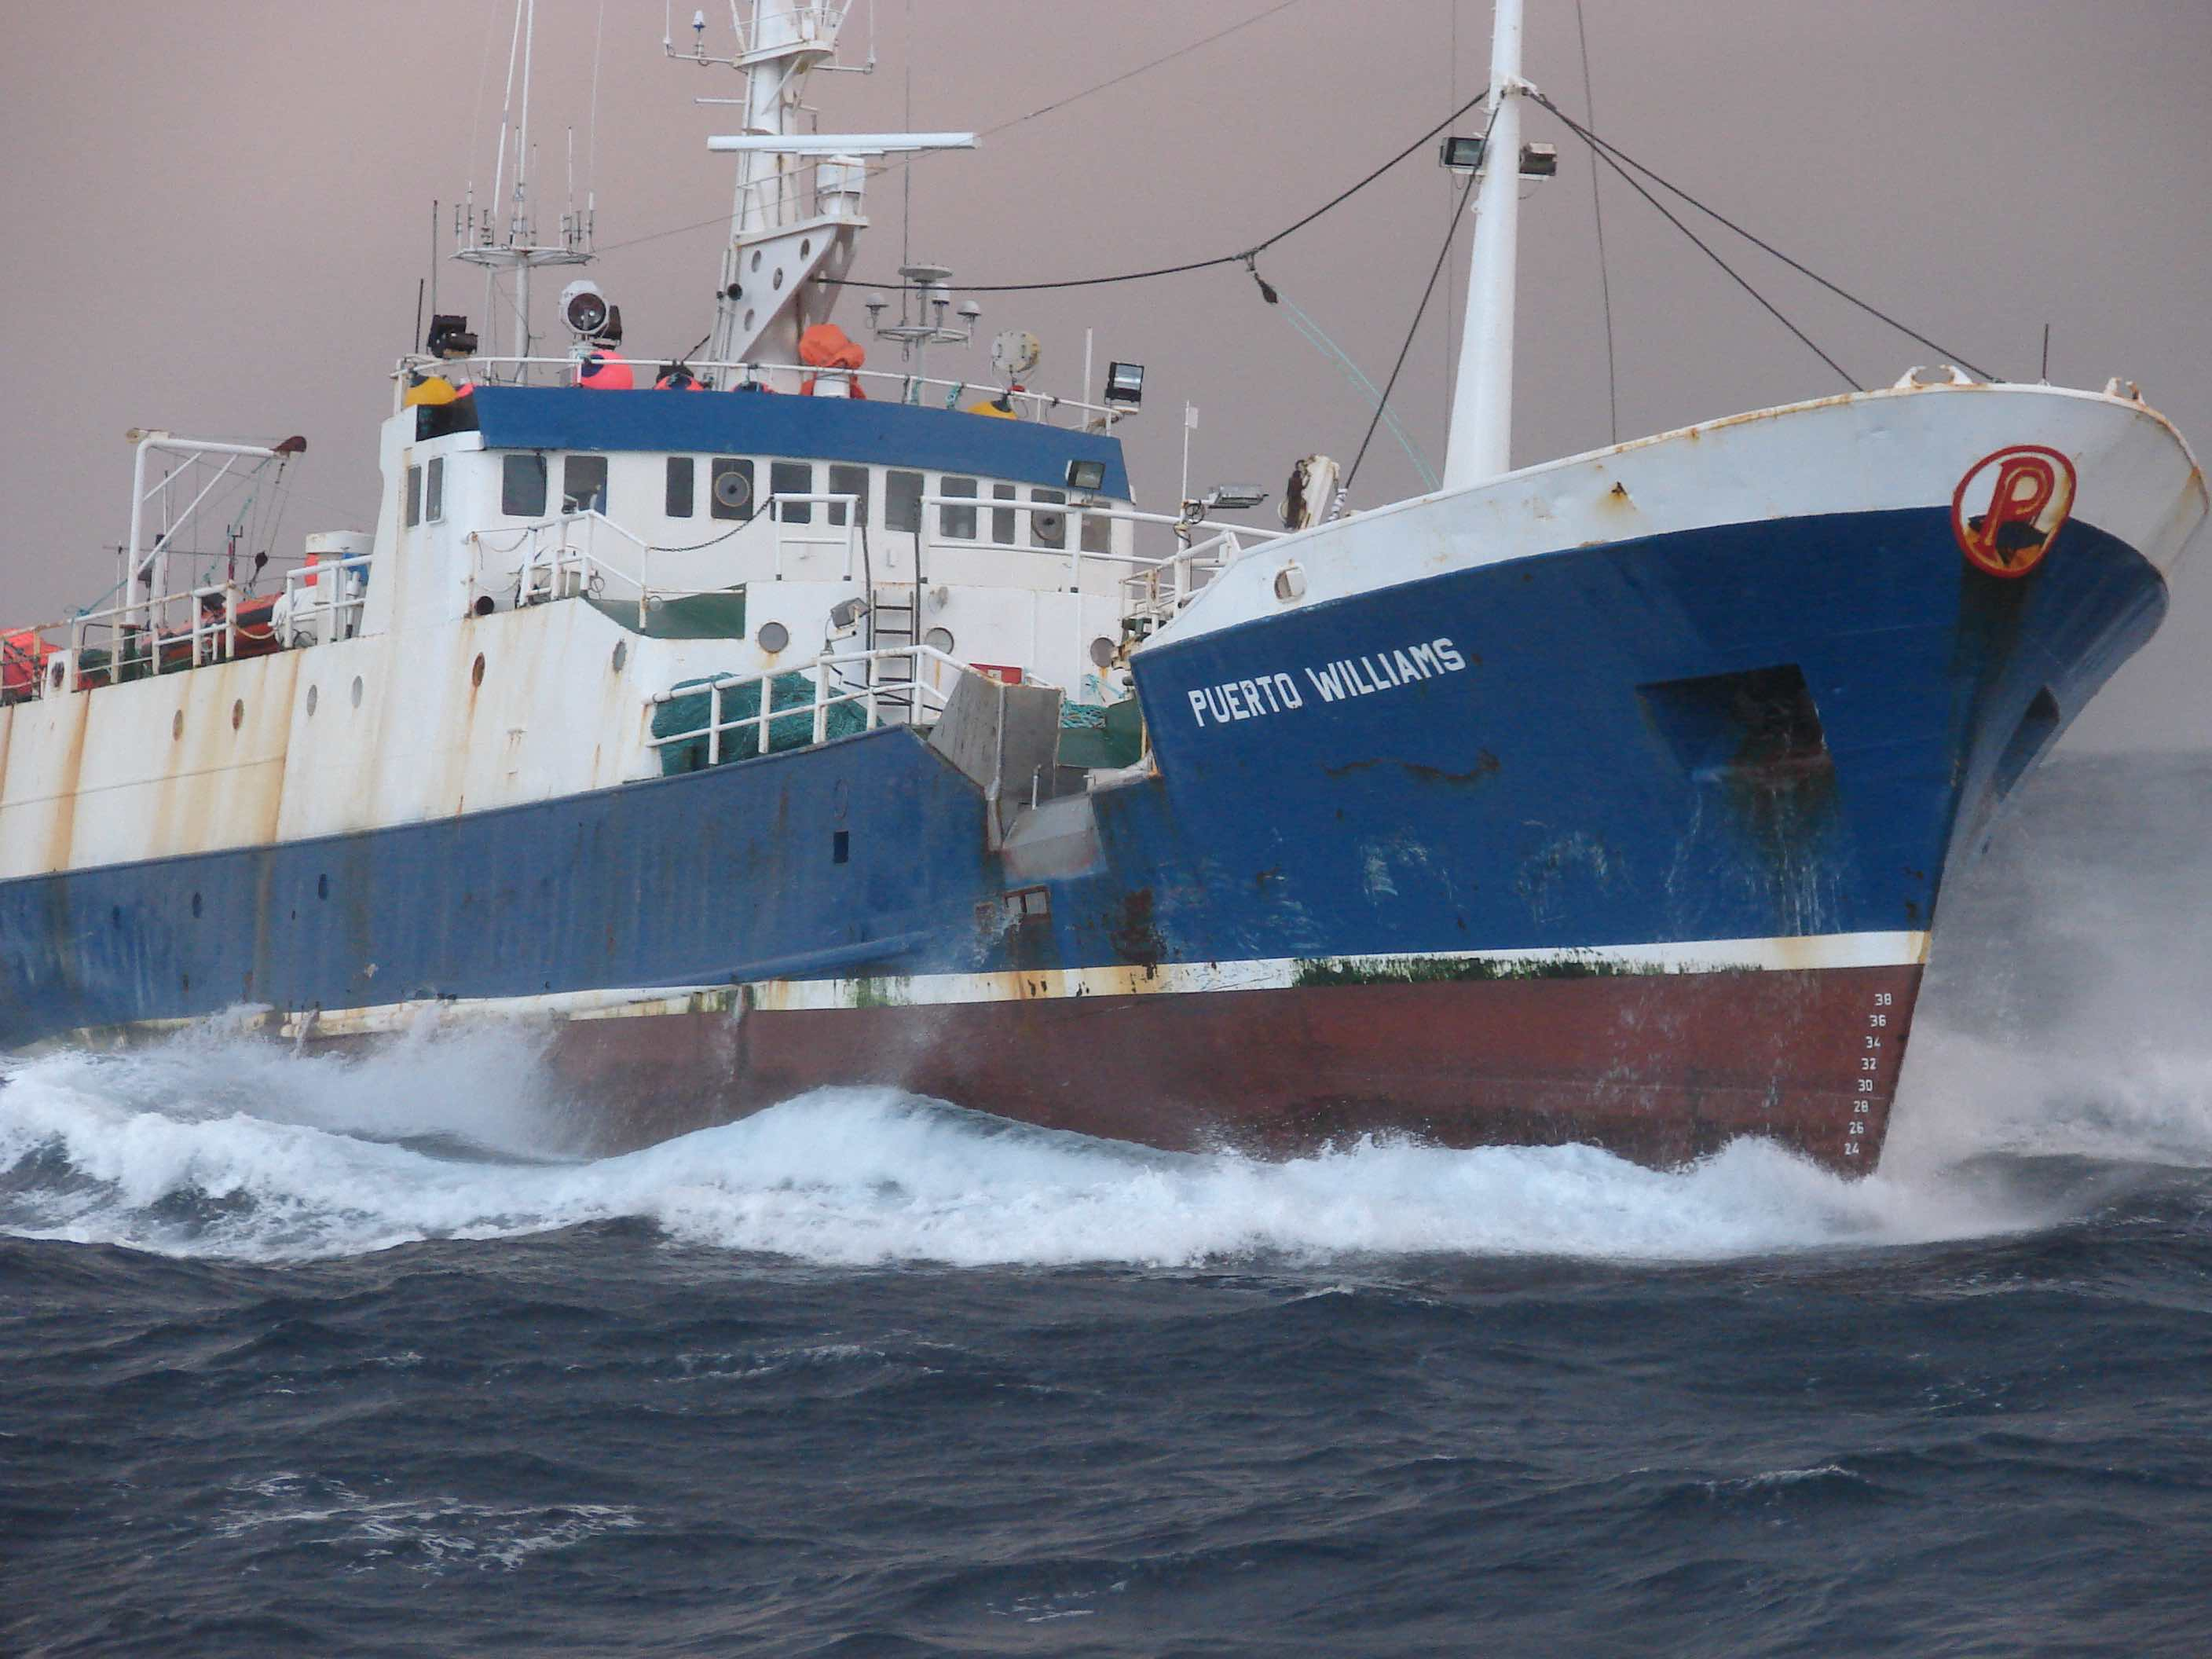
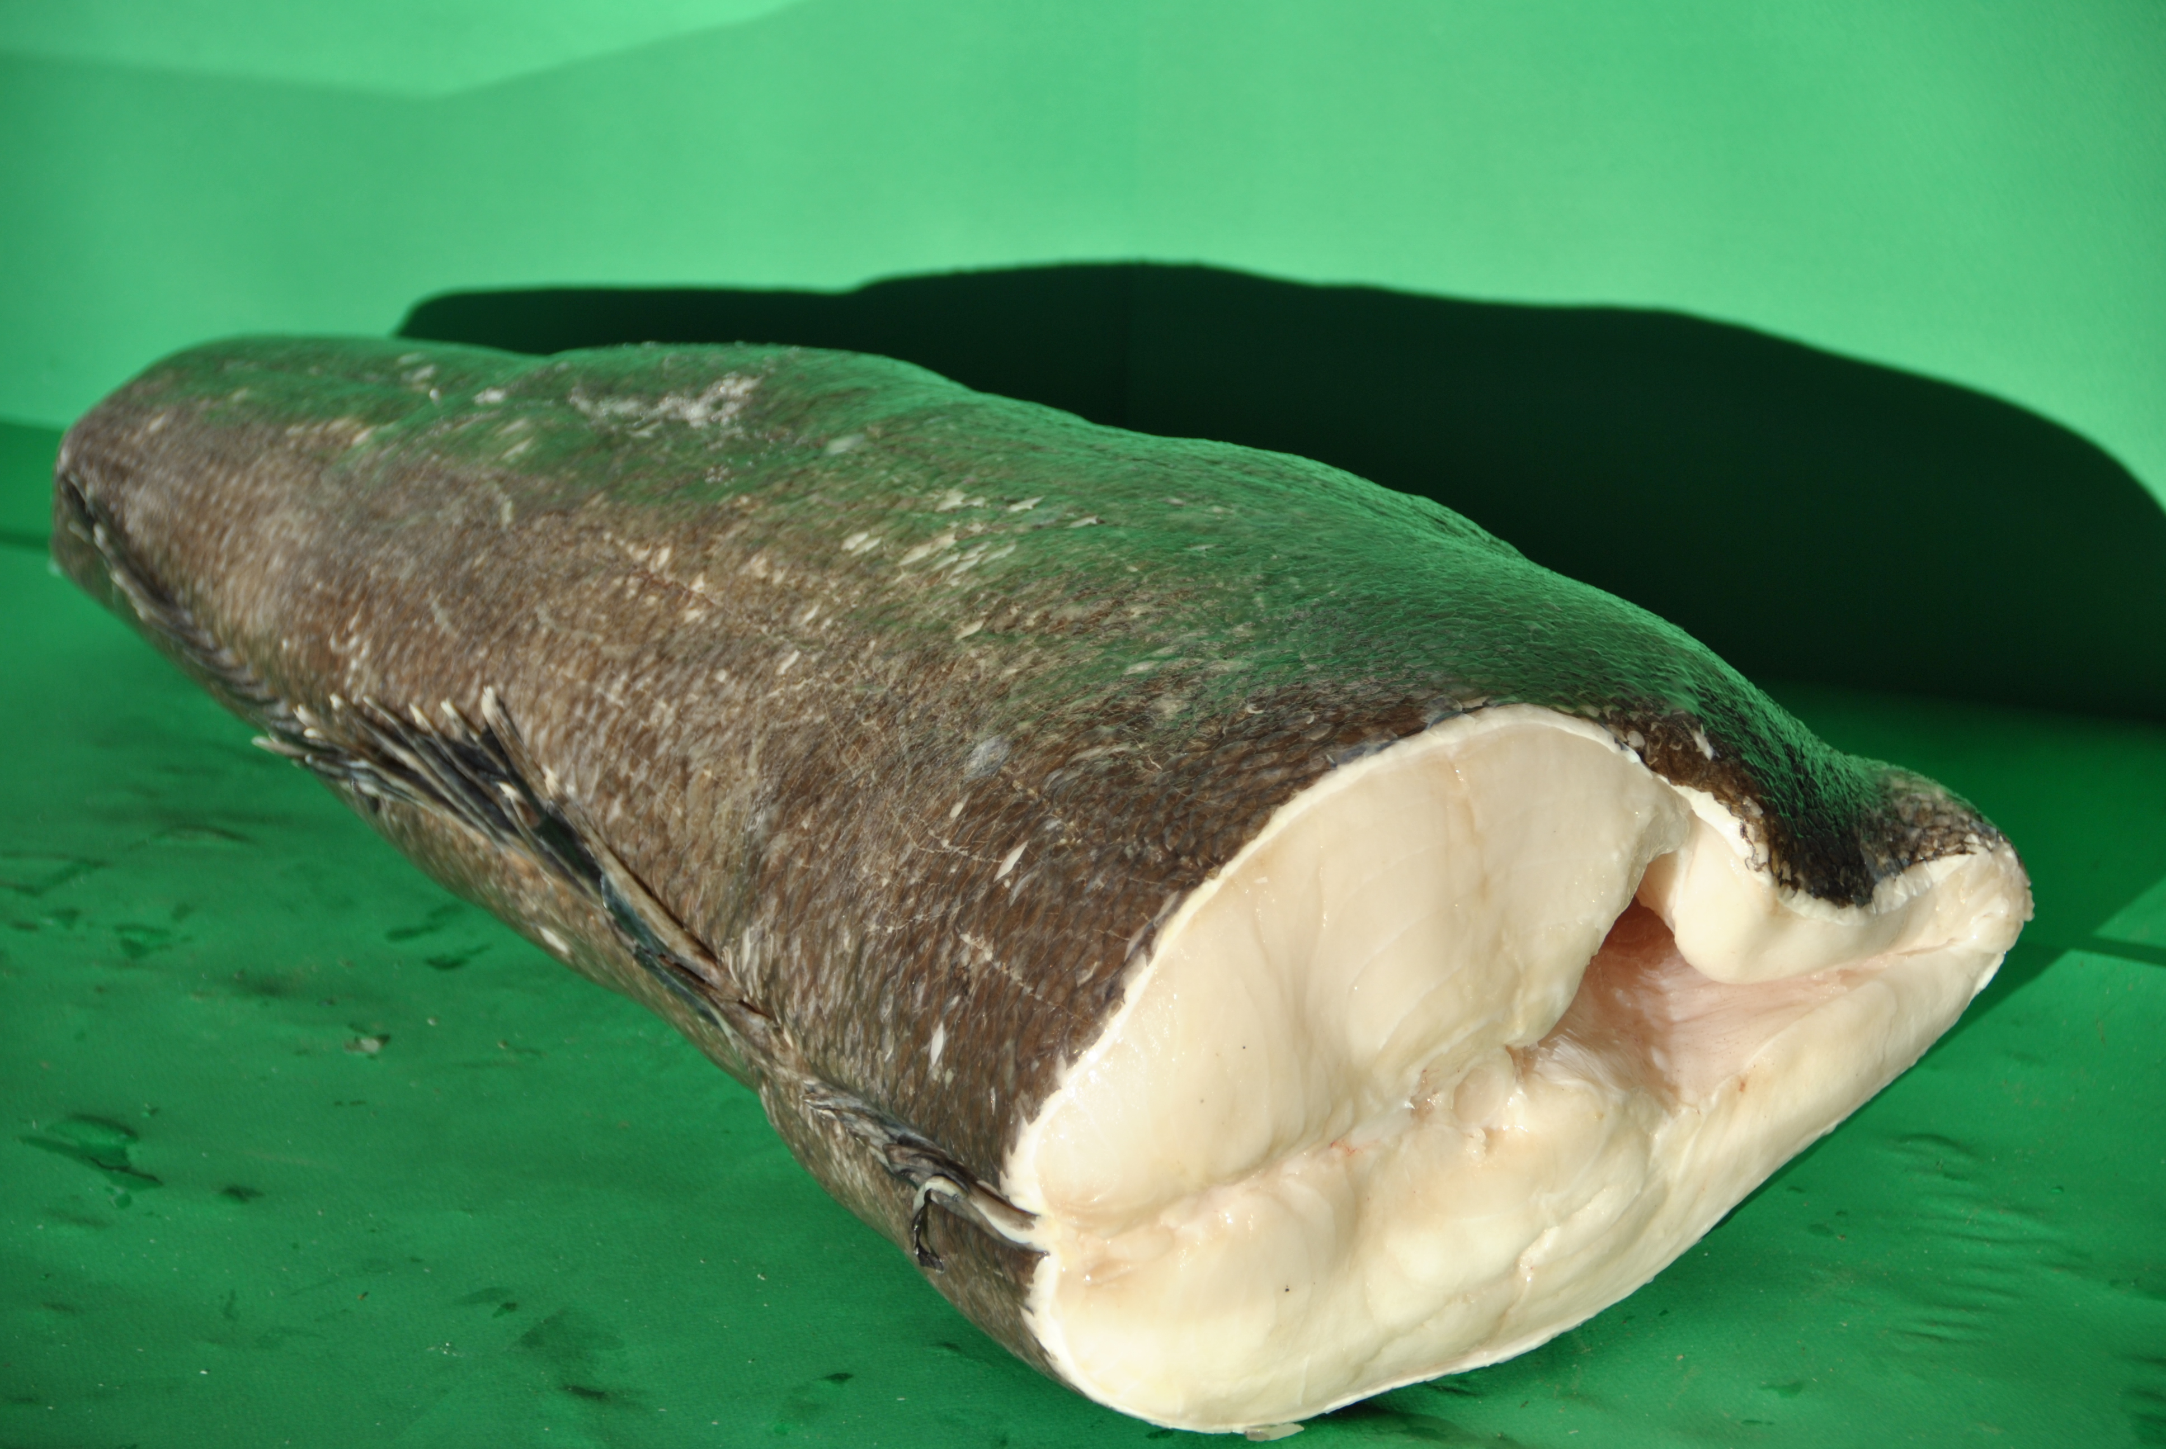
In Chile there are two fishing regimes for Toothfish divided by areas:
North of 47º South. Area reserved for artisanal fishermen:
Vessels with LOA under 18 m. Currently about 120 vessels active in the fishery (from a universe of 1.800 units licensed)
Until 1012 it was no TAC. Since 2013 TAC has been 1.354, 988, 1.211, and 1.491 tons
NO ITQ´s so this is a big trouble for the vessels, for the management and enforcement agencies.
VMS and Discharge Certification mandatory since 2014 (Thanks to CCAMLR´s CDS and USA requirements)
Catch sold to and based factories that process fillets and portions.
South of 47º South. Industrial Fishing:
ITQ´s allocated by Public Tender (Quotas lasts for 10 years and every year there is a 10% in the market)
TAC used to be 3.000 MT until 2012. After that it has been 1.098, 1325 and now 1.656 MT
New Fishing Law reserved up to 30% of the TAC for artisanal Fishermen (Also allocated in Public Tender) in a 6 years period.
Industrial Fleet (AOBAC Members): 3 companies, 8 Freezing longliners (Most of them also used in other species)
VMS mandatory since 1996. Discharge certification since 1999

Slide 6
History of Depredation
Depredation is not a new problem of the industry but has been growing very fast and becoming a major issue.
In the Northern area the main problems are with Sperm whales and Sea Lions while in the southern the interactions are with Killer and Sperm Whales.
We found reports of the issue as old as 1997 but earlier estimations said that it affected not more than 2-3% of the catch so nobody took it really seriously.
It was CEPES who pointed out the importance of the interaction in 2009 in the Research Fishing and was the first that started to record the presence of marine mammals. At that time they estimated depredation was form 10-15% of the catch.
Since then we have recorded the interaction and data is included in the vessels logbook. IFOP scientific observers started to include the information.
But, for the time being, nothing has been done with this information and it has not been taken into consideration on the stock assessments and TAC calculation.
Captains of the vessels experience is that depredation today at very least it accounts for 30% of the catch and maybe more.

Slide 7
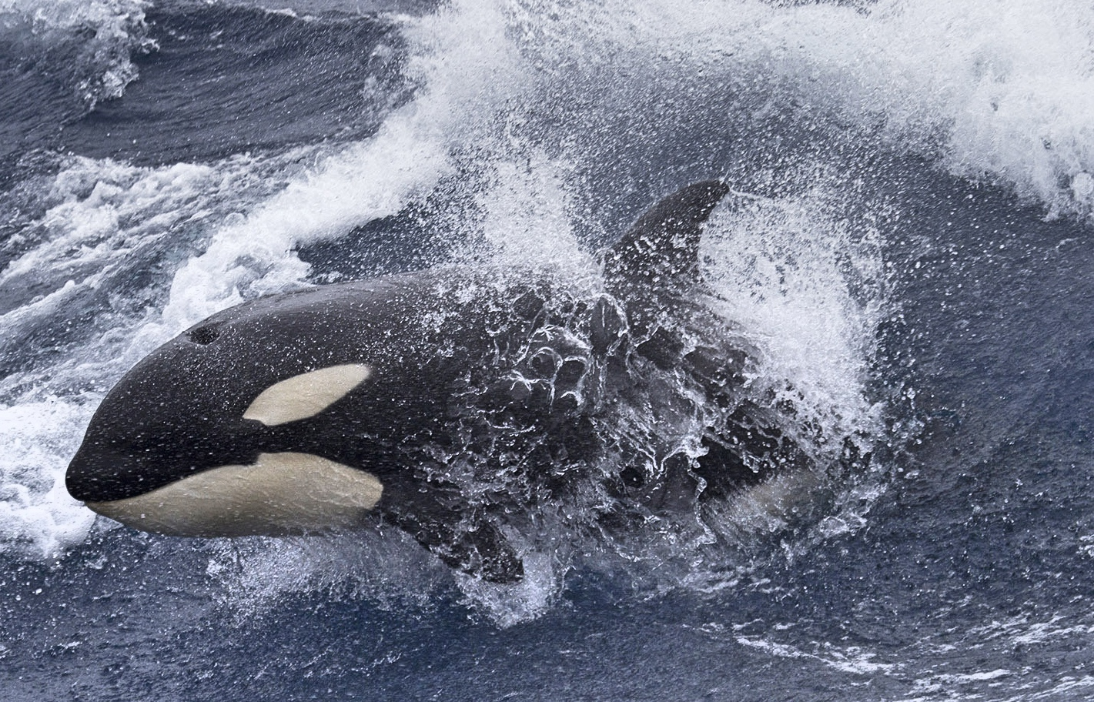
Marine mammals depredation in the toothfish industry is a real problem that needs to be taken seriously and addressed urgently.
Depredation has several main issues:
Socio-economic (lost fishing time, extra fuel consumption…)
Ecological (effects on depredating species)
Conservation issues (impacts on a depredated resource).
Implications of the later can be:
Economic, with significant losses for fishers,
On the management of fish resources (losses due to depredation are not being accounted for in fish stock assessments and quota allocation processes),
On the marine mammal species (risks of mortality by entanglement, modification of energy balance by giving access to new prey sources).
Photo by Paul Tixier

Slide 8
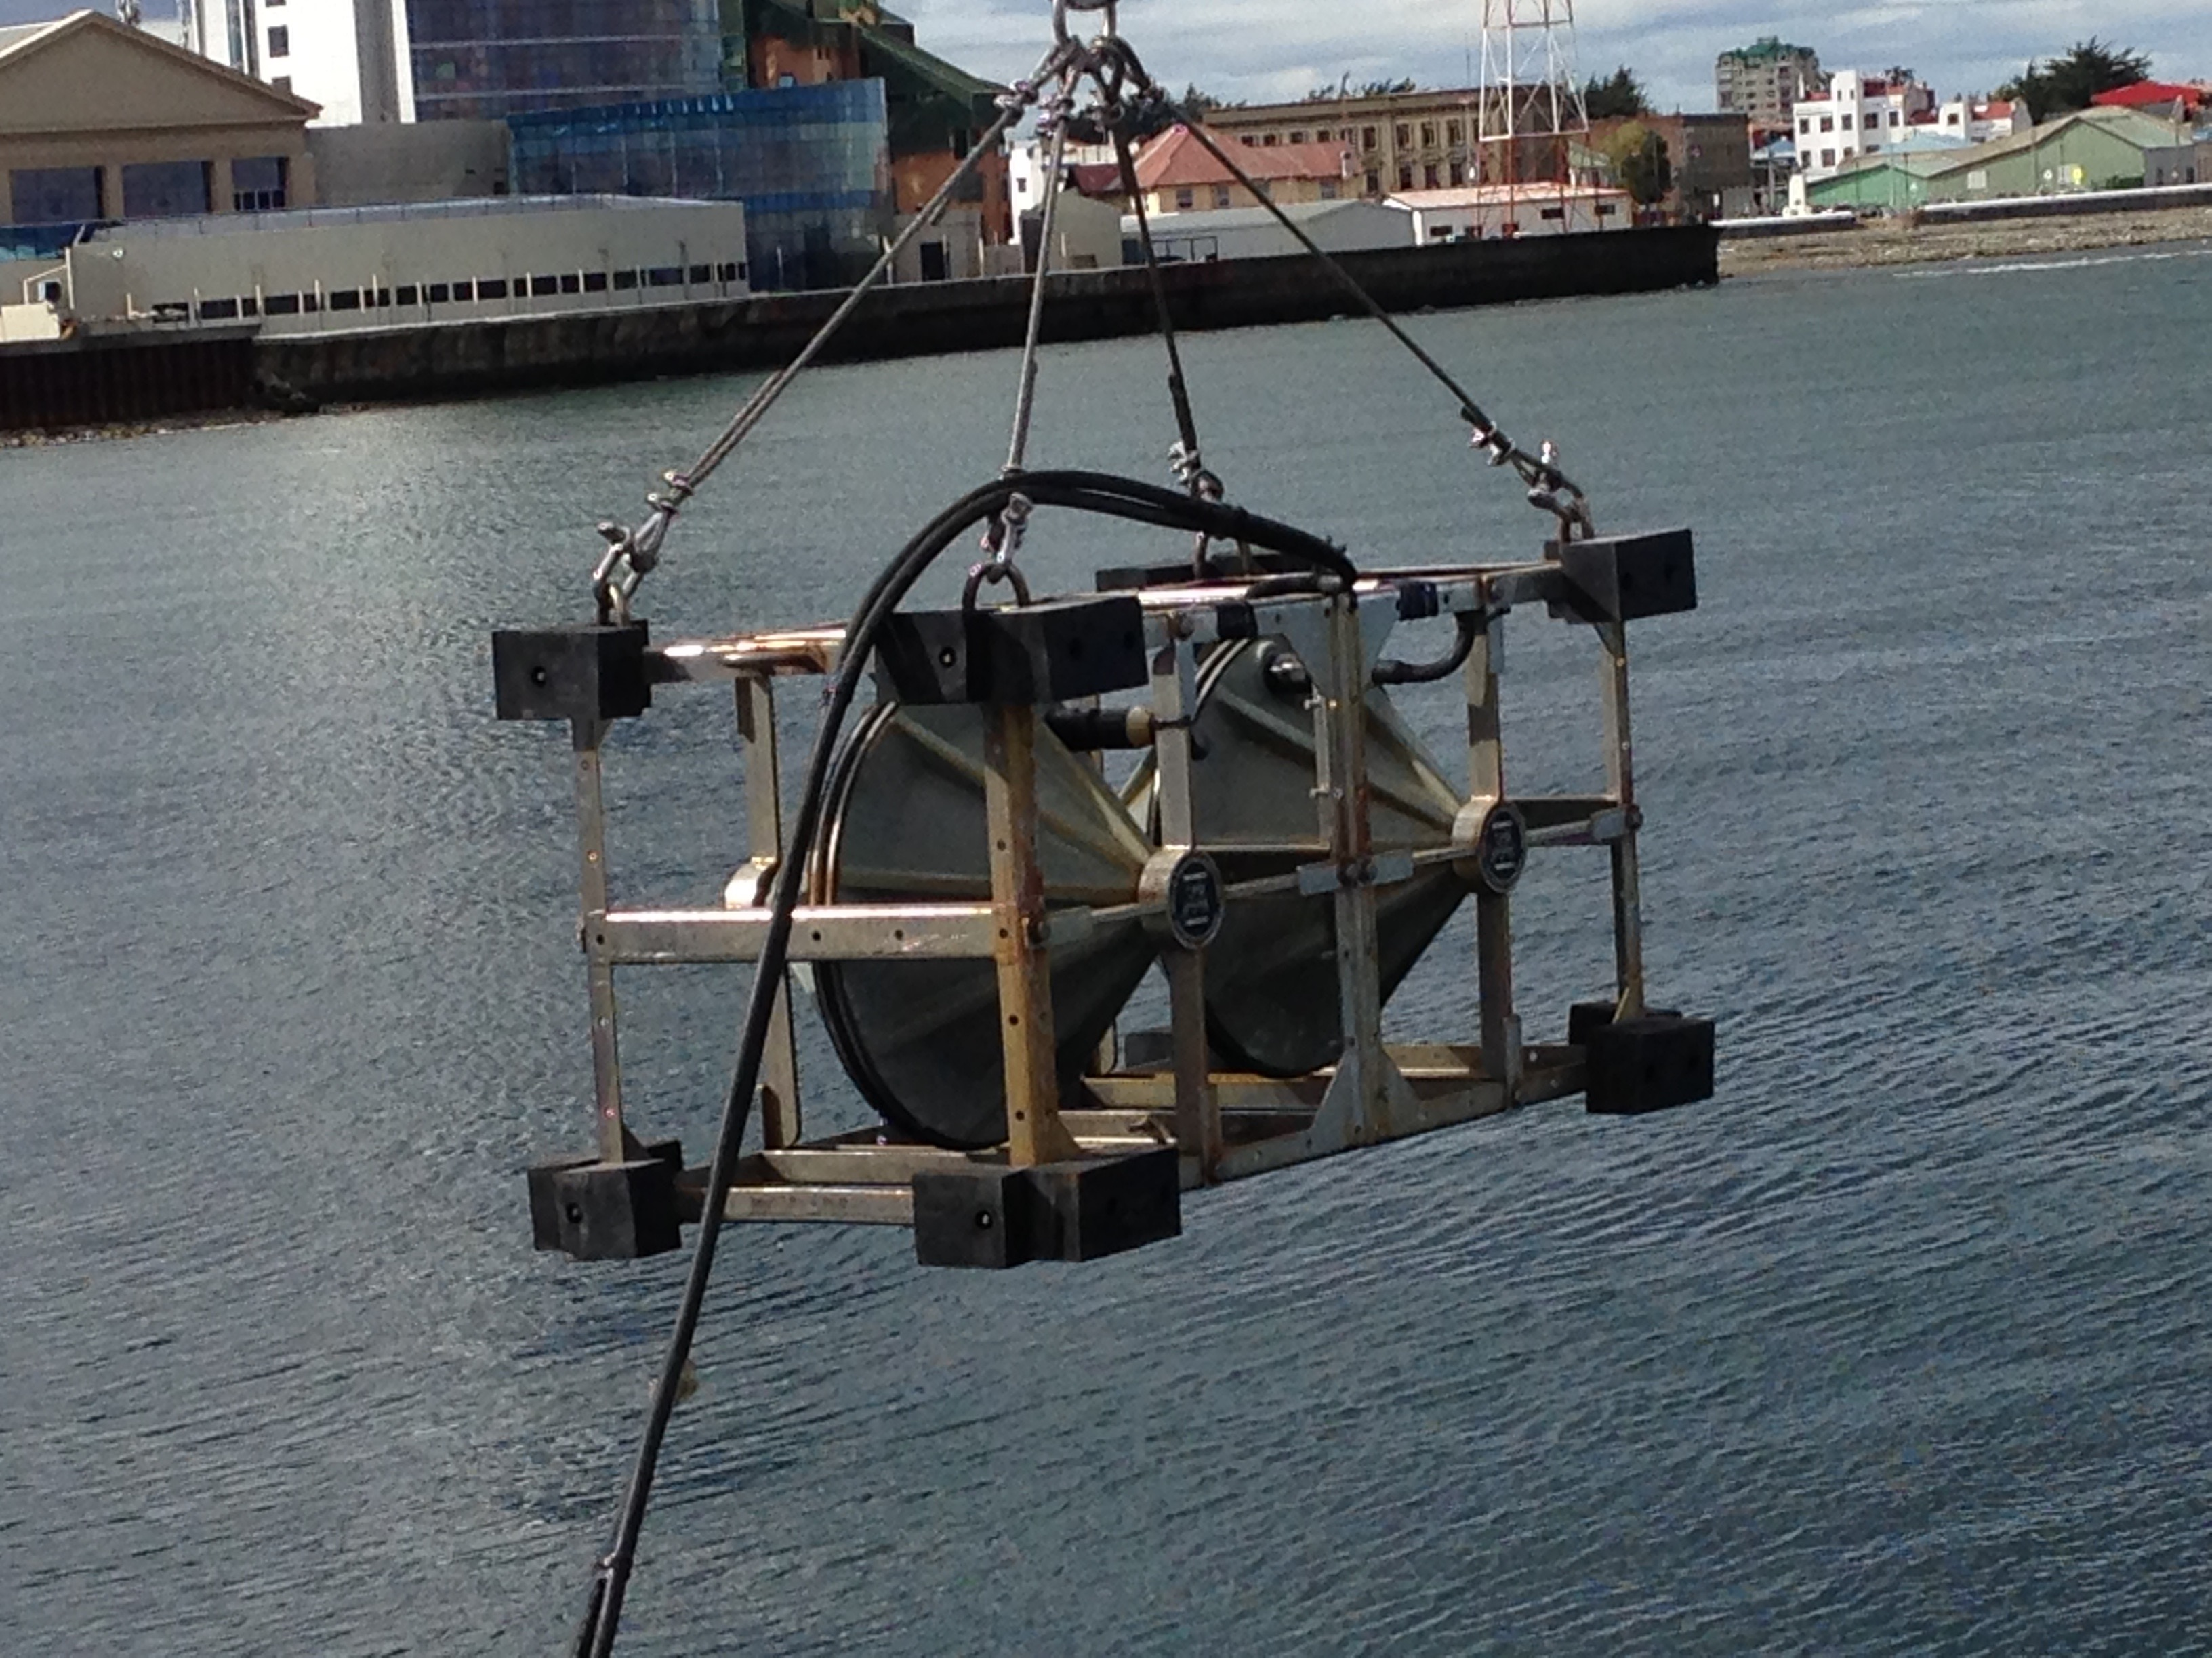
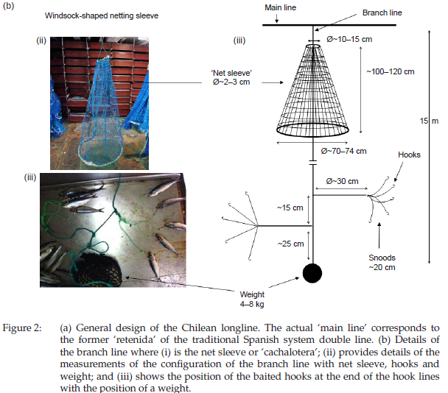
Mitigation
As an industry we have tried several mitigations methods as follows:
Acoustic Deterrents
Orca Saver (not effective)
SASDO (still under trials)
Fishing gear
Cachaloteras (Effective against sperm whales but useless with Killer whales)
Modified Cachalotera (Still under trials)
Fishing Strategy
Avoid areas with too many whales
Navigate to new areas and come back later to retrieve the gear

Slide 9
Data being recorded
The vessel keep a detailed Logbook that goes to IFOP (Stock assessment) and Sernapesca (Enforcement Agency). This is being done by the scientific observer with the help of the crew.
On this logbook we register, by each line set, the catch (Position, Number of Hooks, bait used, catch, resting time, etc…) and biological information (Length of fish, size, weight, sex, maturity, otholites, stomach content, etc…). IFOP has a 20+ years data base on this parameters which is quite impressive.
In the case of marine mammals we register the following:
Specie of mammals: Killer type, Sperm, Both
Presence at the time of setting the line: Yes or NO, number
Presence at the time of retrieving the line: Yes or NO, number
Nº of fish bitten: Number
Damage to the fishing line: Yes or No
Unfortunately Marine mammals observation started only 5 years ago and data has been recorded but not used so far.
Globalpesca together with IFOP is experimenting collecting all these information (specially depredation) in a smaller scale but that will be covered in more detail in another session.

Slide 10
Data being recorded
In the Vessel Logbook we register all detail of the fishing operations and this goes to IFOP (Stock assessment) and Sernapesca (Enforcement Agency). This is being done by the scientific observer with the help of the crew. On the case of marine mammals we register the following:
Specie of mammals: Killer type, Sperm, Both
Presence at the time of setting the line: Yes or NO, number
Presence at the time of retrieving the line: Yes or NO, number
Nº of fish bitten: Number
Damage to the fishing line: Yes or No
Of course every one of this records is related to a every line set and a lot of different biological information is taken on each one (Otholites, maturity, sex, size, length, weight, etc…). IFOP has a 25 years data base on this parameters but Marine mammals observation only for the last 5 years or so.
We are experimenting collecting all these information (Specially depredation) in a smaller scale but that will be covered in another session.

Slide 11
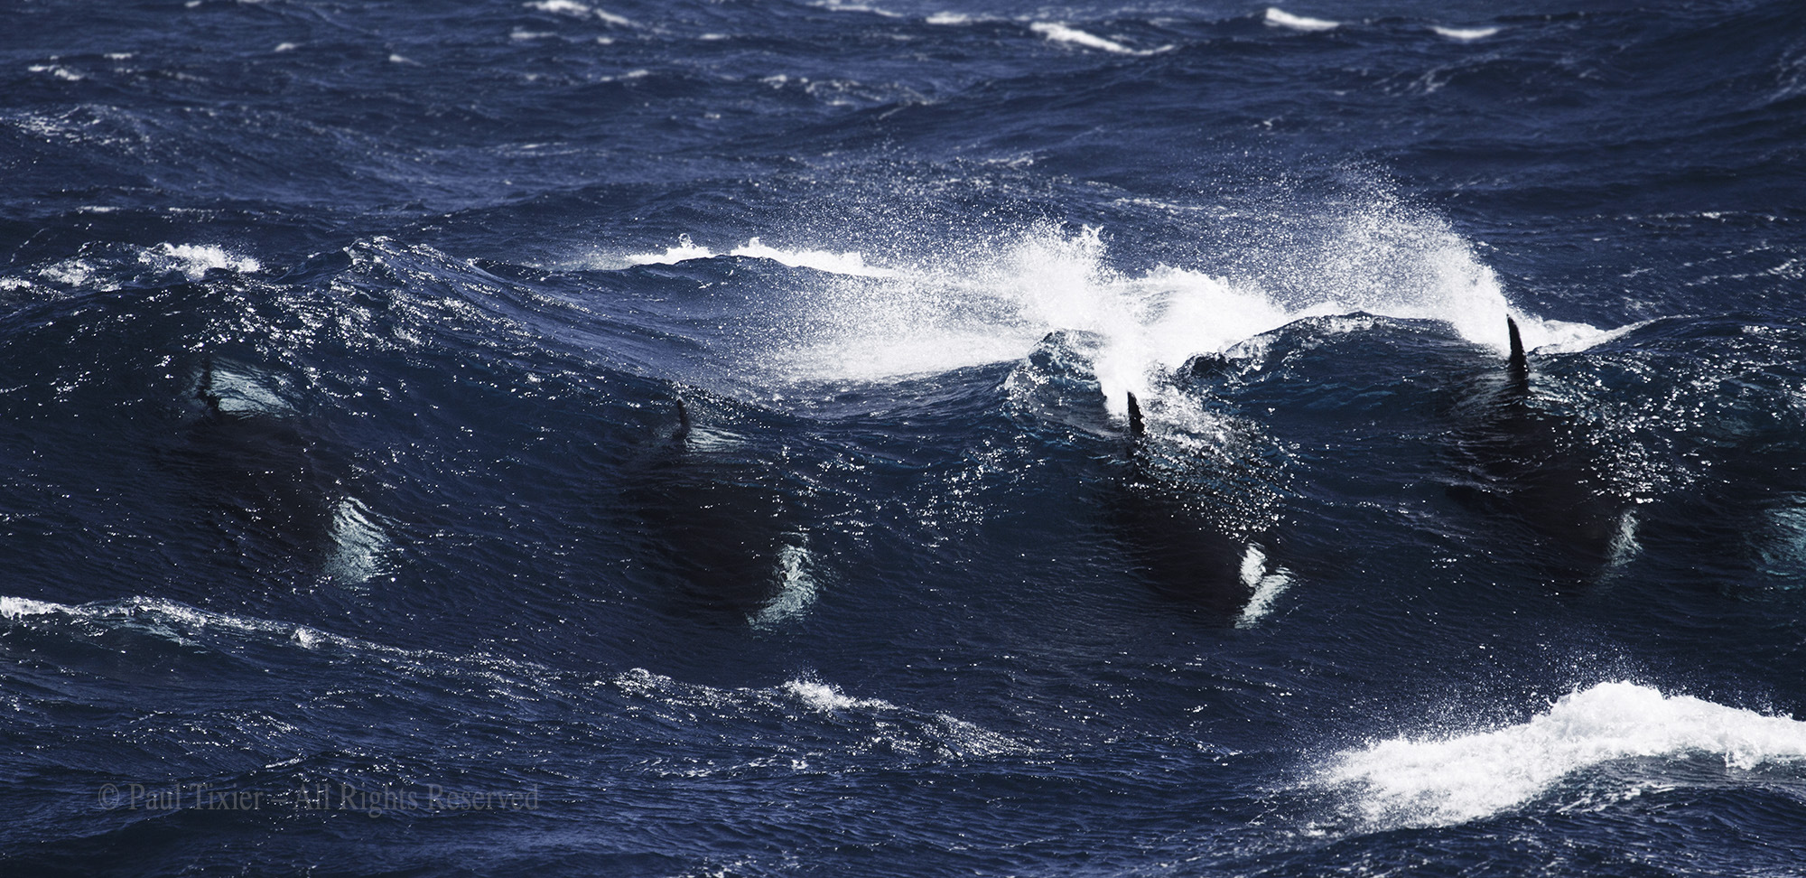
The expected outcomes for this Workshop has been defined as follows:
to develop a standardized data collection methodology to be implemented in all Toothfish fisheries;
to accurately assess the levels and the trends of depredation in Toothfish fisheries;
to agree on a consistent method across fisheries to account for depredated fish in stock assessment procedures; and
to identify mitigation solutions and strategies to reduce depredation, based on technical, operational (i.e. behavior of vessels/skippers) and behavioral (i.e. behavior of marine mammals) studies.
In our opinion all these issues are urgent and critical to the future of our industry and until we have a better understanding of it we will not know for sure the real status of the resource. The management of the fishery has a limited knowledge and stock assessment is not considering the effect of marine mammals depredation that has the potential to completely change our view of the current status.
Photo by Paul Tixier

