Slide 1
COLTO Depredation Workshop – March 2016
Rhys Arangio Austral Fisheries
Heard Island Toothfish Fishery: Background and Depredation Summary
Austral Fisheries Pty Ltd | Level 4, 50 Oxford Close, West Leederville, WA, 6007 | +61 (08) 9217 0100 austral@australfisheries.com.au | australfisheries.com.au | facebook.com/australfisheries

Slide 2
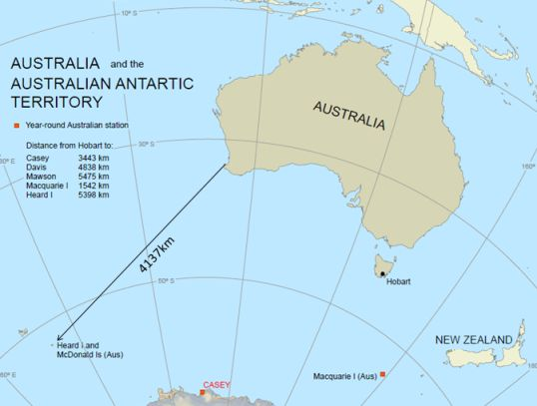
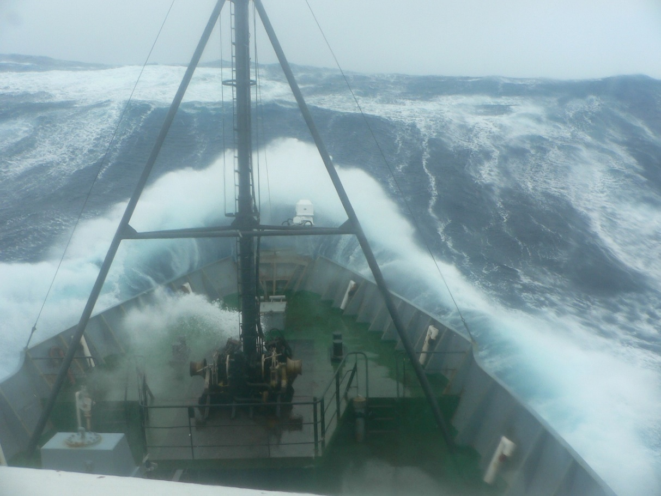
Heard Island Toothfish Fishery
Austral Fisheries Pty Ltd | Level 4, 50 Oxford Close, West Leederville, WA, 6007 | +61 (08) 9217 0100 austral@australfisheries.com.au | australfisheries.com.au | facebook.com/australfisheries

Slide 3
Heard Island Toothfish Fishery - History
Two major quota holders - Austral Fisheries and Australian Longline
2 trawl vessels only, until 2003
Transition to longline finalised in 2014, with only minor trawl catch from RSTS and bycatch from Icefish fishery
Currently 3 longliners, plus 1 dual purpose longliner-trawler
2016 TAC 3405t. Expect all longline except RSTS

Slide 4
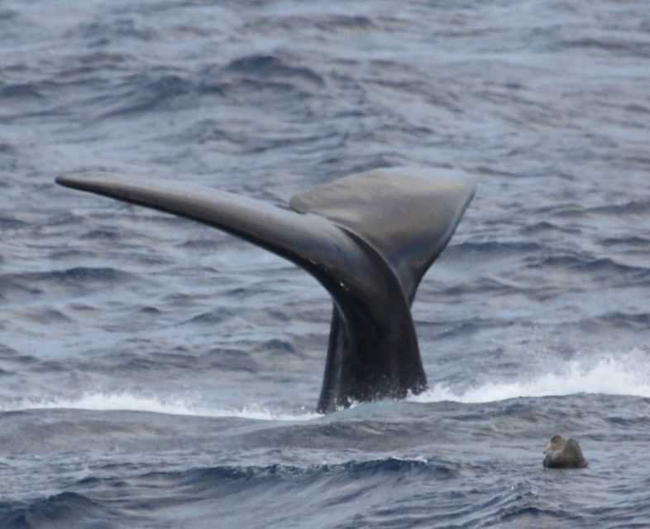
Heard Island Toothfish Fishery – Depredation History
Began 2011 – Sperm whales only – Groups of 1 to 6. Seasonal: April to July only
Linked to expanding longline fleet and season?
Saw 1 Killer whale in 2014, and 1 pod in 2015 – no depredation noticed
Whale sighting rate relatively stable
Have not calculated depredation rate or quantity
Kerguelen fishery so close yet bigger problem
Heard Island Season length
Dec Jan Feb Mar Apr May Jun Jul Aug Sep Oct Nov
Trawl / Traps
Core Longline
Extended Longline
Austral Fisheries Pty Ltd | Level 4, 50 Oxford Close, West Leederville, WA, 6007 | +61 (08) 9217 0100 austral@australfisheries.com.au | australfisheries.com.au | facebook.com/australfisheries

Slide 5
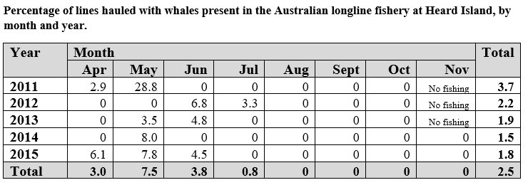
Heard Island Toothfish Fishery – Whale sighting rate
(Longline season)
# LL vessels
2
2
3
3
5
% LL catch
52%
50%
78%
97%
97%
*
*Mitigation - In 2013, industry began voluntary move on measures upon whale sightings.
Austral Fisheries Pty Ltd | Level 4, 50 Oxford Close, West Leederville, WA, 6007 | +61 (08) 9217 0100 austral@australfisheries.com.au | australfisheries.com.au | facebook.com/australfisheries

Slide 6
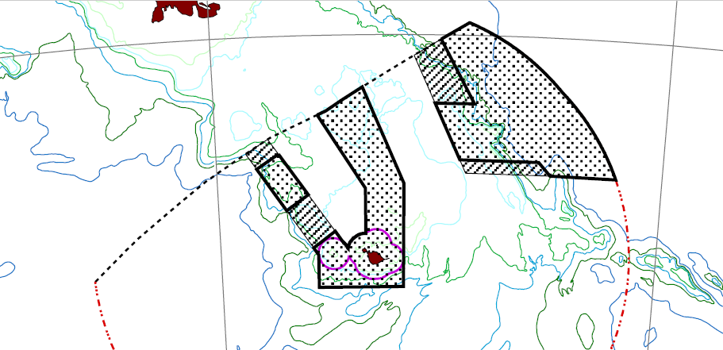
Heard Island Toothfish Fishery – Depredation data records
Began photo ID in 2013 – comparing with French ID catalogue. No matches to date.
AFMA Observer records: date, spp, position, number, dep evidence
Geographic mapping – early results indicate possible:
West to East movement from April to July?
Preference for deeper slopes of plateau?
What next? Listening stations to detect presence/absence?
Austral Fisheries Pty Ltd | Level 4, 50 Oxford Close, West Leederville, WA, 6007 | +61 (08) 9217 0100 austral@australfisheries.com.au | australfisheries.com.au | facebook.com/australfisheries

Slide 7
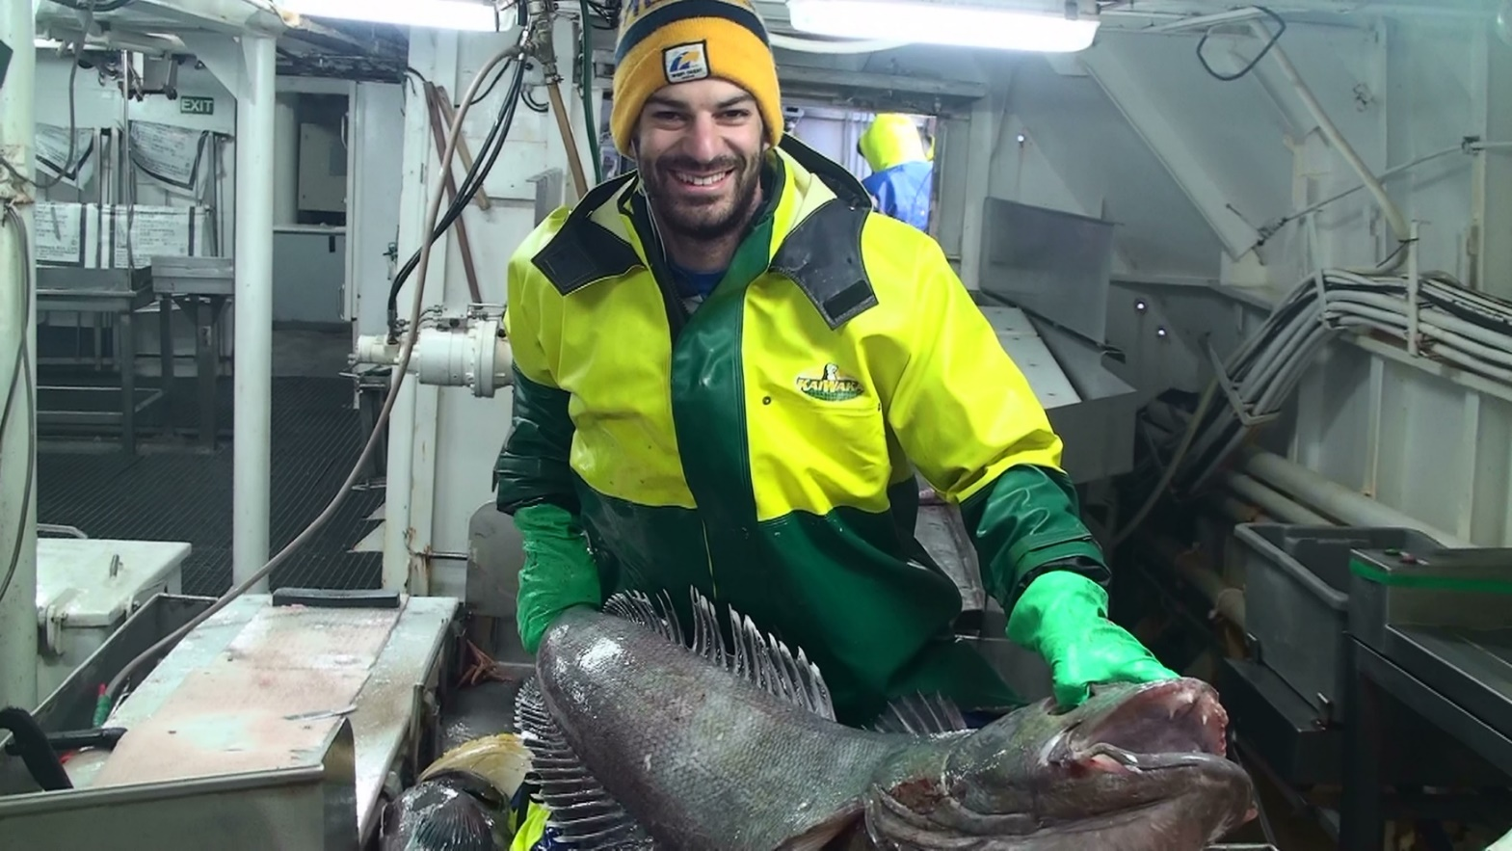
Thank you
Thanks to Dirk Welsford, Australian Antarctic Division, for summarising fishery-wide data
Austral Fisheries Pty Ltd | Level 4, 50 Oxford Close, West Leederville, WA, 6007 | +61 (08) 9217 0100 austral@australfisheries.com.au | australfisheries.com.au | facebook.com/australfisheries

