Slide 1
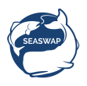
Sperm Whales
and Trends in the Alaskan Sablefish Fishery
Presented by Jeff Farvour
On behalf of SEASWAP and ALFA
Session 1 COLTO March 2016
Punta Arenas, Chile
Notes:
Jeff intro himself and ALFA.
Jeff Fishing experience
ALFA is based in SE Alaska, Approx 100 members working as vessel owners, operators and crew in sablefish and halibut fisheries in all areas of the GOA and BSAI. Many members are diversified and also fish for salmon our members fish.

Slide 2
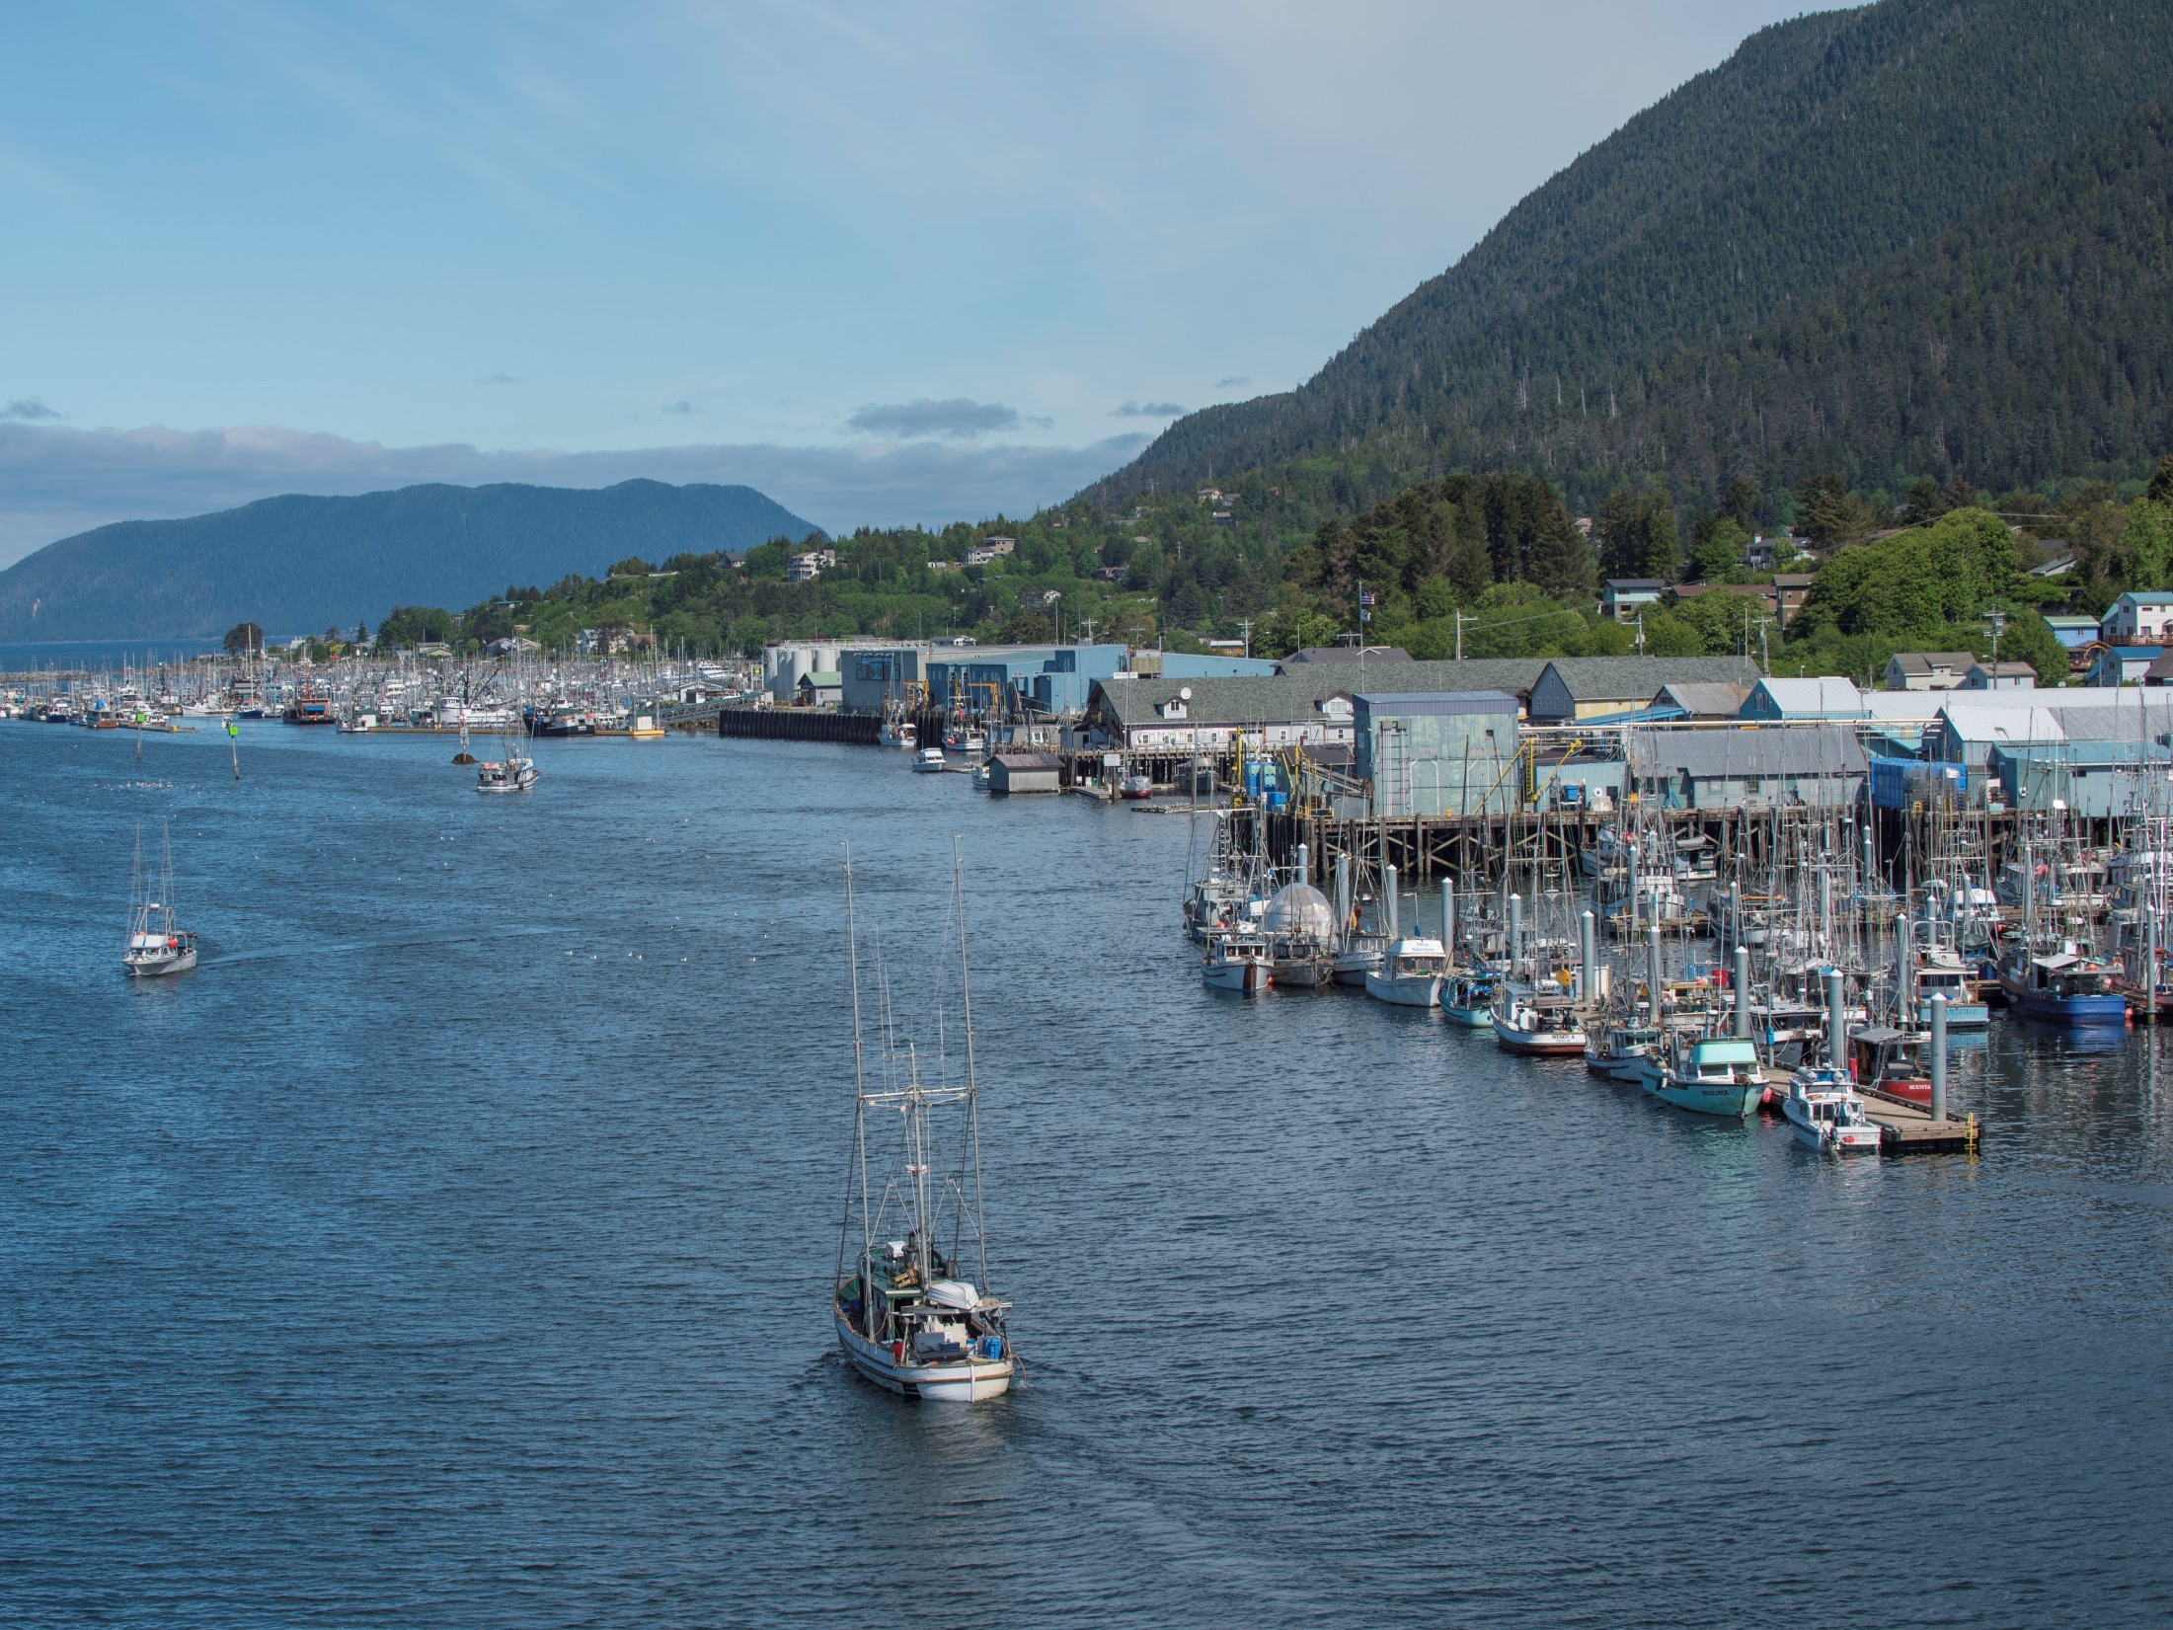
Gulf of Alaska Sablefish Fishery
Fishery Background and Sperm Whale Depredation Trends
Notes:
Alaska is a big place---compare with Chile, Sablefish in AK is considered a single stock management with separate apportionments and management restrictions assigned to XX sub-regions. Assessment is done with a dedicated annual longline survey. Each sub-regions has between XX and XX stations
Sperm whale interactions occur mostly in eastern ½ of GOA. Depredation occurred on only a small percentage of sets and sperm whales take a small to medium percentage of fish when depredating. Killer whale depredation courres mostly on western ½ of areas. Killer whales take a high % of fish when depredating. Megan will talk more about killer whales.

Slide 3
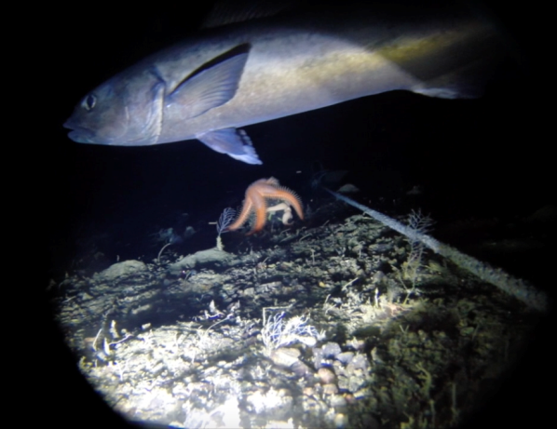
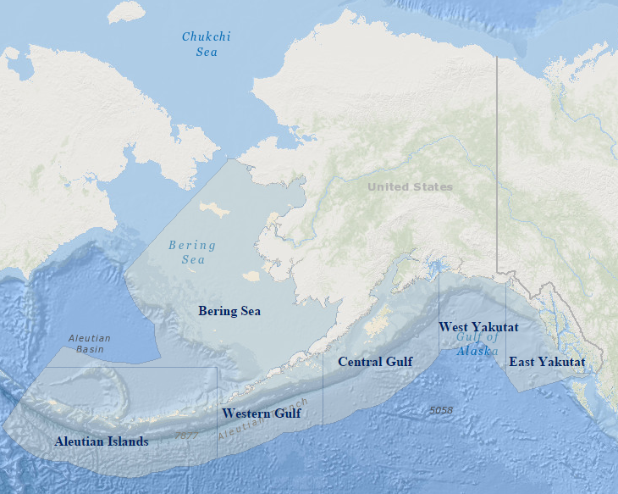
Sablefish Range and Gulf of Alaska Fishing Grounds
Management areas; 6 total with 4 in the Gulf of Alaska and AI, BS
Fishery occurs on the edge of continental shelf
Encompases 3100 miles (5000 km) along the coast of Alaska.
Longlining also occurs in AK state waters.
ALASKA
CANADA
Anchorage
Homer
Juneau
Kodiak
Sitka
Dutch Harbor
Southeast
Notes:
A majority of the sablefish longline fishery is fished in federal waters along the edge of the continental shelf curving about 3100 miles (5000 km) along the coast of Alaska. Some sablefish longlining also occurs in AK state waters.
About 90% of sablefish caught in AK is by the longline fishery

Slide 4
Sablefish Range and Gulf of Alaska Fishing Grounds
In recent years, 70-75% of the total sablefish IFQ catch occurs in CG, WY, and SE
The average range of depth for the fishery is typically between 250-600 fathoms (450-1000 meters)
About 90% of sablefish caught in AK is by the longline fishery
ALASKA
CANADA
Anchorage
Homer
Juneau
Kodiak
Sitka
Dutch Harbor
Southeast

Slide 5
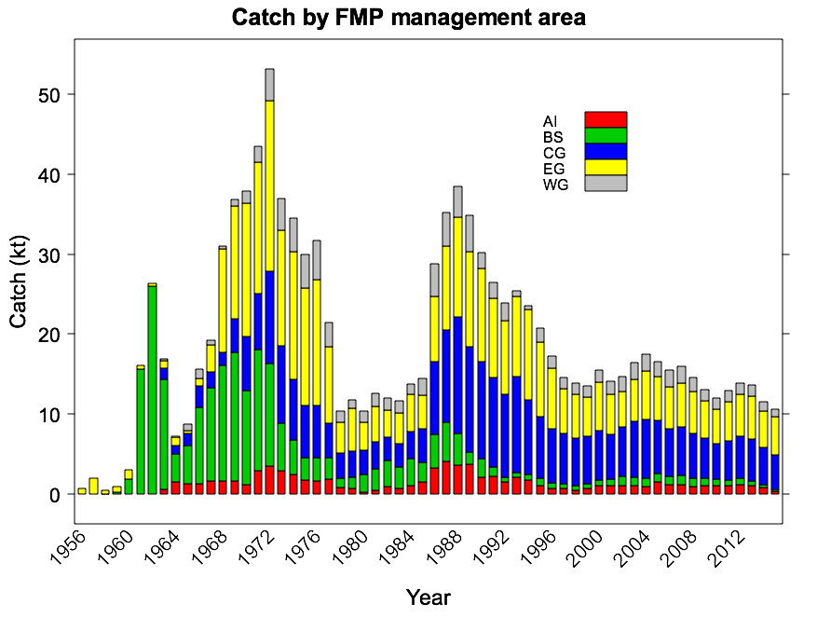
Key Events in Sablefish Fishery History
MMPA (Marine Mammal Protection Act) enacted in 1972 although sperm whales not internationally protected until 1979
The MSA (Magnuson-Stevens Act) was passed in 1976 and started the Americanization process of fisheries in US waters. Sablefish fully “Americanized” in 1988
Whale Management Fishery management
Open ACCESS IFQ
Halibut/Sablefish IFQ implemented in 1995
Slide Credit: Cara Rodgveller, Auke Bay Laboratories Alaska Fisheries Science Center, NOAA Fisheries
Notes:
Sablefish fishery has existed for a long time and gone through several abundance cycles. It is successfully managed. Peaks are caused by strong recruitment events such as the XXXX and XXXX year classes. (See sablefish almanac) Current low abundance is due to poor recruitment. Add in some stuff about recent promising year classes if you want and correlation with PDO warm periods.

Slide 6
Alaska Sablefish Longline Survey Stations
Annual federal survey in GOA, even years in AI, odd years in BS
Some portions of state waters are also surveyed
Depths sampled during the survey range from about 80-550 fathoms (150-1000 meters)
ALASKA
CANADA
Bering Sea
Gulf of Alaska
Aleutian Islands

Slide 7
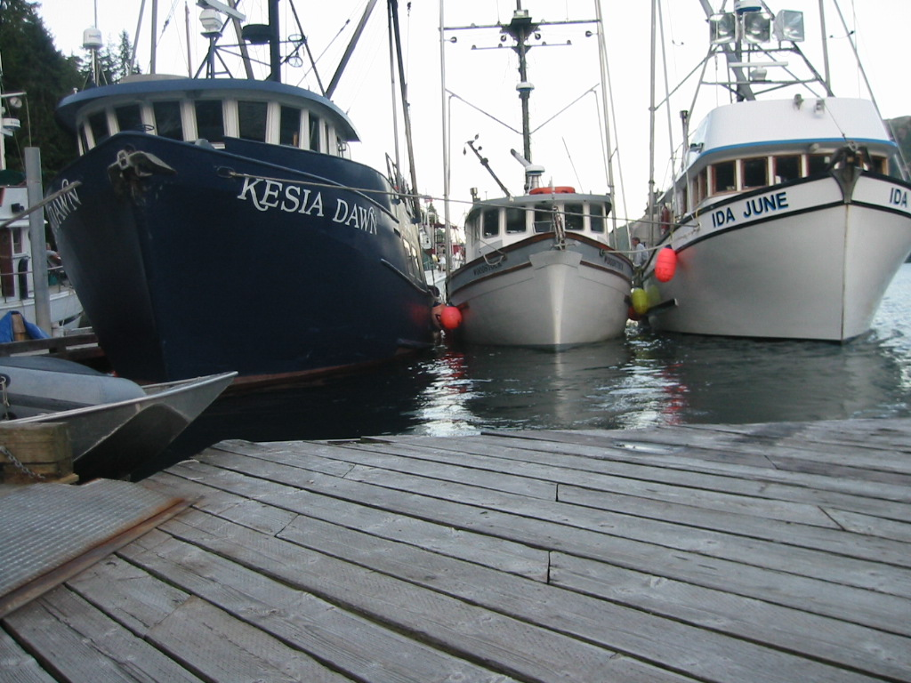
The Individual Fishing Quota (IFQ) Sablefish Fishing Fleet
90% of sablefish catch ~ 320 vessels fishing IFQ sablefish in AK
Size ranges 30-165 feet, (9-50 meters)
most are 40-60 feet (12-18 meter) range. catcher vessels (CVs) deliver fish fresh to processors after 2-5 day trips
`
Notes:
Currently about 350 to 375 vessels fish for sablefish each year. Most are between 40’ and 70’ LOA (might need meters for chile) Most product is landed fresh and processed ashore. About ½ of vesssels land round product with no processsig at sea. These vessles have a very low ofal stream consisting mostly of grenadier bycathc. Theother 1/2 head and gut at sea and have a larger ofal stream. Some of the larger vessesl will even freeze onboard.

Slide 8
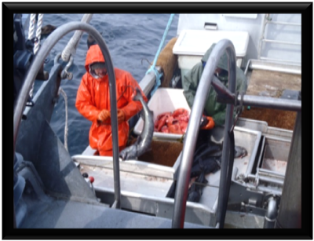
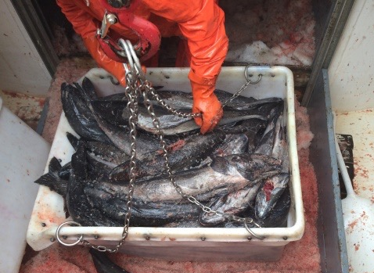
Value of Fishery
18% increase in 2014 wholesale
$95 million in ex-vessel value 2014
Notes:
The fishery occurs over a 9 month period, evenly spaced.

Slide 9
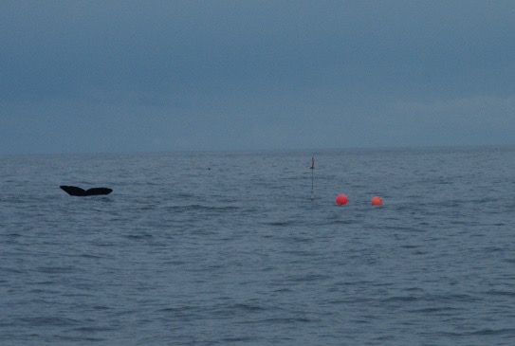
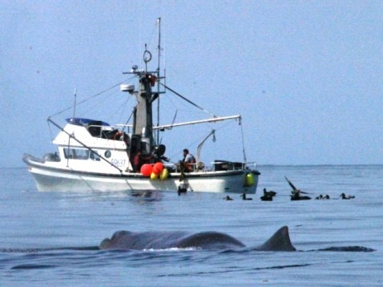
Historical Factors Heightening Awareness of Depredation
1972 MMPA enacted, end of commercial whaling increasing whale populations
1976 started a shift from a foreign fishery to a domestic fishery (MSA)
1995 transition from a derby fishing of just a few days a year to an 8 month IFQ fishery
Notes:
Depredation ahs been occurring sing at least 1980. Several factors have lead to increased attention to sperm whale depredation.
First, transition from foreign fishery to domestic in 1980’s brought more focus on US laws involving marine mammals.
Second Sperm whale abundance is increasing. Russian whale hunting as recently as 1970’s now population seems ot be rebounding
Transition to a 9 month fishery in 1995 with introduction of IFQ management.

Slide 10
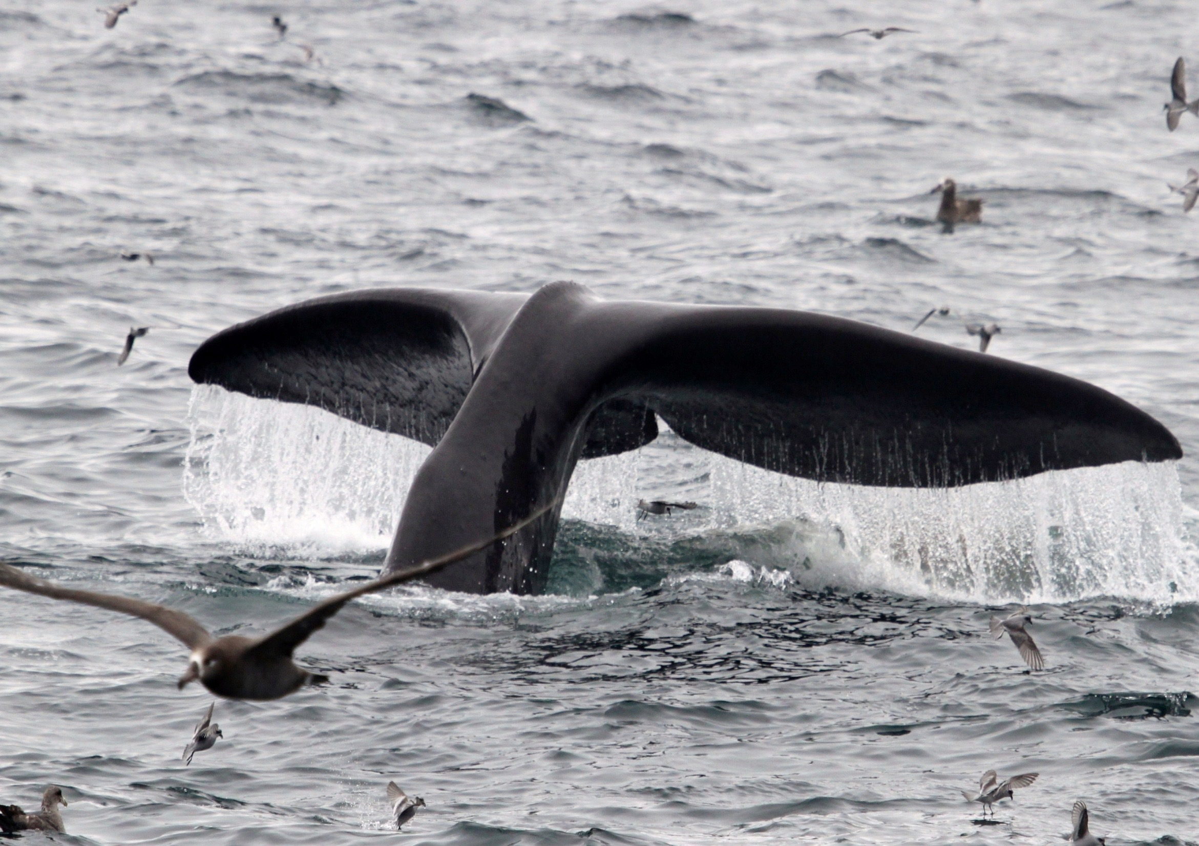
Depredation by sperm whales on sablefish longline has been occurring for over three decades
In 1995, a change in management (IFQ) resulted in an expanded fishing season
This change allowed increased opportunities for sperm whales to depredate longline fishing gear
By 1997, reports of depredation had increased substantially
Sperm Whale Commercial Fishery Depredation
Notes:
*Key here being we can’t incorporate depredation on the survey -in the sablefish abundance index- until we also account for depredation on the commercial fishery (as additional mortality)

Slide 11
Sperm Whale Commercial Fishery Depredation
Sperm whale depredation occurs primarily in the Central to Eastern portion of the Gulf of Alaska
ALASKA
CANADA
Anchorage
Homer
Juneau
Kodiak
Sitka
Dutch Harbor
Southeast

Slide 12
Sperm Whale Survey Depredation
Sperm whale observations have been recorded during the longline surveys since 1998
In 2014, sperm whales were observed during operations at 21 stations
Longline survey catch rates and abundance indices are not adjusted for sperm whale depredation
Notes:
Depredation is a concern on both the commercial fishery and the longline survey. Depredation on Survey may bias estimates of abundance.

Slide 13
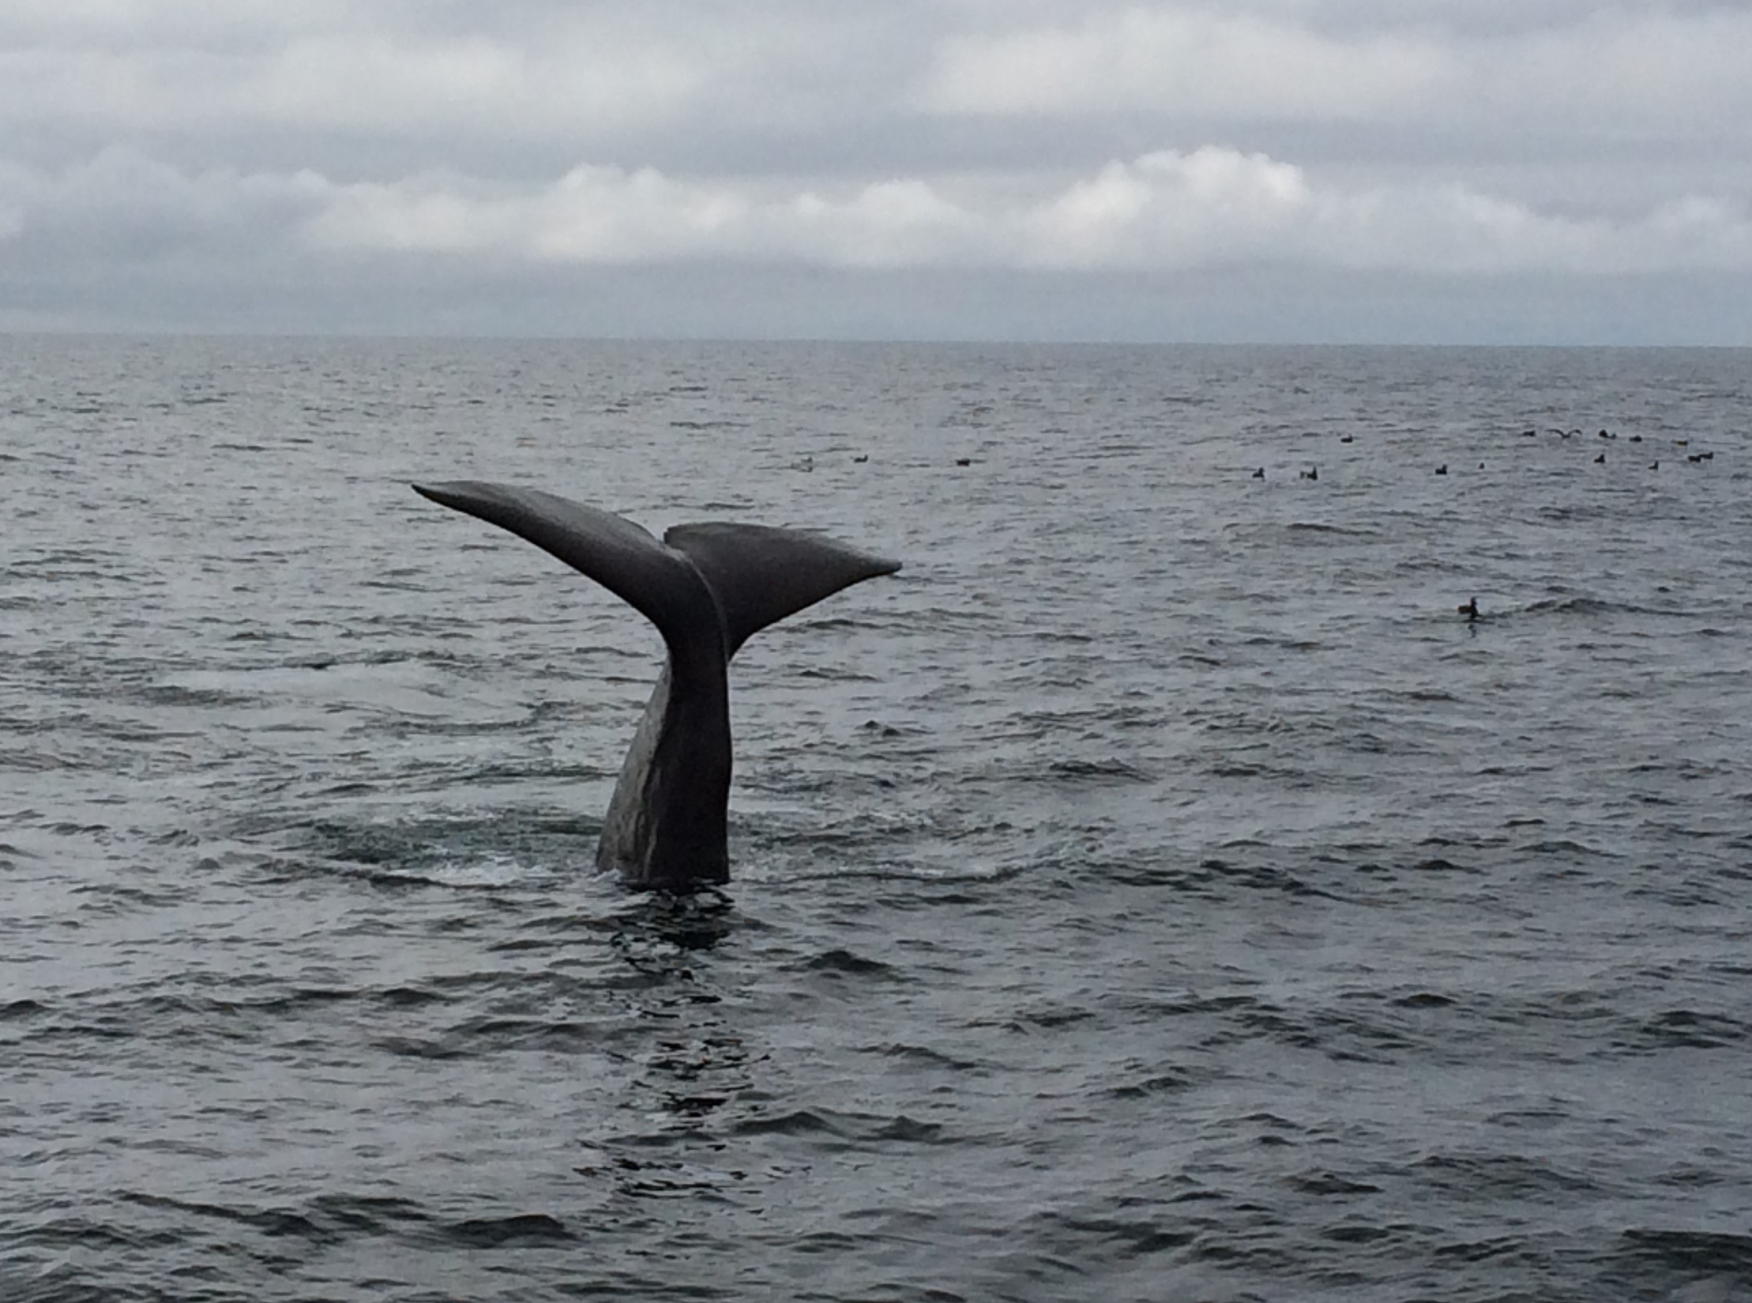
In the late 1990s, fishermen approached scientists Tory O’Connell and Jan Straley with concerns about sperm whale depredation of longline sablefish
In 2003, SEASWAP was launched, creating a team focused on protecting marine mammal populations while maintaining thriving coastal fisheries.
Using logbooks and cameras, fishermen worked with scientists to document sperm whale interactions with fishing gear
Notes:
We started with trying to get basic information on how many whales were depredation on sablefish boats, do they have distinguishing characters that help us tell them apart, how deep are the diving when working the gear, how do they locate the sablefish, how do they locate boats etc.

Slide 14
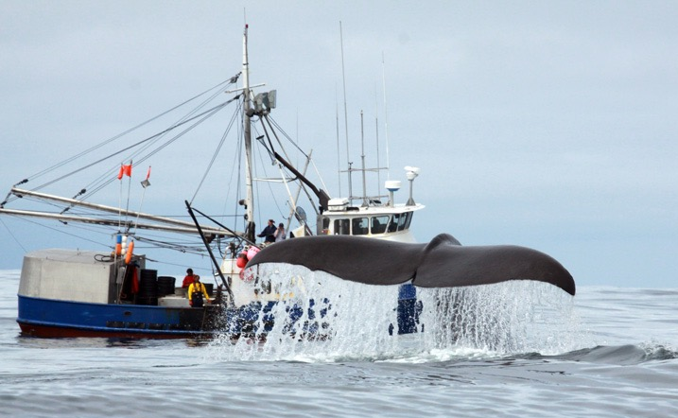
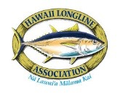
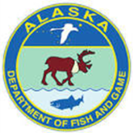
SEASWAP
Southeast Alaska Sperm Whale Avoidance Project
Scientists, fishermen and managers working together to understand depredation and minimize interactions
Notes:
To address roblems caused by sperm whales, fishermen approached university scientist and fishery managers 12 years ago to work collaboratively on this problem. Result was formation of SEASWAP. SEASWAP collaboration has grown ove rthe years to now include scientists form Scripps Inst of oceanography, AK sea Life Center. SSSC, CBAFS, Hawaiian longline fishermen working on false killer whale problems etc.
Jan will tell you more about SEASWAP and I will come back at end to talk about the SEASWAP approach and what our next steps are.

Slide 15
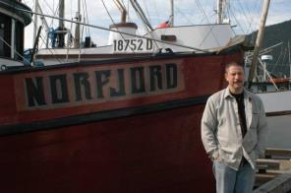
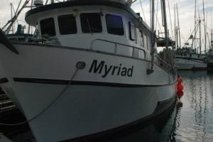
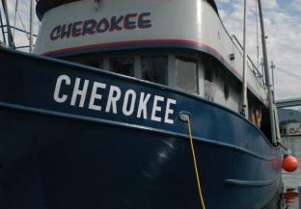
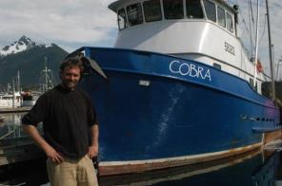
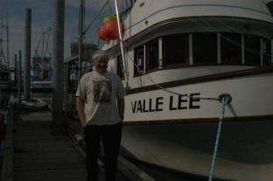
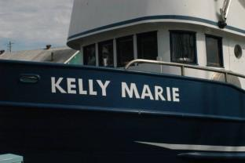
Fishermen are the eyes and ears of the ocean
l
SEASWAP has 25+ small-boat fishermen who are full partners and have designed, tested and collected quantitative data, 2003 to 2015
Notes:
Fishermen first approached ADFG groundfish manager Tory O’Connell in Sitka in the 1980s with reports of sperm whales near their boats, and later suggesting sperm whales might be loitering and taking some of their offal or spin-off. This turned into whales taking fish straight from the gear as it was hauled.
By the 90s, Tory brought the issue to Sitka whale biologist Jan Straley, and they began to look for funding. With the help of Alaska Longline Fishermen’s Association director Linda Behnken and other fishermen, by 2003 the project was funded and SEASWAP was born.

Slide 16
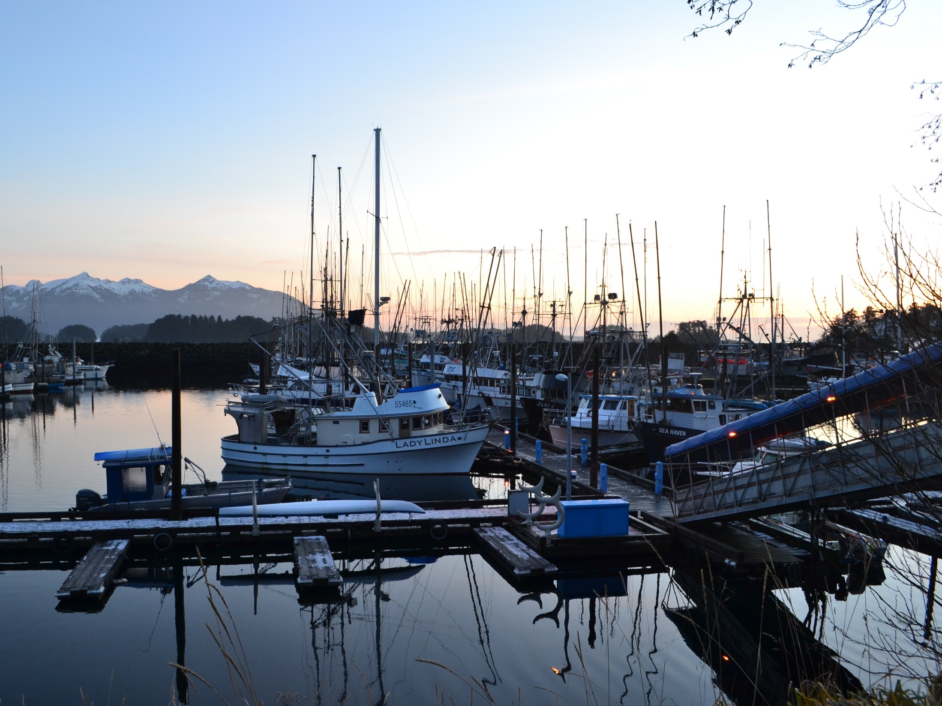
Thank you!

