Slide 1
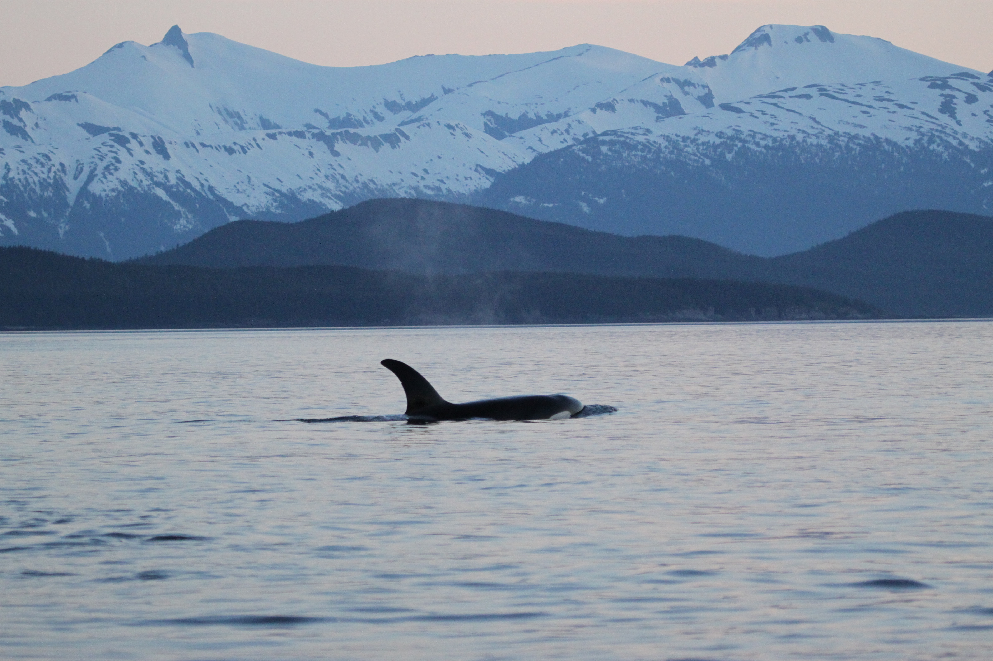
Western Alaska sablefish fishery & killer whale depredation

Slide 2
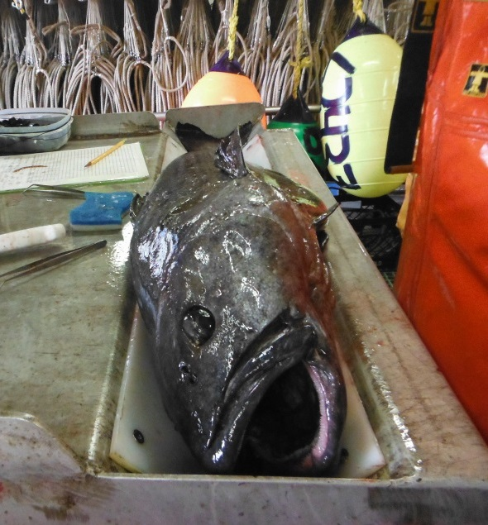
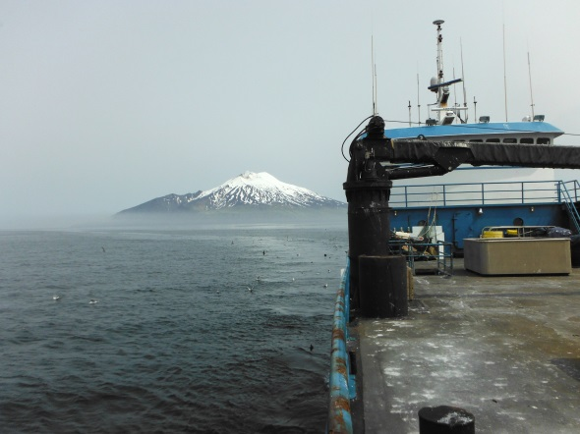
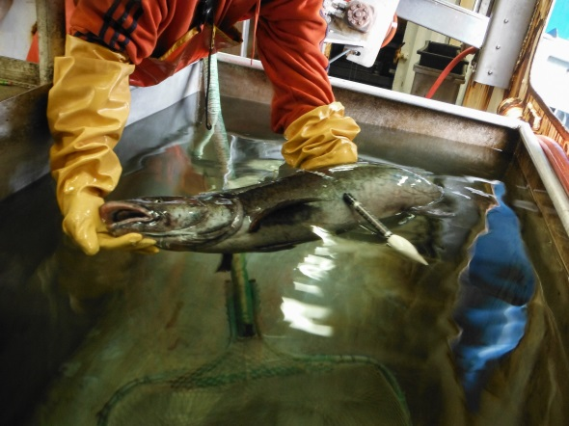
Basic sablefish life history
Distribution extends from northern Mexico through western AK
Move offshore to deeper slope waters and become reproductively viable ~4-5 yrs
Depths > 200 m
Movement between AK management areas
Notes:
northeastern Pacific Ocean
Longlived species- up to 30-40 years. Max around 90 years
Juvenile diet herring, inverts, and late summer post-spawning salmon

Slide 3
Western Alaska sablefish fishery
Bering Sea foreign fishery developed in 1958
Harvest peaked in early 1972s >50,000 mt
US fishery began expanding in 1982
IFQs 1995
Notes:
*actually as a secondary target to pac hal – relatively small takes and limited CA to GOA
Mostly Japenese longliners in BS- took an unsustainable amount of sablefish from BS – target in other fisheries POP and rockfish, Gturb, etc. moved into GOA when BS was exempted.
Fully domesticated by 1988
-9 month fishing season
Much of sablefish is sold internationally- US domestic market is expanding

Slide 4
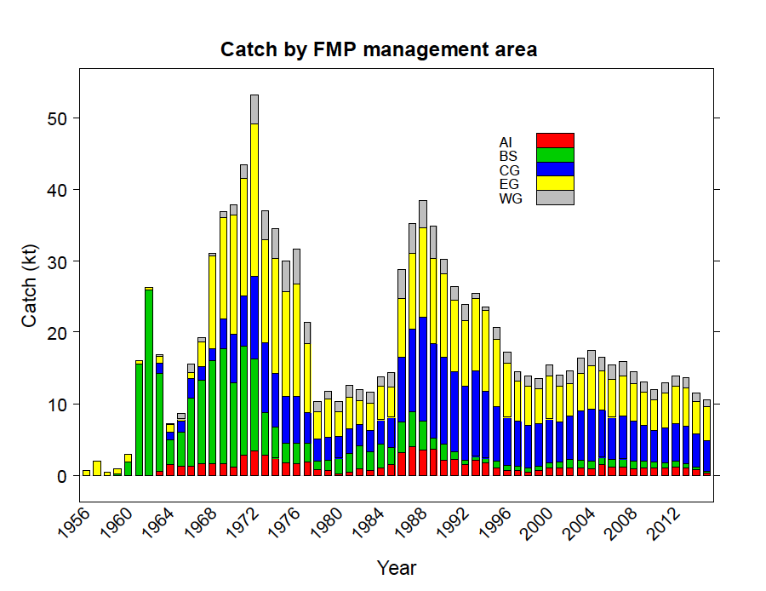
Hanselman et al. 2015

Slide 5
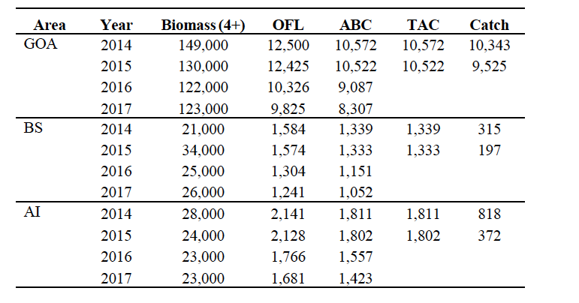
TACs (t) and Catch (t)
Hanselman et al. 2015
Notes:
. Catches in western AK are much smaller than GOA. Addiontally, the TAC is generally not achieved in western AK. This is not the same issue in the GOA.

Slide 6
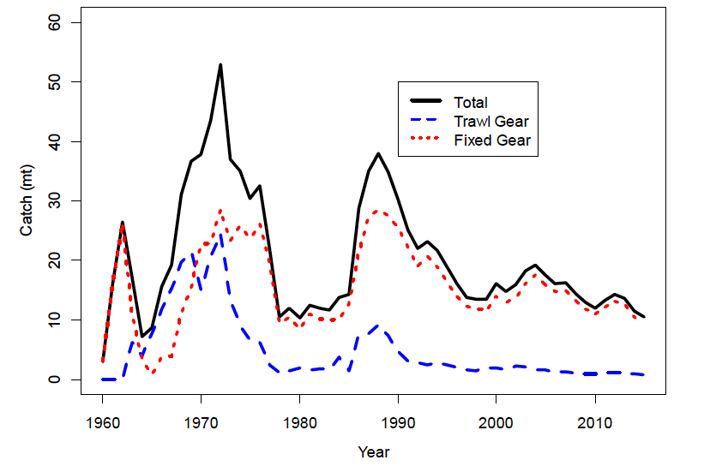
Catch by gear type (all areas)
Hanselman et al. 2015
Notes:
Sablefish in AK is harvested by three main gear types.
Longline as the primary
Pot gear – only currently allowed in AI and BS
and this is one main distinction between the BSAI and GOA- pot gear for sablefish is and has been legal in the BS and AI throughout the history of fishery- not so for the GOA. NPFMC just recently took final action on a measure to legalize pot fishing in GOA- large part due ot
3) Trawl gear

Slide 7
Western Alaska Sablefish Fishery
Demersal longline sets ~ 9 km with 1.2 m space of hooks avg
Western AK tends to have relatively larger vessels (~95 ft avg)
and more catcher processors
Since 2004, pot fishing accounts for > 50% of BS fixed gear catch and 34% of AI fixed gear catch
Generally 40-135 pots per set
Incidental trawl catch approx 10% overall catch

Slide 8
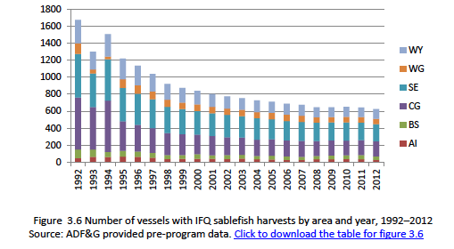
Participation
Hanselman et al. 2015
Notes:
Smaller number of vessels participate in the western AK fisheries. Again, they tend to be bigger boats as well- relatively higher portions of catc er processors.

Slide 9
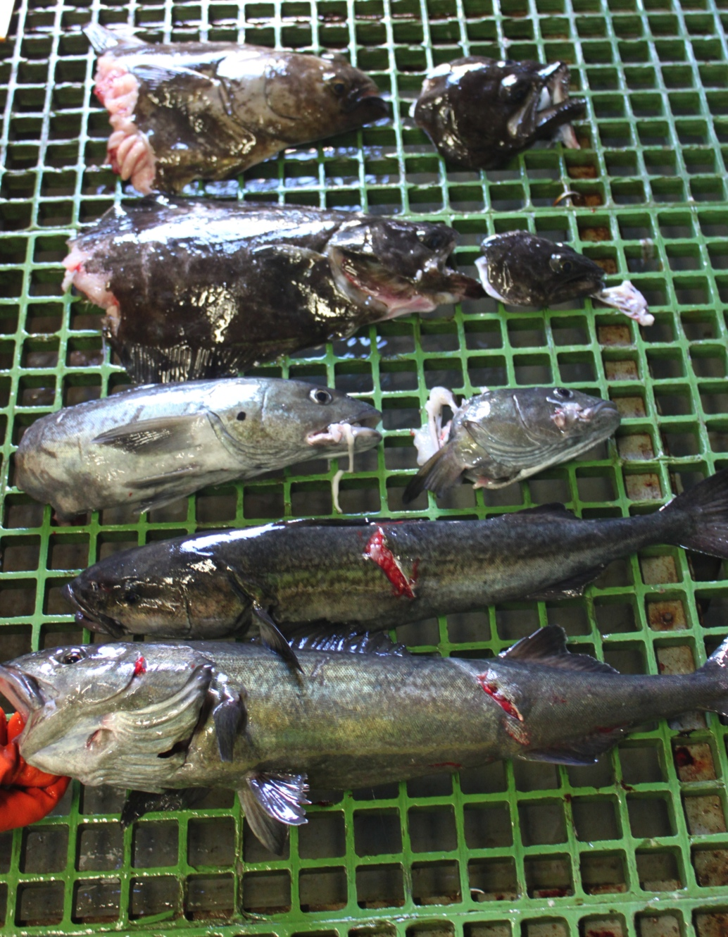
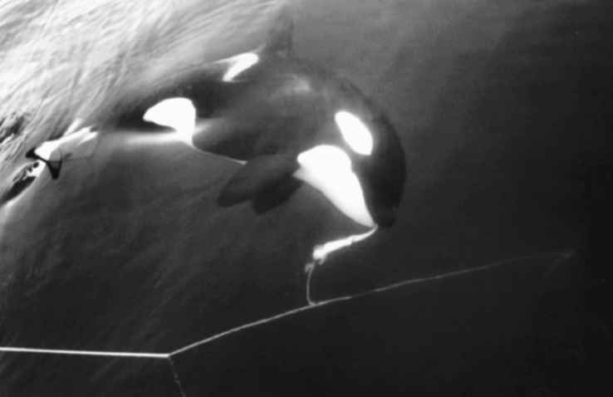
Killer whale depredation
Visser 2000
SEASWAP
Notes:
3 main fisheries impacted turbot, halibut, sablefish.

Slide 10
white
NMFS Longline Survey Stations Depredated
  Eastern Gulf of Alaska & Southeast
  Bering Sea
  Aleutian Islands
  Western Gulf of Alaska
  Central Gulf of Alaska
-
-
-
-
-
Notes:
there is a spatial component to killer whale and sperm whale interactions.

Slide 11
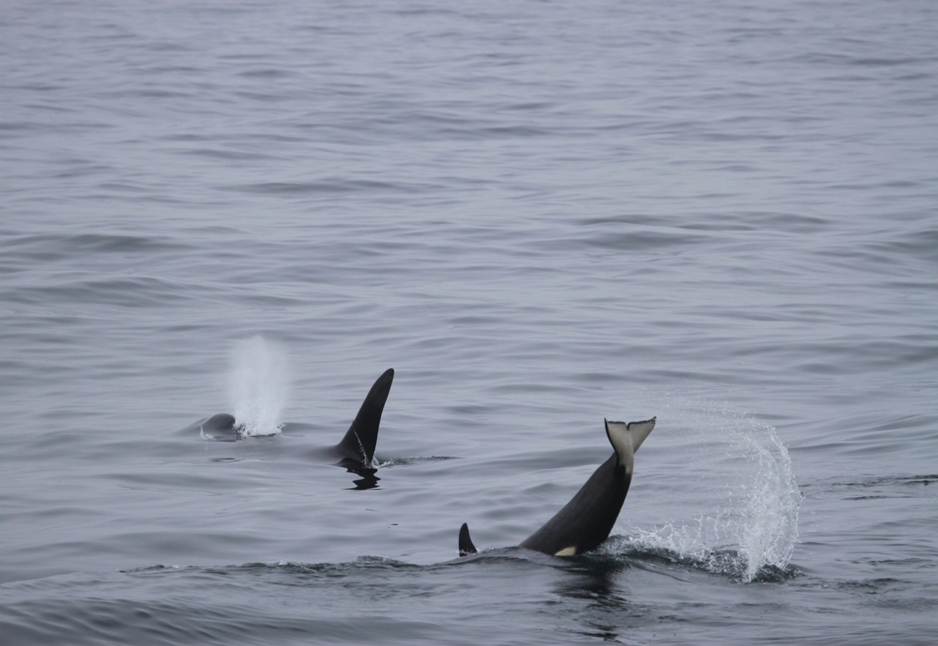
Data collection
Longline survey
Commercial fishery
    Generally just tracking presence/absence depredating whales and evidence of damaged fish
Logbook data
Independent studies (Peterson et al. 2013/14 & SEASWAP)

Slide 12
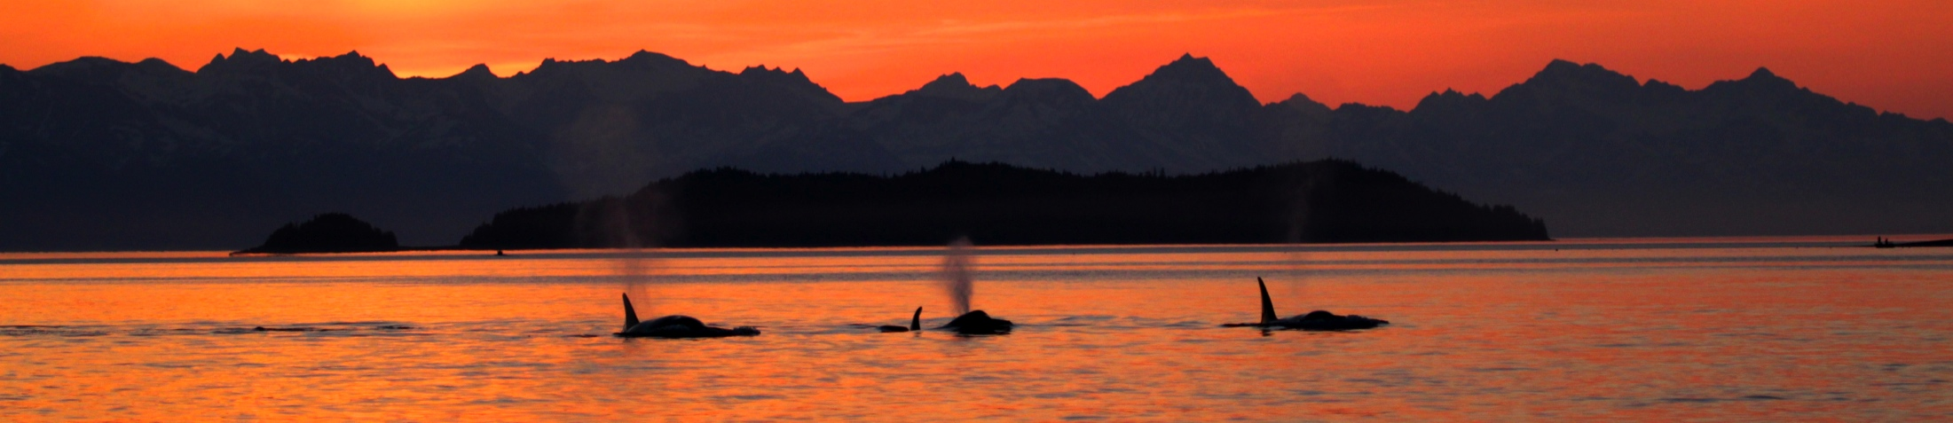
Killer whale depredation frequency
 | Percentage sets depredated
NMFS longline survey (1998-2015) | 9 - 50% (avg 25%)
Commercial fishery Data (1995-2014) | 3 - 21% (avg 6%)
Written surveys (n=95 respondents) | 10 - 25%
Depredation data sheets (fishing grounds, n=846 sets) | 9.6%
Notes:
Looking at depredation frequency and the percentage of sets depredated. , we can see that the proportion of commercial fishery sets depredated was much lower than the proportion of survey skates depredated.
Now these data are not directly comparable, there are differences in scale and sampling areas. But nonetheless, the difference is worth mentioning. And there are a number of reasons that we might see this this. Survey data is recorded at a more refined scale- per 45 hooks. Also, observer data is generally not perfect. But most importantly, this also suggests that fishermen in the commercial fishery are likely actively avoiding the whales and fishermen reports support this.
Adding in a few more data sets- the majority of written survey respondents reported 10-25 . And 9.6% of sets were affected based on data collected by fishermen on the grounds. At the end of the day, I think we are in the ballpark here, but there is still much room to refine these estimates. A better understanding of the proportion of sets impacted would improve our understanding of the impact on the fleets.

Slide 13
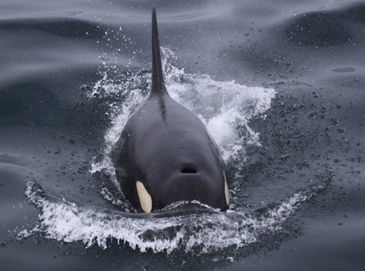
Groundfish catch rate reductions
Predicted Reductions (GLM/ GAMM)
Reported Reductions
 | Longline survey (ICES Journal 2013)
Sablefish | 54 – 72%
Pacific halibut | 39 – 51%
Greenland turbot | 73%
Commercial fishery (PLOS ONE 2014 & In Prep)
46 – 68%
35 – 57%
54 – 67%
Written surveys (Marine Policy 2013)
>40 %
Data sheets (PLOS ONE 2014)
Avg = 56%
Notes:
When we look at groundfish catch reductions… I see somewhat clearer picture.
We first looked at depredation on the survey – and then in a follow up study we ran similar models using commercial fishery data. And it was very encouraging to see very similar results across both data sets despite different methods.
Reductions reported by fishermen were consistent with these estimates as well.
I think we’ve made a lot of progress with this, and next steps will be figuring out how to incorporate some of this into stock assesmments and cost-benefit analyses for the commercial fleet.

Slide 14
Longline survey catch reductions (sablefish)
log(sablefish)= β₀ + year_{i} * station_{j} + kw_depredation_{k} + depth_{l} + ε
--Estimated (no whales)
--Observed
29% reduction
24% reduction
10% reduction
Notes:
Perhaps a better way to visualize this is to look at these overall catch losses over time. Here we have the average sablefish per skate on the y axis and time again on the xaxis. The observed catch or actual catch is shown here in black and model estimated predicted catch had killer whales not been there are in blue.
You can see there there is a a significant amount of interannual variability, but when we average this out over time. We come up with the estimates I showed on the previous slide.
Here we see the highest average reductions occurred in the BS at about 30% and decreased as we moved into the western gulf.
There is a lot of variability between years here- so this are averaged over time.

Slide 15
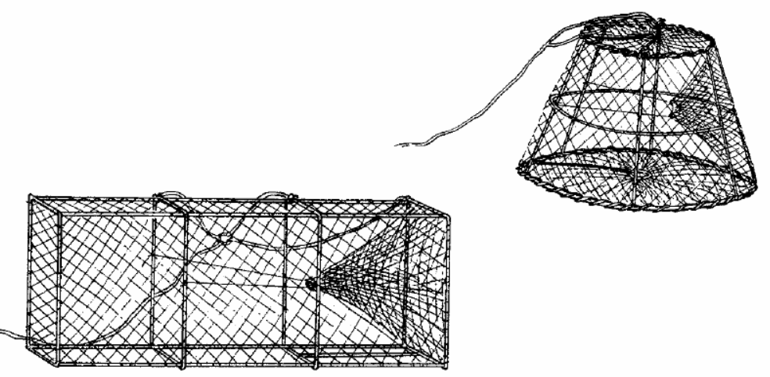
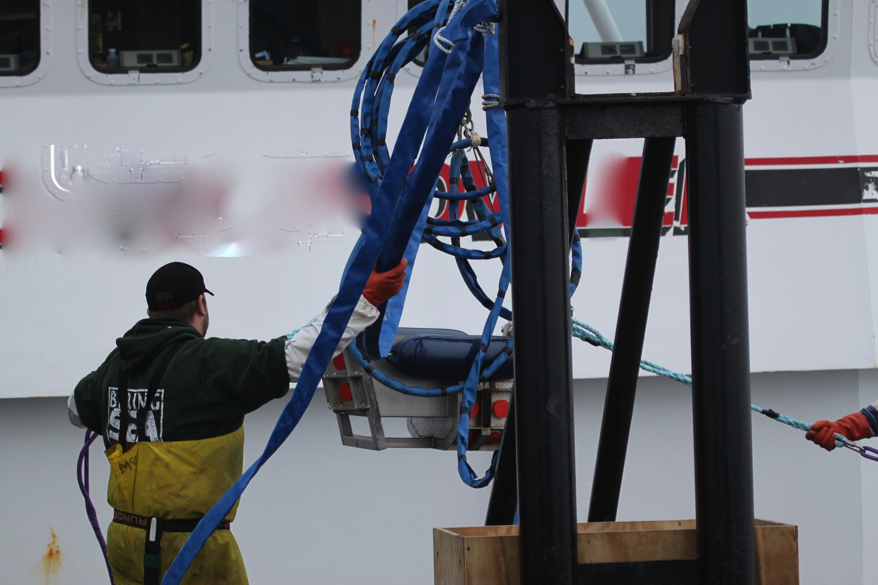

Mitigation
Sablefish pot gear
  Effective
  Expensive transition
  Shifting depredation pressure?
Change fishing behavior
    Drop gear back down
    Move to a different site
    Costly
Acoustic deterrents
  Orca sphere
  Bang pipes
  Seal bombs
  Effective?
finecommittee.org
Notes:
And requires a significant amount of capital investment.- and in many cases is not feasible for some smaller vessels.
There is also a risk associated with whales shifting depredation pressure to the remaining hook and line gear and/or halibut fisheries in particular.

Slide 16
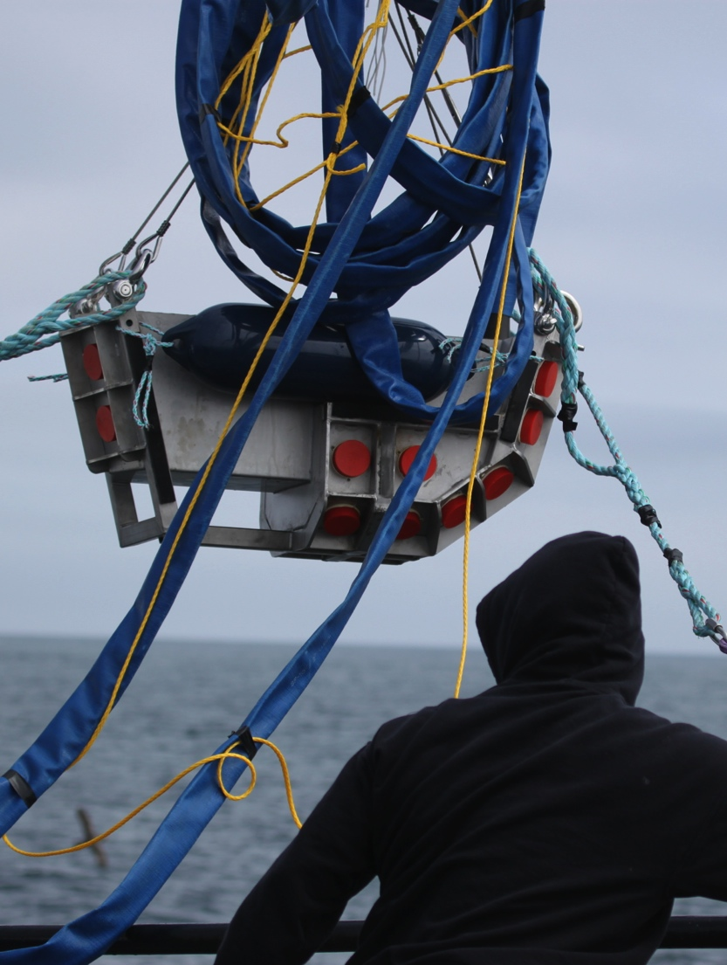
Additional avoidance measures
Chaser skiff
Shorter sets
Tandem fishing
Hauling quickly
Staying in gear while hauling
Notes:
More specifically, respondents were asked to list specific avoidance measures that they felt reduced depredation impacts. These measures had varying to negligible effects and were not consistent between respondents.
***add In orcasaver pic

Slide 17
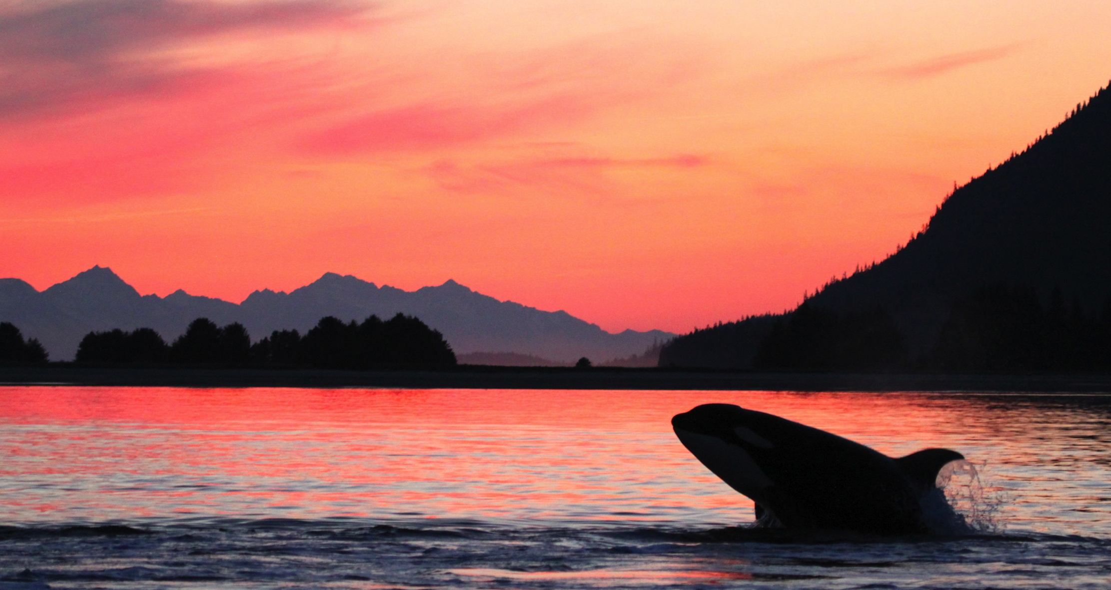
Questions

