Slide 1
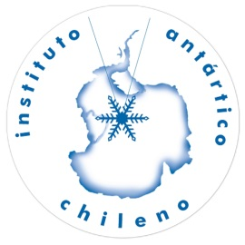
Killer whales of Southern Chile
By
Anelio Aguayo Lobo
Jorge Acevedo
Benjamín Cáceres
March, 2016
Punta Arenas, Chile

Slide 2
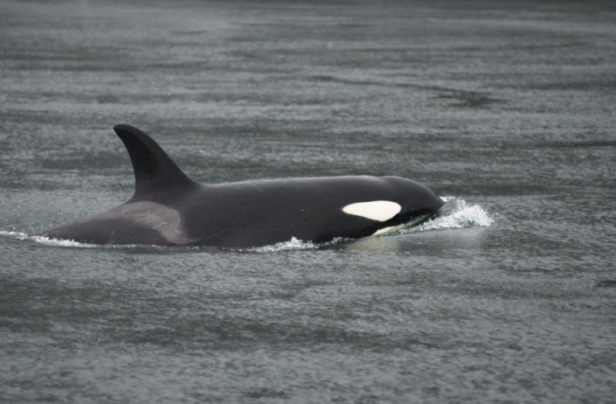
Cetaceans in Chilean Patagonia waters
In Chilean Patagonia waters 29 out of the 42 cetacean species from Chile have been registered, as shown in Table 1. From those, 21 (72%) belong to the suborder Odontoceti, and 28% to the suborder Mysticeti. However, only three species have been registered interacting with the Patagonian toothfish (Dissostichus eleginoides) longline fisheries are: Orcinus orca, Physeter macrocephalus and Globicephala melas.
Figure 3: Orcinus orca
Figure 4: Physeter macrocephalus
Figure 5: Globicephala melas

Slide 3
Table 1: Cetacean species recorded in Chilean Patagonia waters
Scientific name | Common name | Conservation Status
Eubalaena australis | Southern right whale | Endangered
Caperea marginata | Pygmy right whale | Data Deficient
Balaenoptera musculus | Blue whale | Endangered
Balaenoptera physalus | Fin whale | Threatened
Balaenoptera borealis | Sei whale | Threatened
Balaenoptera bonaerensis | Antarctic minke whale | Stable
Balaenoptera acutorostrata | Dwarf minke whale | Stable
Megaptera novaeangliae | Humpback whale | Vulnerable
Physeter macrocephalus | Sperm whale | Stable
Berardius arnouxii | Arnoux’s beaked whale | Not Evaluated
Hyperodon planifrons | Southern bottlenose dolphin | Stable
Mesoplodon layardi | Strap-toothed whale | Not Evaluated
Mesoplodon grayi | Gray’s beaked whale | Data Deficient
Mesoplodon hectori | Hector’s beaked whale | Data Deficient
Mesoplodon densirostris | Blainville’s beaked whale | Data Deficient

Slide 4
Table 1: Continuation
Scientific name | Common name | Conservation Status
Ziphius cavirostris | Cuvier’s beaked whale | Least Concern
Tasmacetus shepherdii | Sheperd’s beaked whale | Not evaluated
Orcinus orca | Killer whale | Stable
Pseudorca crassidens | False killer whale | Not evaluated
Globicephala melas | Long-finned pilot whale | Stable
Grampus grisseus | Risso’s dolphin | Not evaluated
Tursiops truncatus | Bottle nose dolphin | Data Deficient
Lagenorhynchus obscurus | Dusky dolphin | Data Deficient
Lagenorhynchus australis | Peale’s dolphin | Data Deficient
Lissodelphis peronii | Southern right whale dolphin | Data Deficient
Cephalorhynchus commersonii | Commerson’s dolphin | Endangered
Cephalorhynchus eutropia | Chilean dolphin | Endangered
Phocoena spinipinnis | Burmeister’s porpoise | Data Deficient
Phocoena dioptrica | Spectacled porpoise | Not evaluated

Slide 5
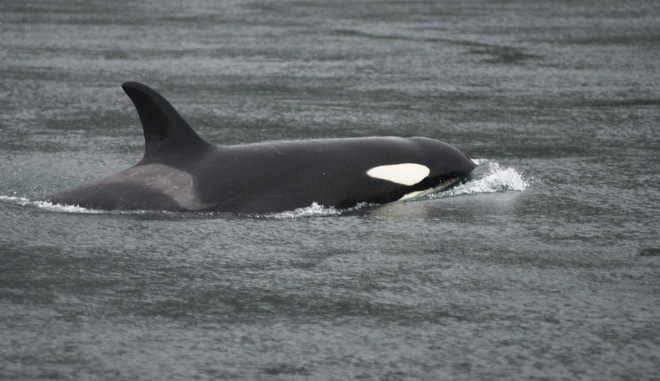
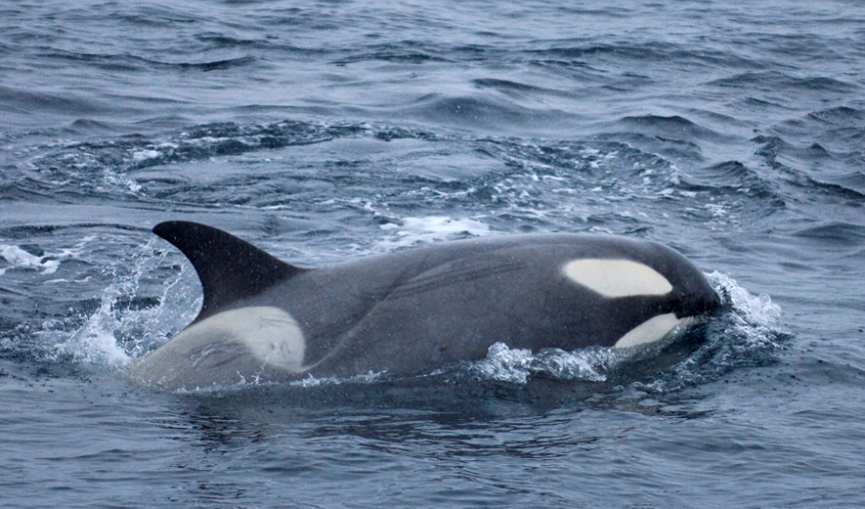
Current knowledge in Chile
What we know about the biology and ecology of Killer whales (Orcinus orca) in Chile is scarce, moreover of its feeding habits. Apparently, they feed on South American sea lion (Otaria flavescens) and to a lower extent, on South American fur seal (Arctocephalus australis) (Capella et al., 1999). It has also been registered preying on birds and sei whales (Balaenoptera borealis) (Haussermann et al., 2013).
This Odontocete species has been registered depredating on the Patagonian toothfish fisheries between 53° and 57°S (Hucke-Gaete et al., 2004; Olivares Mansilla, 2005; Moreno et al., 2008). Häussermann et al. (2013), reported 119 sightings between 2002 y 2012 in Chilean Patagonia waters and present the first killer whale catalogue with 49 identified individuals, which seven of them have been seen more than once. All of them belong to the ecotype A.
Figure 1: Ecotype A. Photo credit: Jorge Acevedo
Figure 2: Ecotype B. Photo credit: Jorge Acevedo

Slide 6
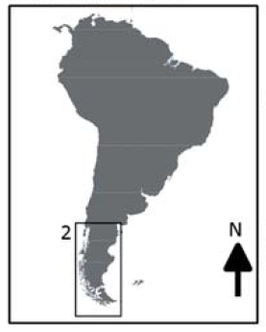
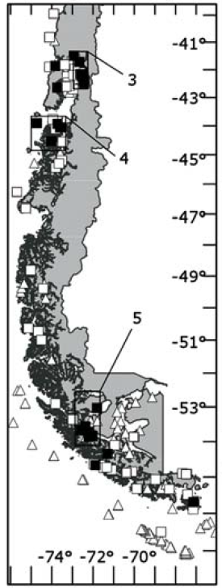
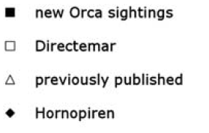
Killer whales in Chilean Patagonia: additional sightings, behavioural observations, and individual identifications
Verena Häussermann, Jorge Acevedo, Gunter Forsterra, Michelle Bailey and Anelio Aguayo-Lobo, 2013. Revista de Biología Marina y Oceanografía. 48 (1): 73-85
Figure 4: Catch area of Globalpesca SA.
Figure 3: Sighting locations along the Chilean Patagonia

Slide 7
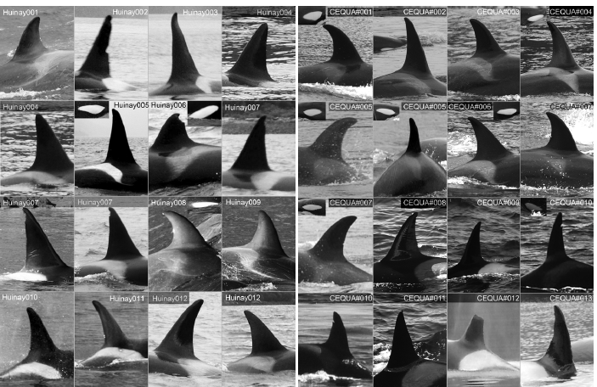
Figure 5: Photo catalogue of Orca’s dorsal fins recorded in Chilean Patagonian waters from 2001 to 2012.

Slide 8
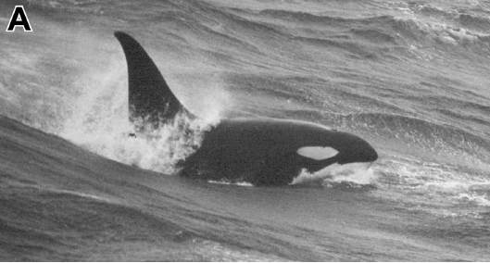
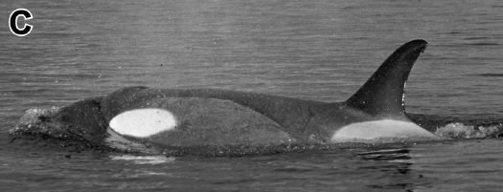
Killer whale morphotypes (A, B)
R.L Pitman & P. Ensor. 2003. Three forms of Killer whale (Orcinus orca) in Antarctic waters. J. Cetacean Res. Manage. 5(2): 131-139
R. L Pitman, J. Durban, M. Greenfelder, C. Guinet, M. Jorgensen, P. Olson, J. Plana, P. Tixier y J. Towers. 2011. Polar Biology. 34: 303-306
A
B
Taken from Pitman & Ensor, 2003)
(Taken from Pitman et al., 2011)
Type A:
-Medium-sized eyepatch oriented parallel to the body axis.
-No dorsal cape.
-Mainly off-shore in ice-free water.
-World distribution.
-Preys upon Antarctic minke whales and catches from the toothfish fisheries around Crozet islands.
Type B:
-Large-sized eyepatch oriented parallel to the body axis.
-With dorsal cape.
-Inhabits inshore waters, regularly occurring in pack-ice.
-Distributed around the Antarctic continent and regularly sighted in the Antarctic Peninsula area.
-Preys mainly upon pinnipeds and penguins.

Slide 9
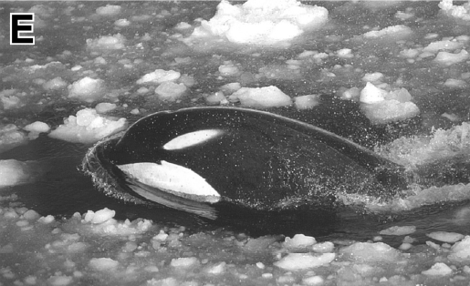
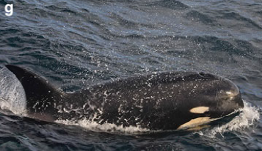
Killer whale morphotypes (C, D)
C
D
(From Pitman & Ensor, 2003)
(From Pitman & Ensor, 2003)
Type C:
-Small forward-slanted eyepatch.
-With dorsal cape.
-Inhabits inshore waters and lives mainly in the pack ice, mostly off East Antarctica.
-Recorded feeding only on Antarctic toothfish.
Type D:
-Extremly small eyepatch.
-No dorsal cape.
-Circumglobal distribution in subantarctic waters.
-Unknown diet, although seen depredating on Patagonian toothfish around long line vessels.
Even though the diet of the ecotype A in Chilean waters is still unknown to us, we think that this is the one preying on the Patagonian toothfish fishery off Southern Chile, like in other places of the Southern Ocean (Soffker et al., 2015).

Slide 10
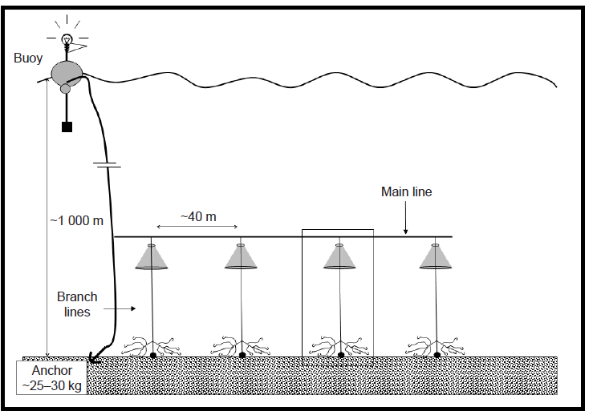
Interactions between Patagonian toothfish fisheries with Orca off Southern Chile
The only Chilean research efforts on Interactions between Killer whales and the Patagonian toothfish fisheries known by us in Southern Chile, besides Arana (2008) in international waters, are Hucke-Gaete et al. (2004) y Moreno et al. (2008).
Moreno et al. (2008), agrees that the “Chilean longline” system diminished significantly the depredation rate for sperm whales and killer whales. Nevertheless, fishing Operators assure that this measure does not work as a mitigation alternative for killer whales. Thus, during the last years, interactions in the Southern Ocean involve orcas and not sperm whales (Clark & Agnew 2010, Soffker et al. 2015).
In conclusion, there has been few systematic studies on cetaceans and how they interact with fisheries in Chile.
Figure 10: Chilean longline (Moreno et al. 2008)

Slide 11
What we should aim for:
Considering that our knowledge is scarce, we have started studying the ecology and dynamics of cetaceans interacting with the Patagonian toothfish fisheries in an alliance with the fishing industry, in order to understand the cetacean predation patterns off Southern Chile; which in the future will help to diminish these interactions. In this Science-Fishing Industry alliance, the data collection has been taken to address:
Evaluating the killer whale and/or sperm whale depredation rate, through the record on fish remains in long lines.
Developing research on spatial and temporal distribution of interactions.
Photo-ID of the individuals depredating on the Patagonian toothfish fisheries.
For the near future:
- Study vocalizations and acoustic environment in the fishing grounds.
- Research on diet using Carbon and Nitrogen stable isotopes.
- Research on movements using satellite telemetry.
Figure 11: Cabo de Hornos Research Vessel.
Figure 12: Globalpesca fishing vessel.

Slide 12
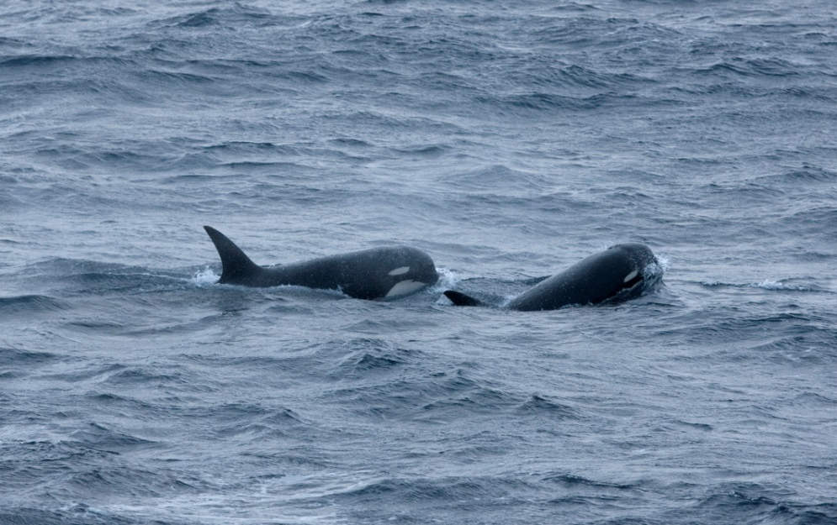
Acknowledgements
Authors would like to thank their respective Institutions for their support in the confection of this presentation, as well as the Organizers of this event, specially Mr. Eduardo Infante for his cordial invitation. Thank you very much.
Punta Arenas, Chile
Photo credit: Jorge Acevedo

Slide 13
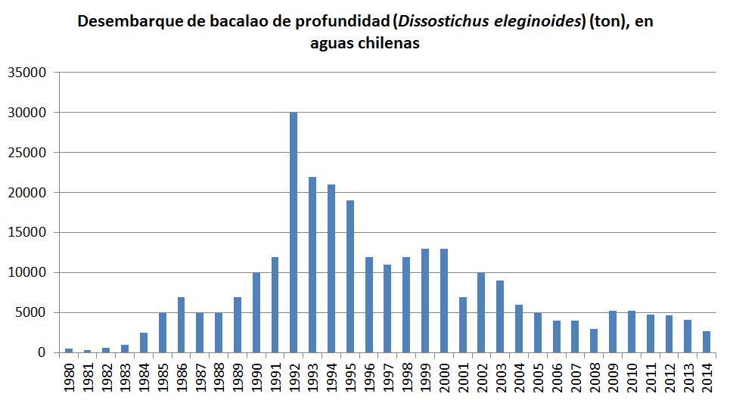
Researchers concern
Figure 14 : Annual Patagonian toothfish (Dissostichus eleginoides) landing in Chile. Taken and modified from Arana (2008).
Question: Looking at the obvious decline since the beginning of 2000 as shown in Arana (2008), we ask, is it not near to its collapse? Therefore, is it time for a recess and the opportunity to start with a Management Plan based on multidisciplinary research efforts? That is to say, together: Universities, Research Institutions, Fisheries, Fishery Services, Government; we must make a great effort to amend this situation.

