Slide 1
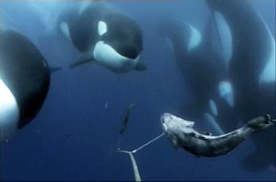
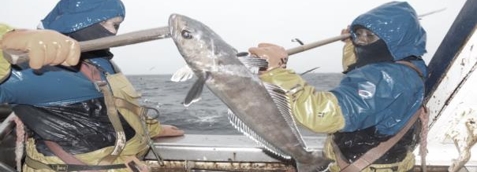
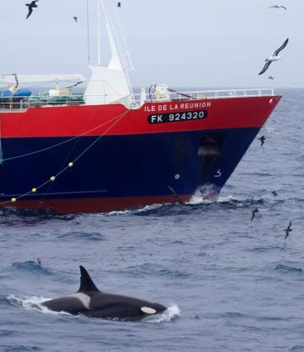
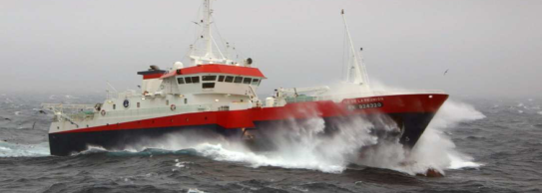
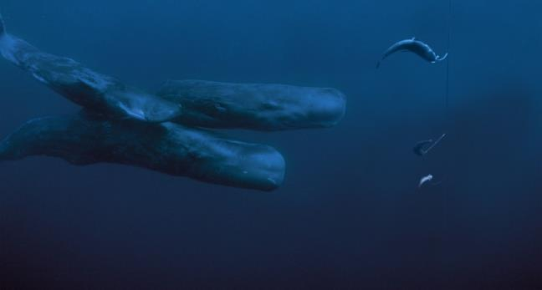





Workshop on depredation – Chile – Session 2
Research on depredating populations
Demography and population structure of depredating killer and sperm whale populations off the Crozet and Kerguelen Islands
Paul Tixier^{1,2}, Nicolas Gasco³, Christophe Guinet¹
¹ Centre d’études Biologiques de Chizé, ² Réserve Naturelle des Terres Australes Françaises, Terres Australes et Antarctiques Françaises
³ Muséum National d’Histoire Naturelle de Paris

Slide 2
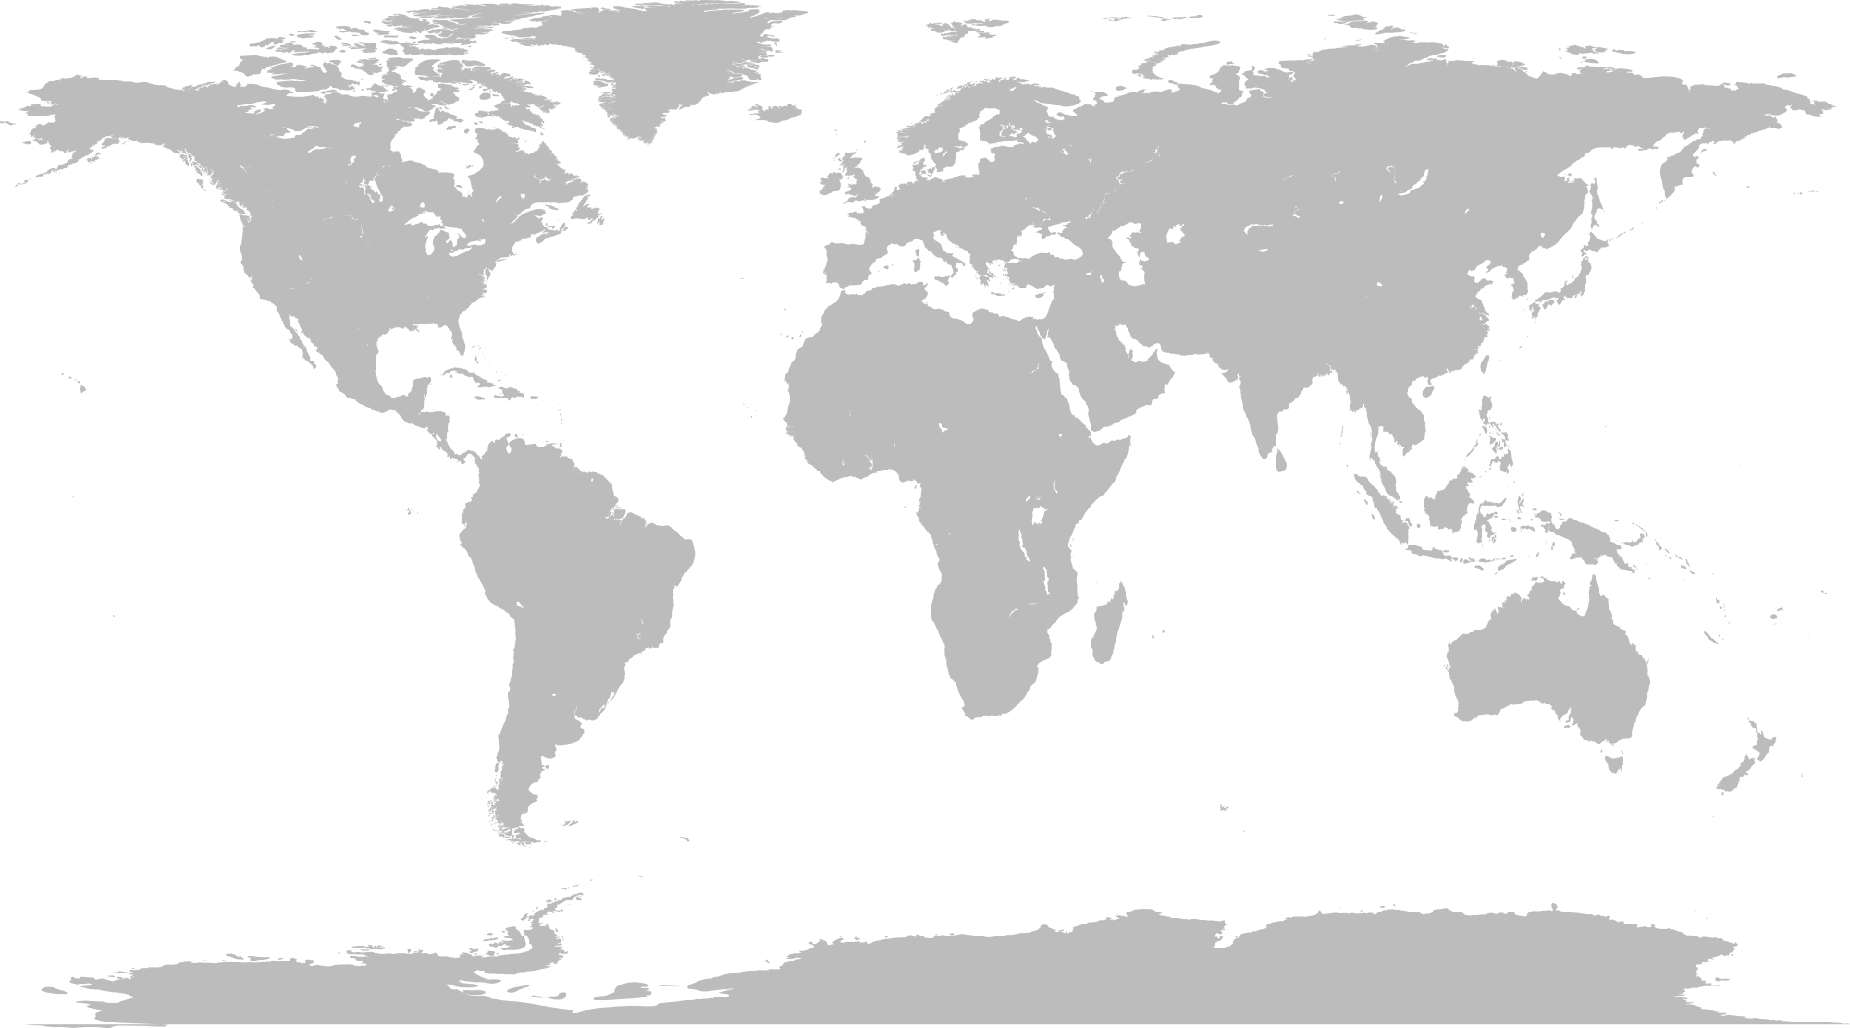
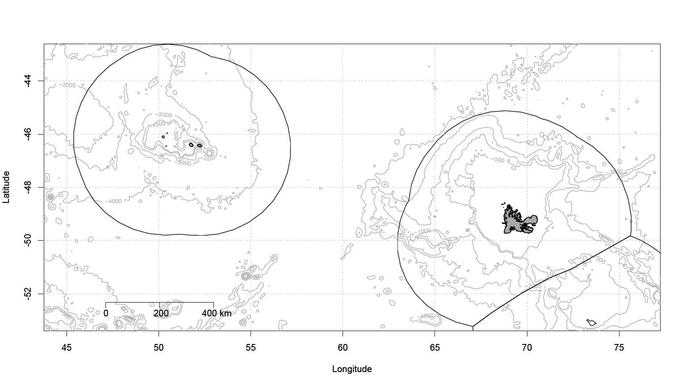
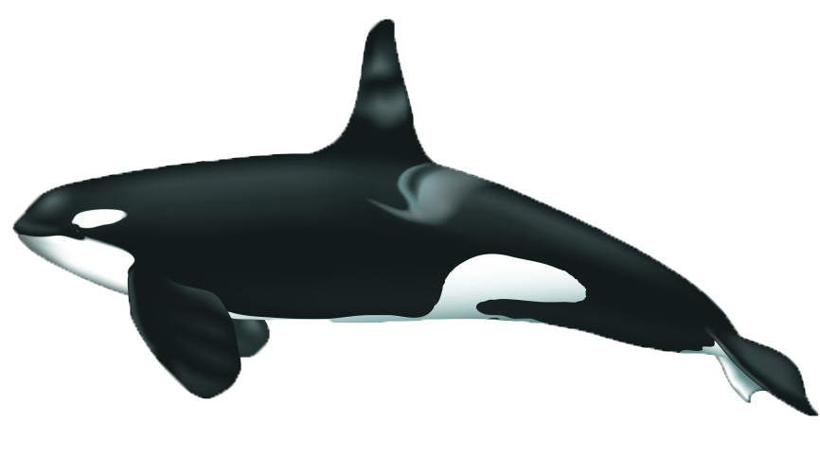
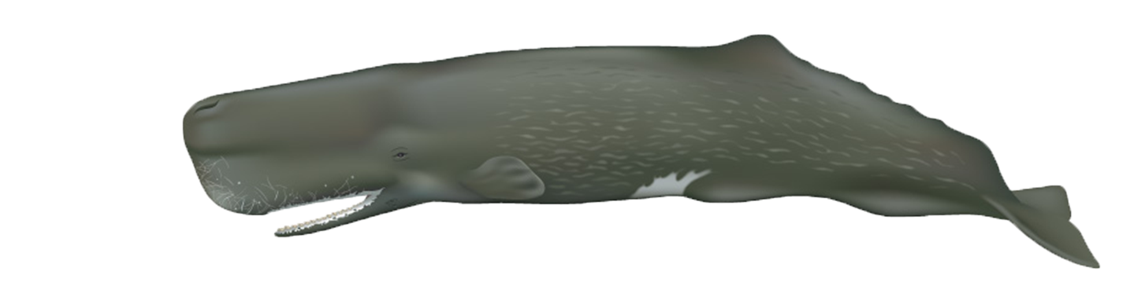
Study Areas
Depredating
killer whales
Depredating
sperm whales
Conclusion
Study areas
Crozet and Kerguelen EEZs
CROZET EEZ
CCAMLR 58.6
KERGUELEN EEZ
CCAMLR 58.5.1

Slide 3
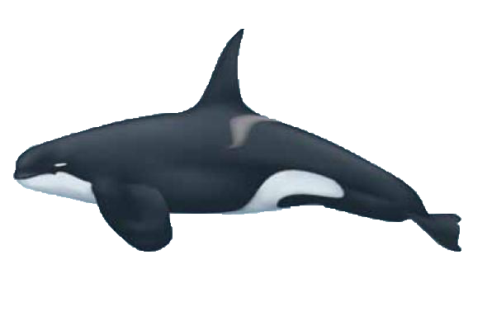
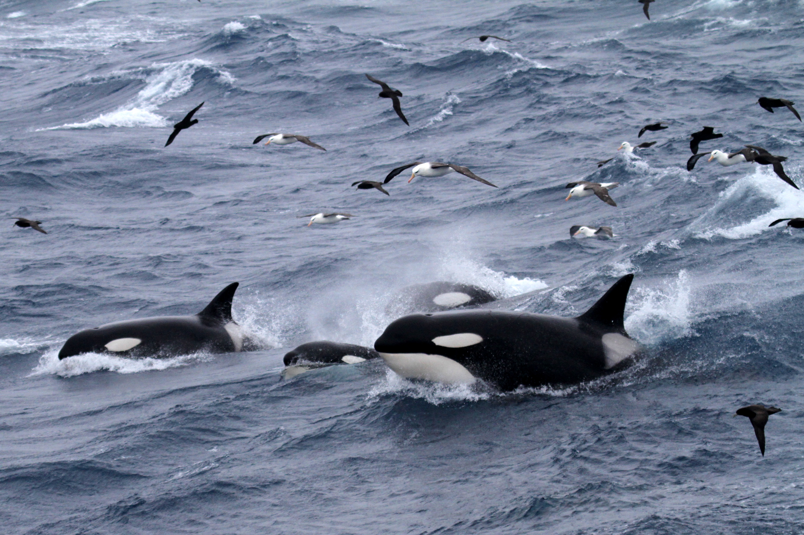
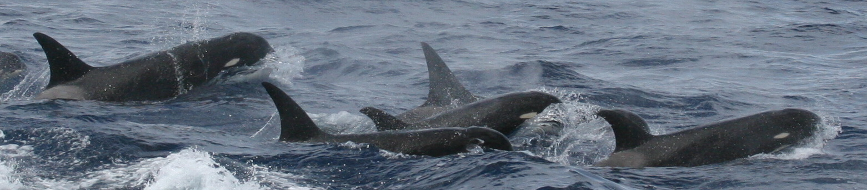
Study Areas
Depredating
killer whales
Depredating
sperm whales
Conclusion
Crozet type
2 morphotypes
Type-D
Tixier, P., Gasco, N., and Guinet, C. 2014. Killer whales of the Crozet islands, photo-identification catalogue 2014. doi: 10.6084/m9.figshare.1060247
Tixier P., Gasco N., Poupart T., Guinet C. 2014. Type-D killer whales of the Crozet Islands. doi: 10.6084/m9.figshare.1060259.

Slide 4
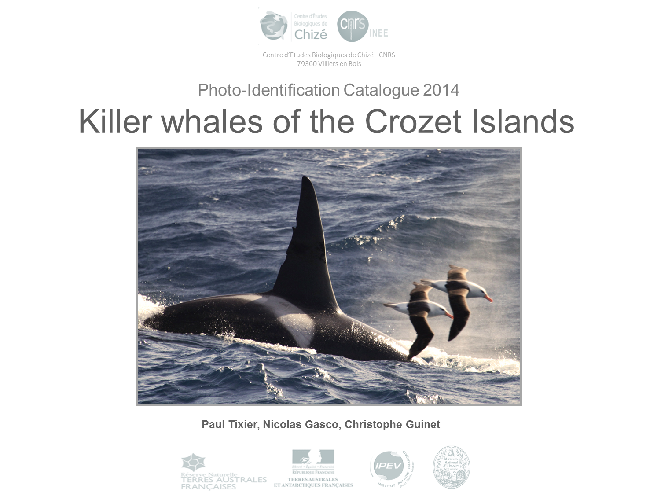
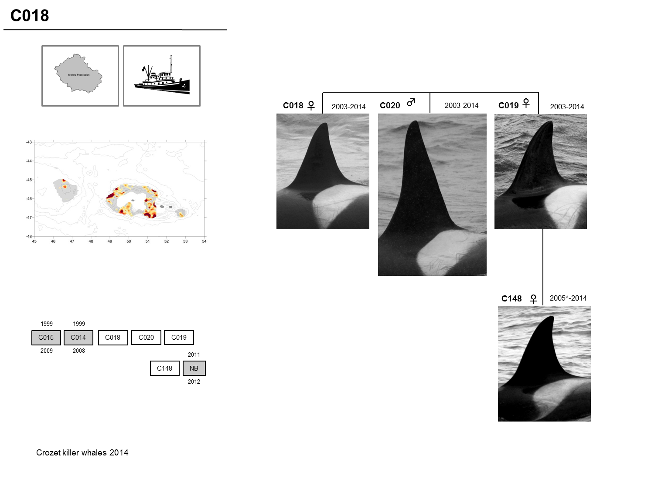
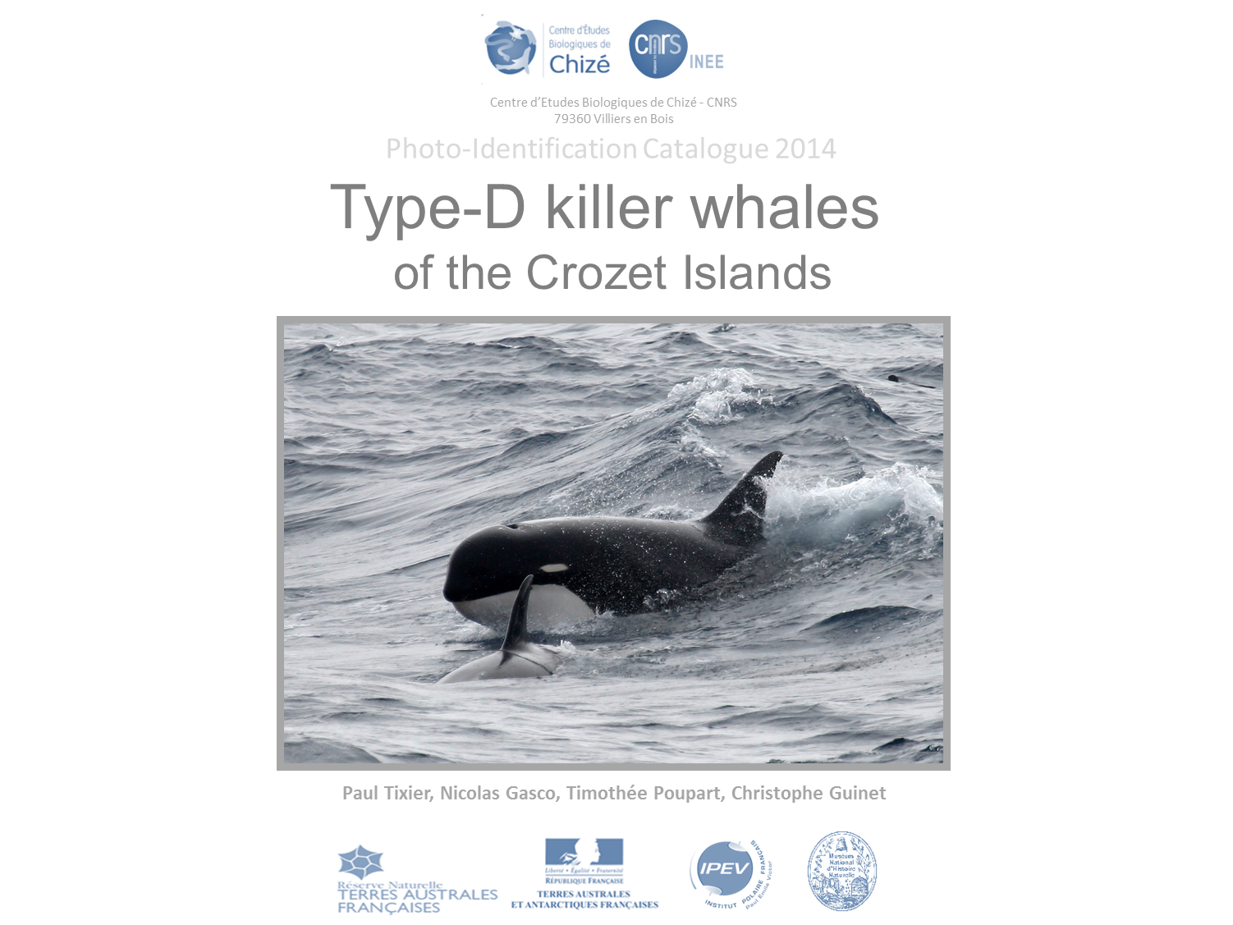
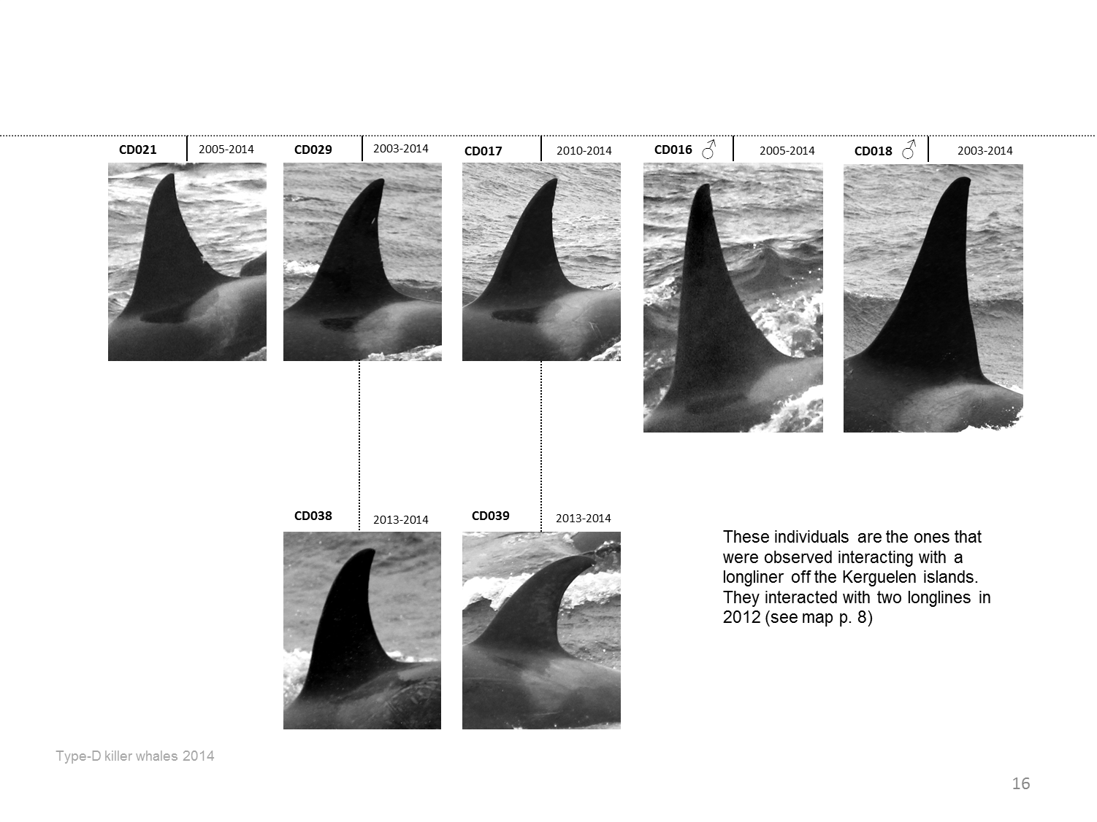
Study Areas
Depredating
killer whales
Depredating
sperm whales
Conclusion
Crozet type
Photo-identification monitoring
Type-D
Monitored since 1964
From land + fishing vessels
Monitored since 2003
From fishing vessels only
2014
74 regularly observed individuals
19 social groups
2014
31 individuals

Slide 5
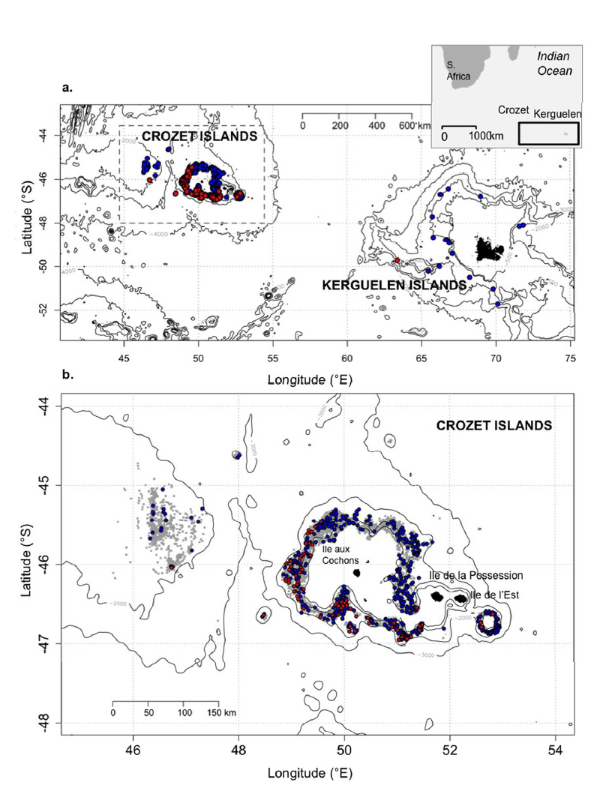
Study Areas
Depredating
killer whales
Depredating
sperm whales
Conclusion
2003 - 2015
746 sets
82 sets
9 sets with two ecotypes
Tixier, P., N. Gasco, G. Duhamel, C. Guinet. 2016. Marine Mammal Sci.

Slide 6
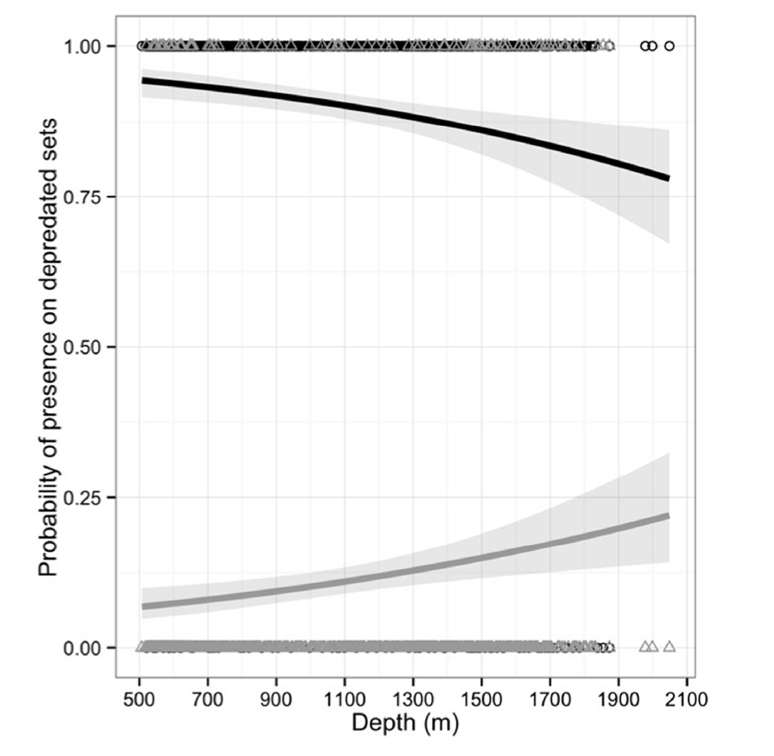
Study Areas
Depredating
killer whales
Depredating
sperm whales
Conclusion
Tixier, P., N. Gasco, G. Duhamel, C. Guinet. 2016. Marine Mammal Sci.

Slide 7
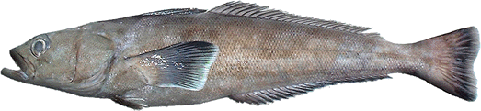
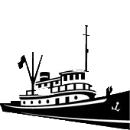
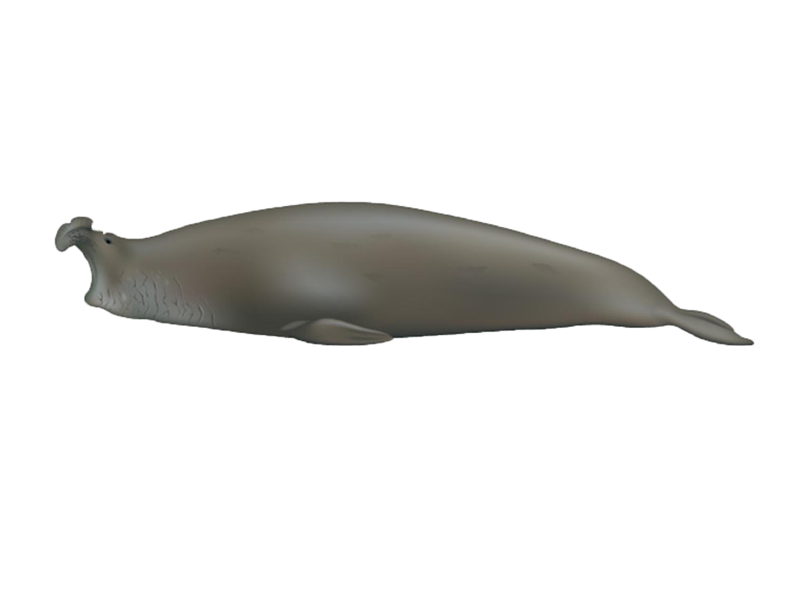
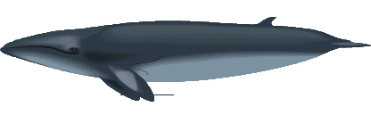

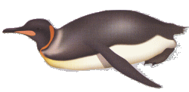
Study Areas
Depredating
killer whales
Depredating
sperm whales
Conclusion
Crozet type
Generalist feeding ecology (Guinet, 1991, 1992)
Large whales
Pinnipeds
Penguins
Fish

Slide 8
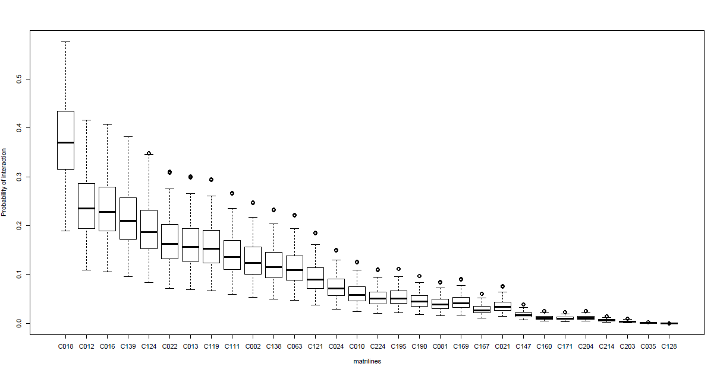
Study Areas
Depredating
killer whales
Depredating
sperm whales
Conclusion
Crozet type
Differences in the level of interactions between killer whale groups
High interaction: group C018
Medium interaction: group C002
Probability of interaction
Highly experienced whales
Groups of killer whales

Slide 9
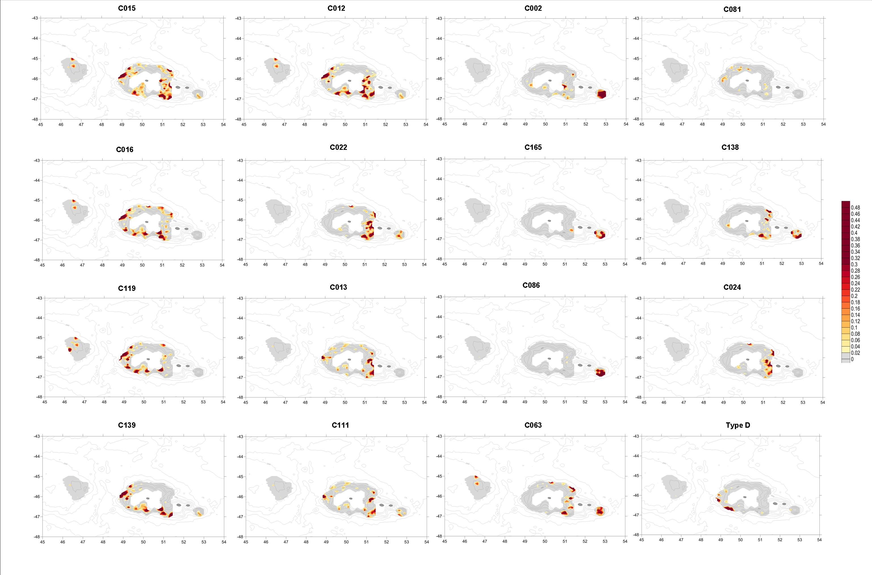

Study Areas
Depredating
killer whales
Depredating
sperm whales
Conclusion
Distribution of interactions
Group specific
Group C018
Interaction rate = 0.34
> 0.5
> Interacts on all fishing grounds
0

Slide 10
Study Areas
Depredating
killer whales
Depredating
sperm whales
Conclusion
Distribution of interactions
Group specific
Group C018
Interaction rate = 0.34
> 0.5
> Interacts on all fishing grounds
Group C002
0
Interaction rate = 0.14
> Preferential areas of interaction

Slide 11
Study Areas
Depredating
killer whales
Depredating
sperm whales
Conclusion
Seasonality
Group specific
Probability of interaction per month
Group C018
Interaction rate = 0.34
> Interacts all year round
Jul Aug Sep Oct Nov Dec Jan Feb Mar Apr May Jun

Slide 12
Study Areas
Depredating
killer whales
Depredating
sperm whales
Conclusion
Seasonality
Group specific
Probability of interaction per month
Group C018
Interaction rate = 0.34
> Interacts all year round
Period of natural resource abundance
Group C002
Interaction rate = 0.14
> No interaction in Oct Nov Dec
Jul Aug Sep Oct Nov Dec Jan Feb Mar Apr May Jun

Slide 13
Study Areas
Depredating
killer whales
Depredating
sperm whales
Conclusion
Changes in resource availability
Intra-population specializations
Depredating individuals
Non-Depredating individuals
Divergent demographic trajectories ?

Slide 14
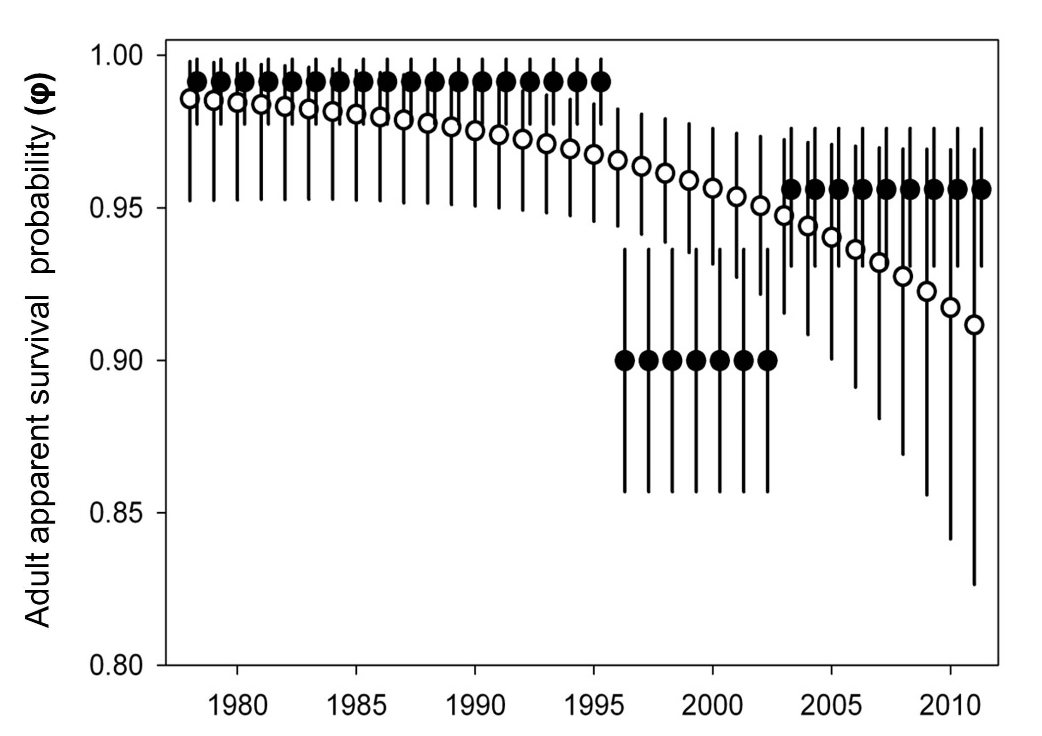
Study Areas
Depredating
killer whales
Depredating
sperm whales
Conclusion
Effects of depredation on the Crozet killer whale population
1996-2002
Over-mortality of depredating whales
Lethal interactions with illegal fisheries
(use of fireguns to repel the whales)
Depredating individuals
Non-Depredating individuals
Tixier, P., Gasco, N., Authier, M., Guinet, 2015 Influence of artificial food provisioning from fisheries on killer whale reproductive output. Animal Conservation
Tixier, P., Pardo, D., Barbraud, C., Gasco, N., Guinet, Demographic consequences of behavioral heterogeneity and interactions with fisheries within a generalist killer whale population, under review.

Slide 15
Study Areas
Depredating
killer whales
Depredating
sperm whales
Conclusion
Effects of depredation on the Crozet killer whale population
Since 2003
Better survival for depredating whales
Depredating individuals
Non-Depredating individuals
Tixier, P., Gasco, N., Authier, M., Guinet, 2014 Influence of artificial food provisioning from fisheries on killer whale reproductive output. Animal Conservation
Tixier, P., Pardo, D., Barbraud, C., Gasco, N., Guinet, Demographic consequences of behavioral heterogeneity and interactions with fisheries within a generalist killer whale population, under review.

Slide 16
Study Areas
Depredating
killer whales
Depredating
sperm whales
Conclusion
Effects of depredation on the Crozet killer whale population
Since 2003
Higher probability of calving for highly depredating females
Tixier, P., Gasco, N., Authier, M., Guinet, 2014 Influence of artificial food provisioning from fisheries on killer whale reproductive output. Animal Conservation
Tixier, P., Pardo, D., Barbraud, C., Gasco, N., Guinet, Demographic consequences of behavioral heterogeneity and interactions with fisheries within a generalist killer whale population, under review.

Slide 17
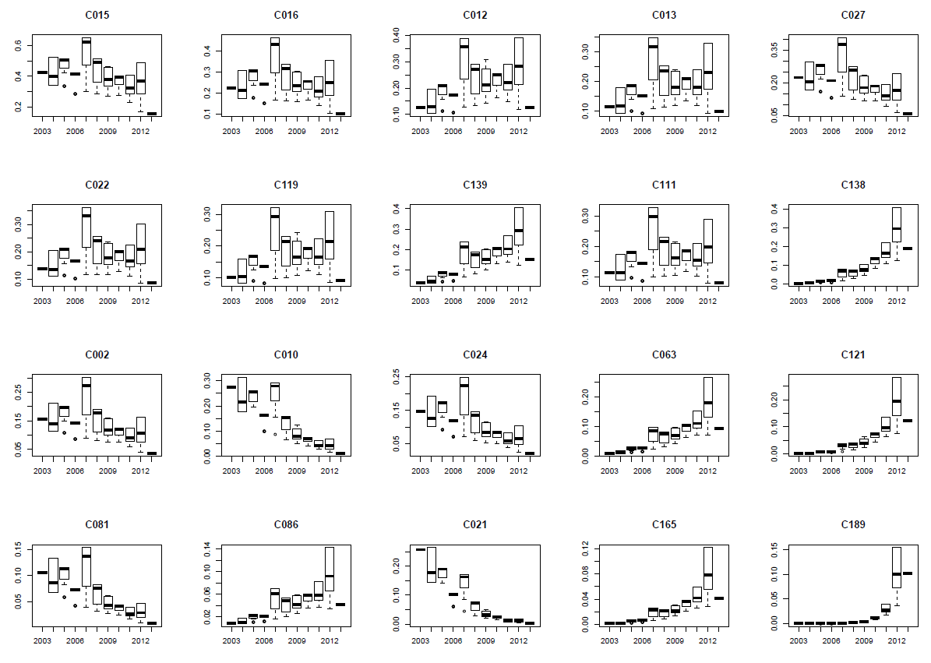
Study Areas
Depredating
killer whales
Depredating
sperm whales
Conclusion
Behavioural heterogeneity
Increase of the depredation probability for several groups

Slide 18
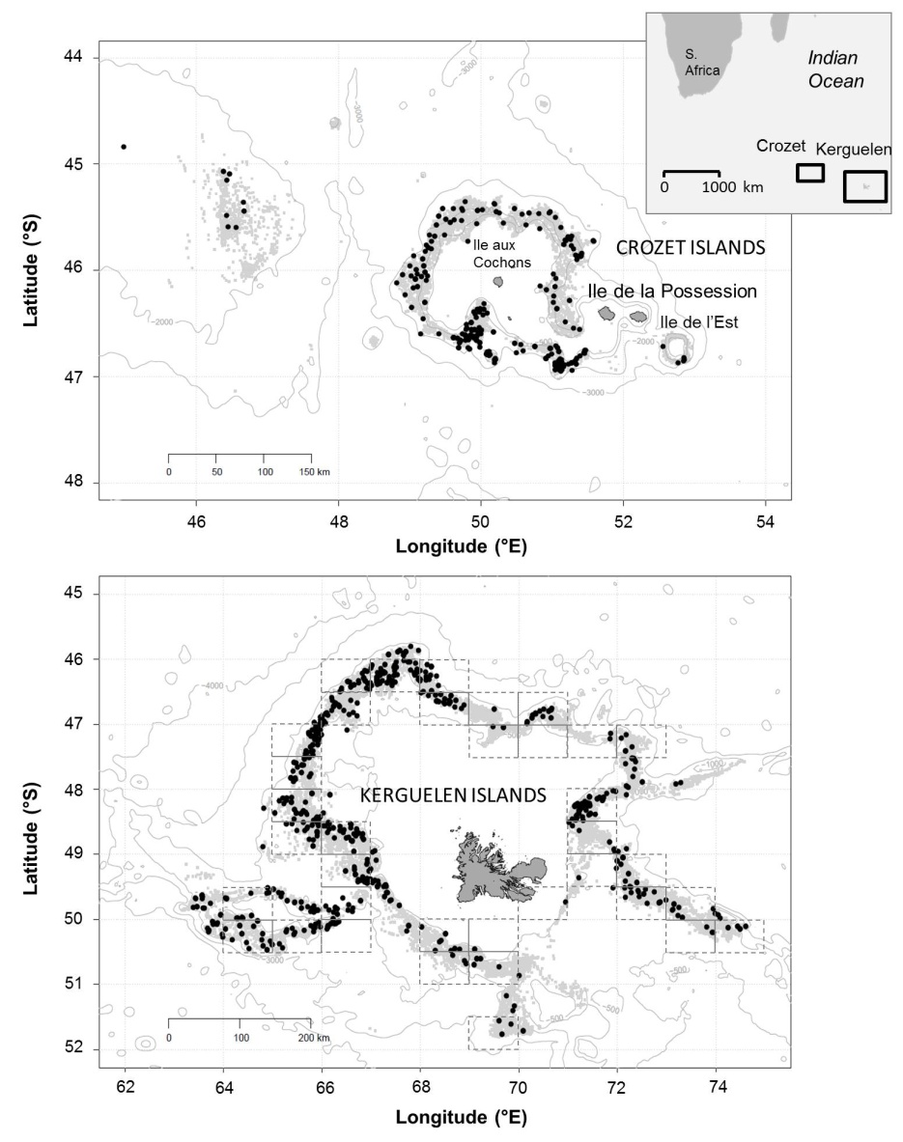
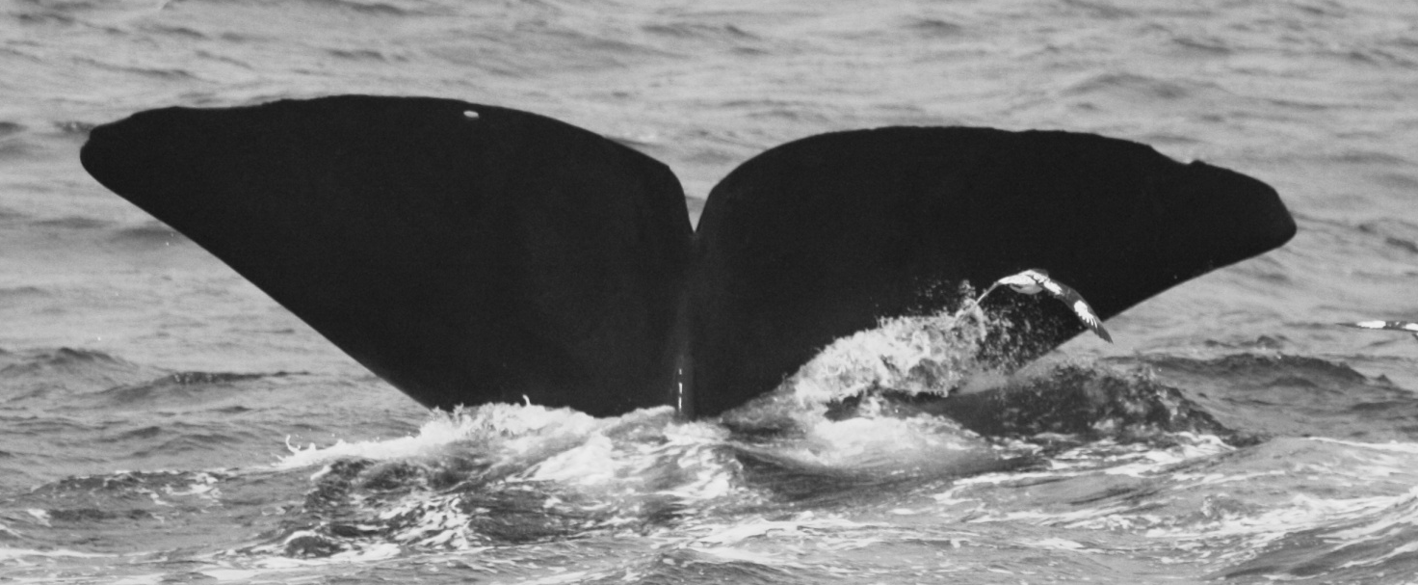
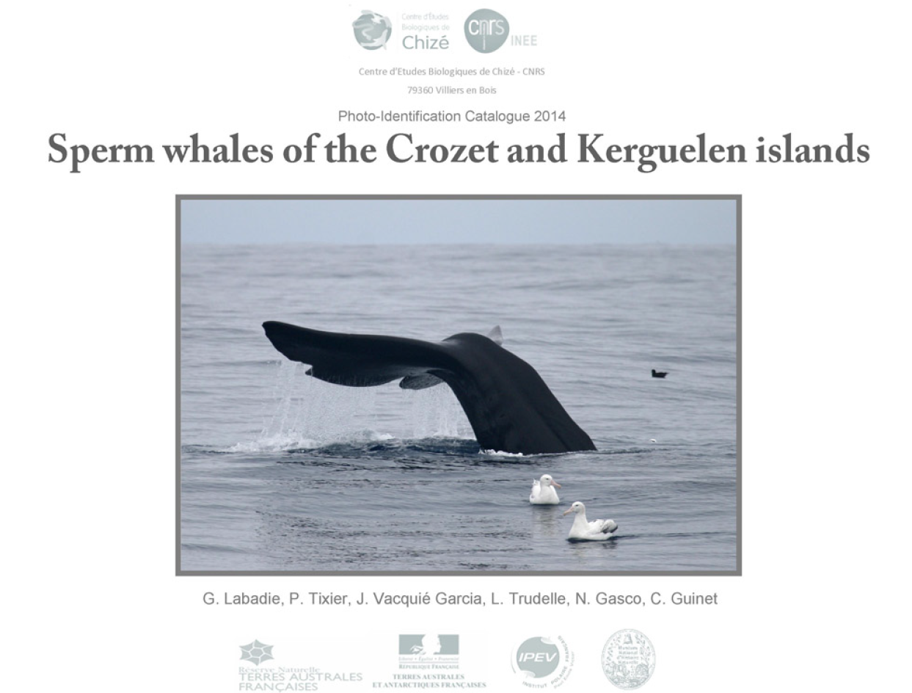
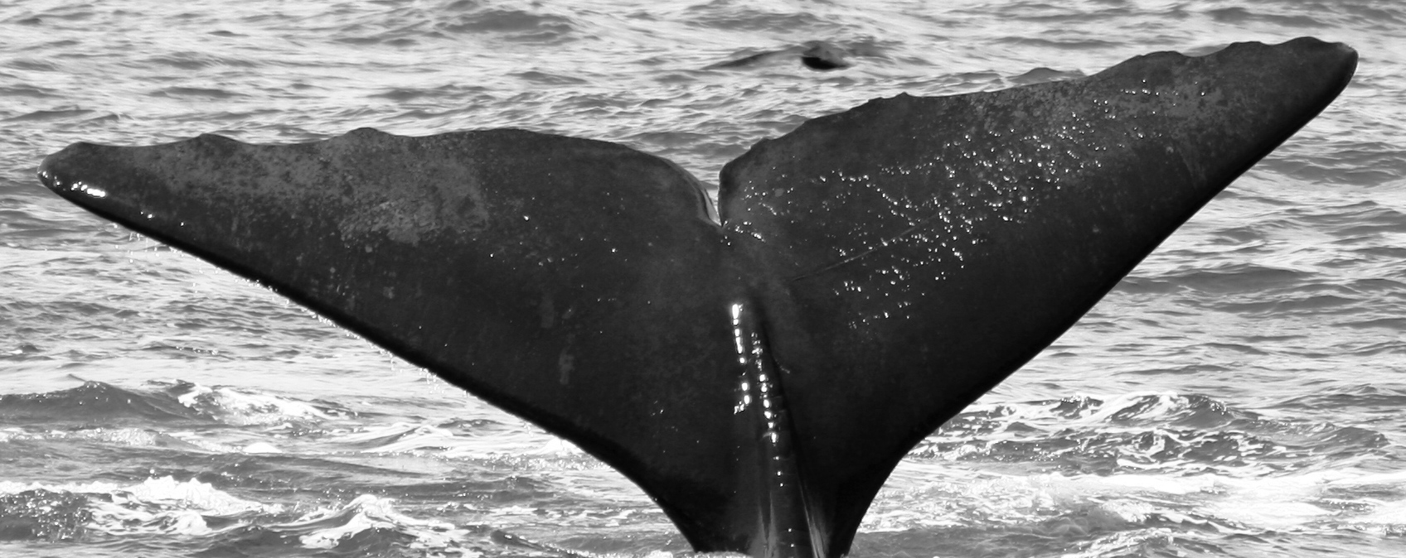
Study Areas
Depredating
killer whales
Depredating
sperm whales
Conclusion
Demographic features of adult male sperm whales populations
Photo-identification monitoring from fishing vessels since 2005
2005 - 2014
Environ 29,000 photos examinées
18,000 avec des représentations de cachalots
50% utilisables pour l’étude et la reconnaissance des caudales
305 individuals identified
7237 observations
Labadie, G., Tixier, P., Trudelle, L., Vacquie-Garcia, J., Gasco, N., Guinet, 2015. Sperm whales of the Crozet and Kerguelen islands - Photo-identification catalogue 2014. Figshare. <http://dx.doi.org/10.6084/m9.figshare.1414472> .

Slide 19
Study Areas
Depredating
killer whales
Depredating
sperm whales
Conclusion
Demographic features of adult male sperm whales populations
Site fidelity:
  Negligible exchanges between Crozet and Kerguelen
  9 individuals sighted in both sites
  Limited distance travlled from location of 1st sighting
  75% of individuals remain < 60 km (Crozet) and < 200 km (Kerguelen) from 1st sighting over period of years
Labadie, G., Tixier, P., Fay, R., Barbraud, C., Gasco, N., Guinet, In Prep. J. Mammalogy.

Slide 20
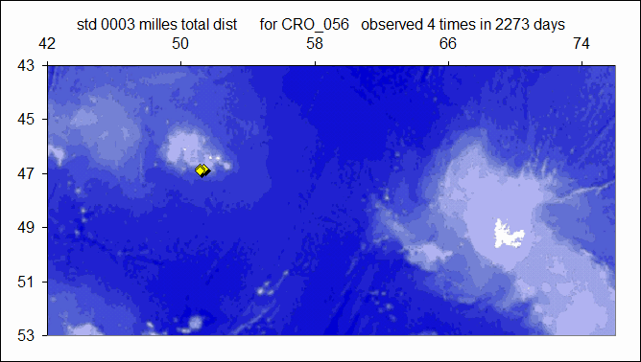

Study Areas
Depredating
killer whales
Depredating
sperm whales
Conclusion
Site fidelity:

Slide 21
Study Areas
Depredating
killer whales
Depredating
sperm whales
Conclusion
Demographic features of adult male sperm whales populations
Robust Design analysis
 | Crozet 2005 - 2014 | Kerguelen 2005 - 2014
Abundance 2014 | 82 [95% CI: 61-117] | 97 [95% CI: 78-127]
Apparent survival (ϕ) | 0.971 [95% CI: 0.928-0.996] | 0.946 [95% CI: 0.869-0.993]
Population Growth Rate (λ) | 0.995 | 1.002
7237 observations
Labadie, G., Tixier, P., Fay, R., Barbraud, C., Gasco, N., Guinet, In Prep. J. Mammalogy.

Slide 22
Study Areas
Depredating
killer whales
Depredating
sperm whales
Conclusion
Extensive fishing datasets
Longterm monitoring
of whale populations
Key Conditions
Multidisciplinary study of Fisheries/marine mammal interactions

Slide 23






Acknowledgements
CEBC - CNRS
Fundings and Partnership
Terres Australes et Antarctiques Françaises
Réserve Naturelle des TAAF
Muséum National d’Histoire Naturelle de Paris
Armements de pêche à la légine réunionais
Institut Polaire Français
Fondation d’entreprises des mers australes
Coordinators
Dr Christophe Guinet Cédric Marteau Pr. Guy Duhamel Thierry Clot
Data Collection
Fishery observers and field workers of Possession Island – special thanks to Nicolas Gasco
Help in analyses
M. Authier, M. Viviant, C. Barbraud, D. Pardo, D. Pinaud, J. Vacquie Garcia, T. Jeaniard Dudot, P.Monestiez
Photographers
AUBERT Jean Luc; BARRETT-LENNARD Lance; BEILLOEIL; BELBEYC'H Bruno; BERTHET Philippe; BERTRAND Geoffrey; BLANCHARD Pierrick; BOITEAU Christophe;
BONNET Joël; BOST Charles-André; BURLE Marie-Hélène; CARCAILLET Christopher; CARDOT Gilles; CHEVRIER Claude; DE STEPHANIS Renaud; DERVAUX Antoine;
DESMARET Rolland; DESPIN Bernard; DONDELINGER Caroline; DOREMUS Ghislain; DUFRENE Rémy; FERNANDEZ Eric; FOURNIER Jean-Charles; GASCO Nicolas GAUTHIER-CLERC Michel; GOUEDARD Yvon; GUINET Christophe; HANDRICH Yves; HANUISE Nicolas; HOARAU Eric; LANGUENOU Roger; LE CORRE Yann; LEGRAN Jérôme; LEMARCHAN Christian; LEQUETTE Benoît; LERIDON Jean; LEROUX Eric; LESCAROUX Jean-Michel; LOUBON Maxime; MAISON Jérome; MANGIN Stéphane; MANILEVE Patrick; MARECHAL Pierre; MELLEE Jean-Luc; MOURIES Jacques; NOORKHAN Alain; NOYAN Patrick; PAULIN Rémy; PAWLOWSKI Frédéric; PERROT Yohann; PETER Jean; RIDOUX Vincent; RINGOT Frédéric; SCHWEBEL Luc; SORIN Dominique; STENBERGER Ludovic;THERON Franck; TIXIER Paul; VERLAND Henri; VERMANDE Hugues; VILLEMIN Catherine; WEIMERSKIRCH Henri

