Slide 1
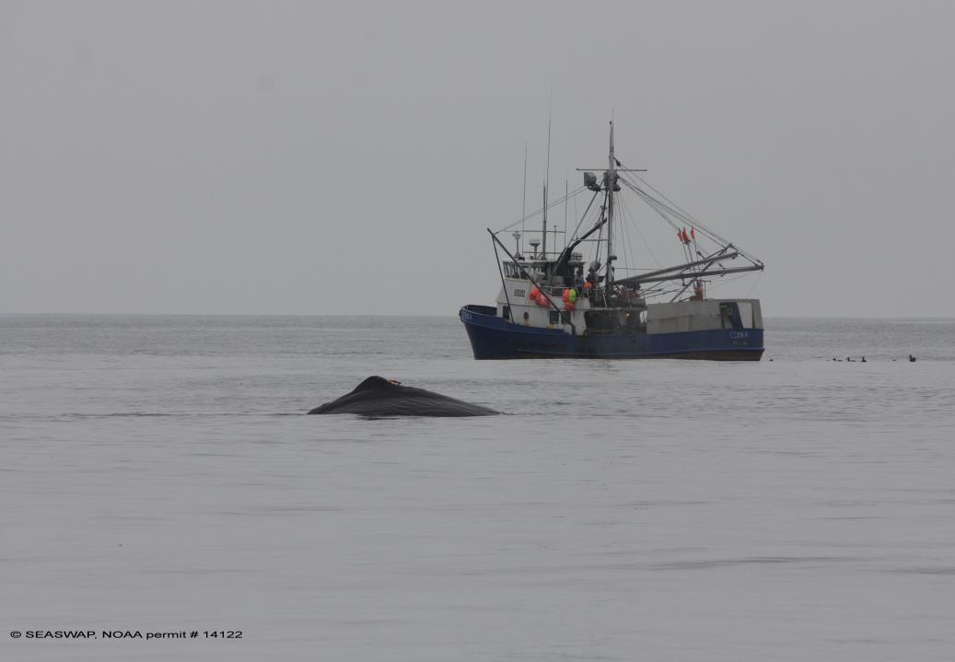
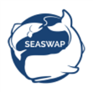
Is Depredation Increasing in the Gulf of Alaska?
Presented by Jan Straley
Session 3 COLTO March 2016
On behalf of SEASWAP
Punta Arenas, Chile

Slide 2
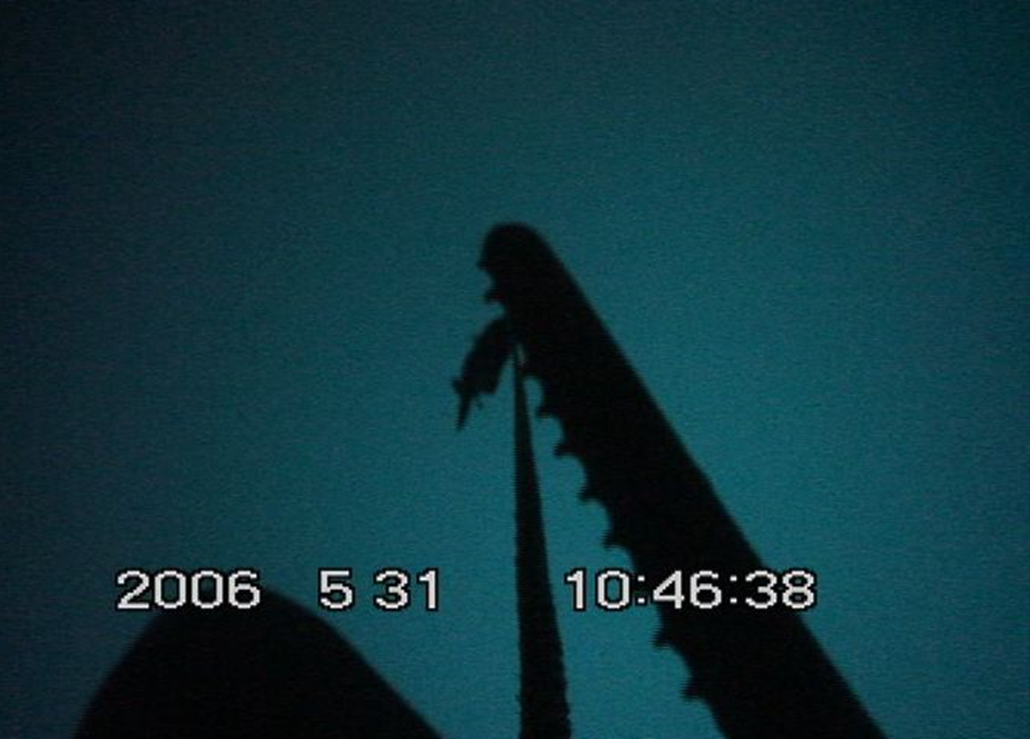
The spread of a novel foraging behavior in the Gulf of Alaska:
Exploring models of social learning among sperm whales
Notes:
Slide 3. Quick description of SW depredation in the Gulf of Alaska.
-observations of depredation go back to late 1970s, but by 1995/1996, coincident with a management change, observations of the behavior became much more widespread.
-the spread of depredation, especially the rate is which seemed to spread through the entire region led to the following question; did the novel behavior spread via social or individual transmission
-to address this we applied two theoretical models of cultural/social transmission from the human/animal literature; DCA and Wave of advance
Slide 4.
Diffusion curve analysis: Used extensively to describe the innovation and transmission of human technology(and a few cases of animal transmission). Facebook or myspace example, slow start with increasing rate of transmission. The exponential rate is diagnostic of social learning, seen in logistic or exponential functions. The alternative would be linear of logarithmic, which is a constant or decelerating rate, suggestive of asocial transmission
Important to note that it has been criticized, and it cannot alone be used for social learning, can be useful with other models of social transmission, such as Wave of Advance
Slide 5. Wave is a spatial model of transmission.
First used by Cavalli to document the spread of agriculture in Europe during Neolithic
Picture documents a locus of innovation followed by a radiation through time. You can track the through time, each year appears to radiate outward, suggestive of social learning. In contrast, if each indiv learned it on their own, it would pop up randomly in space and time and no linear relationship.
Slide 6; Survey info, I emphasize that its fishery independent, standardized and samples same stations each year. Samples sablefish, which are what sperm whales target from long lines, so it inadvertently became a SW survey as well
Slide 7:
The number of stations with depredation varied among years, but cumulative number of stations best with logistic function
Slide 8-10: Describe first locations central gulf, then spatially radiating pattern out through time.
Slide 11:
-Both models suggestive of social learning
-But, we lack the pre-1998 information on when the innovation arose and was transmitted early on.
-Also both models are population based, further behavioral data on identified individuals may shed light into the transmission.
-We do know that when depredation is observed, several individuals congregate around vessel, which is unique compared to natural foraging.
- The social learning mechanisms underlying depredation require further investigation.
-There may be stimulus enhancement, potentially involving vocalizations. For instance, its been demonstrated in other locales that when males are foraging they’re solitary, but in range of hearing other conspecfics, suggesting a role for eavesdropping. During depredation, individuals emit novel vocalization patterns, (show picture from delphine) the picture shows the individual locating the fish on the line and removing it, during this may ‘cue’ nearby conspecifics . I always go anthropomorphic and say they hear someone vocalizing a lot and very shallow, which means it's a free meal, so they go check it out, increasing the chance of them learning to depredate.
In conclusion, the creation of novel concentrations often results in the spread of novel, foraging behaviors. The learning mechanisms influence the rate and geographic spread of behavior. i.e. change management, or use deterrents early on.

Slide 3
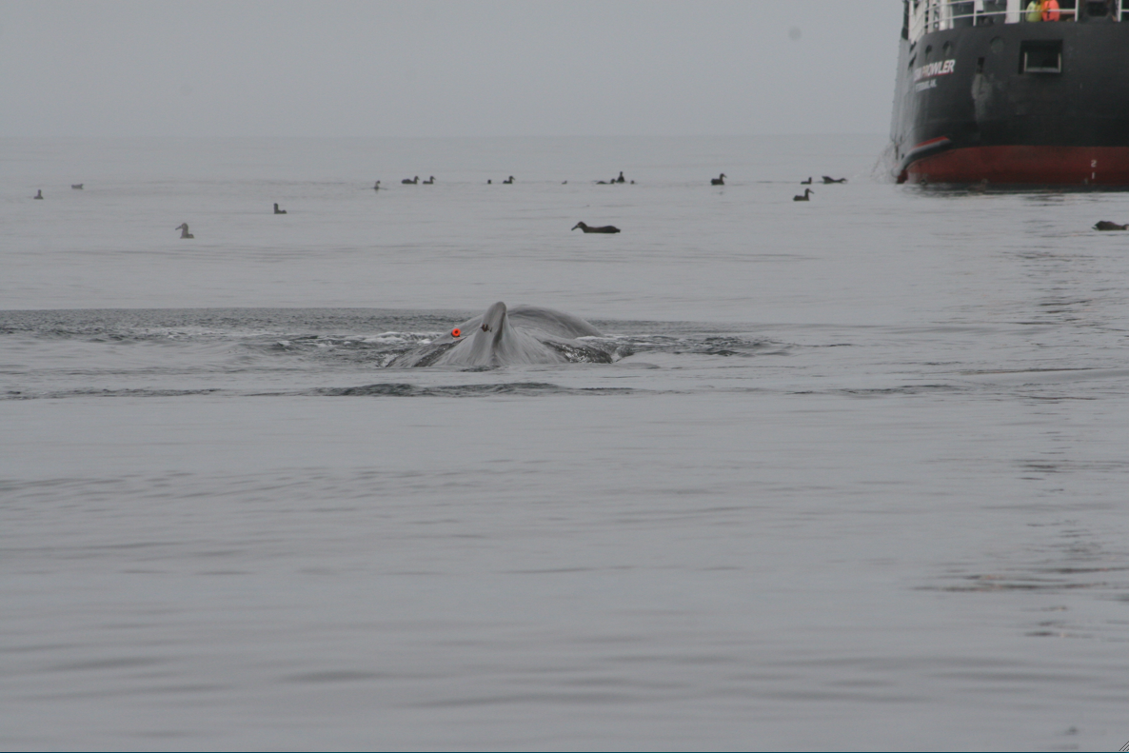

Presentation of results in published paper by Zach Shakner for his masters
Schakner, Z.A., Lunsford, C., Straley, J., Eguchi, T., and Mesnick, S.L. (2014). “Using models of social transmission to examine the spread of depredation behavior among sperm whales in the Gulf of Alaska.” Plos One. 9(10): 109079-109084..
Notes:
Slide 2: The overlap of humans and wildlife often results in conflict. Humans create novel resources, or novel concentrations of resources that animals can learn to exploit
-these behaviors are termed depredation and are a growing issue from a management and conservation perspective
In Alaska Sperm whales and killer whales remove fish from demersal longlines in both the Bering Sea and the Gulf of Alaska. Killer whales primarily restricted to the Bering Sea and Prince William Sound Sperm whales were depredation in the Gulf of Alaska. For sablefish and some halibut.
These are two of the most lucrative fisheries in Alaska.

Slide 4
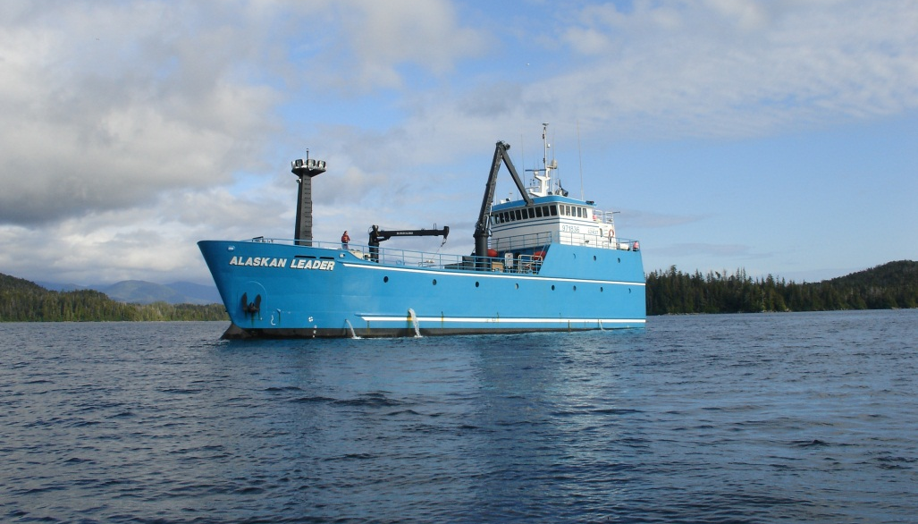
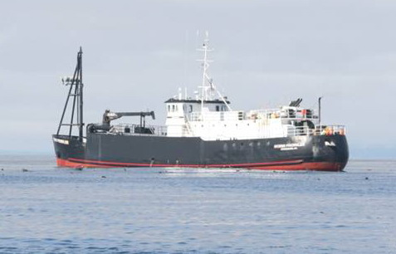
US NOAA Federal Sablefish Survey
NMFS longline sablefish assessment surveys in GOA
Fish same stations/year
Record the behavior of sperm whales around fishing operations
Photo-identify sperm whales
F/V Alaskan Leader
F/V Ocean Prowler
Photo: upper Capt. Dennis Black; lower SEASWAP

Slide 5
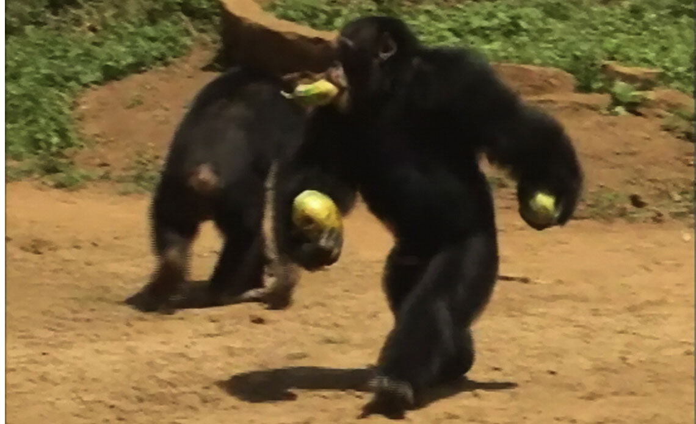
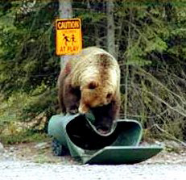
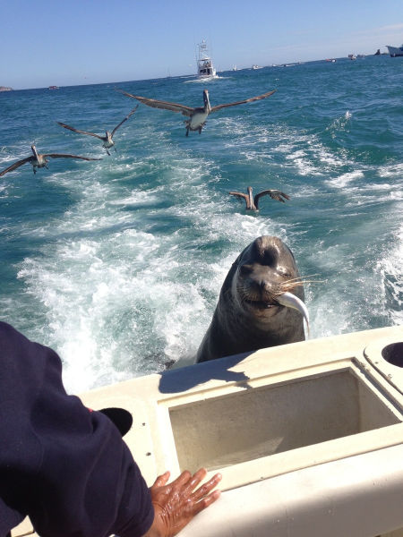
Human-Wildlife Conflict
fishing, farming and ranching
sperm whale, killer whale depredation of longlines; humpbacks salmon fry and smotls
scientific, management, and conservation issue
  socio-economic, how to incorporate into predictive models
  bycatch
  mortality from ingestion/entanglement ??
  potential for retaliatory actions by fisherman ?? Not documnted
Notes:
Slide 2: The overlap of humans and wildlife often results in conflict. Humans create novel resources, or novel concentrations of resources that animals can learn to exploit
-these behaviors are termed depredation and are a growing issue from a management and conservation perspective

Slide 6
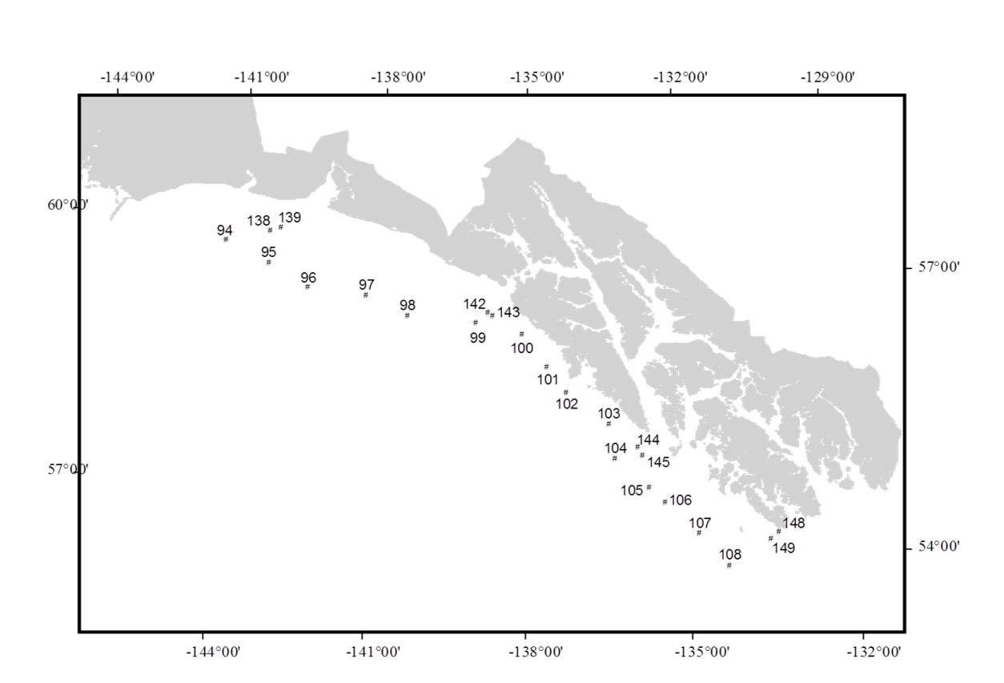
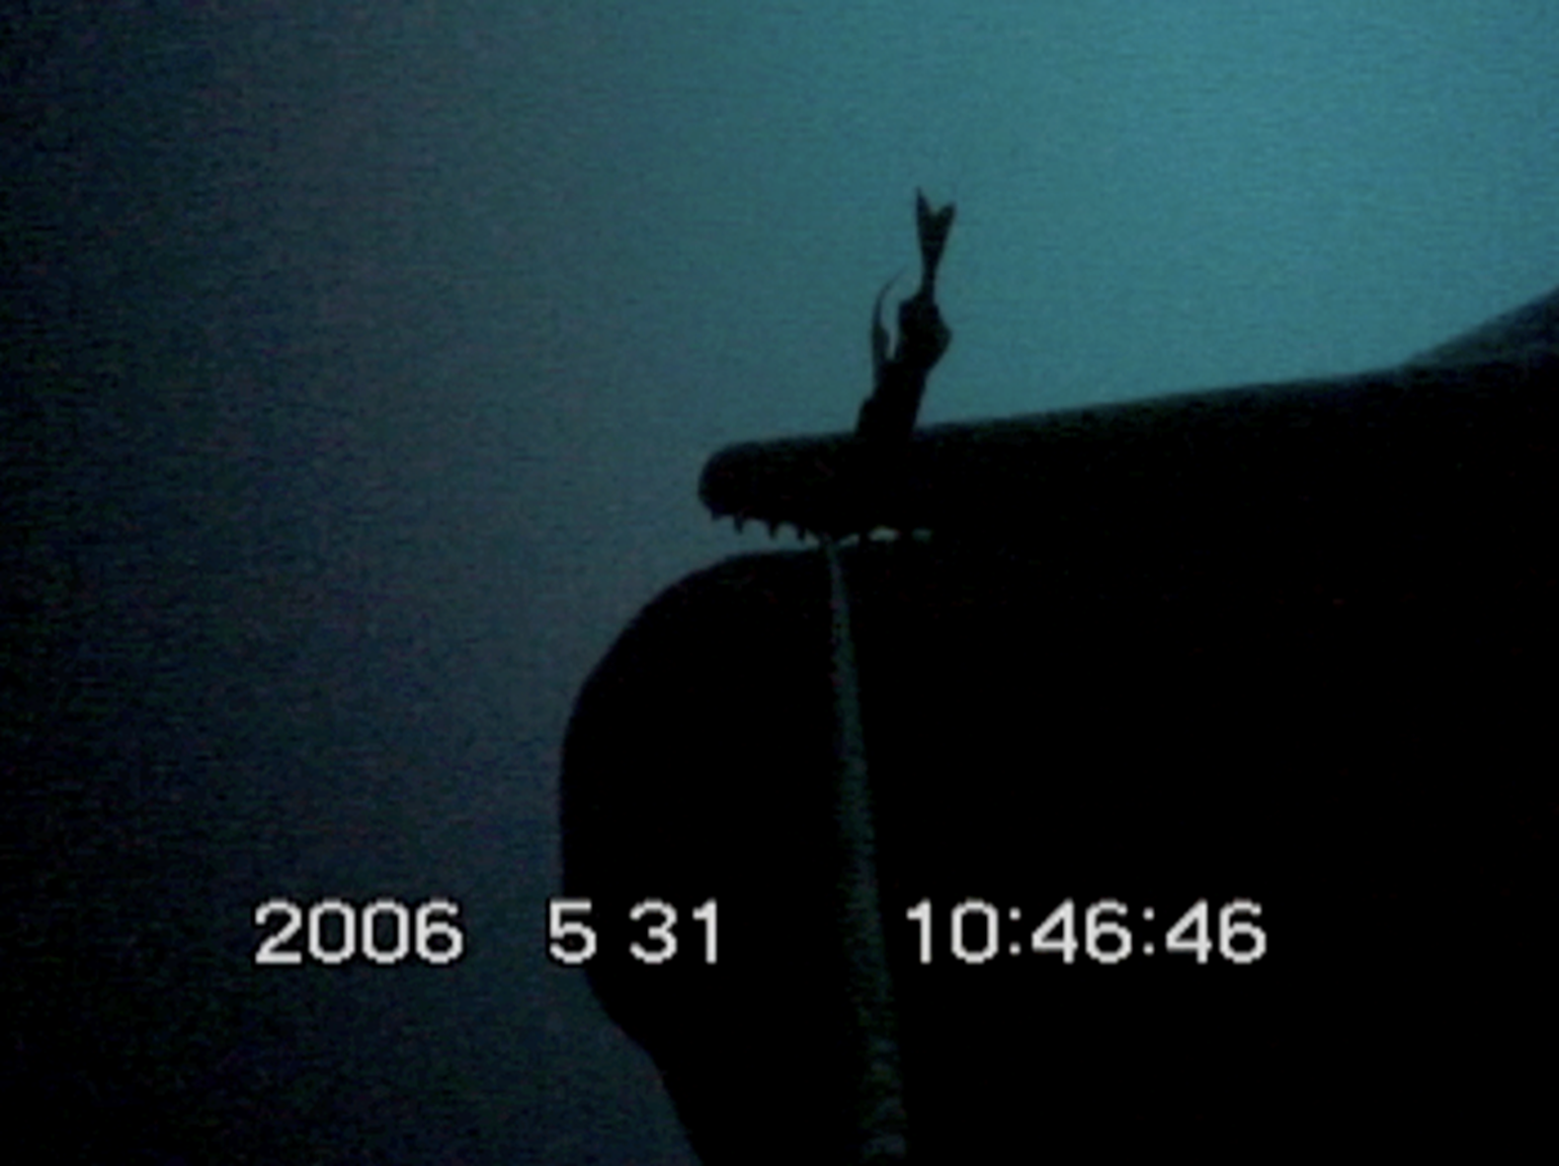
social transmission or independent among multiple individuals (individual learning)?
#
74
Notes:
to address this we used two theoretical models of cultural/social transmission from the human/animal literature
Slide 3. Quick description of SW depredation in the Gulf of Alaska.
Slide 3. Quick description of SW depredation in the Gulf of Alaska.
-observations of depredation go back to late 1970s, but by 1995/1996, coincident with a management change, observations of the behavior became much more widespread.
-the spread of depredation, especially the rate is which seemed to spread through the entire region led to the following question; did the novel behavior spread via social or individual transmission
-to address this we applied two theoretical models of cultural/social transmission from the human/animal literature; DCA and Wave of advance
Slide 4.
Diffusion curve analysis: Used extensively to describe the innovation and transmission of human technology(and a few cases of animal transmission). Facebook or myspace example, slow start with increasing rate of transmission. The exponential rate is diagnostic of social learning, seen in logistic or exponential functions. The alternative would be linear of logarithmic, which is a constant or decelerating rate, suggestive of asocial transmission
Important to note that it has been criticized, and it cannot alone be used for social learning, can be useful with other models of social transmission, such as Wave of Advance
Slide 5. Wave is a spatial model of transmission.
First used by Cavalli to document the spread of agriculture in Europe during Neolithic
Picture documents a locus of innovation followed by a radiation through time. You can track the through time, each year appears to radiate outward, suggestive of social learning. In contrast, if each indiv learned it on their own, it would pop up randomly in space and time and no linear relationship.
Slide 6; Survey info, I emphasize that its fishery independent, standardized and samples same stations each year. Samples sablefish, which are what sperm whales target from long lines, so it inadvertently became a SW survey as well
Slide 7:
The number of stations with depredation varied among years, but cumulative number of stations best with logistic function
Slide 8-10: Describe first locations central gulf, then spatially radiating pattern out through time.
Slide 11:
-Both models suggestive of social learning
-But, we lack the pre-1998 information on when the innovation arose and was transmitted early on.
-Also both models are population based, further behavioral data on identified individuals may shed light into the transmission.
-We do know that when depredation is observed, several individuals congregate around vessel, which is unique compared to natural foraging.
- The social learning mechanisms underlying depredation require further investigation.
-There may be stimulus enhancement, potentially involving vocalizations. For instance, its been demonstrated in other locales that when males are foraging they’re solitary, but in range of hearing other conspecfics, suggesting a role for eavesdropping. During depredation, individuals emit novel vocalization patterns, (show picture from delphine) the picture shows the individual locating the fish on the line and removing it, during this may ‘cue’ nearby conspecifics . I always go anthropomorphic and say they hear someone vocalizing a lot and very shallow, which means it's a free meal, so they go check it out, increasing the chance of them learning to depredate.
In conclusion, the creation of novel concentrations often results in the spread of novel, foraging behaviors. The learning mechanisms influence the rate and geographic spread of behavior. i.e. change management, or use deterrents early on.

Slide 7
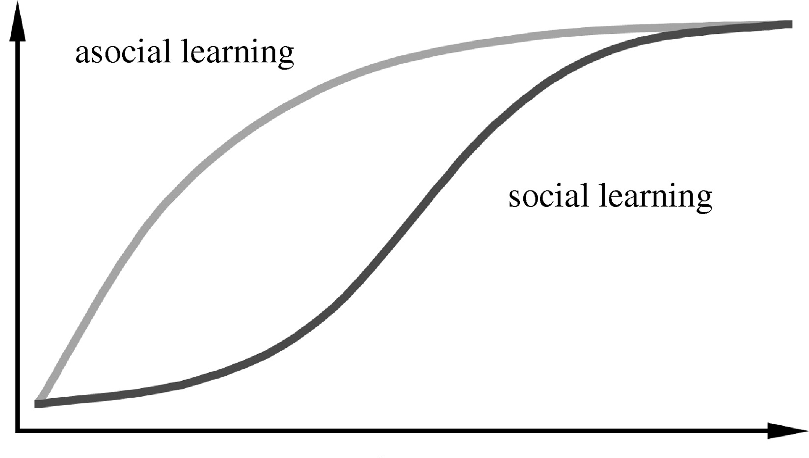
Diffusion Curve Analysis (DCA)
temporal spread of a new behavior through a population
Number of whales
involved in depredation
Social learning
Time
Can not be used alone to describe social learning
Can be used with other methods such as Wave of Advance
Rogers 1995, Cavalli –Sforza and Feldman 1981, Heinrich 2001, Reeder 2004
Notes:
Slide 4.
Diffusion curve analysis: Used extensively to describe the innovation and transmission of human technology(and a few cases of animal transmission). Facebook or myspace example, slow start with increasing rate of transmission. The exponential rate is diagnostic of social learning, seen in logistic or exponential functions. The alternative would be linear of logarithmic, which is a constant or decelerating rate, suggestive of asocial transmission
Important to note that it has been criticized, and it cannot alone be used for social learning, can be useful with other models of social transmission, such as Wave of Advance

Slide 8
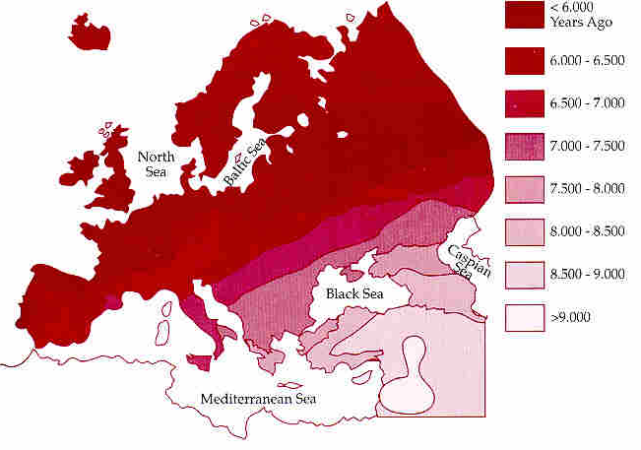
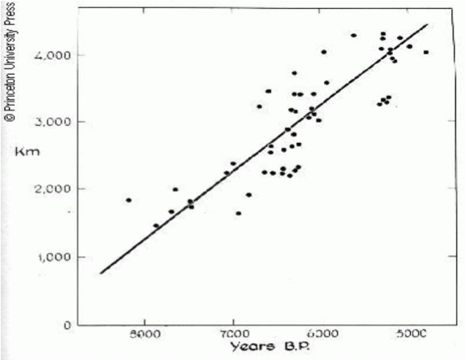
Wave of Advance
Track through time
Locus of innovation
Spatial radiation
Otherwise pop up randomly
Europe
-
Used to document the spread
agriculture in Europe
during the Neolithic
Ammerman and Cavalli-Sforza (1984)
Notes:
Wave of Advance
First used by Cavalli to document the spread of agriculture in Europe during Neolithic
Picture documents a locus of innovation followed by a radiation through time. You can track the through time, each year appears to radiate outward, suggestive of social learning. In contrast, if each indiv learned it on their own, it would pop up randomly in space and time and no linear relationship.

Slide 9
  US NOAA Federal Sablefish Survey standardized, fishery-independent survey
  Sample sablefish habitat overlap/ commercial fishing grounds
  DCA Diffusion Curve Analysis
  x=survey year and predation presence / number of whales
  y=cumulative number of stations
Notes:
This is not exactly good news for fishermen. Sablefish fishermen and sperm whales like to be at the same place along the shelf edge in the GOA. Of course the good news is that the fishermen are sharing these whales with Canada. We hope to place more satellite tags on whales this year to obtain a better idea of seasonal movements and to investigate if there are pluses of whales using specific areas. With these real time data we can provide fishermen with real time feedback as to the presence of whales and they can decide to avoid fishing in those areas. This will give the fishermen options of where not to fish.
The other implication from these data is that avoidance may need to be accomplished by other means as well such as passive or possibly active deterrents of which we are in the midst of developing and testing.

Slide 10
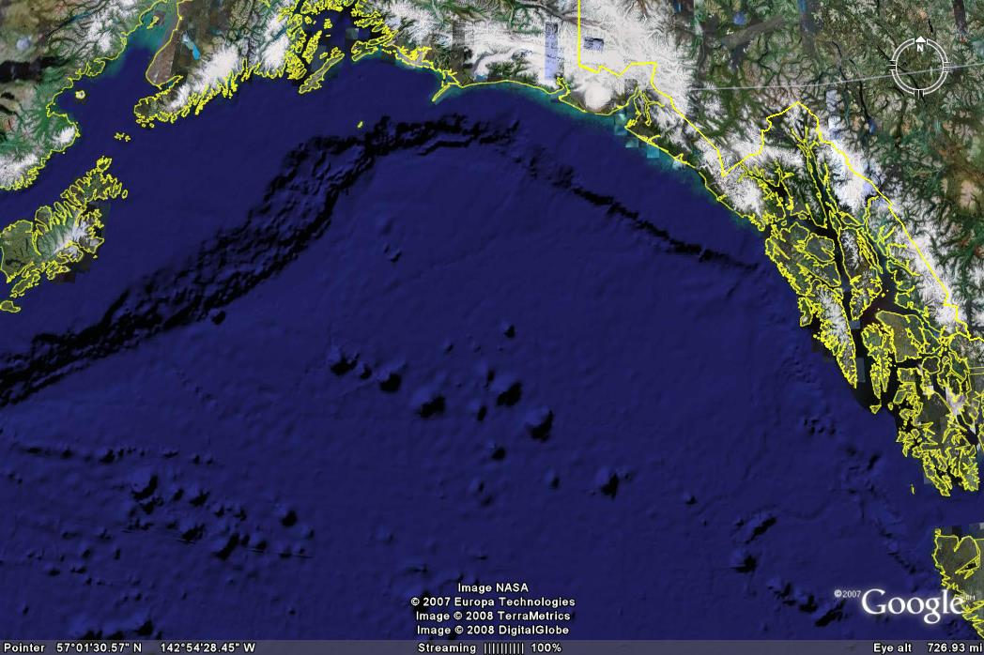
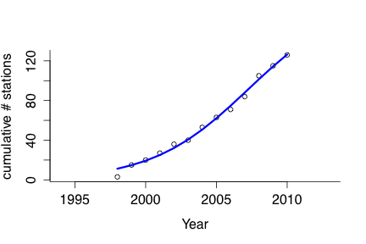
Diffusion Curve Analysis
Depredation
N=126 stations
Cumulative stations with whales
1998 2010
Whales at station ranged 1-7 (mean of 3)
Linear model was the best AAIC fit

Slide 11
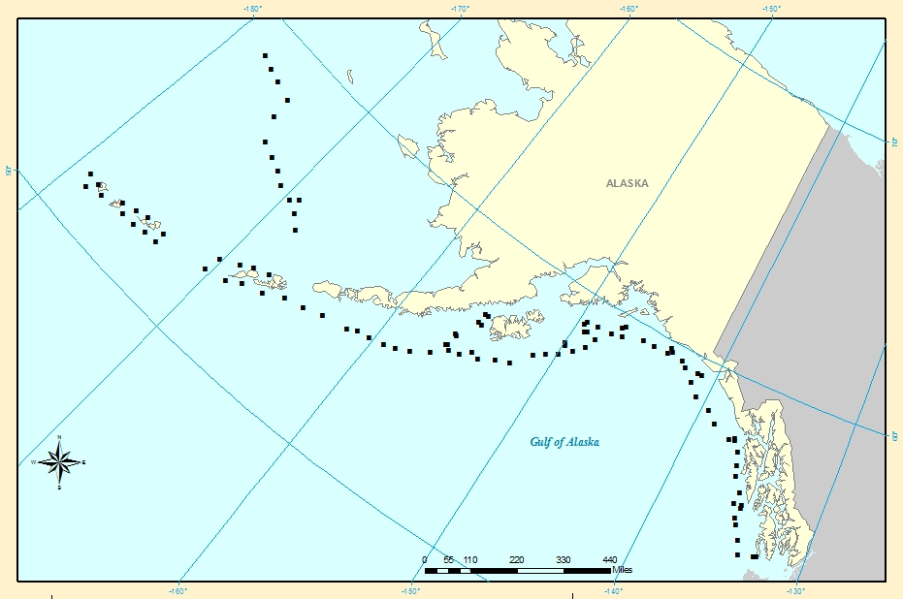
Results: Wave of Advance
1998

Slide 12
Results: Wave of Advance
1999-2004

Slide 13
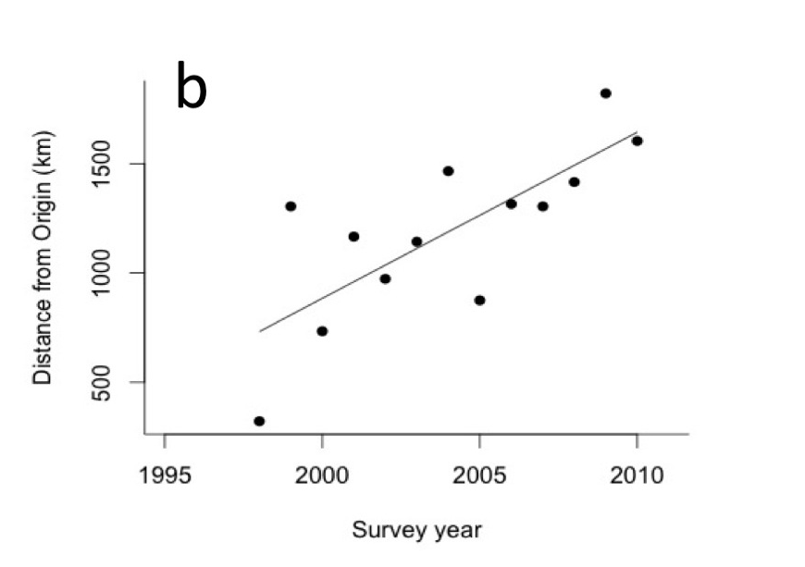
r² = 0.55; p = .001

Slide 14
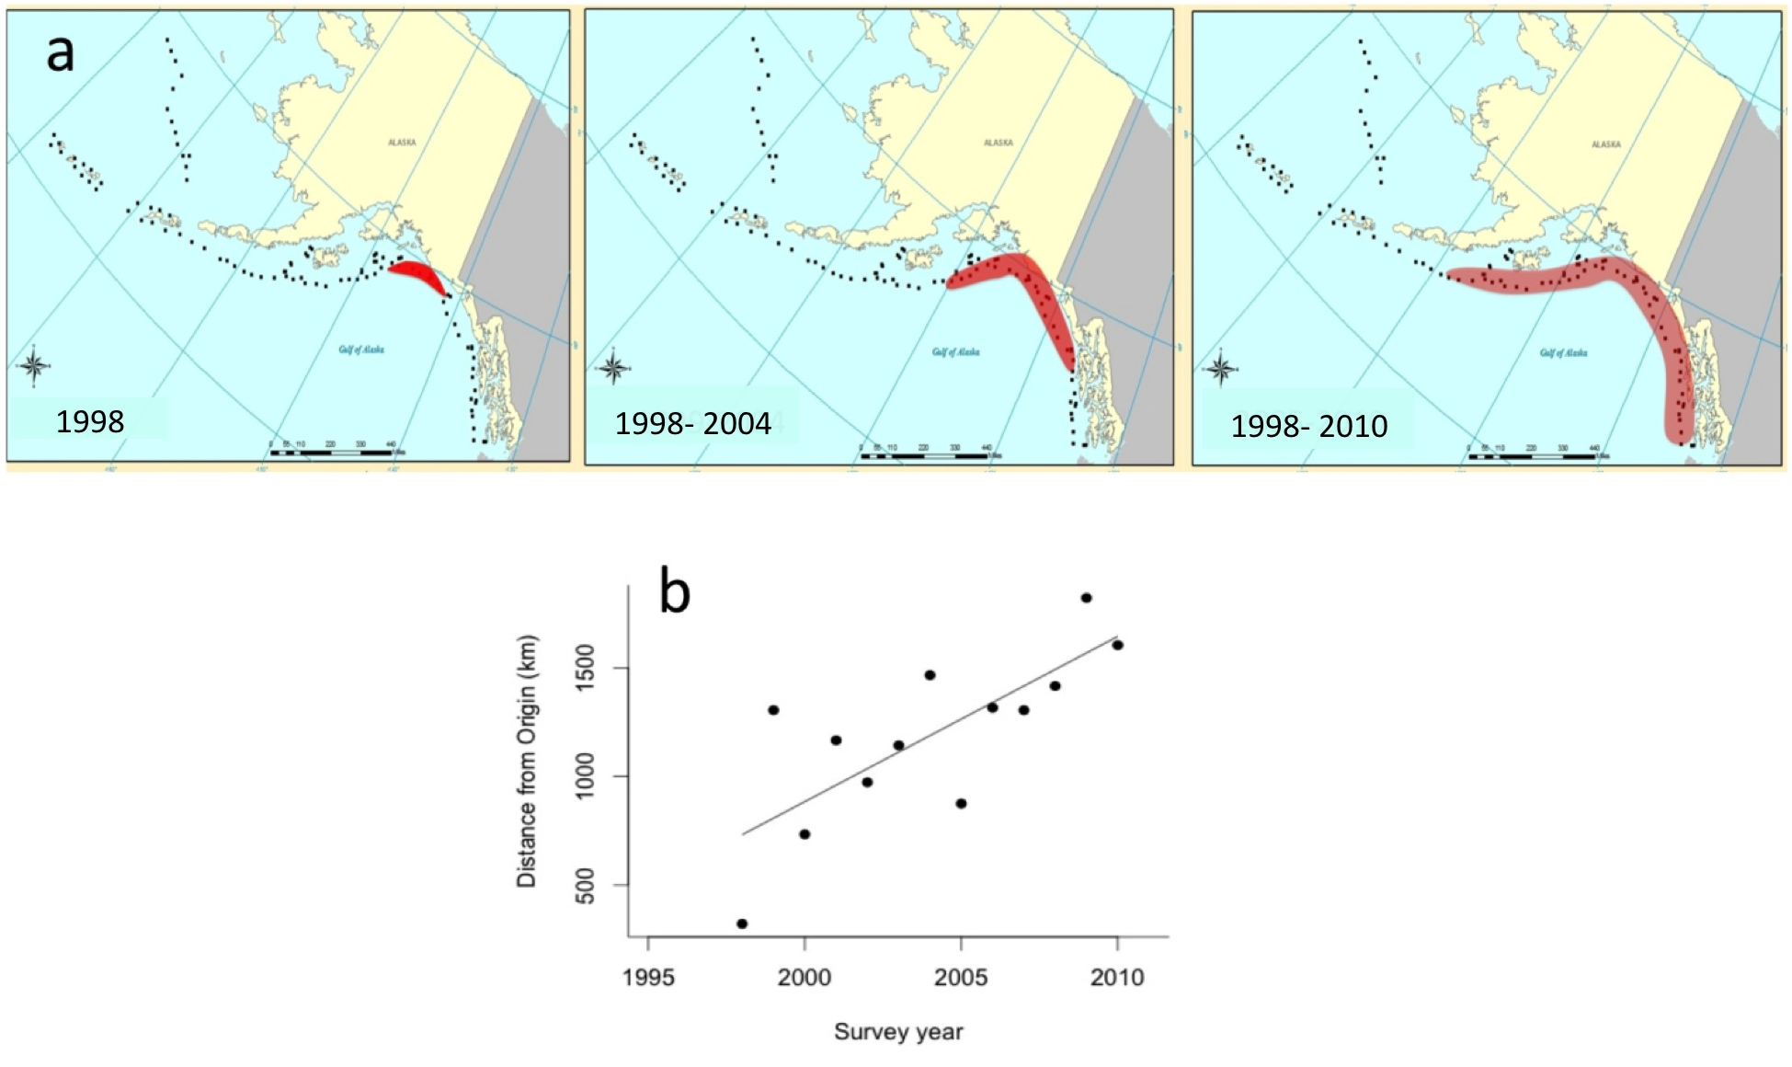
r² = 0.55; p = .001

Slide 15
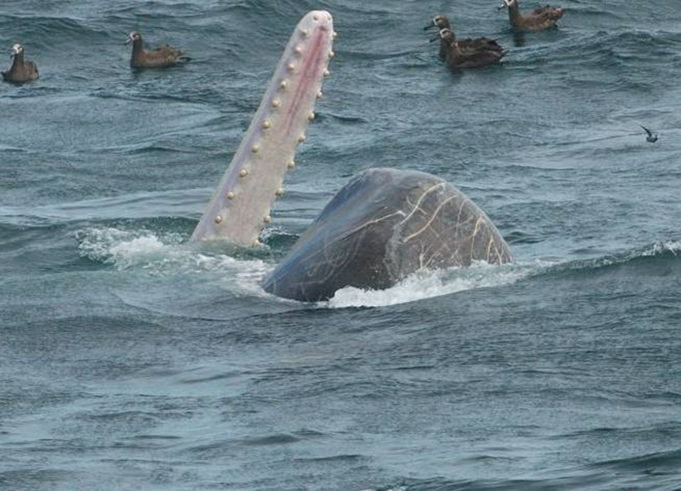
Both models provide evidence for social transmission
Limitations: population-level, lack of innovation data, what whales are doing
Learning mechanisms (imitation, emulation, observational conditioning)
Notes:
In conclusion, the creation of novel concentrations often results in the spread of novel, foraging behaviors. The learning mechanisms influence the rate and geographic spread of behavior. i.e. change management, or use deterrents early on.
In conclusion, the creation of novel concentrations often results in the spread of novel, foraging behaviors. The learning mechanisms influence the rate and geographic spread of behavior. i.e. change management, or use deterrents early on.
In conclusion, the creation of novel concentrations often results in the spread of novel, foraging behaviors. The learning mechanisms influence the rate and geographic spread of behavior. i.e. change management, or use deterrents early on.

Slide 16
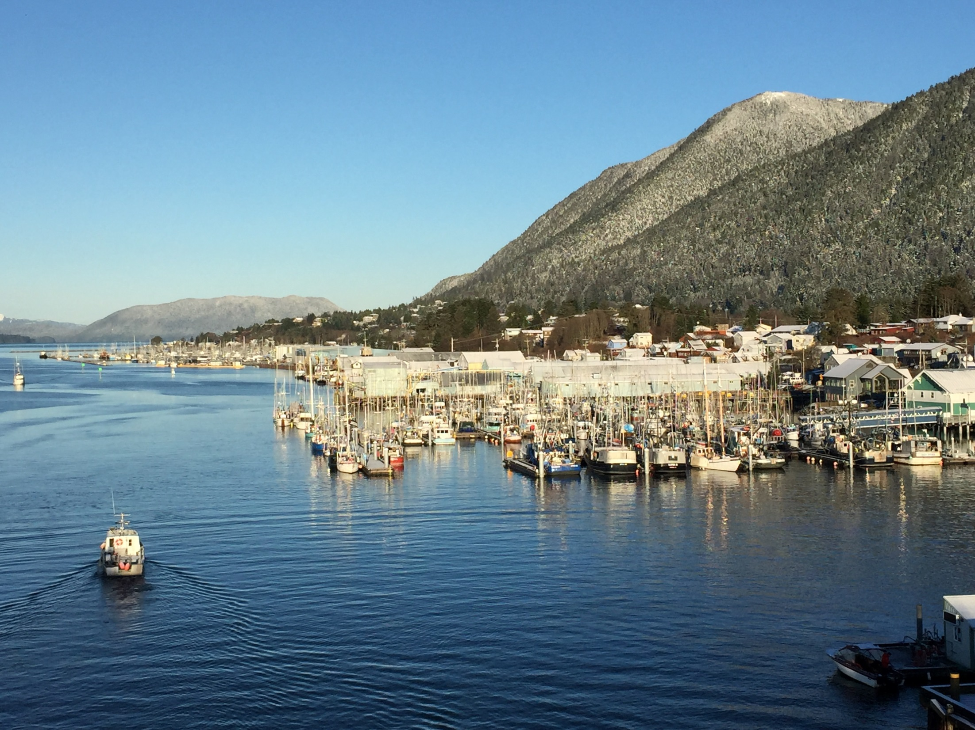
Acknowledgements
Zach Shackner
NOAA for the years
of data
Background Photos courtesy of Southeast Alaska Sperm Whale Avoidance Project (SEASWAP). SEASWAP cooperative study fishermen, scientists and government managers formed to find ways to mitigate the impacts of depredation.
www.seaswap.info/

