Slide 1
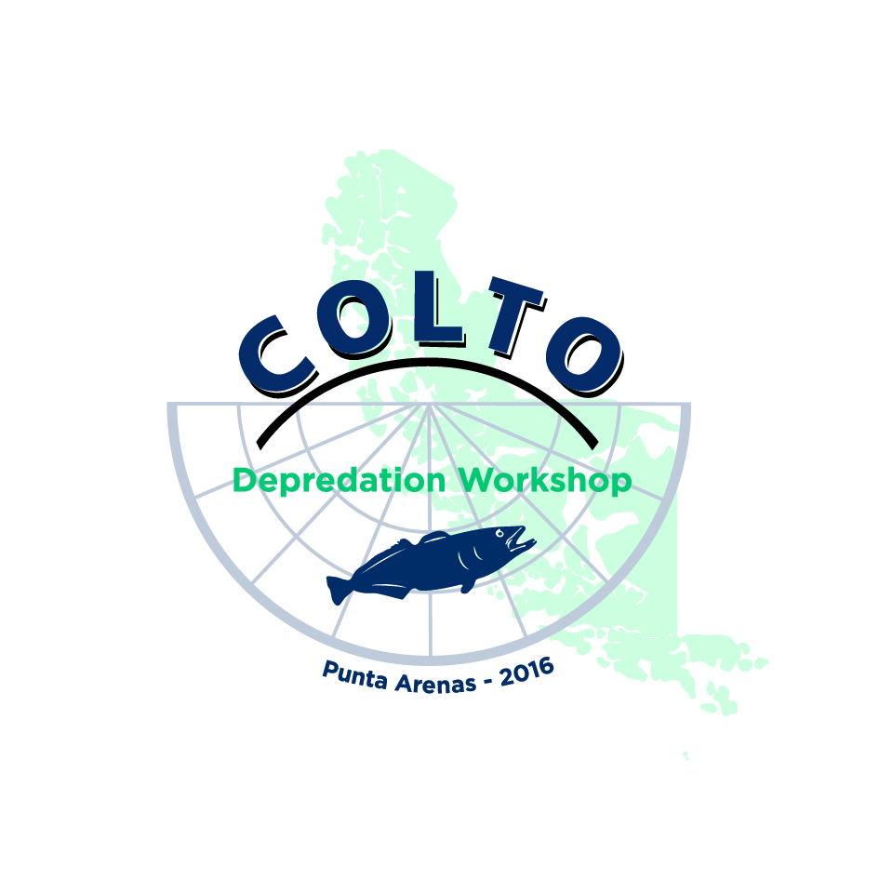
Globalpesca.
Depredation and the attempt to dissuade it.
Punta Arenas, March 2016.

Slide 2
Little History
Globalpesca started its operation on 2003
At the beginning only sperm whales depredation were experienced
crew members use to take pictures of orca whales when the appeared
2006 - 2007 Cachalotera: first attempt to prevent depredation
sperm whales depredation were reduced and total depredation remained constant.
2005 - today, Orca whales depredation has grown (exponentially?)
evading strategies (evading fishing zones)
2007 - today, extensive use of Cachaloteras. Orcas got to know how to violate them (mother teaching calfs)
2011 - 2012, first attempt OrcaSaver (failure)
2013, desperate we took the problem on our hands.

Slide 3
Little History: Globalpesca’s
2013, Globalpesca hires a consultant office (Intep)
2014 - Today: SASDO (Orca-Deterrent Acoustic-Submarine System)
2015 - Today:
New fishing art: Orqueras.
Observation online form (with Ifop)
Depredation Estimation through marks.
Crew member experience and photoID.
(Aobac: Orca whales GPS tracking system)

Slide 4
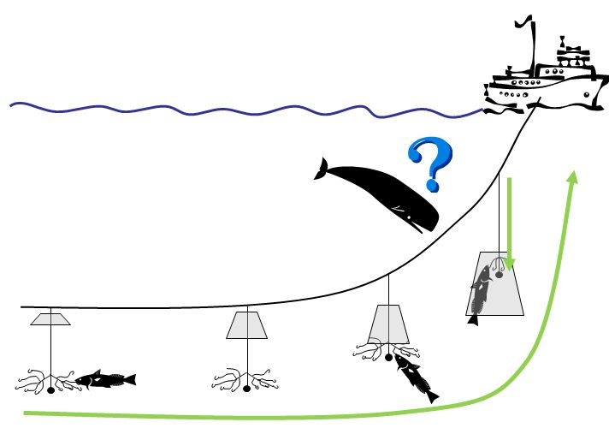
Cachalotera
image: www.colto.org

Slide 5
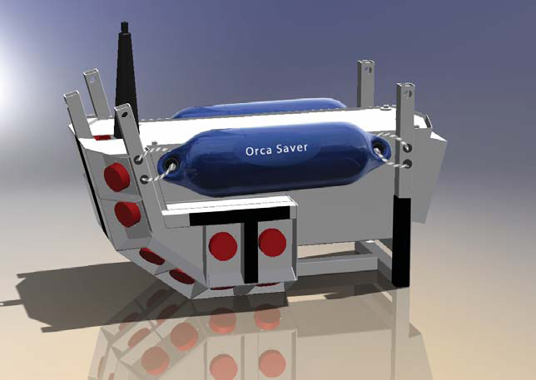
Orca Saver
failure (after 7 fishing seasons):
just a three pre-set signals for an always adaptive animal.
very hard to operate: the whole system is allocated in the submersible unit.
unsolved electrical issues
It does not dissuade orcas from preying.
image: http://mustadautoline.com/

Slide 6
Intep’s results:
2013, Globalpesca hires a consultant office (Intep)
Conclusions: all systems found in literature have failed
There are not enough studies about Chilean Orca whales and their behaviour: new studies are mandatory to find a solution.
Due to Orca’s high adaptability, it’s hard to believe that a single system will prevent depredation. A multi-system strategy is needed.
Technology LFAS (Low Frecuency Active Sonar => mass standings)
Conclusion: more study, strategy that combines resources, LFAS.

Slide 7
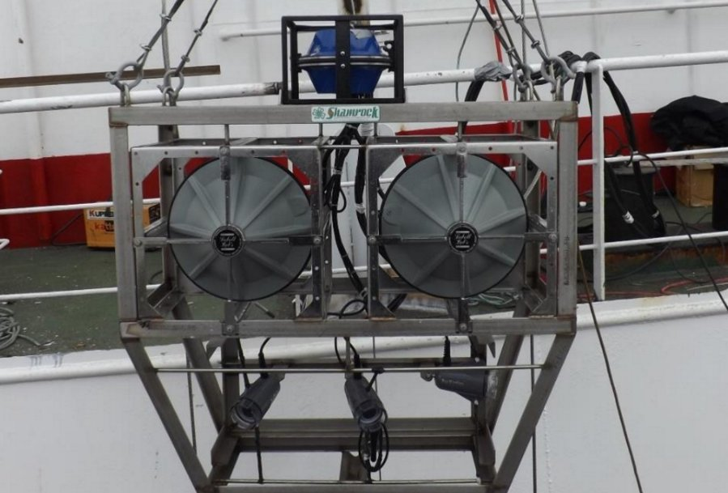
SASDO (2nd version out of 4; 6 fishing seasons)
transductors submerge.
amplifiers and power units are installed in the deck.
main frequencies, power and waveform are adaptable.
Failure after failure, until now!

Slide 8
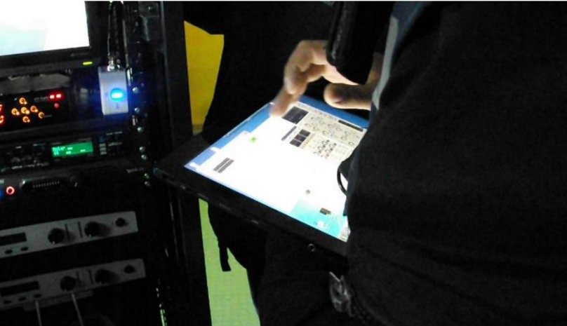
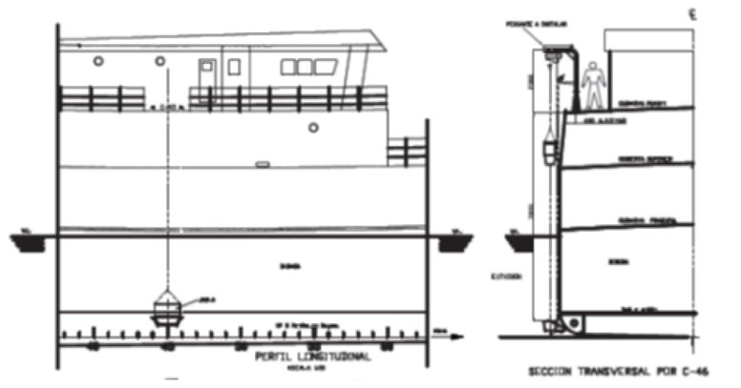
SASDO

Slide 9
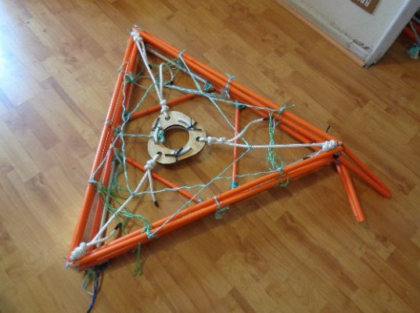
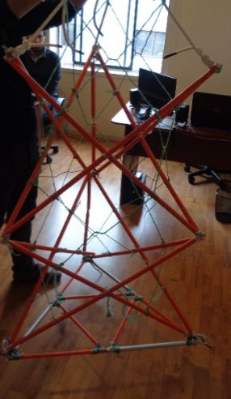
Orqueras (5th version out of 8; 4 fishing seasons)

Slide 10
Depredation Estimation: Marks
online Ifop forms.
Each line is divided by marks
one line ~ 20 km, 700 barandillos
1 mark = 100 barandillos.
for each mark:
number of fishes
time, depth and position.
total line:
number of fishes
weight of the total caught
By other side Orca appearance observation.

Slide 11
Photo Identification Project (Cequa and Ifop)
Huge crew member experience.
Project Photo Id (Globalpesca - Cequa - IFOP)

Slide 12
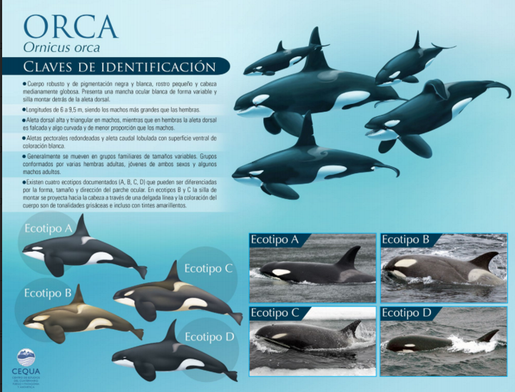

Slide 13
