Slide 1
The OrcaSaver
- A better way to fish

Slide 2
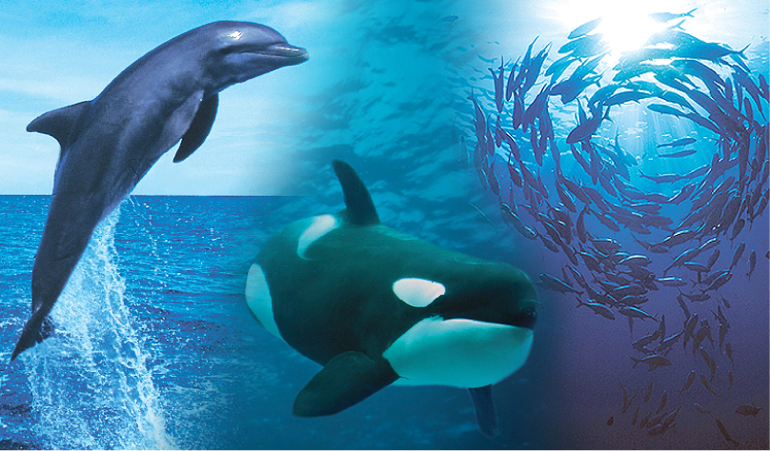
SaveWave
Dutch based company specialized in developing solutions to the challenges the fishing industry and marine wildlife are facing

Slide 3
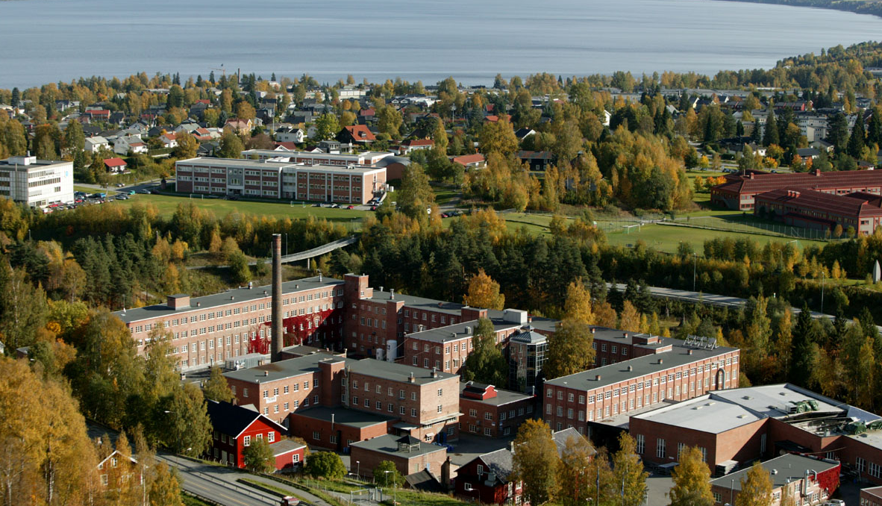
Mustad Autoline
Mustad Autoline develops and supplies technology to the world’s longline fishing fleet.

Slide 4
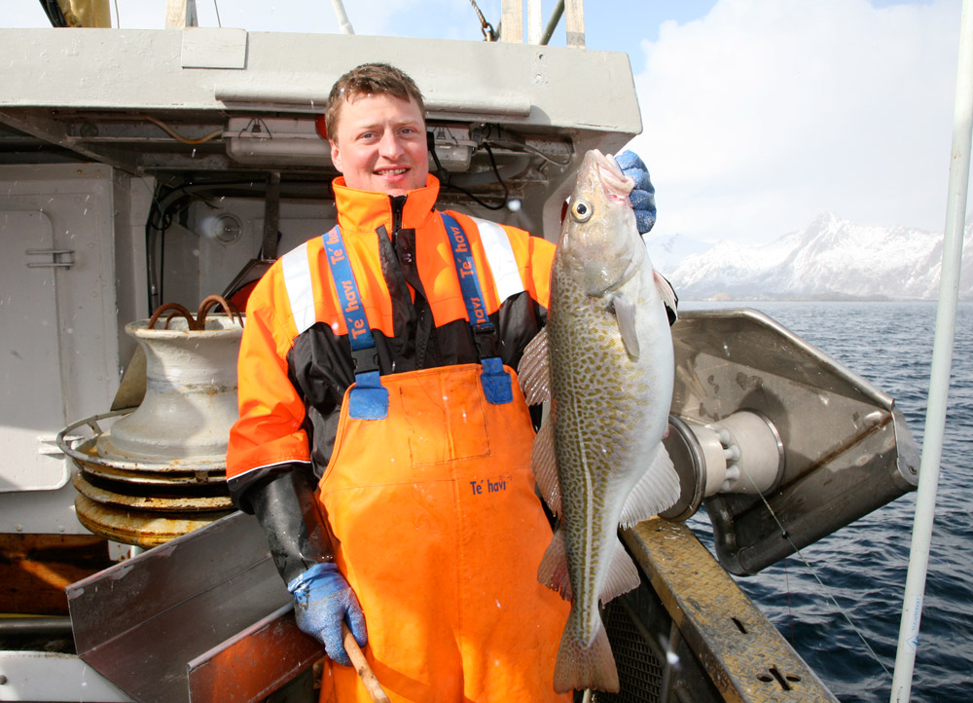
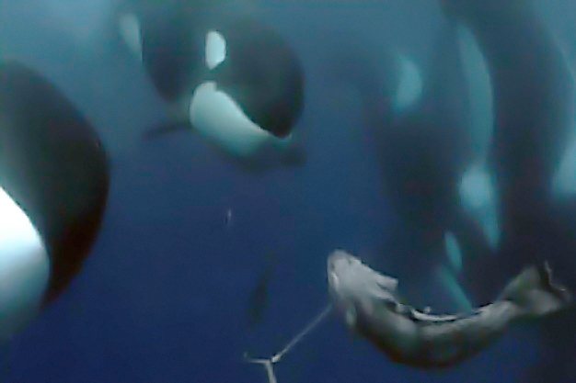
Mustad Autoline & SaveWave Partners for more than 10 years
A Dutch-Norwegian partnership that develops and distributes profitable and ecologically sustainable solutions to the world’s depredation challenges

Slide 5
Timeline OrcaSaver
2004
Signed LOI with Mustad
2005
Started development of the Orca Saver based on the Dolphin Savers
Concept is 16 transducers in one unit working on internal batteries
2006-2007
Production and testing.
First results were positive but we experienced technical challenges with the hanging system.
This model produced 15 – 60 kHz sweeps on approx 150 dB. And because of the small flat transducers of the Dolphin savers we accomplished wide frequency range but low output.
Results were promising but we determined more power was needed
2008
We focused on engineering new transducers for more power.
Batteries are no longer an option because high dB is needed.
2009
2 products were produced and tested
Both products functioned as planned and captains were enthusiastic.
Conclusion: Pain peak signals produced the best results. Technical improvements on casing and cable needed
Notes:
LOI = letter of intent
One Dolphin Saver had 2 trandusers

Slide 6
Timeline OrcaSaver
2010
A series of 11 products with 195-197 dB signals on 6-7 kHz and fixed 20 kHz combination to find the most effective signals
Double system inside (variable – fixed). Conclusion: more technical failures and increased costs. Variable 6-7kHz works best.
2011 - 2012
6-7 kHz signals on different modes
Mixed results received most likely due to electrical feedback problems.
Conclusion: At this point we were uncertain if the unit was working or not due to this.
2013
Sensitive electronics were enclosed in a Faraday cage (isolating electronics inside)
Previous models were filled with epoxy now gel was used inside. This allowed repairing to be possible.
Conclusion: Biological results dropped while technically there were no issues
2014-2015
Expanded to 5-8 kHz with up and down sweeps, signal overlapping, short pulses at high dB levels
Conclusion: using a digital signal on this frequency range, nothing can be done to improve efficacy. Only way ahead is a broader frequency range, analog signals with high output, unlimited mixing possibilities
Notes:
Faraday principle: prevents electrical interference from transducers on the electrical components

Slide 7
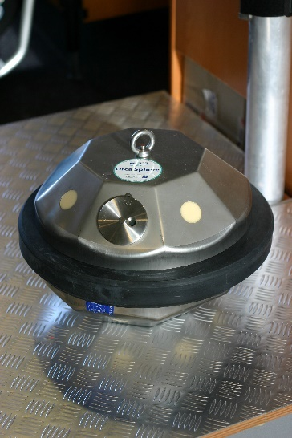
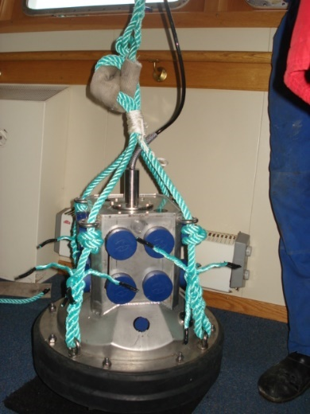
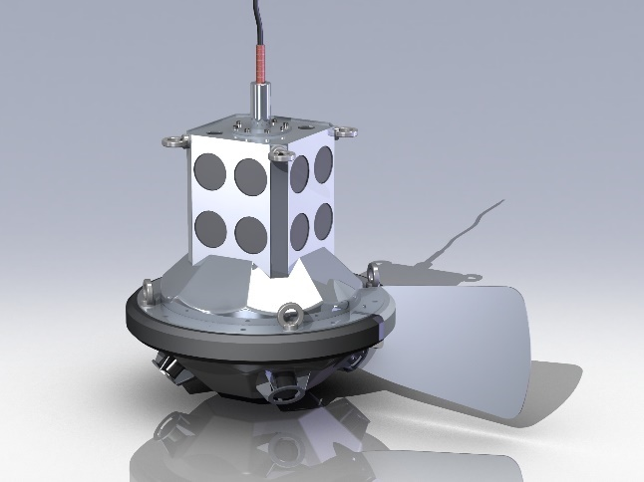
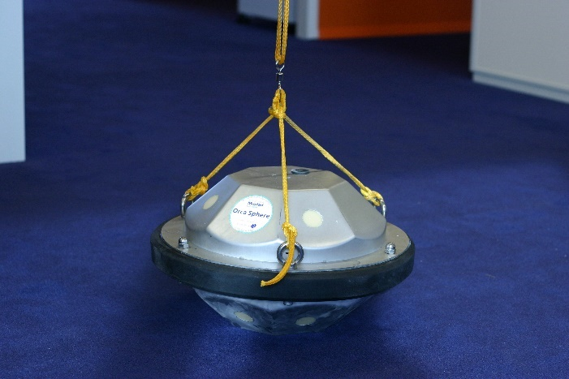
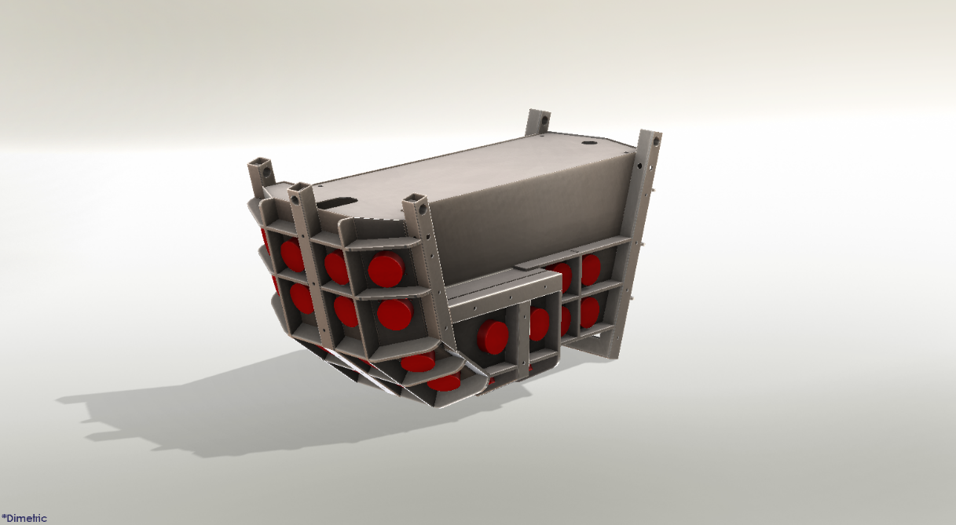
Product development
2009 version with high dB transducers
Rendered with vane
First product 2006
Product upgrade 2007
Latest version

Slide 8
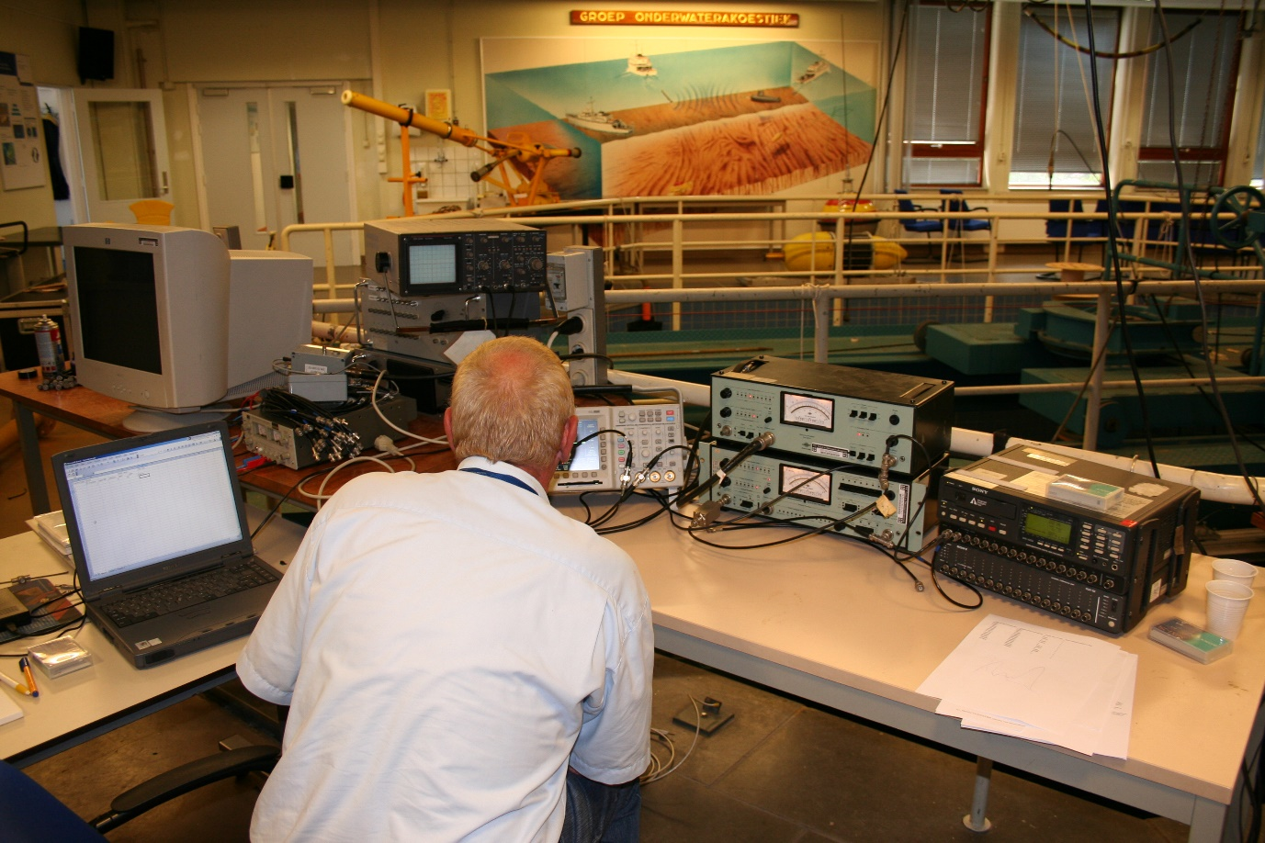
Product development
Testing in Acoustic at Military Base in the Netherlands

Slide 9
Customer Feedback & Habituation
First feeback from all customers was perfect. All reports received said the whale challange was resolved. Vessel owners were lining up to purchase this device.
After 8-10 months of usage we received the first negative feedback. Some orcas kept feeding while the OrcaSaver was on. At first we thought it was technical issues, but after testing the unit and finding no techincal errors we thought it might be the type of whale (territorial, migrating, etc.)
After receiving more and more feedback reporting the same issue, we realized that most likely habituation was occuring
Today there are still a few fishing vessels in Alaska using the OrcaSaver saying it still works every now and then and its better to have on board then not.
SaveWave and Mustad Autoline began working on a new approch developing a new OrcaSaver and a SoundBeam

Slide 10
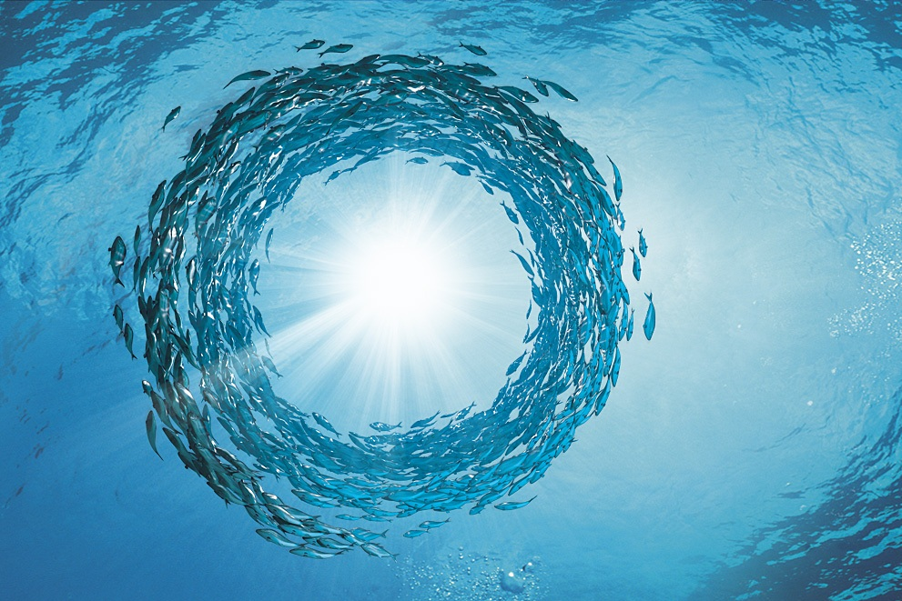
Thanks for you attention
Questions?
?

