Slide 1
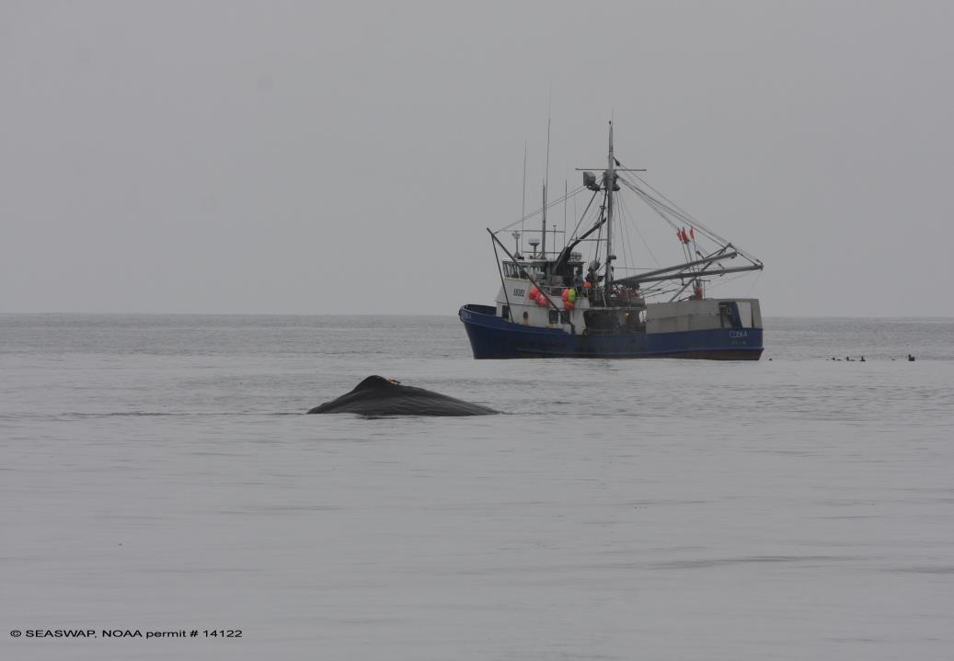
Can we be as Clever as a Sperm Whale: Using Gizmos and Gadgets
Presented by Jan Straley
Session 4 COLTO
On behalf of SEASWAP
Punta Arenas, Chile

Slide 2
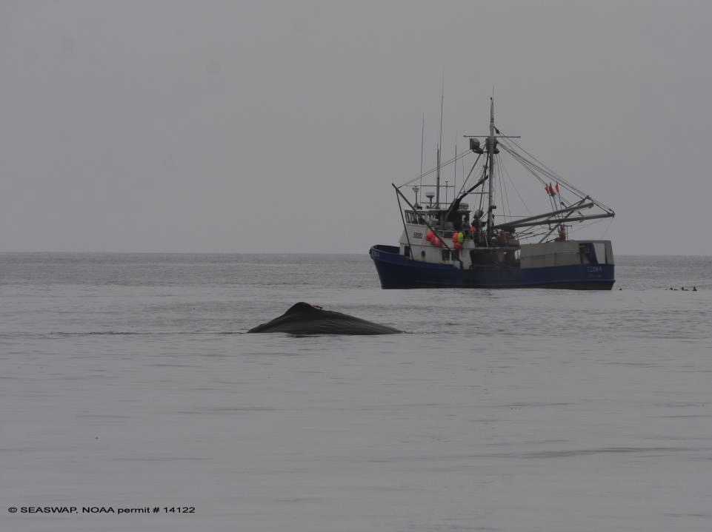
Field Trials of an Acoustic Decoy
Goal: Reduce Sperm Whale Depredation on Demersal Longlines in the Gulf of Alaska
Lauren Wild, Aaron Thode, Jan Straley, Linda Behnken, Dan Falvey, Tory O’Connell, Joe Liddle
Notes:
Hello, today I will be discussing deterrence testing on sperm whale - longline fisheries interactions in the Gulf of Alaska
This is a collaborative project with many key participants and collaborating institutions
I would like to first thank my co-authors for letting me present this data on behalf of our project. This project was funded by the North Pacific Research Board.

Slide 3
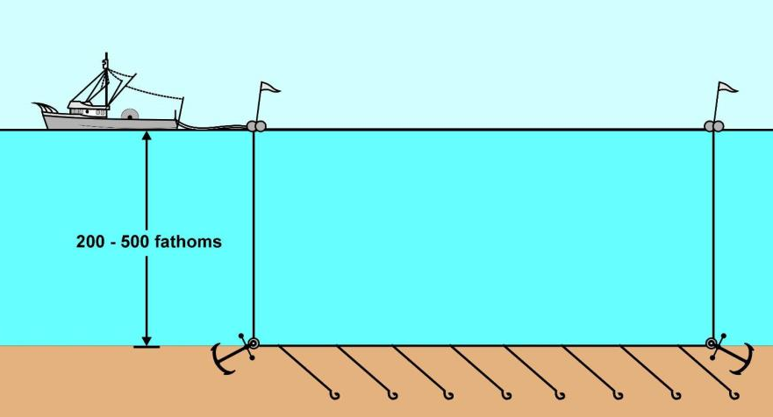
Sperm whales remove fish, “depredate,” from commercial fishing gear worldwide.
Gulf of Alaska: targeting longline fishing vessels catching black cod (sablefish)
Notes:
Sperm whales and other whales remove fish from commercial fishing gear world-wide; this behavior is known as depredation.
In the Gulf of Alaska they are targeting commercial longline fishing vessels catching sablefish, or black cod.
To date, we have only recorded male sperm whales in this habitat, in this interaction.
Longline fishing consists of a single long line with hooks placed on the ocean floor between two anchored buoylines
In the Gulf of Alaska longline fishermen target halibut and sablefish, on the continental slope, between 400-1000m (1,200ft to 3,000ft.)
The sablefish industry is very lucrative, with the peak price for black cod fetching over $9 per pound at the dock in the late 2000’s.
As the fisherman hauls his gear in, the line stretches up from the bottom over ½ mile deep, with the catch dangling from hooks.
It’s an easy meal for a whale; sort of like a conveyor belt of food.

Slide 4
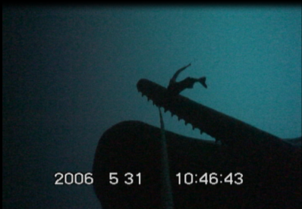
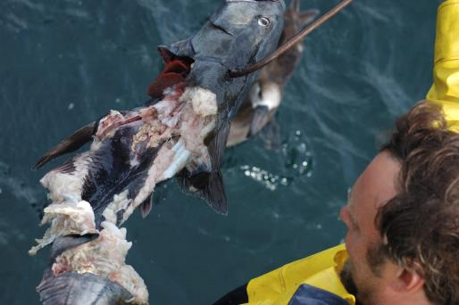
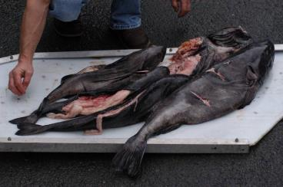
Reported since
1970s
Encounters becoming more frequent
Notes:
This issue is not new, but encounters are becoming more frequent, and the behavior seems to be spreading.

Slide 5
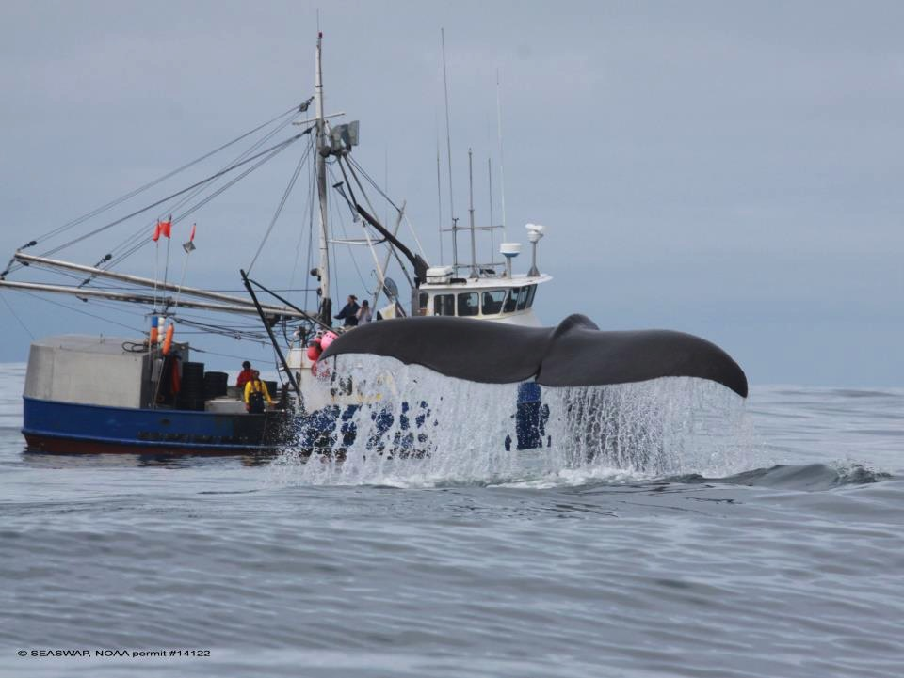
Southeast Alaska Sperm Whale Avoidance Project
(SEASWAP)
www.seaswap.info
Cooperative research between scientists, fishermen, and fisheries managers
Notes:
The Southeast Alaska Sperm Whale Avoidance Project, known as SEASWAP, was first funded and born in 2003, as a collaborative effort to better understand this interaction, and reduce sperm whale depredation on longline fishing gear in the Gulf of Alaska.
SEASWAP is based out of Sitka, Alaska, with collaborators around the state and nation.

Slide 6
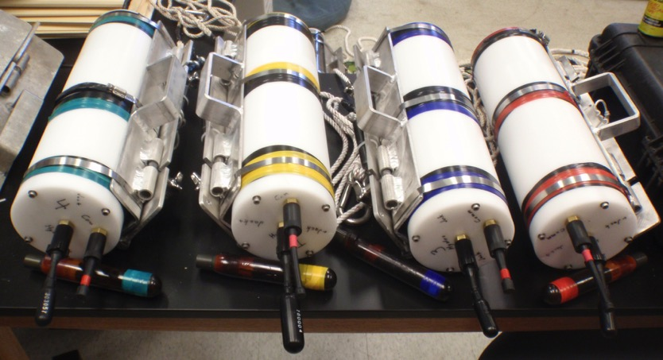
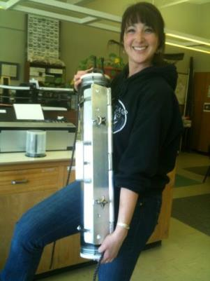
Acoustics
Acoustically active
Constantly producing echolocation signals.
Photos: SEASWAP’s acoustic recorders over the last 10 years
Notes:
Sperm whales are acoustically active, and vocalize almost constantly when diving, so we use acoustics to study them
We use a variety of passive acoustic platforms, including tags and autonomous recording devices to study foraging rates, directionalize, and track their movements.
The acoustic base for SEASWAP has taught us a lot about how whales interact with fishing gear in this unique scenario.
We have also learned how sperm whales are alerted to, and locate fishing activity in their vast ocean habitat.

Slide 7
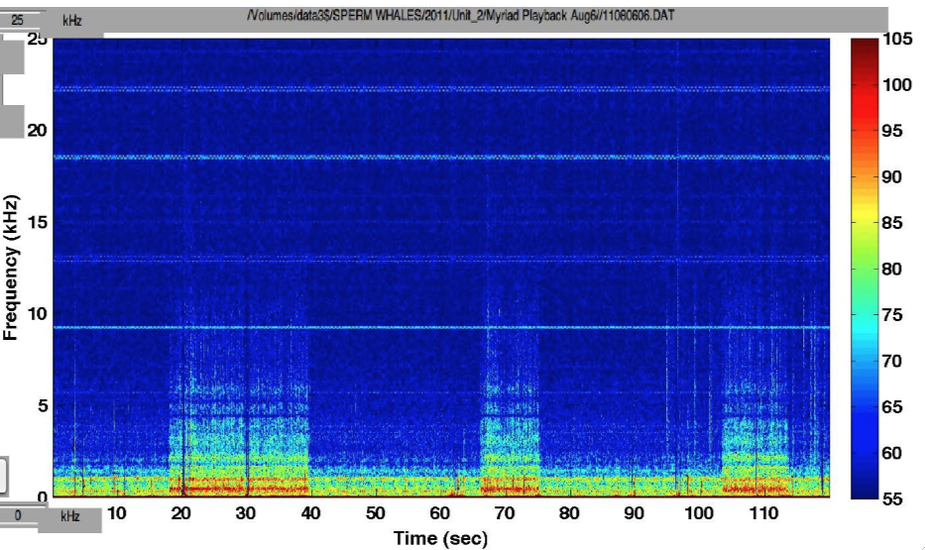
Acoustic Cue: Engine Cycling
Thode et al. 2007
Propeller Cavitation – Engine Engages 0-10kHz
Engine in neutral, 0-2kHz
Thode et al. 2007, JASA
Notes:
When longline fishing vessels haul their gear, they must constantly shift in and out of gear, engaging the engine to stay on top of their line as it comes up from the bottom.
This shifting causes propeller cavitation, creating bubbles, which is extremely loud acoustically, and can be heard at great distances.
This spectrogram shows a visual representation of the sound a longline fishing vessel makes while hauling gear.
You can see in this lower frequency, here, that while the engine is in neutral we see energy in the 0-2kHz bandwidth.
Then, when the skipper shifts into gear, you can see how loud the cavitation is, showing energy up to 10kHz.
You can see over the 1-minute period of time in this image, how the vessels make a unique sound while they haul their fishing gear.
SEASWAP has found that this sound has become an acoustic cue for sperm whales, affectionately called a “dinner bell” by fishermen, which alerts them that fishing activity is occurring.

Slide 8
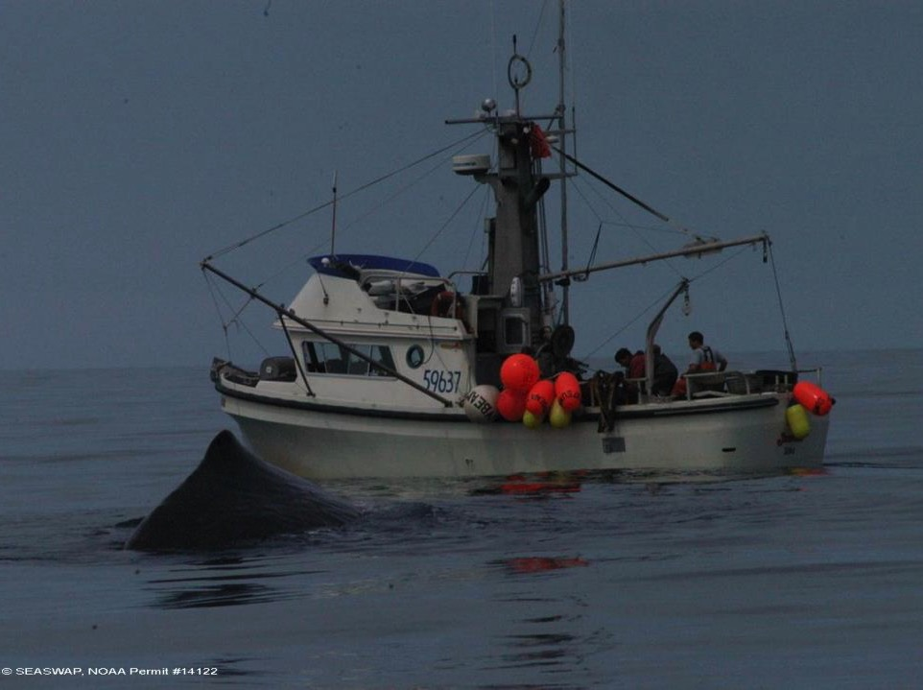
Acoustic Decoy:
Can we delay whales’ arrival at the fishing haul by attracting them elsewhere?
Notes:
So this experiment sought to use the acoustic cue to our advantage.
We thought if we could record that sound, and then play it back to whales at an area where there wasn’t any fishing, they would be attracted to it, and leave areas where real fishing was going to take place.
Fishermen drop whales on each other and that’s what gave us the idea.

Slide 9
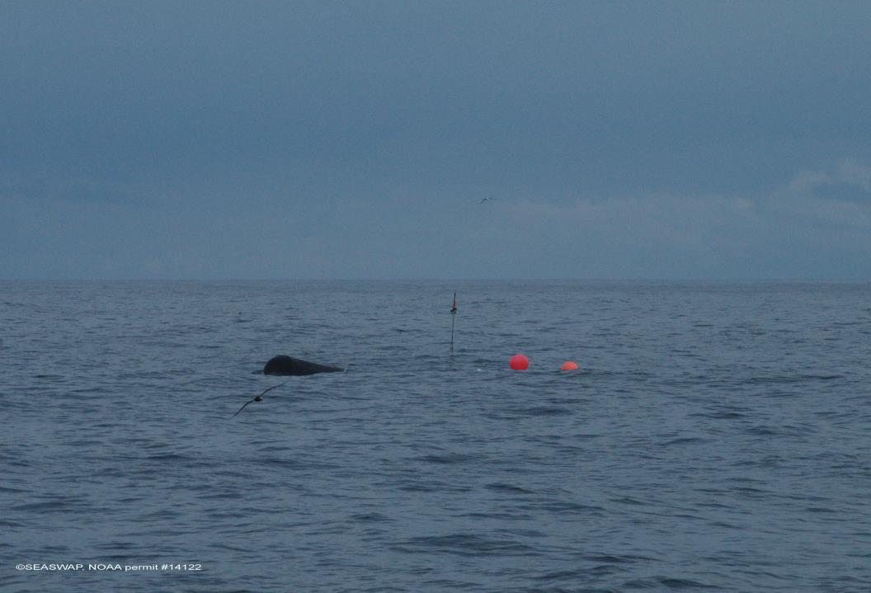
Acoustic Decoys: can we be as clever as a sperm whale?
Playbacks designed to deter whales from longline haul Not effective (2009)
Decoy designed to attract whales away from the true longline haul
Notes:
Common approaches with marine mammal interactions have been designed to use acoustic deterrents to keep animals away from fishing gear,
and this experiment follows a natural progression from some of the playback experiments we have explored in the past, that have proven ineffective.
This is what we think is the first demonstration of an acoustic decoy used on marine mammals to attract them away from fishing gear.

Slide 10
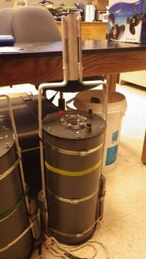
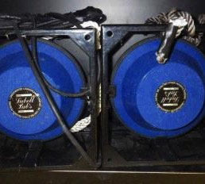
Decoy: experimental design
Autonomous playback device fitted with 3-min clips of engine cycling from a SEASWAP member vessel.
VHF communication allows captains to remotely activate playback from up to 10nm away
Speaker capabilities:
Frequency range = 250Hz-20kHz
SPL = 194dB/uPa/m @ 10.6kHz
Depth=5-20ft.
Playback device, custom design SEASWAP Acoustic Lab, Scripps Institution of Oceanography
Decoy speakers (Lubell LL9162T)
Notes:
We modified a custom playback device using in-house recordings of fishing vessels hauling their gear.
We loaded them onto the device, which was connected to an underwater speaker.
A deck box with communication antenna attached to the fishing vessel’s mast allowed radio communication between the vessel and the device once deployed.
This way, the fishermen could press a button on a “deck box” and activate the playback.
The device had an activation range of about 10 miles, though variable weather and sea-state conditions reduced that range at times.

Slide 11
Decoy Deployment:
Varying distances of decoy from true fishing set: Between 1-10nm
Decoy
True fishing set
Playback device & underwater speaker (20m depth)
Acoustic recorder (200-300m depth):
Confirm whale presence at fishing haul.
Acoustic recorder (200-300m depth):
Confirm decoy operation & whale presence in vicinity of Decoy
Groundline with hooks on fishing set
Notes:
For deployment, we asked fishermen who took the device to set the device 1-10nm from their true fishing set, immediately after the set of the gear
During the soak, the vessel moved away from the deployments, preferably to shallow waters on the continental shelf, where sperm whales have more difficulty detecting and tracking vessels.
After soaking the gear, the captain would remotely activate the playback device, before beginning to haul his true set.
In this way, whales would be drawn to the sounds of engine cycling at the decoy, before detecting the true fishing vessel hauling the true set.
Thus the decoy essentially acts as a pseudo vessel hauling gear in another area, to draw the whales to it.
Meanwhile, the true fishing vessel would begin hauling the true set, which would hopefully be whale-free.
Autonomous recording devices were set both with the playback and with the true fishing set to record whale activity in the area, and fishermen recorded set and distance information, as well as visual sightings of whales.

Slide 12
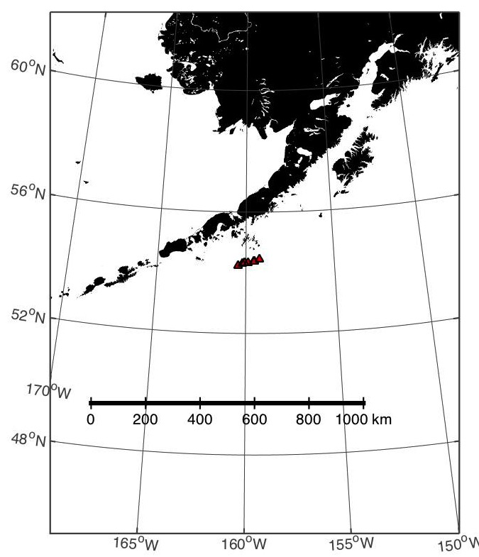
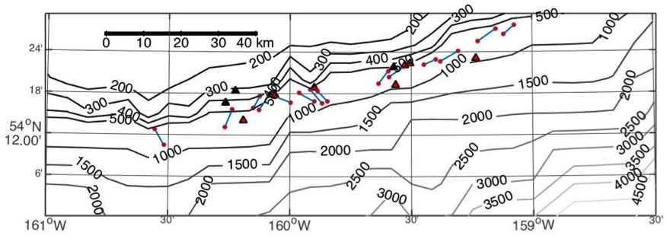
Decoy: Summer 2013 Trials
Single vessel: F/V Magia,
skipper Stephen Rhoads
Single area: Western Gulf of Alaska
28 deployments
14 usable sets
Notes:
Summer 2013 – trials w/ Stephen Rhoads on F/V Magia
Out of 28 deployments we got 14 usable sets.
Sets were determined to be usable if: (1) The decoy activated correctly and broadcasted during a haul; (2) sperm whales were acoustically detected either at the decoy or at the true fishing haul.
Thus half of the sets either had malfunctioning equipment with recorders or the decoy not activating, or no whales were present in either the vicinity of the decoy or the fishing set.

Slide 13
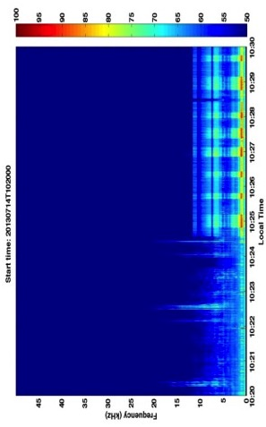
Decoy analysis: detecting whales with acoustics
Long-term averaged spectrograms allow us to look at whale activity over long periods of time
10:24am – Decoy activates
Recorder at Decoy
Decoy ON
Distant whale activity
Notes:
The first thing we did when the trials finished was go through the acoustic data.
Acoustic data from recorders was processed using long-term averaged spectrograms, which allow us to look at acoustic data over long periods of time.
This plot shows 10 minutes between 10:20 to 10:30am on July 14.
Mr. Rhoads had put this recorder below the playback device, and noted that he activated the device at 10:24am.
If you look at this spectrogram you can clearly see the decoy activate at 10:24am.
You can also see some whale signals, showing us that sperm whales were in the area, but not near to the device.
For each set on each day Mr. Rhoads fished, we manually reviewed the acoustic data to confirm the decoy had activated at the time Mr. Rhoads had written down.
We also confirmed all recorders were actively recording during those times as well. As you can see, it was very clear when the decoy activated.

Slide 14
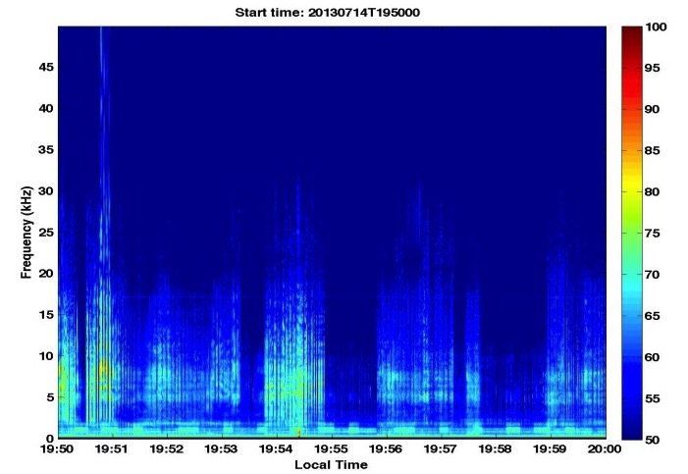
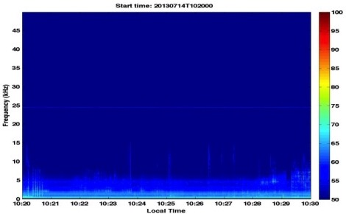
Decoy analysis: detecting whales with acoustics
Heavy whale activity during haul
Minimal to no whale activity
Notes:
Here are a few other plots, from the recorders on the fishing gear;
In the top plot you can see sperm whale activity very close to the recorder; this is at a time when Mr. Rhoads reported active heavy depredation.
And in the bottom plot a recorder on a distant set that had no visual sightings of whales, and no acoustic detections.

Slide 15
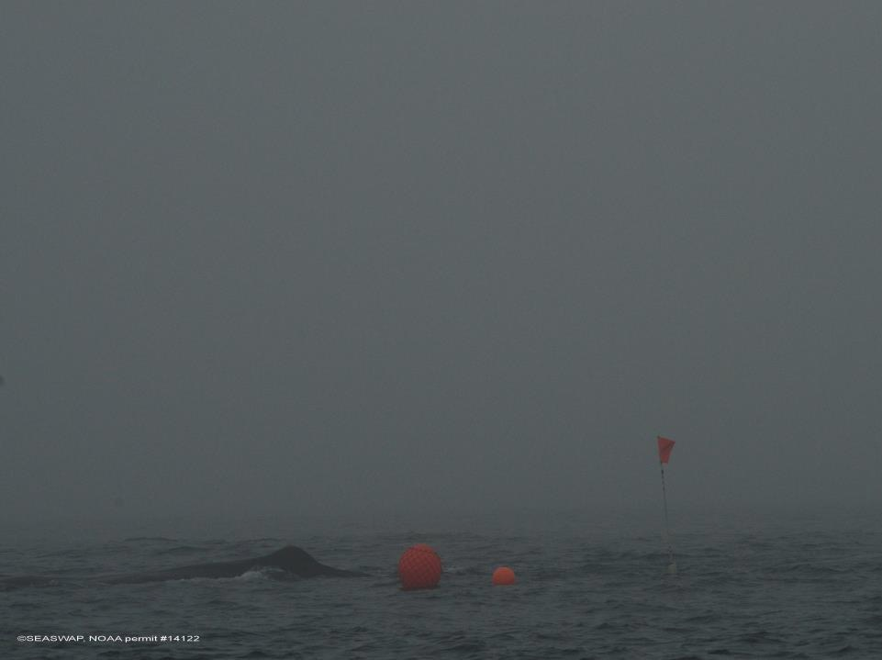
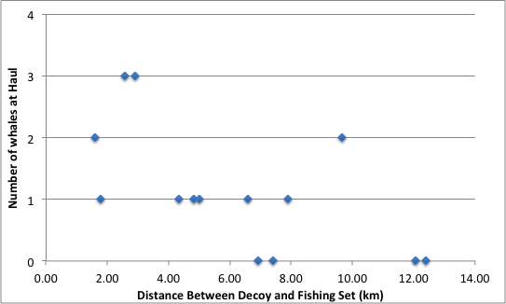
Decoy Results: 14 successful trials
Whales at Decoy Only
Notes:
This plot shows a summary of the 14 usable sets we analyzed.
You can also see that on 4 of the sets, whales were detected acoustically near the decoy, but were never sighted nor acoustically detected near the fishing haul.

Slide 16
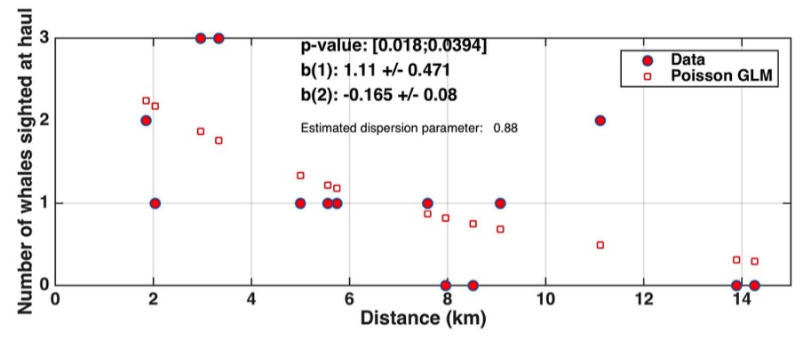
Decoy Results: Generalized Linear Model (Poisson)
The farther away the decoy was from the fishing haul, the fewer whales showed up at the haul.
p = 0.039, significant at the 5% level
Notes:
Our first statistical analysis looked at the number of whales that arrived at the fishing haul with respect to the distance between the decoy and fishing haul.
We fit a poisson regression, and the fitted points matched the data well, with statistical significance at the 5% level.
As distance between the decoy and haul increased, the number of whales to show up at the haul decreased.
This suggests that at greater distances some whales may stay near the decoy, choosing not to make the trek to where they hear other fishing activity.

Slide 17
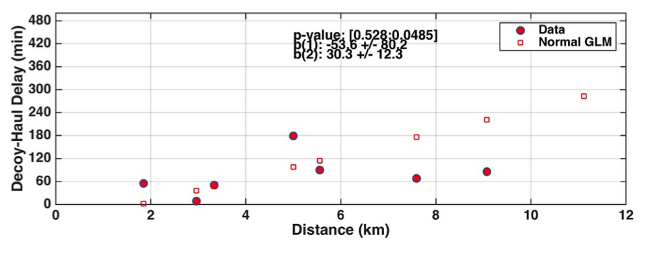
Decoy Results: Normal GLM
Time between decoy activation and first whale detected at fishing haul (decoy-haul-delay time)
Whale delay in arriving at the haul increased when decoy farther away
Smaller sample size n=8
p = 0.05, significant at the 5% level
Notes:
In our second model we fit a normal linear regression testing whether the decoy delayed whales arrival at the true haul;
For this test we only had 8 data points, as we could only use sets where whales actually showed up at the fishing haul.
Here we found that distance was a significant predictor of decoy-haul delay time. And remember, the four data points we had to omit for this test
had distances in the upper range here from 7-12 km, with infinite delay time, supporting the increasing linear trend we see here with our fitted values.
So there are likely confounding effects here. Perhaps whales that showed up at the true fishing haul were coming from a different direction, or did not first stop by the decoy.
We can say here that we do see a positive trend in the distance between the decoy and true haul and the decoy-haul delay time.
However, we would need more data to say for sure what is really going on in these scenarios.
The inverse of the delay time coefficient gives a swimming rate of 2km/hr for the whales swim speeds, which is less than 1knot, and much slower than a typical sperm whale swim speed of 5 knots.

Slide 18
Conclusions: Successes
May be first demonstration of an acoustic decoy on marine mammals
Distance is key – farther decoy => fewer whales arrive
Sometimes whales stayed at decoy and never approached true fishing haul.
Conclusions: Caveats
Applicable to a limited set of circumstances:
- Whales must be known to be present.
- Fishing vessel is alone.
Testing requires intersection of fishermen, whales, and fish:
Mr. Rhoads took device again in 2014 to collect more data:
2 months at sea saw no whales, did not deploy decoy.
Device is heavy and awkward – hard to maneuver on vessel
-Further engineering effort would be required
-Wider number of vessel samples to reduce habituation risk.
Notes:
What we can say from this experiment is that distance does seem to be important. Increasing the distance between the decoy and the fishing set allowed Mr. Rhoads to expierence less depredation, whether it be in the form of fewer whales arriving at his gear in some cases, delaying whales arrival at his gear, and in a few cases, distracting whales enough that they never made the trek over to his fishing gear.
This is our most promising deterrent to date, but is to be used in limited circumstances, when whales are known to be present, and when the fishing vessel is alone, because
other vessels present kind of negate the utility of the decoy.

Slide 19
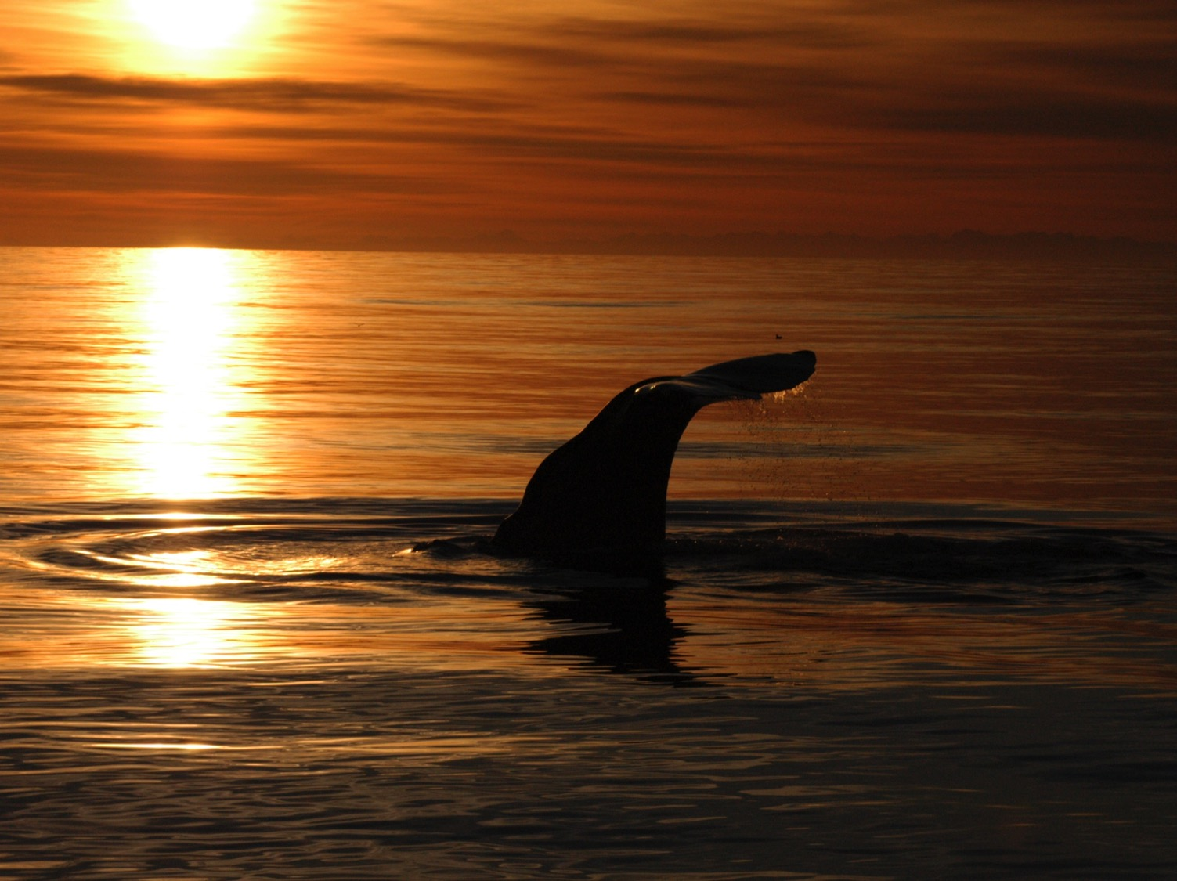
Thank You!
Photo Credit: Dick Curran, F/V Cherokee
Skippers: Dan Falvey, Stephen Rhoads, Walt Pasternak
Crew members on F/V Myriad, F/V Christi-Rob, & F/V Magia
www.seaswap.info
Thursday 14:15, Aaron Thode
Continental Ballroom 1-4
SEASWAP Go-Pros
Notes:
I would like to thank the skippers and crew members on the vessels that helped with this experiment;
These fishermen are small-vessel operators in southeast alaska that work collaboratively with us, and we wouldn’t be able to do this work without them;
And finally our collaborating institutions as well as our funder for this project, NPRB
Another plug for our website!
Tomorrow at 14:15 In Continental Room 1-4, Aaron Thode will be giving another talk about SEASWAP work, this time with Go-Pro cameras we have been using the past few years, and some experimental work we did in collaboration with the Hawaiian Longliners Association, so tune in!

