Slide 1

Assessing depredation in a small fishery
Andreas Winter
Joost Pompert
Falkland Islands Government

Slide 2
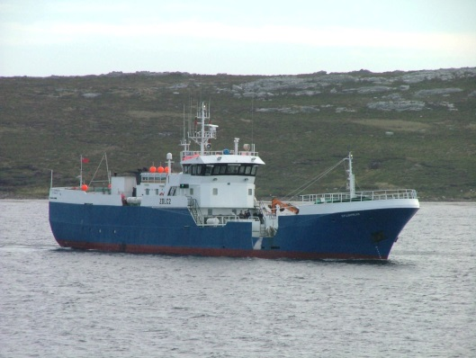
Single quota
Single vessel

Slide 3
Single quota
Single vessel
Limits opportunities for comparing depredation among longline sets.

Slide 4
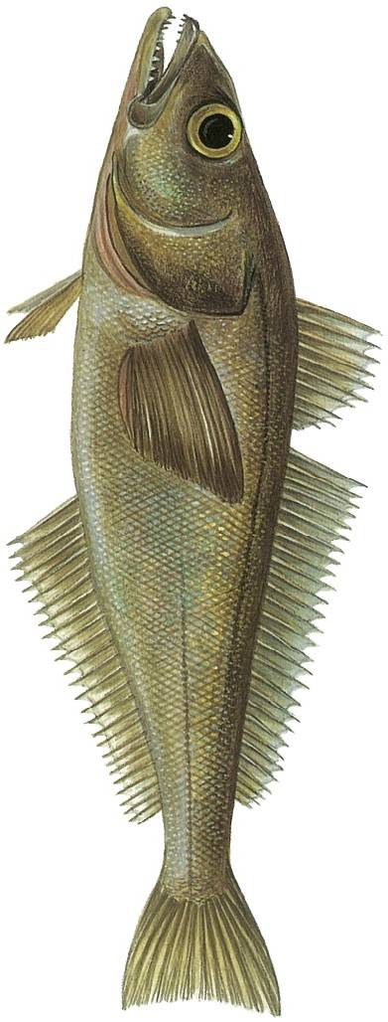
‘Invisible’ depredation
?

Slide 5
Whale interaction data:
Starting in 2002, longline observers were employed by the Fisheries Department specifically to monitor seabird mortalities.

Slide 6
Whale interaction data:
Starting in 2002, longline observers were employed by the FIFD specifically to monitor seabird mortalities.
Initially 75% of observer time on seabird
interaction monitoring, 25% on
biological catch sampling.
Observer time gradually reduced as
seabird mortality declined in the fishery.

Slide 7
Whale monitoring:
Presence / interactions recorded during seabird observation periods

Slide 8
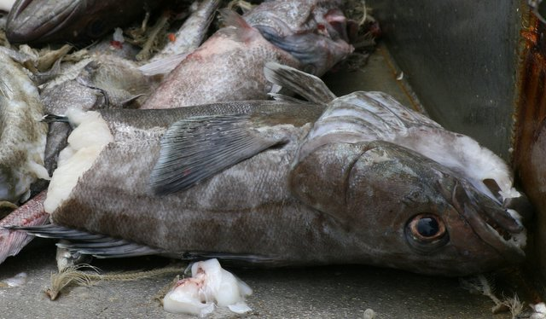
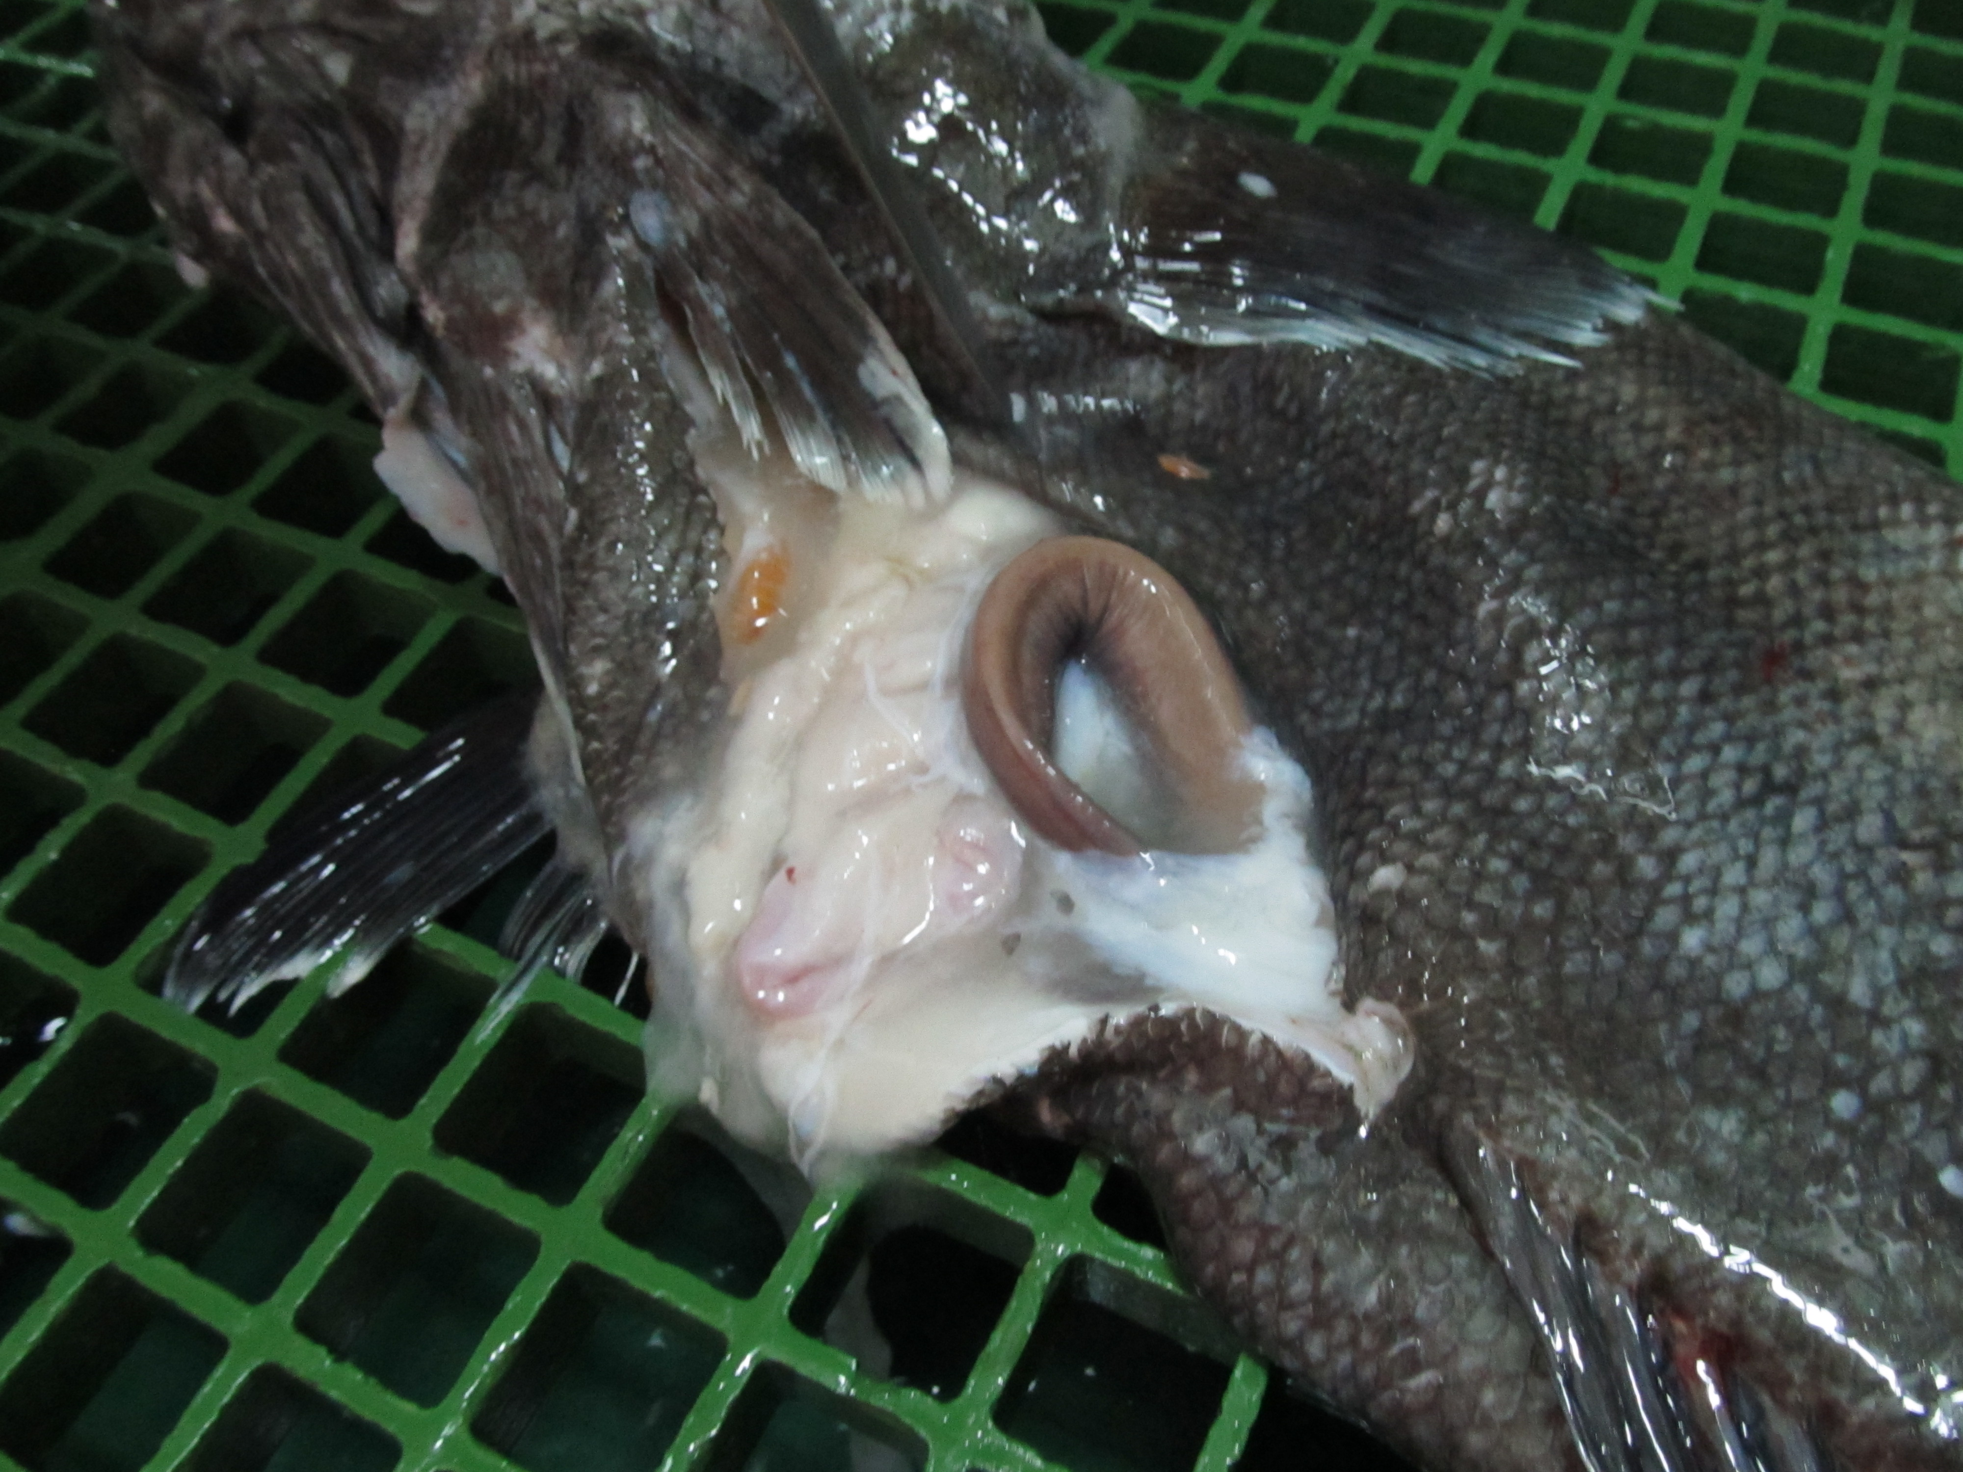
As well as toothfish depredation.

Slide 9
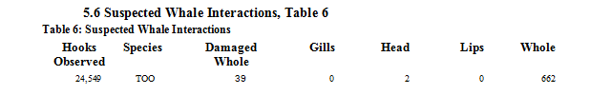
Whale interaction data:
Summary table produced and included in the observer report for each trip.

Slide 10
Whale interaction data:
Summary table produced and included in the observer report for each trip.
Data are screened and uploaded onto the Fisheries Department server.

Slide 11
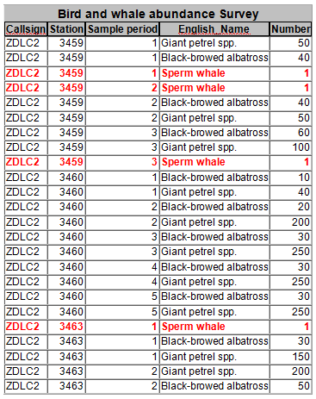
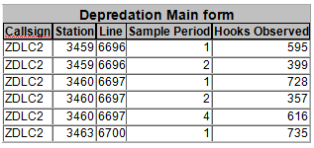
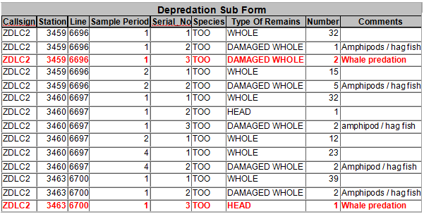
Whale interaction database records:

Slide 12
Estimate depredation by comparison –
No interaction longline sets:
No fish on the line reported damaged or destroyed.
Whale interaction longline sets:
At least one fish of any species on the line reported damaged or destroyed
(‘heads’, ‘lips’, ‘gills’).

Slide 13
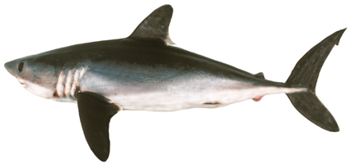
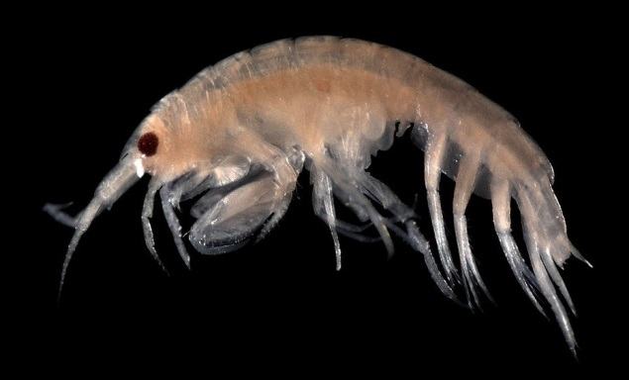
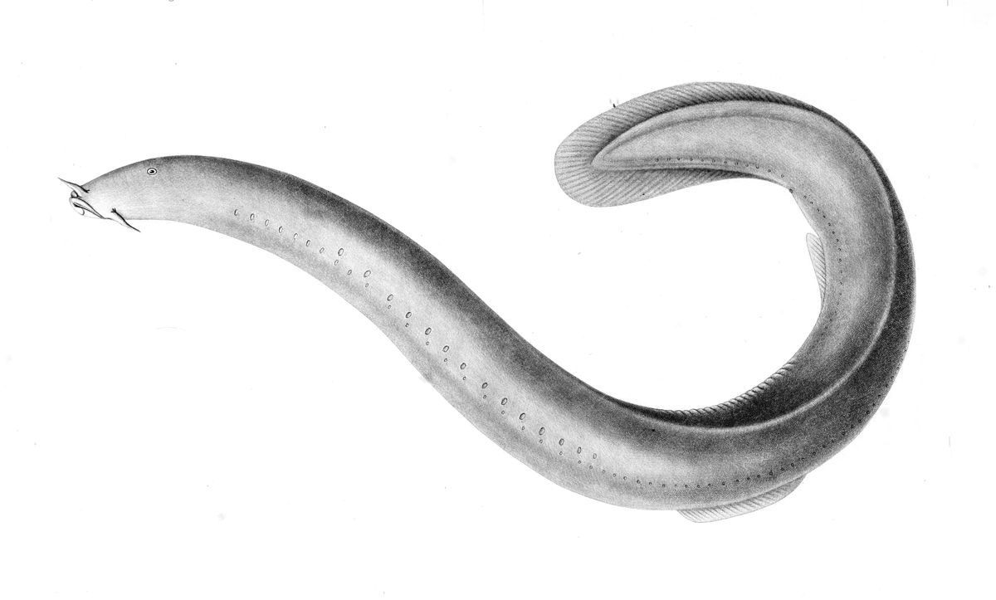
And – Damage not reported as:
Shark
Crustacean
Hagfish

Slide 14
1948 ‘observed’ longline sets, 2004 to 2015
296 Whale interaction sets
1652 No interaction sets

Slide 15
1948 ‘observed’ longline sets, 2004 to 2015
296 Whale interaction sets
1652 No interaction sets
Compare by: Proximity
Predictive model

Slide 16
Proximity: within 2 days , 6 km
296 Whale interaction sets
105 Whale interaction sets have at least
one ‘No interaction’ set within range.

Slide 17
Proximity: within 2 days , 6 km
296 Whale interaction sets
105 Whale interaction sets have at least
one ‘No interaction’ set within range.
Comparing CPUE (kg or N toothfish / hooks):
Not statistically significant by paired t-test.

Slide 18
Predictive model: GLM
Toothfish catch ~ Year Month
Vessel Depth
Haul Duration N Hooks Soak Time
Gear method Latitude Longitude

Slide 19
Predictive model: GLM
Toothfish catch ~ Year Month
Vessel Depth
Haul Duration N Hooks Soak Time
Gear method Latitude Longitude
‘Spanish’ or ‘Umbrella’
system

Slide 20
Predictive model: GLM
Toothfish catch ~ Year Month
Vessel Depth
Haul Duration N Hooks Soak Time
Gear method Latitude Longitude
GLM using only ‘No interaction’ sets
GLM using all longline sets

Slide 21
Predictive model: GLM
Toothfish catch ~ Year Month
Vessel Depth
Haul Duration N Hooks Soak Time
Gear method Latitude Longitude
GLM using only ‘No interaction’ sets
GLM using all longline sets
Project model prediction onto all sets

Slide 22
Toothfish catch N (Poisson distribution):
Toothfish catch ~ Year Month
Vessel Depth
Haul Duration N Hooks Soak Time
Gear method Latitude Longitude

Slide 23
Toothfish catch N (Poisson distribution):
Toothfish catch ~ Year Month
Vessel Depth
Haul Duration N Hooks Soak Time
Gear method Latitude Longitude
GLM using ‘No interaction’ sets: 30.5% R²
GLM using all longline sets: 33.0% R²

Slide 24
Toothfish catch kg (Gaussian distribution):
Toothfish catch ~ Year Month
Vessel Depth
Haul Duration N Hooks Soak Time
Gear method Latitude Longitude

Slide 25
Toothfish catch kg (Gaussian distribution):
Toothfish catch ~ Year Month
Vessel Depth
Haul Duration N Hooks Soak Time
Gear method Latitude Longitude
GLM using ‘No interaction’ sets: 31.0% R²
GLM using all longline sets: 32.7% R²

Slide 26
Toothfish catch Numbers:
For longline sets that actually had
‘No interaction’:
predicted N ≈ predicted N
[GLM-all sets] [GLM-no interact.]
No statistically significant difference.

Slide 27
Toothfish catch Numbers:
For longline sets that actually had
‘Whale interaction’:
predicted N > predicted N
[GLM-all sets] [GLM-no interact.]
Significantly higher average N (p < 0.001).

Slide 28
Longline sets attended by whales have more toothfish.

Slide 29
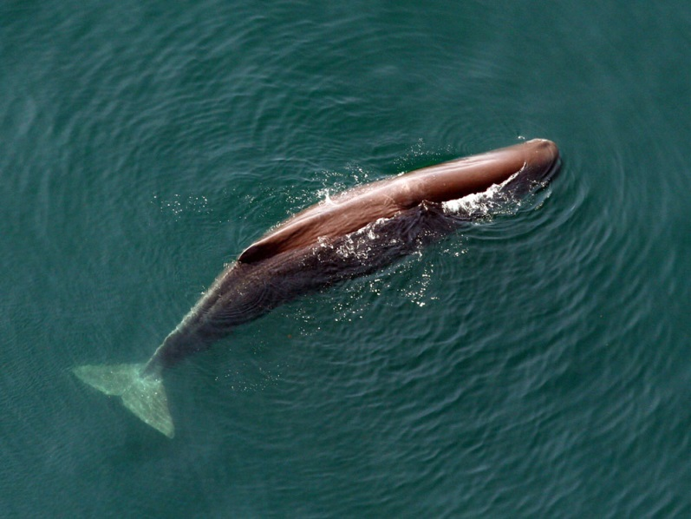
Longline sets attended by whales have more toothfish.
In Falkland Islands waters, most whales are sperm whales.
Sperm whales feed
naturally on tooth-
fish.
Tixier et al. CCAMLR 2010

Slide 30
Toothfish catch Weight:
For longline sets that actually had
‘Whale interaction’:
predicted kg ≈ predicted kg
[GLM-all sets] [GLM-no interact.]
No statistically significant difference.

Slide 31
Toothfish catch Weight:
For longline sets that actually had
‘No interaction’:
predicted kg < predicted kg
[GLM-all sets] [GLM-no interact.]
Significantly lower average kg (p < 0.001).

Slide 32
Toothfish catch weight is significantly reduced on longline sets attended by whales;
despite the contrasting bias of higher numbers of toothfish in the presence of whales.

Slide 33
Toothfish catch weight is significantly reduced on longline sets attended by whales;
despite the contrasting bias of higher numbers of toothfish in the presence of whales.
Both killer whales and sperm whales selectively retrieve larger-sized fish from the lines.
Guinet et al. ICES 2014

Slide 34
Evaluate differences between ‘All sets’ and ‘No interaction’ model predictions:
Subtract one from the other.
Plot differences vs. co-variates.
GLM by catch weight, ‘No-interact.’ sets

Slide 35
Predicted kg [GLM no interact.] – [GLM all sets]
Difference of toothfish catch (kg)
Depth (m)

Slide 36
Predicted kg [GLM no interact.] – [GLM all sets]
Difference of toothfish catch (kg)
Depredation occurs less in shallower water.
Depth (m)
Notes:
The plot shows that it becomes less and less of an “advantage” to use the ‘no interaction’ model for prediction in shallow water, therefore depredation occurs less in shallow water. May be correlated with toothfish being smaller in shallow water.

Slide 37
Predicted kg [GLM no interact.] – [GLM all sets]
Difference of toothfish catch (kg)
Depredation occurs more to the west.
Longitude (W)

Slide 38
Predicted kg [GLM no interact.] – [GLM all sets]
Difference of toothfish catch (kg)
Depredation increases with soak time.
(Small effect > 2 days).
Soak time (days)

Slide 39
Predicted kg [GLM no interact.] – [GLM all sets]
Whale depredation
not different by month.
Difference of toothfish catch (kg)
Month

Slide 40
In a small fishery with limited comparability, model differencing can provide a means to estimate depredation.
More accurate approach to infer ‘Interaction’ vs ‘Non-interaction’ sets?
Quantify differences w.r.t. co-variates, and w.r.t. offset bias of higher toothfish catch numbers co-occurring with whale presence.

