Slide 1
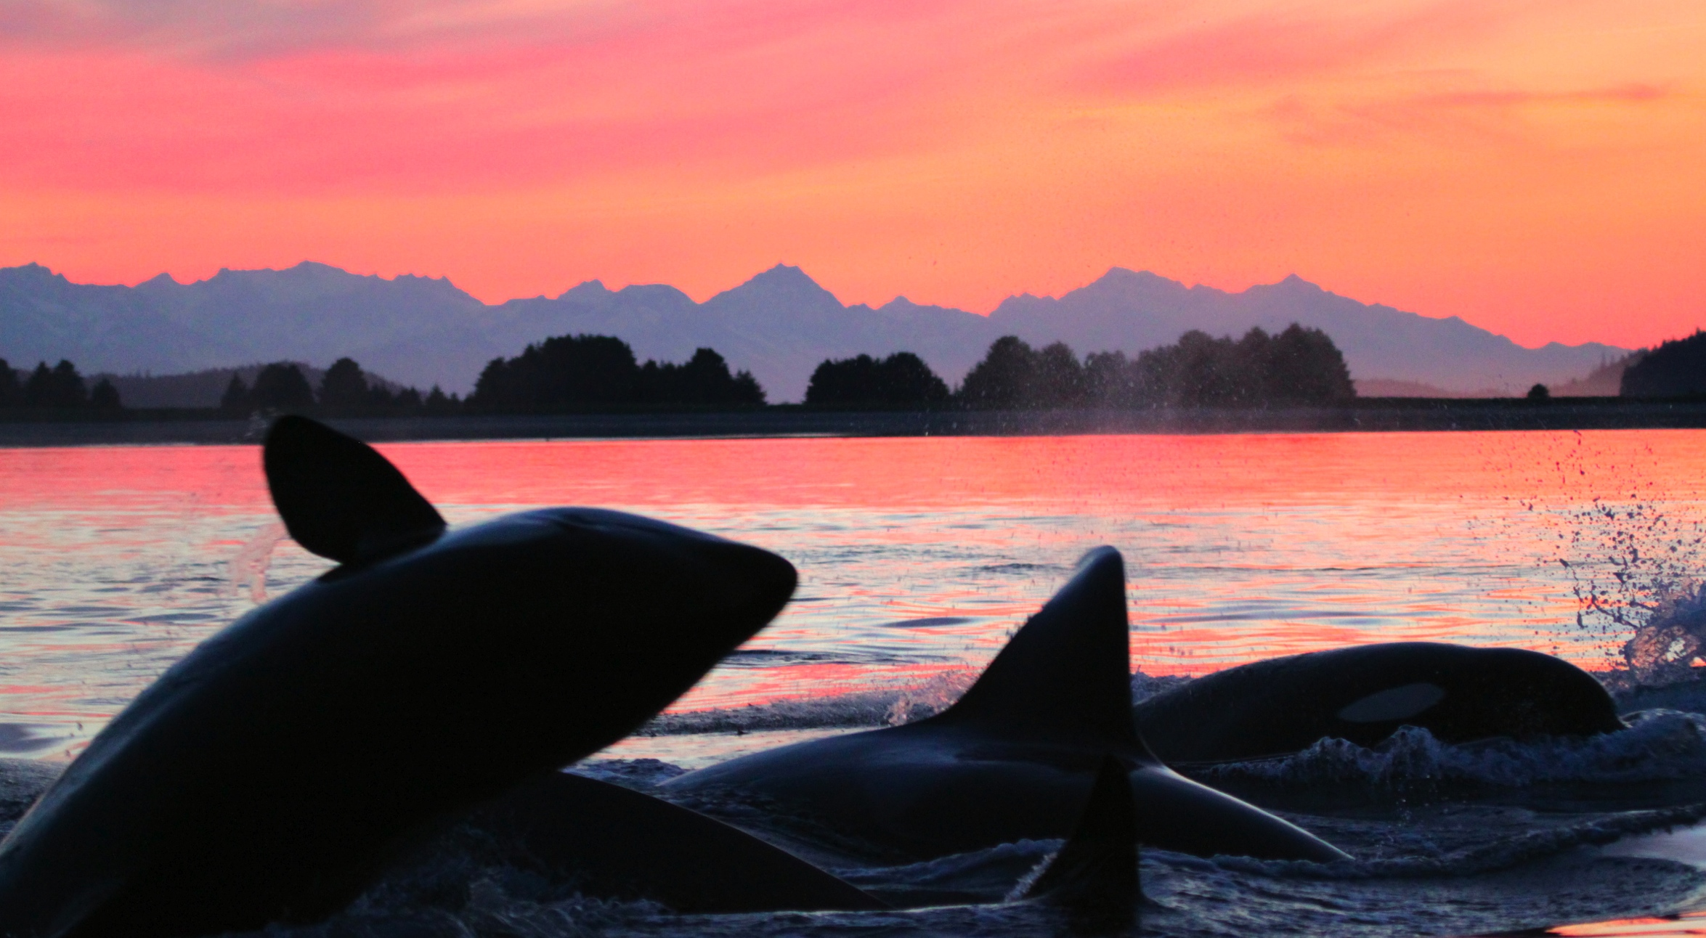






The entangled economics of killer whale depredation in western AK
Megan J. Peterson, Franz Mueter
Keith Criddle, Alan C. Haynie
March 2016
PLOS ONE 2014

Slide 2
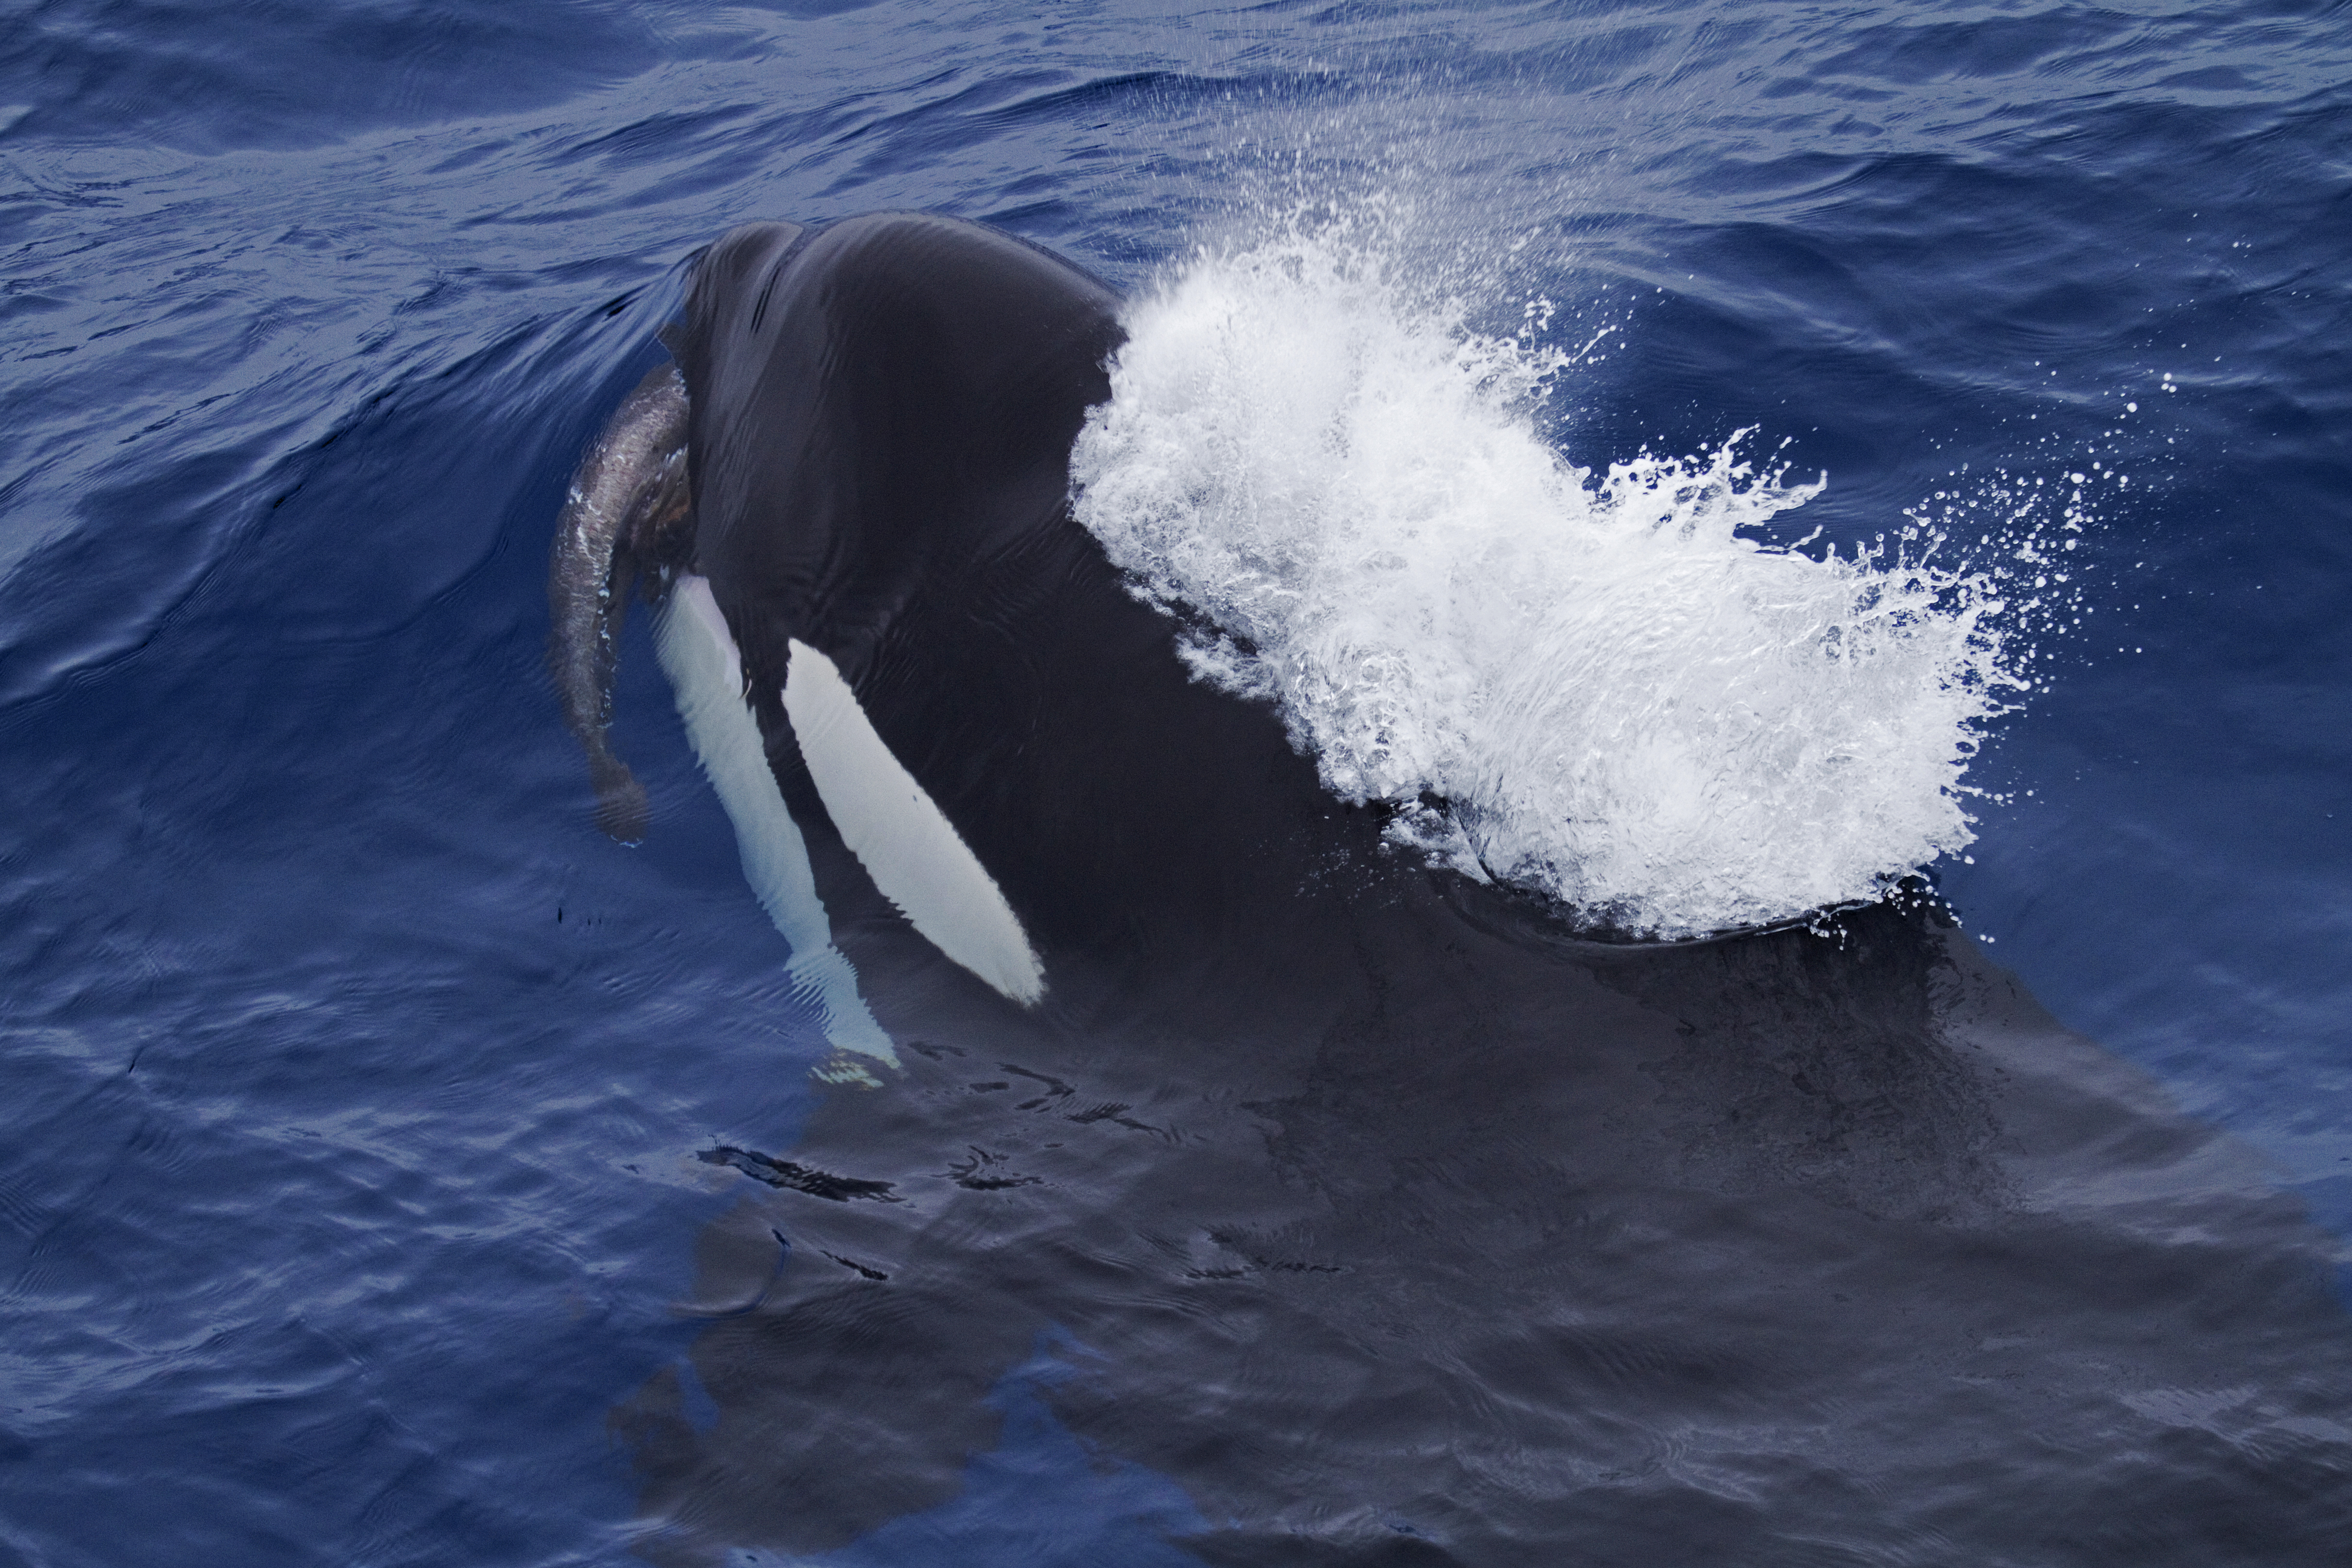
Implications
© Paul Tixier
⬇ Catch per unit effort (CPUE)
⬆ Operating costs
⬆ Uncertainty stock assessments
⬆ Increased risk entanglement/ altered foraging strategies
Notes:
We know that killer whale depredation can significantly reduce or depress catch rates or CPUE – (by as much as 40-70% based on analysis we did using NMFS longline survey data)
With these reduced CPUEswe also knew that fishermen would incur some degree of increased operating costs to catch their quotas.
And depredation also increases uncertainty in fishery stock assessments,
So when faced with this, fishermen are forced to make choices about their oprations.

Slide 3
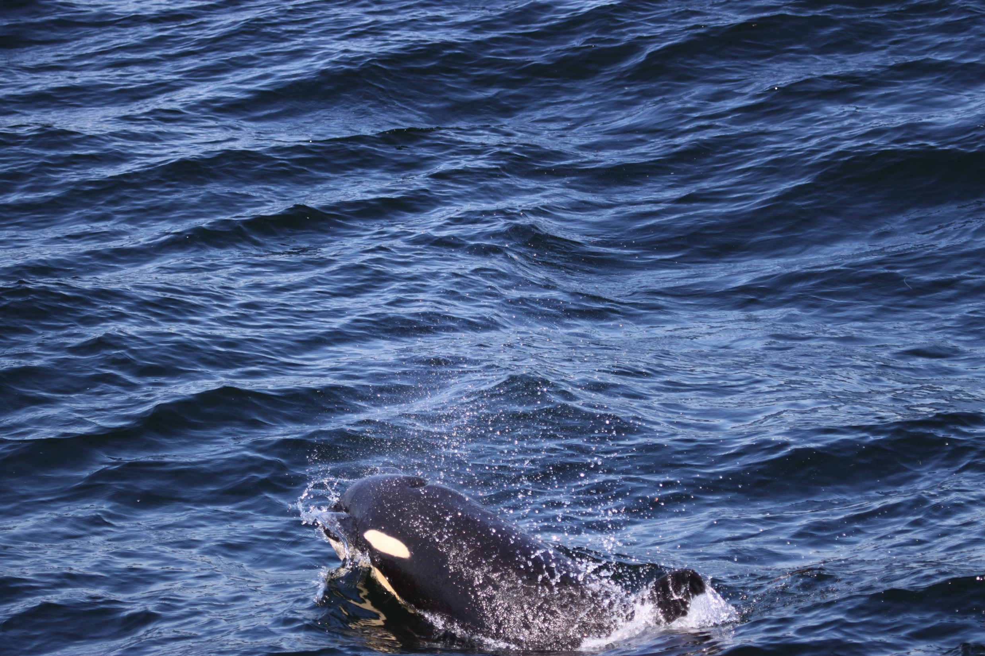
Objectives
Estimate depredation frequency and CPUE for the commercial fleet in western AK
Estimate increased operating costs (fuel, crew food) and opportunity costs (foregone wages)
Notes:
For this chapter,
this second part is something that really hasn’t been done on this scale before.

Slide 4
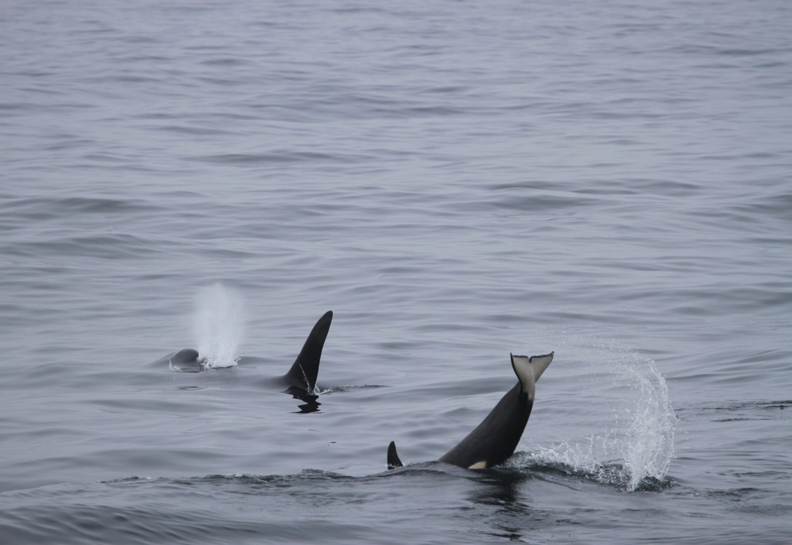
Data & Methods
  1. Fishing through the whales:
  NMFS Commercial Fishery Data (n=15,729 sets)
  Generalized Additive Model (GAM) to estimate CPUE
  Linear model to estimate additional fuel consumption
  2. Depredation avoidance:
  Fishermen-collected depredation data (n=846 sets)
  Estimating direct effort inputs and opportunity costs
Notes:
Bascially we are trying to assess the costs of two potential responses to depredation.
We relied on two primary data sources for this analysis.
NMFS commercial fishery data collected by observers
GAM
We also used linear modeling to estimate fuel consumption for the observed fleet
and I will explain this method in particular in more detail later in this section as this proved a lot more challenging than we anticipated.
The second source of data , we also used fishermen collected depredation data from 2011 and 2012.
Detailed study with 6 vessels fsihing in western Alaska in 2011 and 2012 (n=846 sets, 262 days fishing)
Respondents recorded their total number of sets, # sets affected, avoidance measures (distance traveled, hours waited, etc.)
We used this to results to estimate some of the direct costs costs such as increased fuel use and crew food and opportunity costs in lost time.

Slide 5
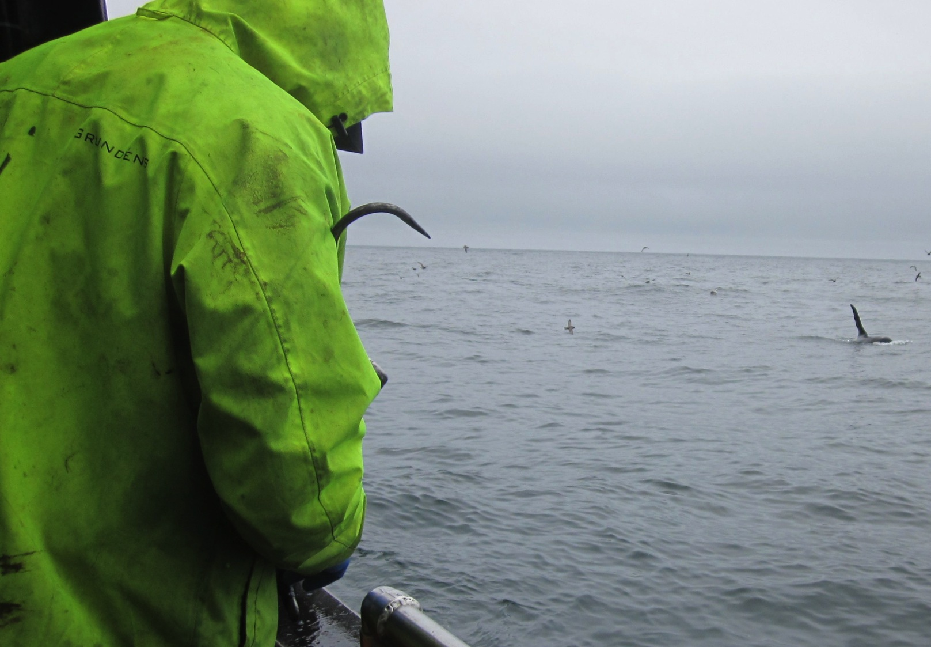
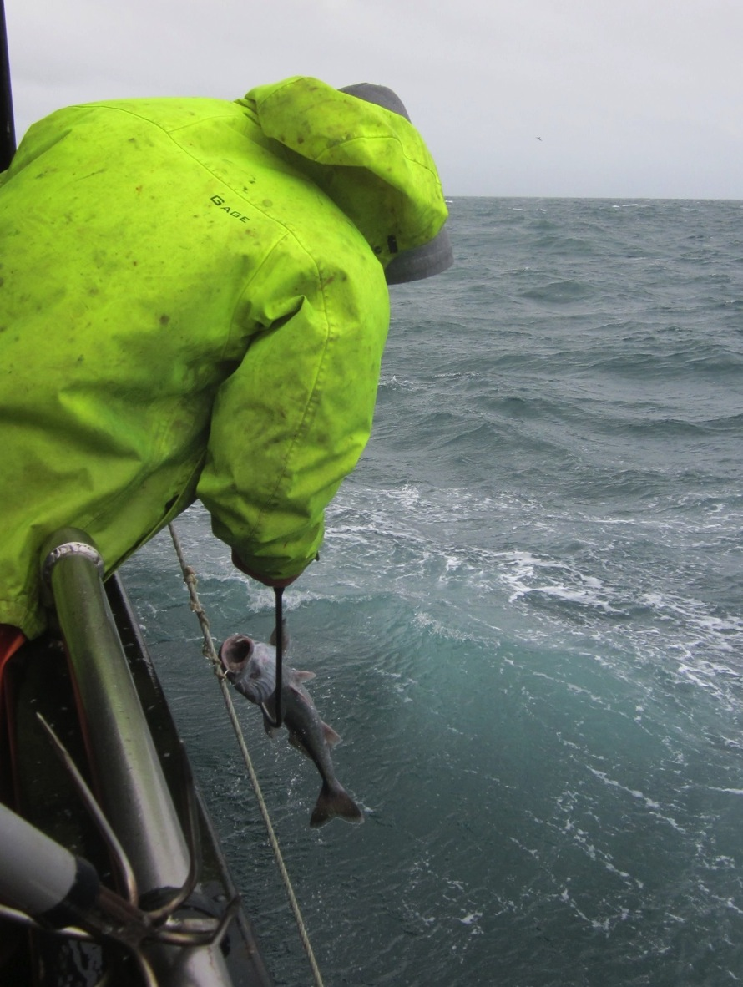
Fishing choices and associated costs
Fish through the whales
Drop gear/ extended soaks
Move to a different fishing site
Operation costs (fuel, bait)
Opportunity costs
Operation costs, Opportunity costs
Actual/predicted lost catch * $ / lb (Roche et al. 2007, TEC 2009, Tixier et al. 2010, Peterson et al. In Prep)
I hate killer whales
With their stinking breath
And thrashing tails
They're eating blackcod
Off my hooks
They're nothing but
Tuxedoed crooks.
I hate killer whales
With their stinking breath
And thrashing tails
They're eating blackcod
Off my hooks
They're nothing but
Tuxedoed crooks.
I hate killer whales
With their stinking breath
And thrashing tails
They're eating blackcod
Off my hooks
They're nothing but
Tuxedoed crooks.
And spermwhale breath
Is even worse
As if their apertures
Were reversed
They're killing me
It makes me pine
For Nantucket 1859.
And spermwhale breath
Is even worse
As if their apertures
Were reversed
They're killing me
It makes me pine
For Nantucket 1859.
And spermwhale breath
Is even worse
As if their apertures
Were reversed
They're killing me
It makes me pine
For Nantucket 1859.
I only wish the Japanese
Would do their research
Work on these
And leave those Baleen
Whales alone
STRIKE DEEP!
And take these
Bastards home.
I only wish the Japanese
Would do their research
Work on these
And leave those Baleen
Whales alone
STRIKE DEEP!
And take these
Bastards home.
I only wish the Japanese
Would do their research
Work on these
And leave those Baleen
Whales alone
STRIKE DEEP!
And take these
Bastards home.
-Bill Harrington (longliner)
-Bill Harrington (longliner)
-Bill Harrington (longliner)
Notes:
And what this really boils down to these fishing choices. You can
But in order to make effective decisions about whale avoidance - you need to be able to weigh the costs and benefits of fishing choices and depredation avoidance. This was a challenging step and somehting that definitely had not been done at this refined level before.

Slide 6
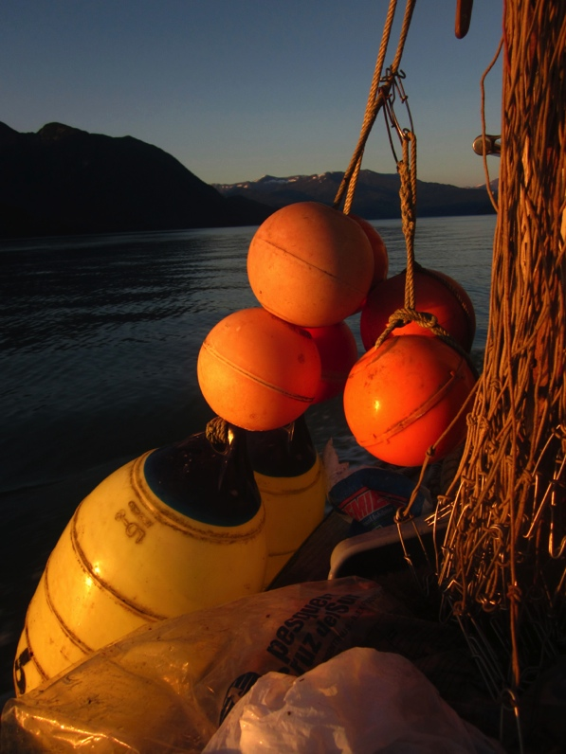
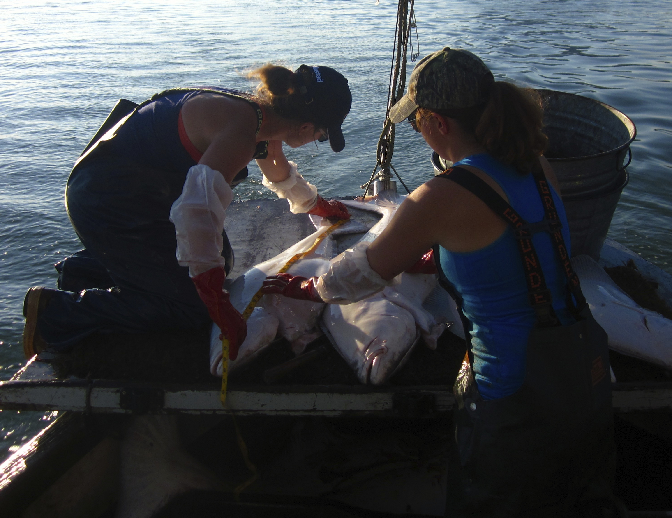
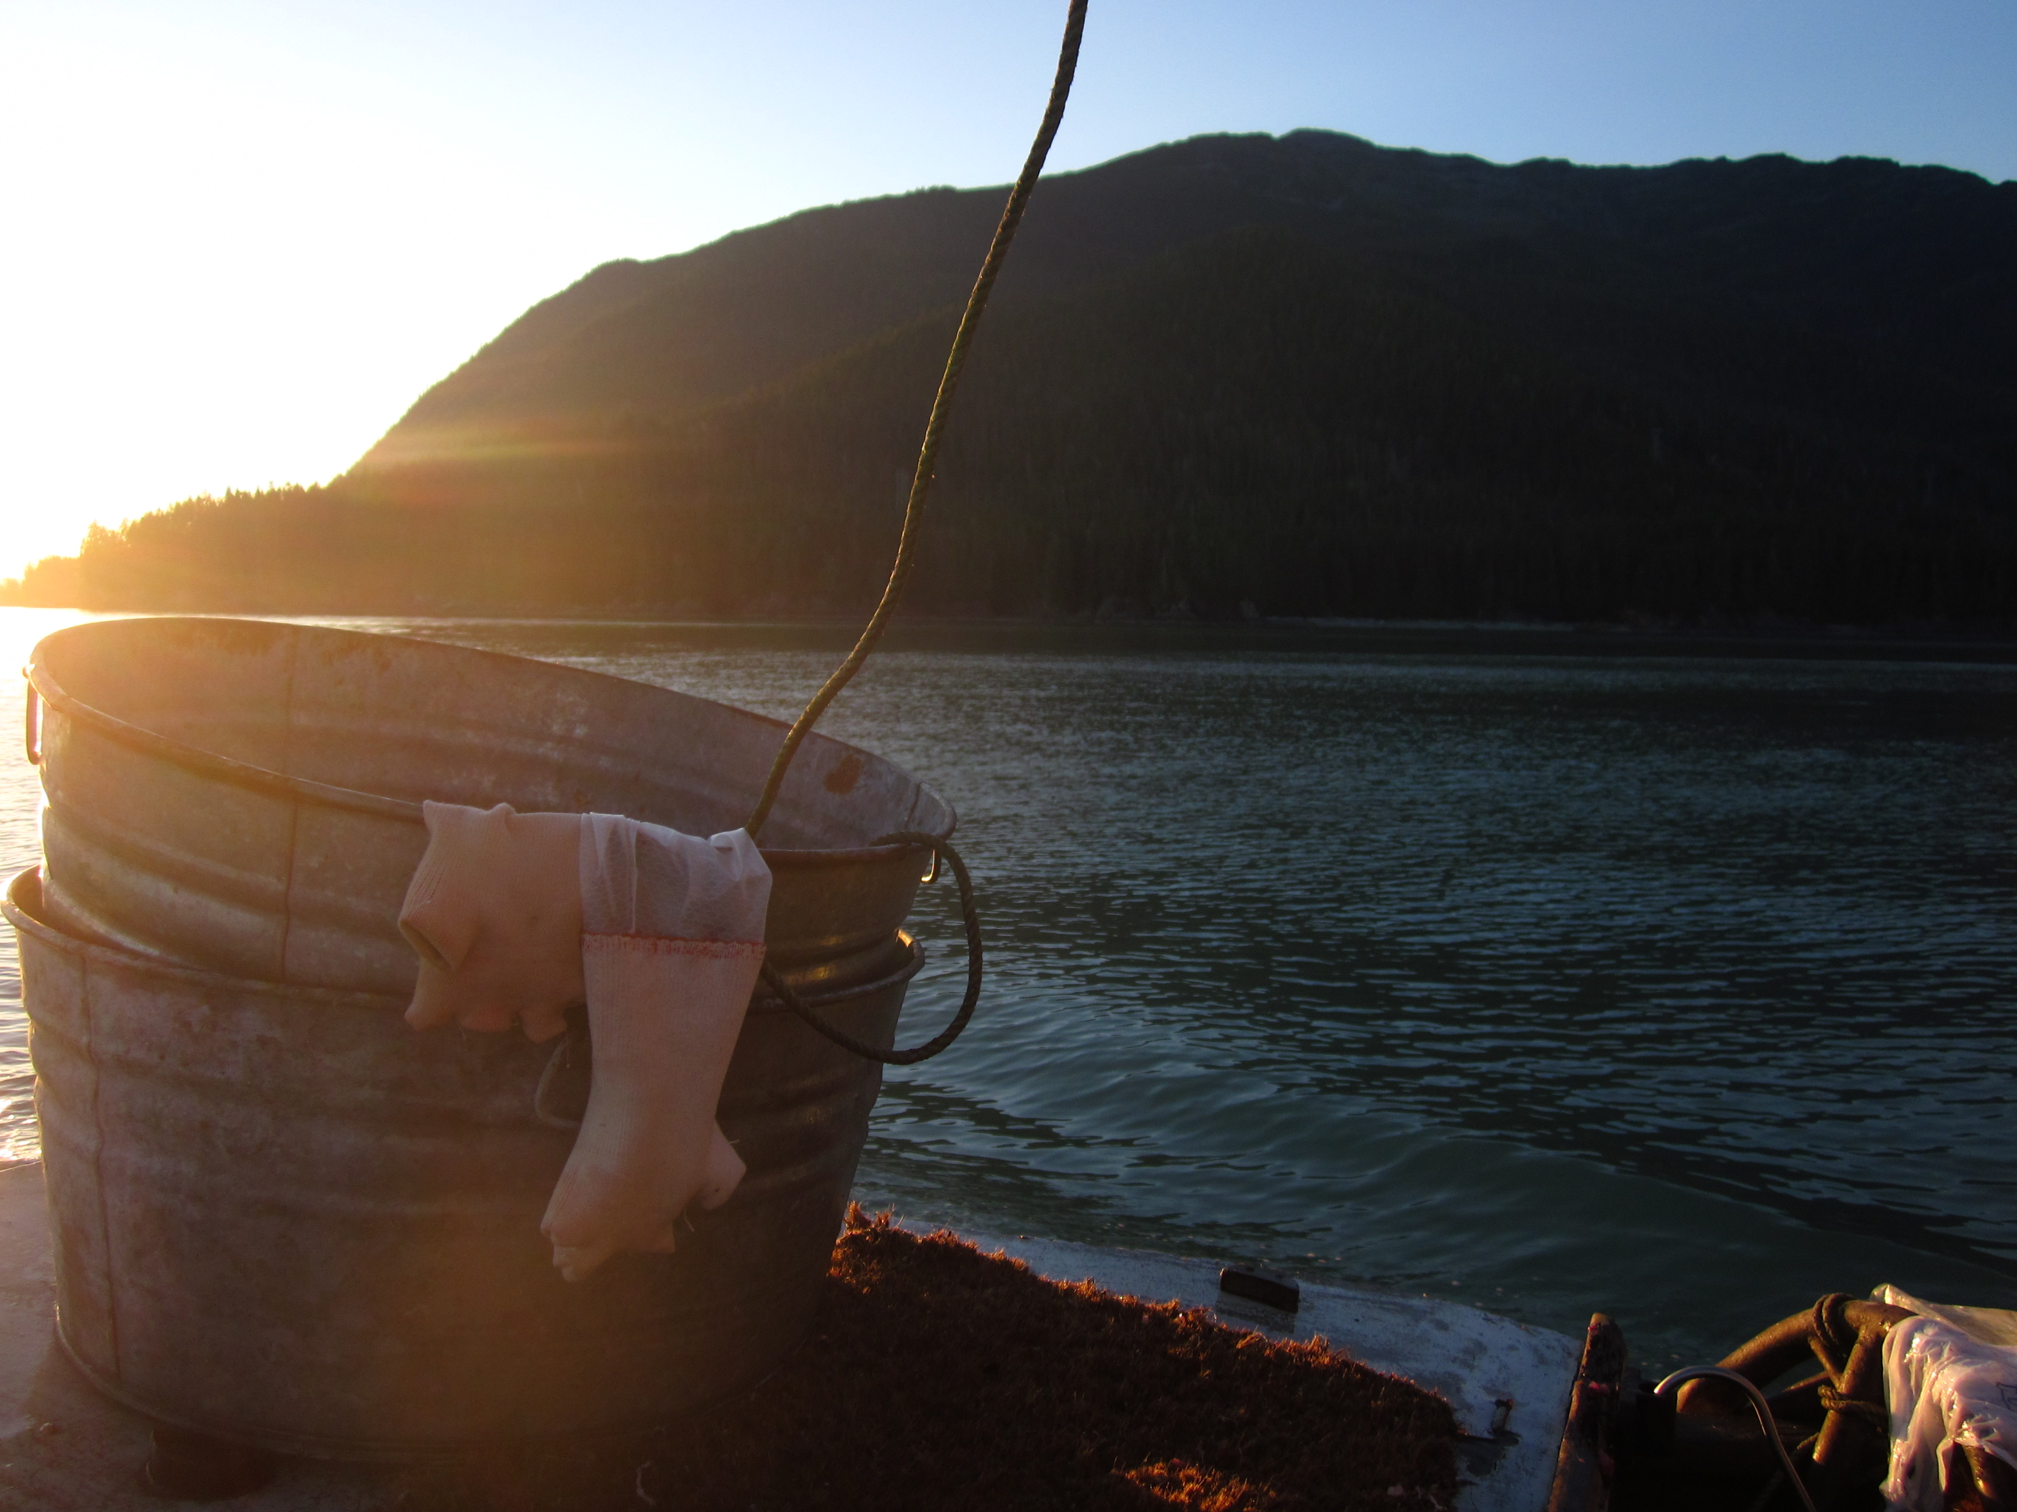
A new approach
High-value longline fisheries- fishermen will fish longer to catch entire quota → CPUEs
CPUEs → effort inputs must proportionally to catch same amount of quota
(e.g. fuel, bait, crew food,
opportunity costs)
Notes:
And this required a different- and very new approach.
What it boils down to- higher value-longline (per pound) fisheries, fishermen will generally fish longer to catch their quota- so they don’t exactly incur costs in lost catch. So basically they are incurring costs in reduced cpue-
With reduced CPUE → effort inputs must increase to catch the same amount of quota
And we based our subsequent evaluations of some of the costs incurred by fishermen on this very principle.

Slide 7
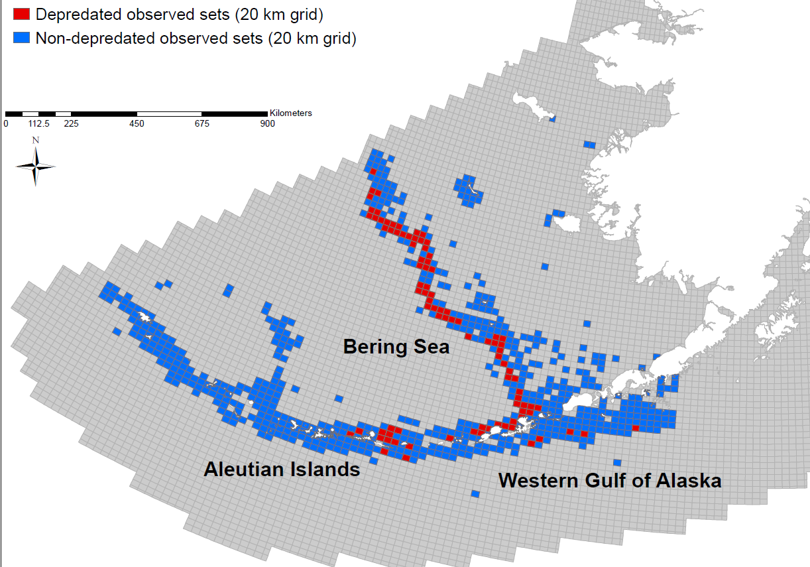
Observed commercial fishery depredation
n = 15,729 sets; 1998-2012
48-68% CPUE ⬇
avg = 12,160 hooks per set
Pribilofs
Umnak & Unalaska
21%
3%
3%
Notes:
Right off- moving into into results- This is that same western alaska region but now we are looking at commercial fishery sets.
Depredated sets are in red- and non-depredated in blue. The data is gridded by 20 km squares for confidentiality reasons.
Broken down by region, BS still shows about 21% of sets are impacted by killer whales, but the percentage of impacted sets in the AI and WGOA was quite low.
We have our commercial fishery information, but now we needed to get into fuel consumption .

Slide 8
Estimating fuel consumption
Detailed trip information from 60 longline fishing trips in western Alaska (Tyedmers 2001)
Notes:
we set out first to estimate increased fuel consumption costs associated with fishing through killer whales – we did this with the observer data first.
This was tricky though- we did not have standard fuel consumption data for the observed fleet. Instead, we used a subset of fishing trip data- that included detailed fuel consumption, fishing and steam days data for 60 longline fishing trips.
Based on a method established by Tyedmers in 2001 we regressed gallons of fuel consumed against vessel horsepower times days at sea to get an average fuel consumption rate for vessels less and and greater than 100 feet. And we extrapolated those rates to the observed fleet, for which we had vessel size and hp data.

Slide 9
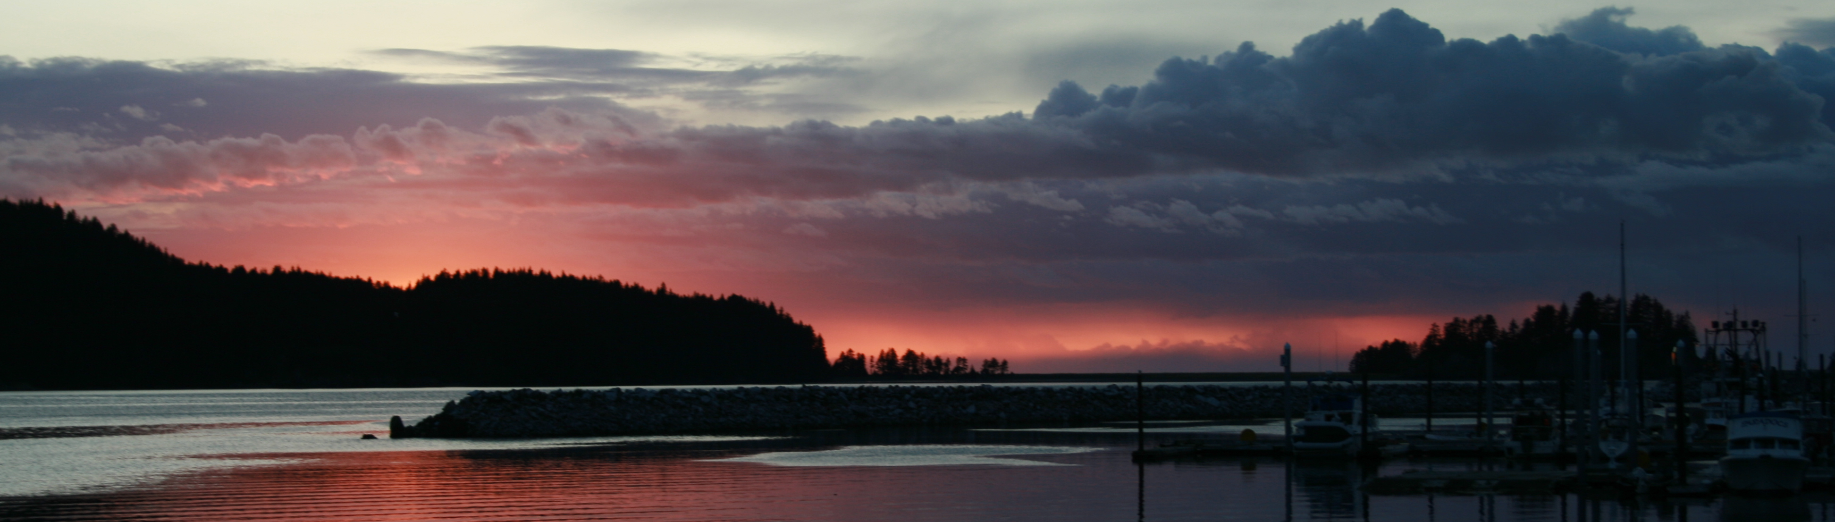
1. Costs of fishing through the whales
fuel consumption rate * days at sea * average vessel horsepower = gallons fuel consumed
Estimated fuel per set
 | Fuel consumption rate | Estimated gallons | 95% CI (gallons)
≤100 ft | 0.405 | 199 | ±23
>100 ft | 0.442 | 427 | ±30
Notes:
And we input the estimated fuel consumption rate wit* days at sea * hp to get an estimated gallons of fuel consumed per vessel. We could take that value to individual haul level because we knew how many hauls occurred.

Slide 10
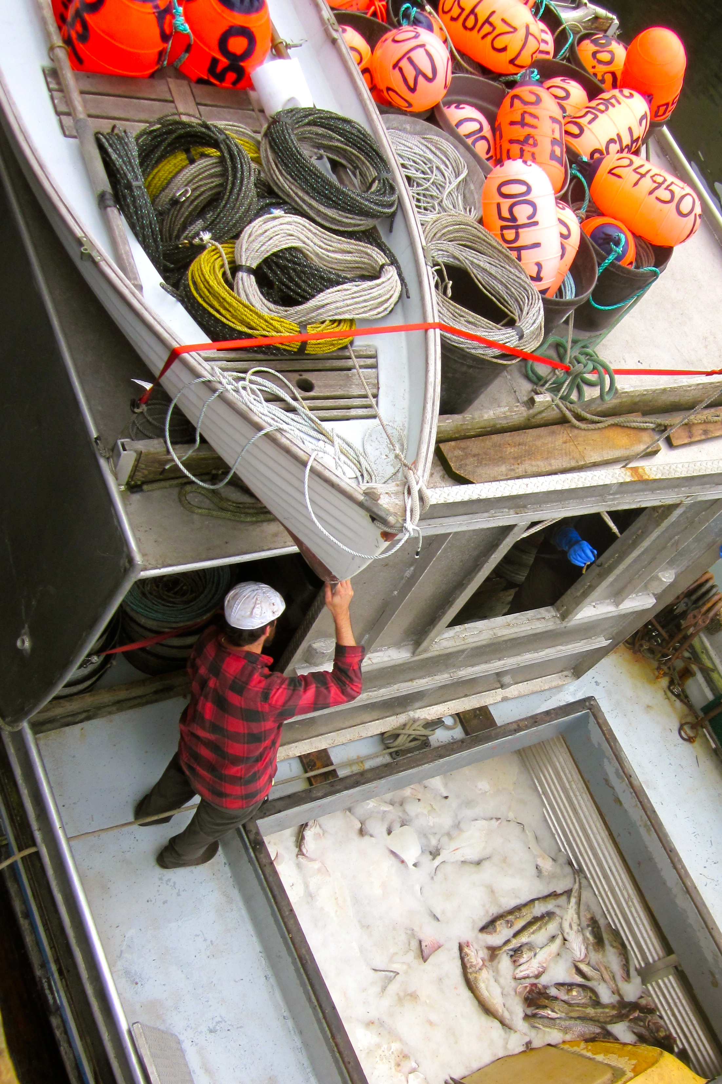
1. Costs of fishing through the whales
Gallons per set * CPUE⬇_{area, target} = additional fuel needed
* $/gallon
Cost of additional fuel per depredated set
 | Cost per set | 95% CI | AVG
≤100 ft | $231 | ±$107 | $433 ± 147
>100 ft | $462 | ±$148
Notes:
We then took estimated gallons per set time times the CPUE reduction by area and target to calcuate the additional fuel a fishermen might need to fish through the whales. You could get then get crazy and turn that into a dollar value.
So that’s what we estimated it costed- at its most basic level in additional fuel- to fish through the whales.
But fishermen can make other choices and as I stated earlier in this presentation- we know that fishermen will often opt to NOT fish through the whales and will employ avoidance measures.

Slide 11
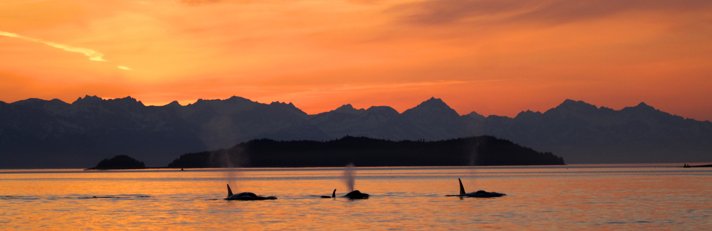
2. Costs of depredation avoidance
Detailed study with 6 vessels 2011 and 2012 (n=846 sets)
  Recorded # sets affected, avoidance measures (distance traveled, hours waited, etc.)

Slide 13
Depredation Avoidance Costs (Average per set)
Additional Fuel | Additional Crew Food | Opportunity Costs | TOTAL
$289 | $58 | $217 | $564
Doesn’t take into account:
Bait
Crew food
Opportunity costs
# Sets per day
Whales reinforced/ spreads behavior
Costs to fish through (Average per set)
Additional Fuel
$433 ± $147
Notes:
Based on data collected by fishermen on the grounds, we estimated that they spent on average an $289 per depredated-vessel—set on additional fuel. Opportunity cost of not working- an indirect cost…
So then compare that to what we estimated per set in additional fuel to fish through the whales
It’s important to point out though- that this does not take into account…
When considering all the additional costs to fishing through the whales, we can conclude that is generally preferable to NOT fish through the whales – especially when considering the long-term sustainaibility of the fishery and the reduced risk of gear entanglement or bycatch.
**appear /disappear these ones.
The estimated cost of additional fuel used to move to avoid the whales (fishermen respondent data 2011 and 2012; $290 per depredated set) was lower than the estimated cost of additional fuel used to fish through the whales (observer data 1998-2012; vessel average $433 ± $147 per depredated set).
). Additional fuel consumed due to killer whales varied with observed vessel size; vessels less than or equal to 100 ft spent on average $228 ± $107 for additional fuel per depredated haul, and vessels greater than 100 ft spent on average $457 ± $152 on additional fuel per depredated haul.

Slide 14
Conclusions
Dropping gear down moderately effective
  **Reduces risk entanglement/bycatch
  Costly → lost time, operation costs, fish quality degradation, risk gear loss in high current areas, etc.
  Whales can depredate stationary gear
Moving to outrun whales moderately effective
  **Reduces risk entanglement/bycatch
  Doesn’t always work
  Costly → fuel, lost time, operation costs
  Not feasible for all vessels
I hate killer whales
With their stinking breath
And thrashing tails
They're eating blackcod
Off my hooks
They're nothing but
Tuxedoed crooks.
I hate killer whales
With their stinking breath
And thrashing tails
They're eating blackcod
Off my hooks
They're nothing but
Tuxedoed crooks.
I hate killer whales
With their stinking breath
And thrashing tails
They're eating blackcod
Off my hooks
They're nothing but
Tuxedoed crooks.
And spermwhale breath
Is even worse
As if their apertures
Were reversed
They're killing me
It makes me pine
For Nantucket 1859.
And spermwhale breath
Is even worse
As if their apertures
Were reversed
They're killing me
It makes me pine
For Nantucket 1859.
And spermwhale breath
Is even worse
As if their apertures
Were reversed
They're killing me
It makes me pine
For Nantucket 1859.
I only wish the Japanese
Would do their research
Work on these
And leave those Baleen
Whales alone
STRIKE DEEP!
And take these
Bastards home.
I only wish the Japanese
Would do their research
Work on these
And leave those Baleen
Whales alone
STRIKE DEEP!
And take these
Bastards home.
I only wish the Japanese
Would do their research
Work on these
And leave those Baleen
Whales alone
STRIKE DEEP!
And take these
Bastards home.
-Bill Harrington (longliner)
-Bill Harrington (longliner)
-Bill Harrington (longliner)
Notes:
Whales can depredate stationary gear- especially say for a shallow pacific halibut set. It’s also very costly to the fleet- not as costly as depressed cpues in the long term, but they are still dealing with opporunity costs in lost time, increaed opeation costs in crew food, they risk fish quality degradation due to sand fleas or too much tiem on the bottom, also in high current areas like the AI there is a greater risk of gear loss with extended soaks.
And in the end although this minizes the risk of bycatch and entanglements and may slow the spread of the depredation bahavior it’s not what I consider a long term solution because it is inefficient for the fleet.
Same thing- this is not a long-term solution.
First, depredation is influencing a shift to pot fishing in the AI and especially in the BS, and this in part due to the fact that killer whale can not depredate pot gear. However, pot fishing for sablefish is currently not legal in the Gulf of Alaska. And the council is now reviewing the option of opening up federal waters in Gulf waters to sablefish pot gear. This would obviously change the depredation game in the Gulf for both sablefish and halibut fisheries.
Bigger boats / bigger engines can move farther
Drop gear/move→ not fish through→ fewer interactions with whales
*Now these longline fisheries are still generally very lucrative for the fishermen- thus I do not think we are likely to see fishermen dropping out of. Instead they will fish longer to catch the same quota, which will result in occassionally feeding the whales and unaccounted for mortality from the sablefish/halibut/ turbot stocks. And that does jeopardize the long-term sustainability of the fleet.
Last but not least, new data and studies suggest there a lot more fish-eating killer whales in Western Alaska than we previously thought. Maybe even double… and this distrubiot and killer whale social learning could faciltate the depredation behavior- especially in the Western Gulf even into the Central Gulf.

Slide 15
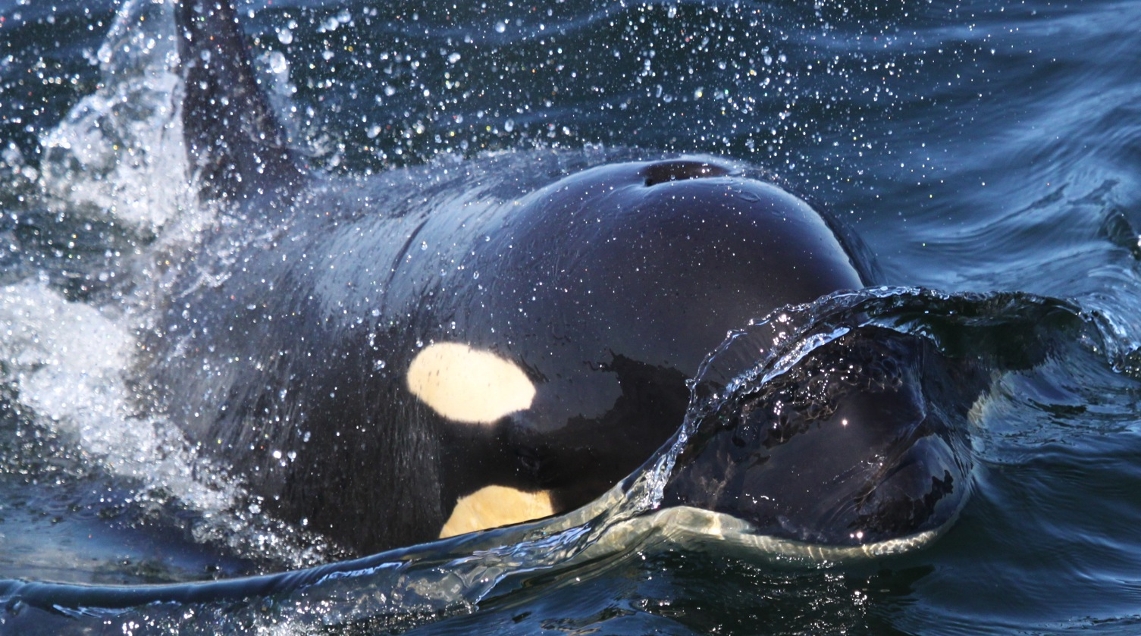
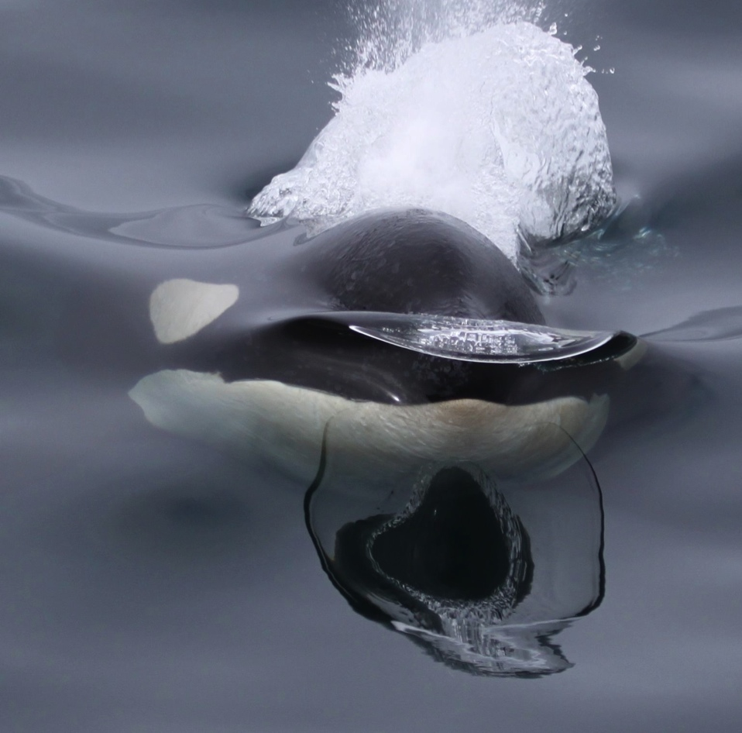
Conclusions
CPUE reductions high (48-68%),% sets affected variable
Depredation avoidance measures costly ~$564/ set
Fishing through the whales expensive ~$433/ set
Depredation avoidance preferred long-term solution

Slide 16


Closing thoughts
Depredation changing the nature of fisheries in western Alaska
  Season timing
  Pot gear in the BS, AI, GOA
  Costly avoidance measures
Killer whale distribution/social learning could facilitate the spread of depredation behavior
Cooperative research and proactive mitigation
I hate killer whales
With their stinking breath
And thrashing tails
They're eating blackcod
Off my hooks
They're nothing but
Tuxedoed crooks.
I hate killer whales
With their stinking breath
And thrashing tails
They're eating blackcod
Off my hooks
They're nothing but
Tuxedoed crooks.
I hate killer whales
With their stinking breath
And thrashing tails
They're eating blackcod
Off my hooks
They're nothing but
Tuxedoed crooks.
And spermwhale breath
Is even worse
As if their apertures
Were reversed
They're killing me
It makes me pine
For Nantucket 1859.
And spermwhale breath
Is even worse
As if their apertures
Were reversed
They're killing me
It makes me pine
For Nantucket 1859.
And spermwhale breath
Is even worse
As if their apertures
Were reversed
They're killing me
It makes me pine
For Nantucket 1859.
I only wish the Japanese
Would do their research
Work on these
And leave those Baleen
Whales alone
STRIKE DEEP!
And take these
Bastards home.
I only wish the Japanese
Would do their research
Work on these
And leave those Baleen
Whales alone
STRIKE DEEP!
And take these
Bastards home.
I only wish the Japanese
Would do their research
Work on these
And leave those Baleen
Whales alone
STRIKE DEEP!
And take these
Bastards home.
-Bill Harrington (longliner)
-Bill Harrington (longliner)
-Bill Harrington (longliner)
Notes:
We were very excited about this analysis- as this represents an entirely new approach to this issue.
These interactions are changing the way longline fisheries are prosecuted in western Alaska.
The timing of fishery operations are being altered- in both the state waters of PWS and the BS Gturbot fishery fishing effort has been pushed later into the year to avoid killer whales.
Pot fishing gear is currently not legal in the GOA, although the Council is revisiting this gear type for the GOA due to largely to whale interactions. In the BS and AI, where pot gear is legal for sablefish. There has been a transition to pot gear, esp in the BS. There is currently discussion within the Council to legalize sablefish pot fishing gear in the GOA- largely due to sperm whale depredation.
Last but not least, new data and studies suggest there a lot more fish-eating killer whales in Western Alaska than we previously thought. Maybe even double… and this distrubiot and killer whale social learning could faciltate the depredation behavior- especially in the Western Gulf even into the Central Gulf.

Slide 17


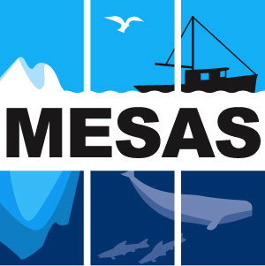
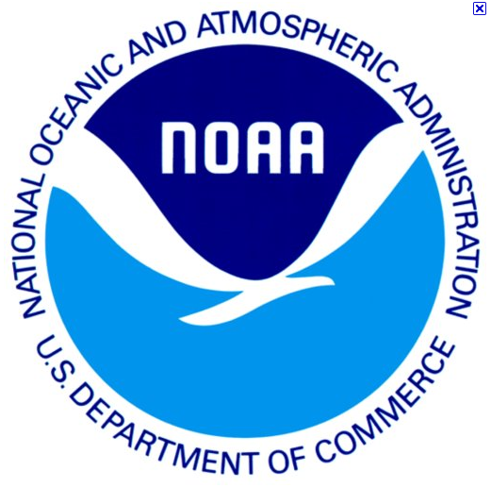
Thanks!
Courtney Carothers (UAF)
Craig Matkin (NGOS)
Chris Lunsford (NOAA)
Dana Hanselman (NOAA)
Cara Rodgveller (NOAA)
Jan Straley (SEASWAP)
Paul Williams (CCFD)
Suzie Teerlink (UAF)
Jason Gasper (NMFS)
Todd Hoppe (F/V Deliverance)
Scott Thorne (F/V Primus)
Jim Hubbard (F/V Kruzof)
M. Offerman (F/V Kristiana)
Bill Harrington (F/V Miss Lori)
Oystein Lone (F/V Sounder)
Pat McBride (F/V Judi B)
*All whale photos taken under Permit # 14122

Slide 18
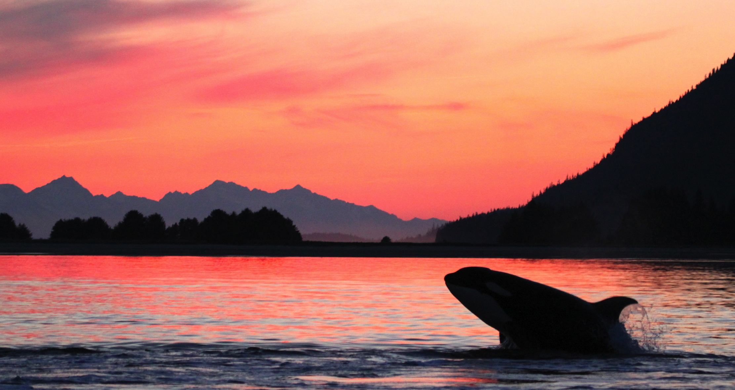
Questions
Questions?

Slide 19
 | Reduction CPUE (kw) | 95% CI (kw) | p-value (kw) | %Dev (kw) | %Dev (full model) | n | % Sets Affected
Sablefish
Bering Sea | 69.3% | 58.3 - 77.3% | p < 0.0001 | 10.8% | 65.9% | 252 | 21.4%
Aleutian Islands | 54.8% | 45.9 - 62.2% | p < 0.0001 | 2.3% | 25.2% | 2614 | 2.3%
Western Gulf of Alaska | 64.8% | 55.9 - 71.9% | p < 0.0001 | 2.2% | 25.6% | 2850 | 1.0%
Greenland turbot
Bering Sea | 53.6% | 50.1 - 56.8% | p < 0.0001 | 6.1% | 35.6% | 4909 | 9.9%
Aleutian Islands | 66.9% | 57.4 - 74.2% | p < 0.0001 | 4.8% | 40.6% | 1006 | 4.5%
Pacific halibut
Bering Sea | 35.1% | 20.7 - 46.7% | p < 0.0001 | 0.1% | 49.7% | 1575 | 6.9%
Aleutian Islands | 56.9% | 36.4 - 70.7% | p < 0.0001 | 0.1% | 38.9% | 1533 | 1.7%
Western Gulf of Alaska | 14.9% | NA | p = 0.45 | 0.0% | 49.9% | 1008 | 1.2%

Slide 20
Additional Distance Traveled | Extended Trip Time (travel and wait time) | Additional Fuel | Additonal Crew Food | Opportunity Cost Not Working | Total Additional Expenditures
Avg per vessel (nm) per season | Avg per vessel (hrs) per season | Avg per vessel per day ($) | Avg per vessel per day ($) | Avg per vessel day ($) | Total ($) | Avg per vessel per season ($) | Avg per vessel per day ($)
204 nm | 162 hrs | $411 | $83 | $486 | $45,685 | $9,137 | $802

