Slide 1
SEASWAP Real Time Network
© SEASWAP, NOAA permit # 14122
www.seaswap.info
(907) 738-4494
seaswap03@gmail.com
This publication is supported in part by funds from NOAA Award # NA15NMF4270271. The statements, findings, conclusions and recommendations are those of the authors and do not necessarily reflect the views of NOAA or the Dept. of Commerce.
Notes:
PERMIT NUMBER

Slide 2
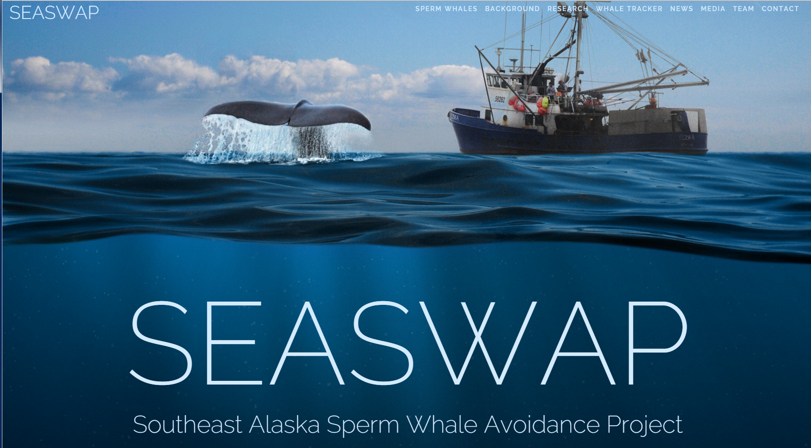
SEASWAP Overview
Formed in 2003 to address the issue of sperm whale depredation on commercial fishing gear in the Gulf of Alaska
GOAL: Collaboration between scientists, fishermen, and managers to understand and reduce removal of catch from fishing gear
Ongoing – we always welcome feedback and suggestions!
WWW.SEASWAP.info
Notes:
Check out website for more info!
Always welcome feedback from fishermen

Slide 3
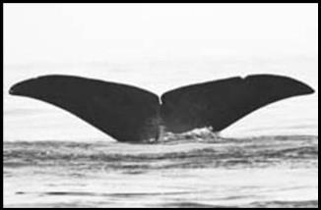
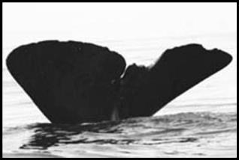
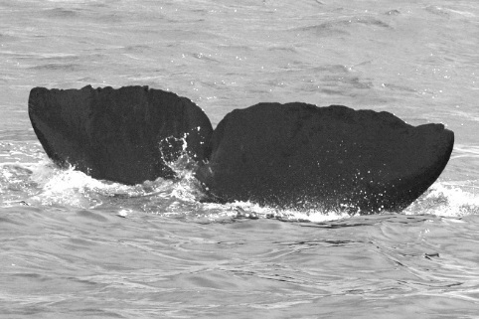
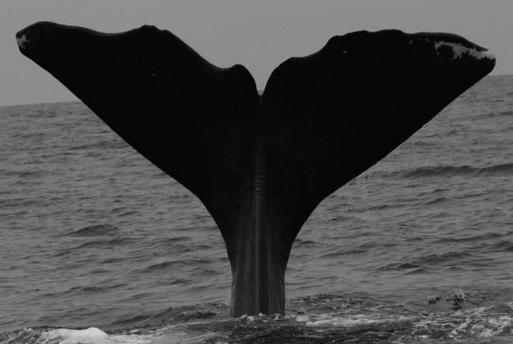
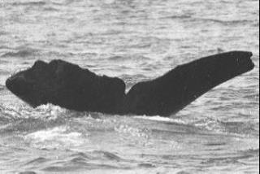
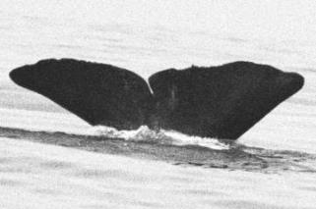
Repeat Depredators
Individual whales are identifiable by cuts and nicks on flukes and dorsal fins
120 individual sperm whales in our photo ID catalog (GOA), but 11-12 individuals account for most sightings due to prevalence near vessels and depredation
© SEASWAP, NOAA permit # 14122
© SEASWAP, NOAA permit # 14122
© SEASWAP, NOAA permit # 14122
© SEASWAP, NOAA permit # 14122
© SEASWAP, NOAA permit # 14122
© SEASWAP, NOAA permit # 14122
Notes:
As you probably know, sperm whales can be individually recognized by markings on their head, bodies dorsal fins, and mostly by the unique pattern of their flukes.
We currently have about 120 whales in our catalog, and if you’d like to check it out in full, feel free to stop by our office next door after the meeting today or during a break and we can show you more of these whales, and some of the gadgets we’re using on them.

Slide 4
Tagging results
One whale (ID: GOA-091) tagged on September 13th near Takatz Bay
GOA-091 is a repeat depredator – has been tagged in 2010 and 2014, and has ben seen repeatedly in Chatham
Tag transmitted until October 30th (46 days)
GOA-091 travelled 1918 miles, an average of 42 miles a day
Minimum of 4 whales (including GOA-091) in Chatham over longlining season
© SEASWAP, NOAA permit # 14122
© SEASWAP, NOAA permit # 14122
Notes:
Talk about map – into Chatham twice, went up into Lynn Canal, circumnav Baranof and Chichagof through Icy Strait and cross sound, went down into Dixon entrance

Slide 5
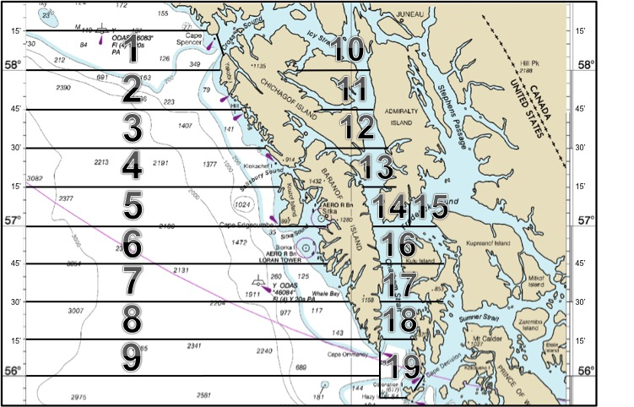
Sperm Whale Avoidance Network
Inreach devices, cell phones, and satellite phones
ALFA provided 10 Inreaches to check out
Participants reported their location and presence or absence of whales twice daily to the shore-based coordinator
Fishermen also reported all whale sightings as soon as they occurred
Participants then received twice daily reports of whale activity
Tagged whale locations were given as exact locations, participant reports were anonymous and generalized by region to protect confidentiality

Slide 6
Communication Network Results
48 permit holders representing 34 vessels participated to some degree
63% of the active fleet!
117 field reports from 28 vessels over the season
13 visual reports of sperm whales in Chatham from 10 vessels
Only 3 participating vessels had catch removed from gear by sperm whales
91% of participating vessels successfully avoided depredation
© SEASWAP, NOAA permit # 14122
Notes:
79 total permit holders and 54 total vessels

Slide 7
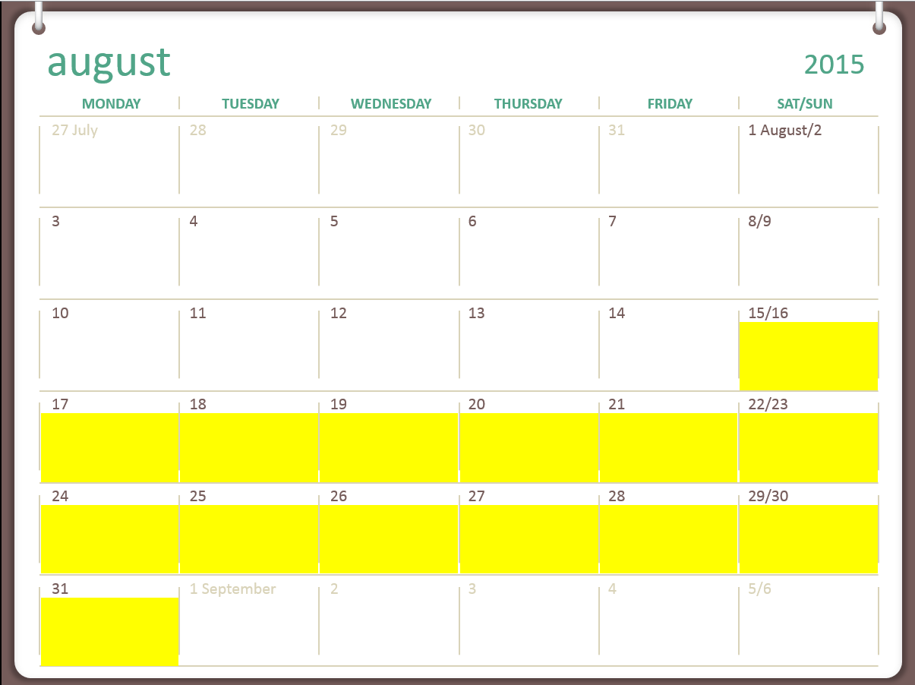
Full fleet catch and whale activity
2 whales in Chatham
Chatham Strait divided into 4 regions to represent pounds of sablefish landed:
Northern
Central
Southern
Frederick Sound
Whale locations from:
Researchers tagging and monitoring with acoustics
Reports from fishermen
Satellite tag locations
36, 475 lb
76,393 lb
0 lb
5,2899 lb
Notes:
Label regions

Slide 8
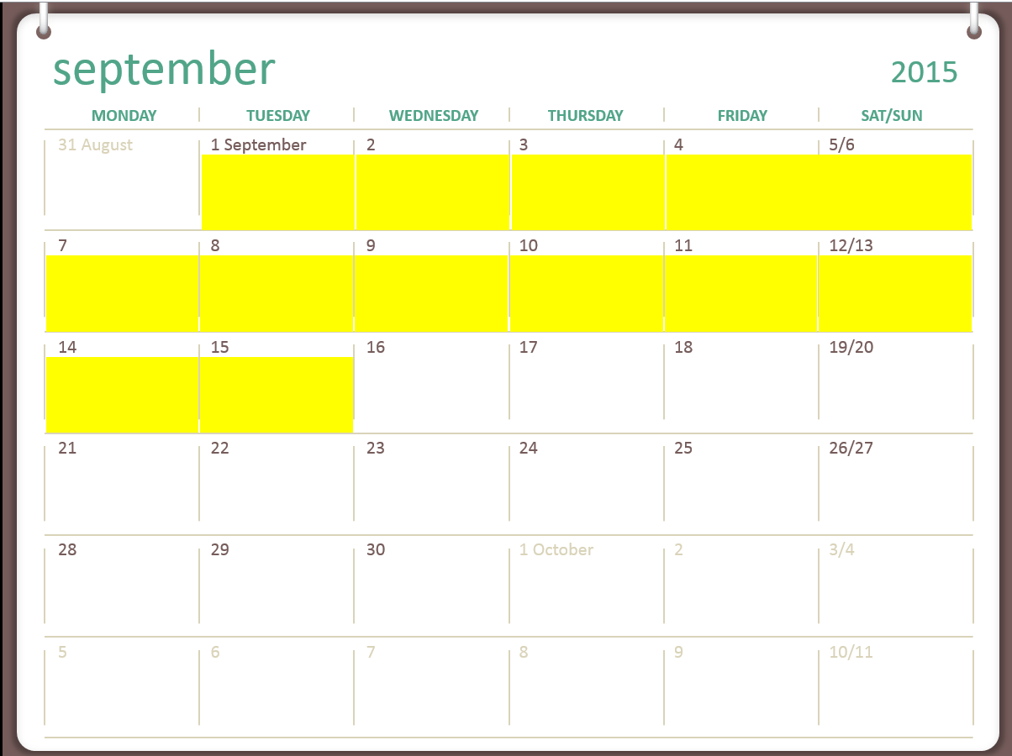
2 whales in Chatham
24,952 lb
53,347 lb
20,974 lb
75,599 lb

Slide 9
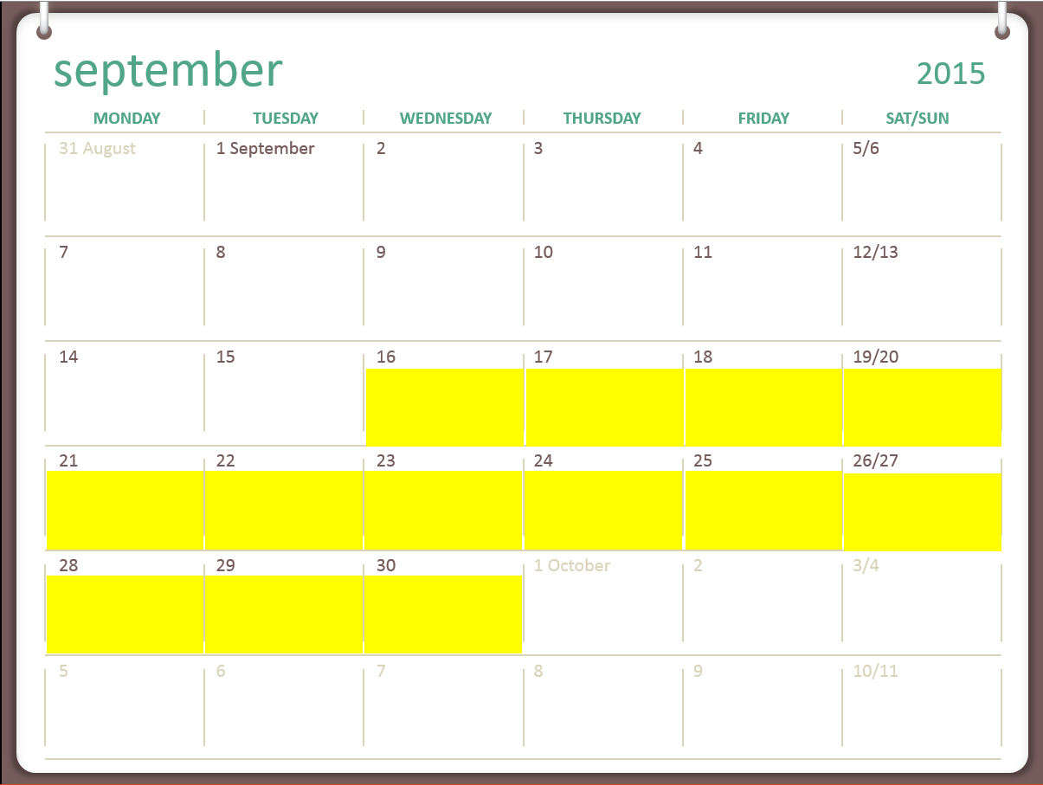
4 whales in Chatham
24,314 lb
77,059 lb
11,725 lb
34,644 lb

Slide 10
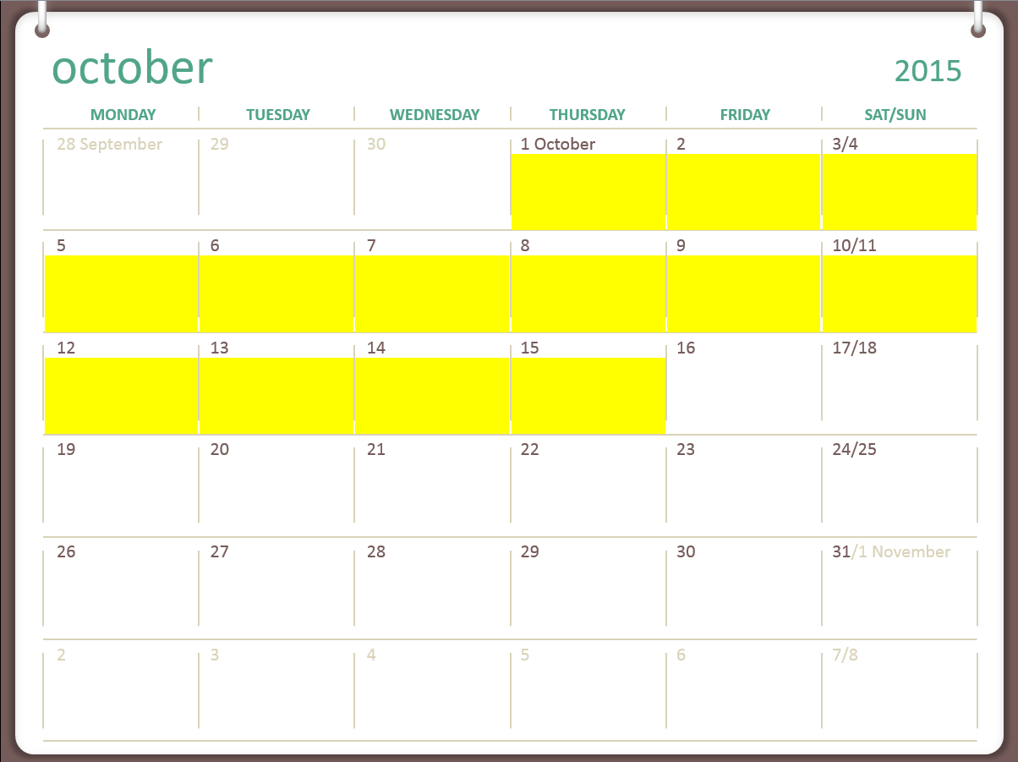
2 whales in Chatham
41,063 lb
40,491 lb
0 lb
42,923 lb

Slide 11
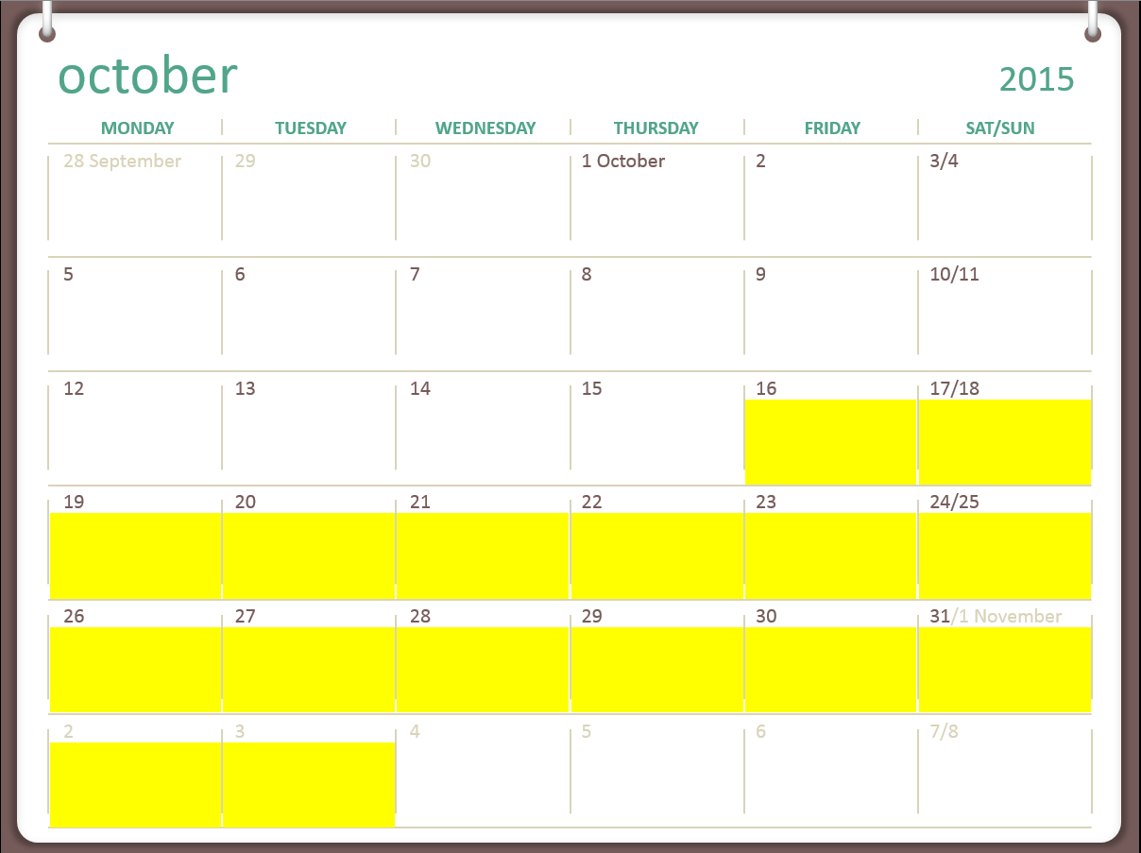
1 whale in Chatham
2 whales in Stephen’s Passage
18,251 lb
54,568 b
0 lb
0 lb
Notes:
Not goa 091

Slide 12
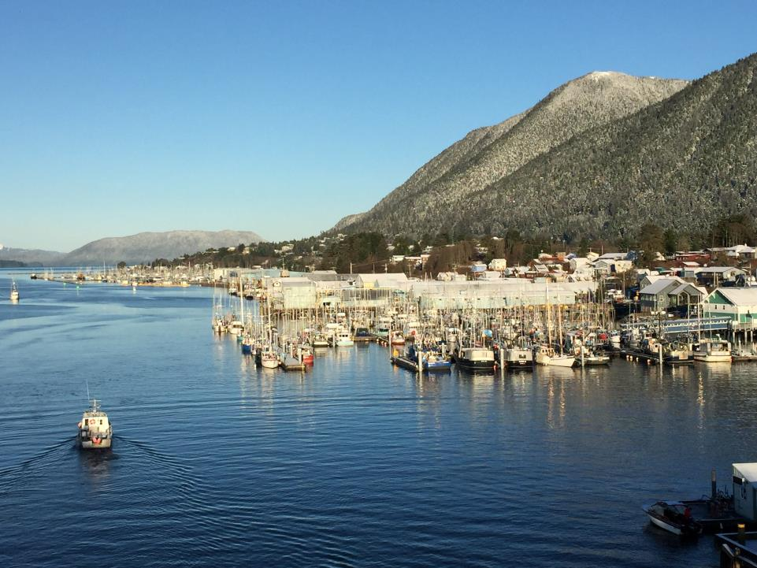

Slide 13
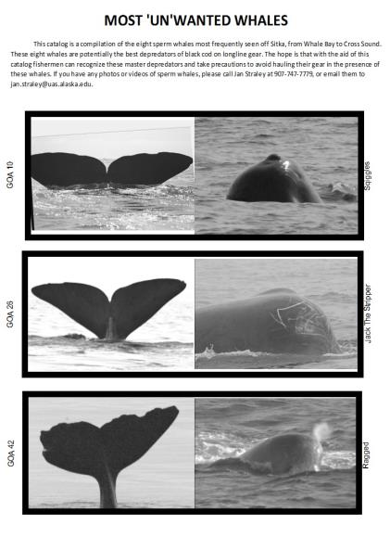
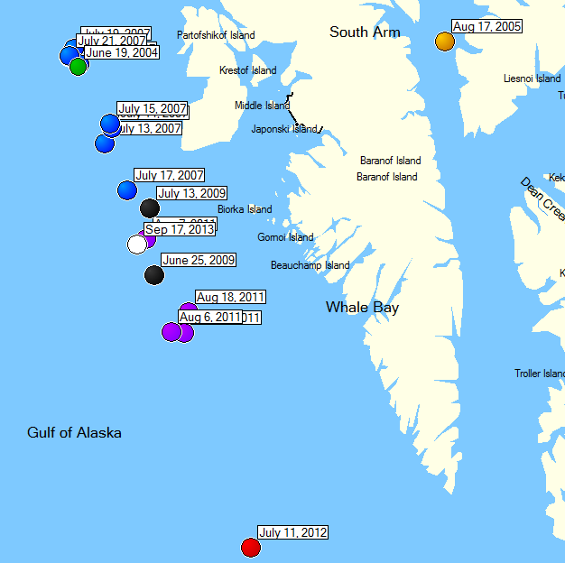
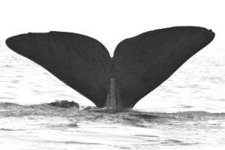
Serial Depredators: Most “Un”Wanted Whales
Jack the Stripper
Seen 9 out of the last 10 years – always close to Sitka
Notes:
Although photoID suggests that there are about 120 sperm whales that have associated with vessels in Southeast Alaska, less than 15 of them account for the vast majority of the interactions with longline vessels, and so we are interested in seeing if we can track the whereabouts of these “bad boys” and give the fishermen the info they need to potentially avoid costly depredation interactions.
Jan’s photo ID work has resulted in 120 whales in the current catalog, and a Bayesian estimate of about 130 individual whales, all apparently adult males, that are engaging in depredation of the fishery off of Sitka

Slide 14
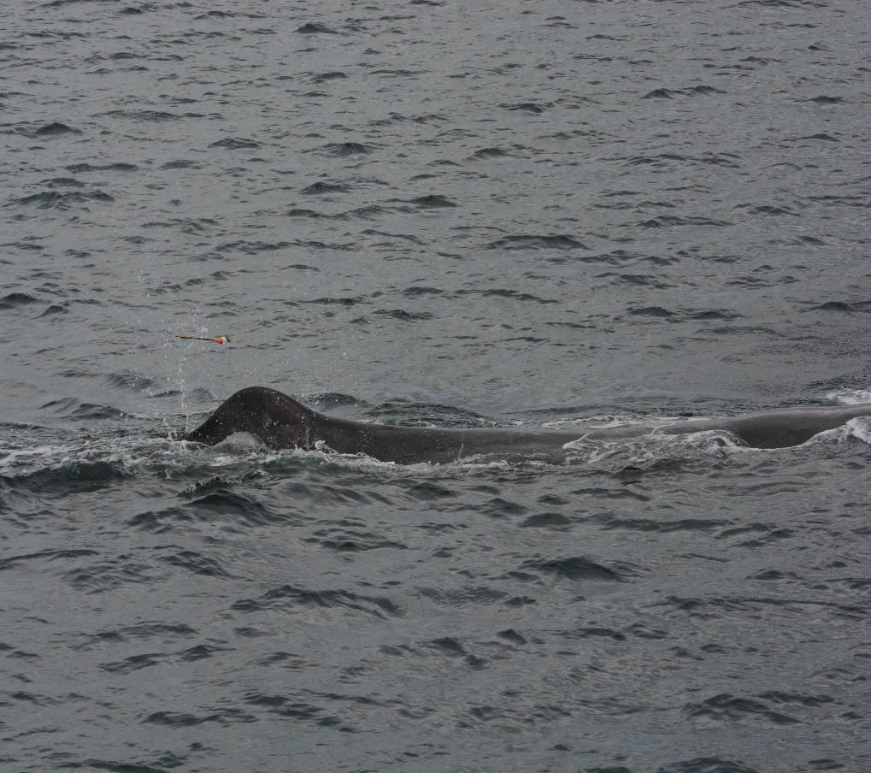
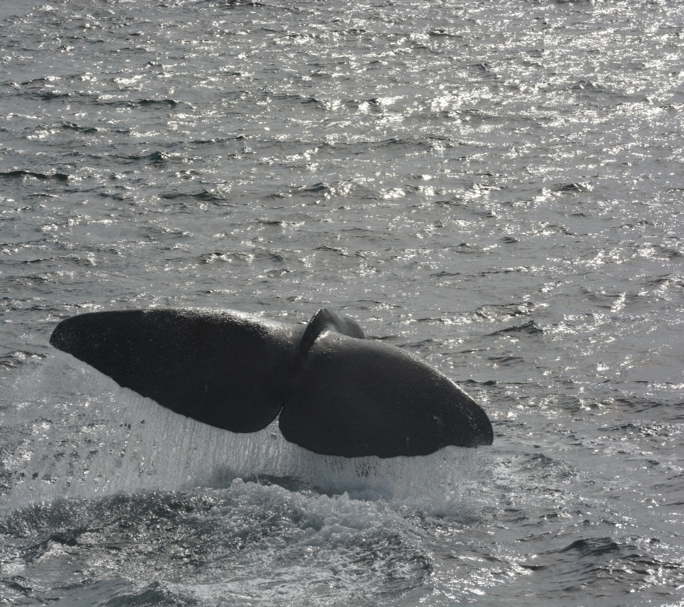
Plans for the future
Satellite tagging of sperm whales before/during the 2016 Chatham opening; continuing with the Sperm Whale Avoidance Network
Expanding the communication network to offshore
ALFA has 10 In-reach devices to check out; we can also reimburse part of the cost of your own In-reach
Towed-array sonar project
© SEASWAP, NOAA permit # 14122
www.SEASWAP.info
(907) 738-4494
seaswap03@gmail.com
© SEASWAP, NOAA permit # 14122
Notes:
If you were not involved in 2015 and would like to be involved in 2016, we are passing around a sign up roster in order to get more info, also come talk to me!

Slide 15
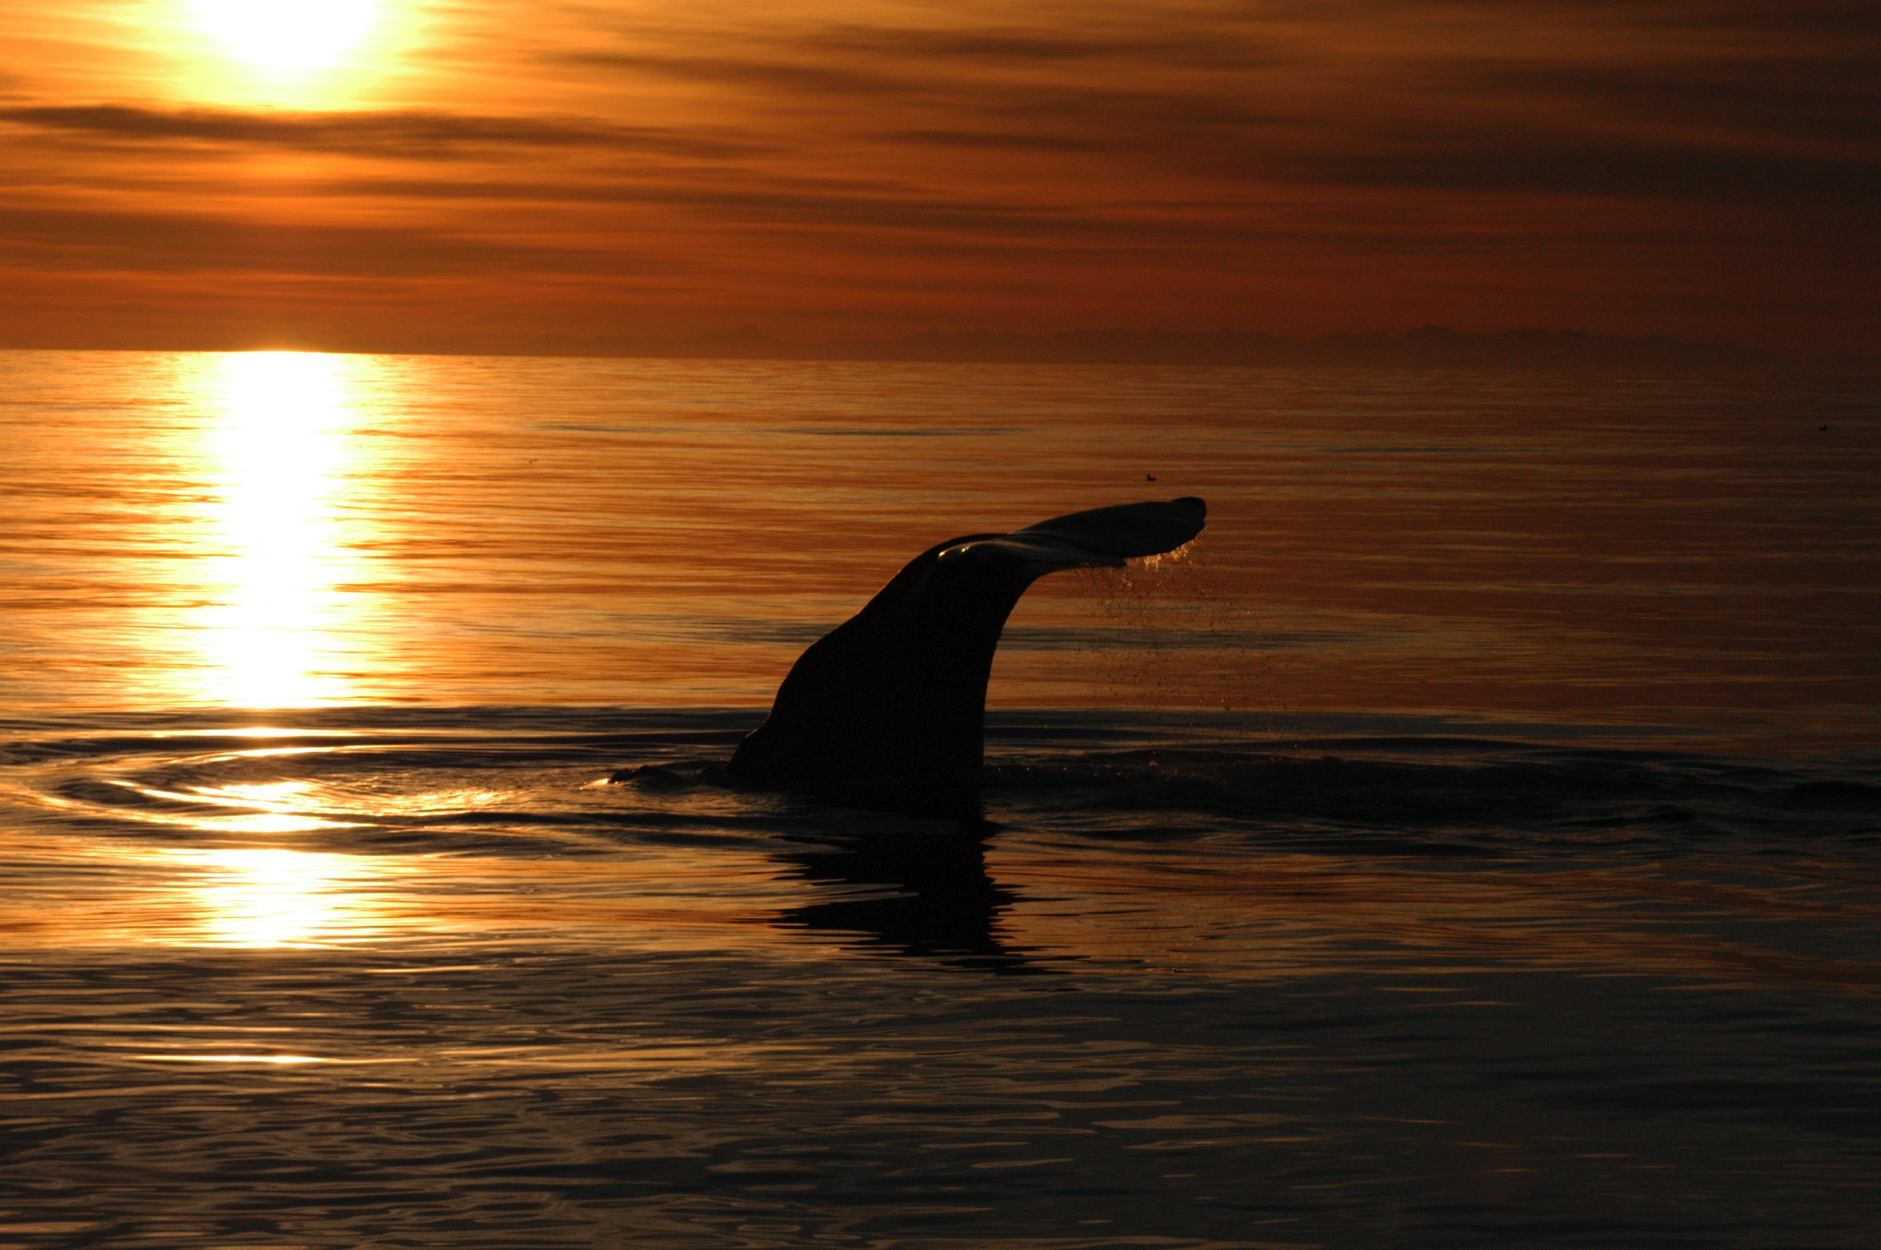
What we learned
Whales travel freely in and out of Chatham Strait
The number of whales in Chatham varies over the season
Whales in Chatham are not always depredating vessels, may be natural foraging
Whales may spend more time in shallow areas and inside waters than previously thought
© SEASWAP, NOAA permit # 14122

Slide 16
Footage courtesy of BBC Two: Alaska: Earth’s Frozen Kingdom, Spring;
Notes:
I’m not sure I explained that very well, and these things always sound better with a British Accent, so in 2014 we worked with the BBC on film that highlighted this sperm whale – fishermen interaction.
Sperm whale diving down, plucking fish off line

Slide 17
Notes:
Hooks, and heads.

Slide 18
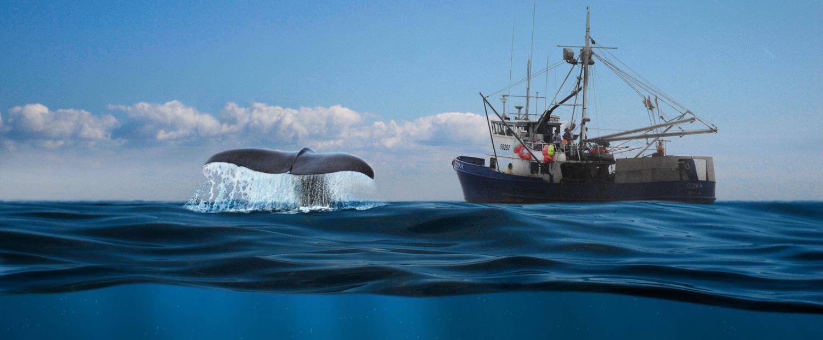
A Whale of a Problem
SEASWAP:
Southeast Alaska Sperm Whale Avoidance Project
Goals & Objectives
Biology of sperm whales in the GOA
Spatial and temporal patterns of whales and fishing behavior (interactions)
Determine cues whales are using to find vessels
Cooperatively work to reduce depredation

Slide 19
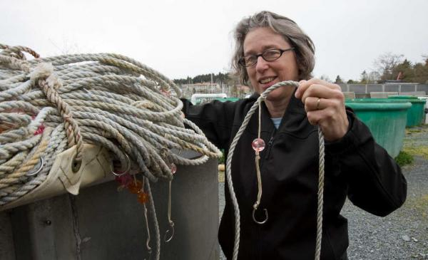
O’Connell, Straley, Liddle, Wild, Behnken, Falvey, Thode (2015). ICES J. Mar. Sci. 72:1667-1672
Notes:
Many solutions have been conceived and implemented, for example plastic beads near each hook – the beads reflect the sperm whale’s echolocation clicks similarly to a black cod, hopefully making it hard for the whales to recognize which hooks have black cod on them.

Slide 20
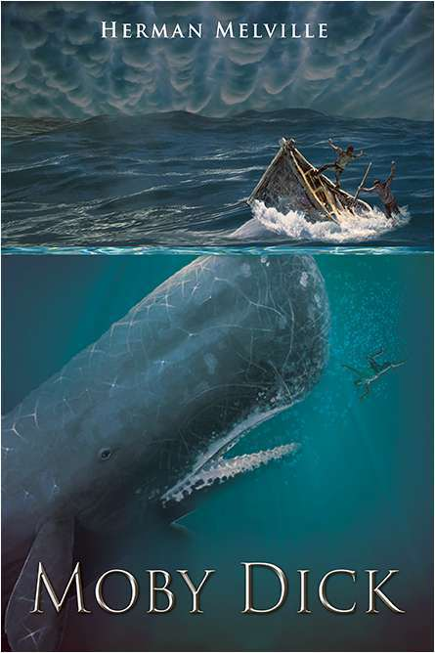
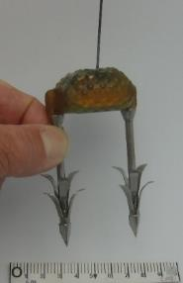
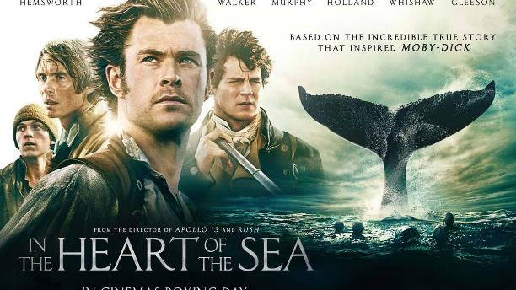

Slide 22
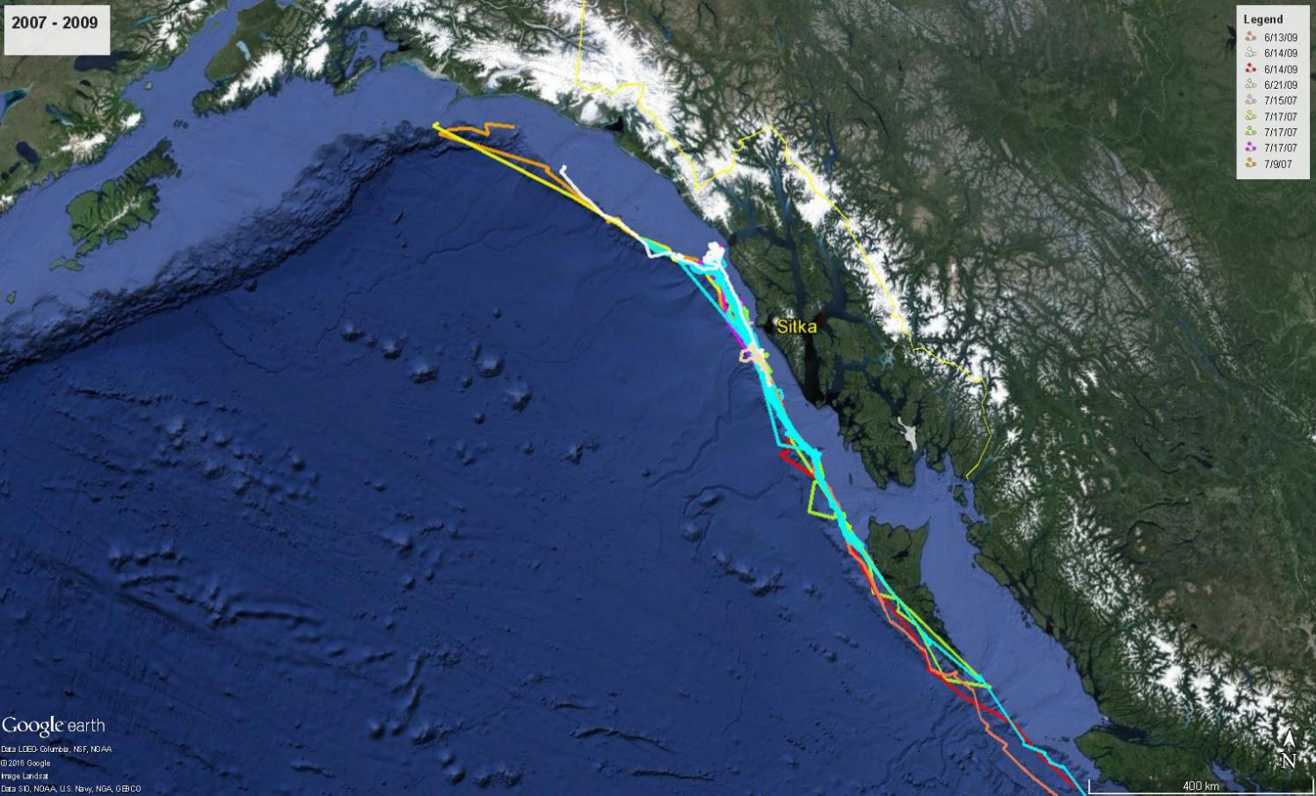
70 to 100% of each whale’s locations were over the slope

Slide 23
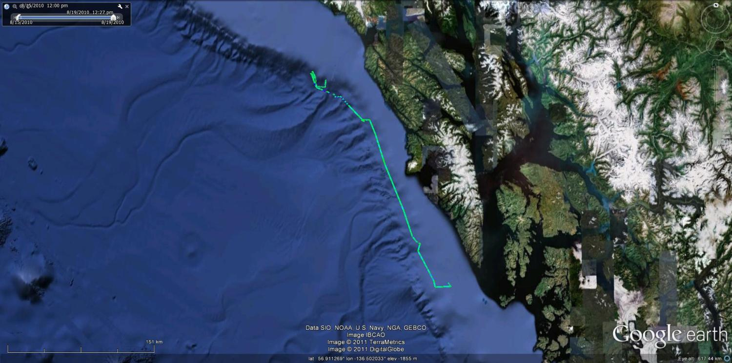
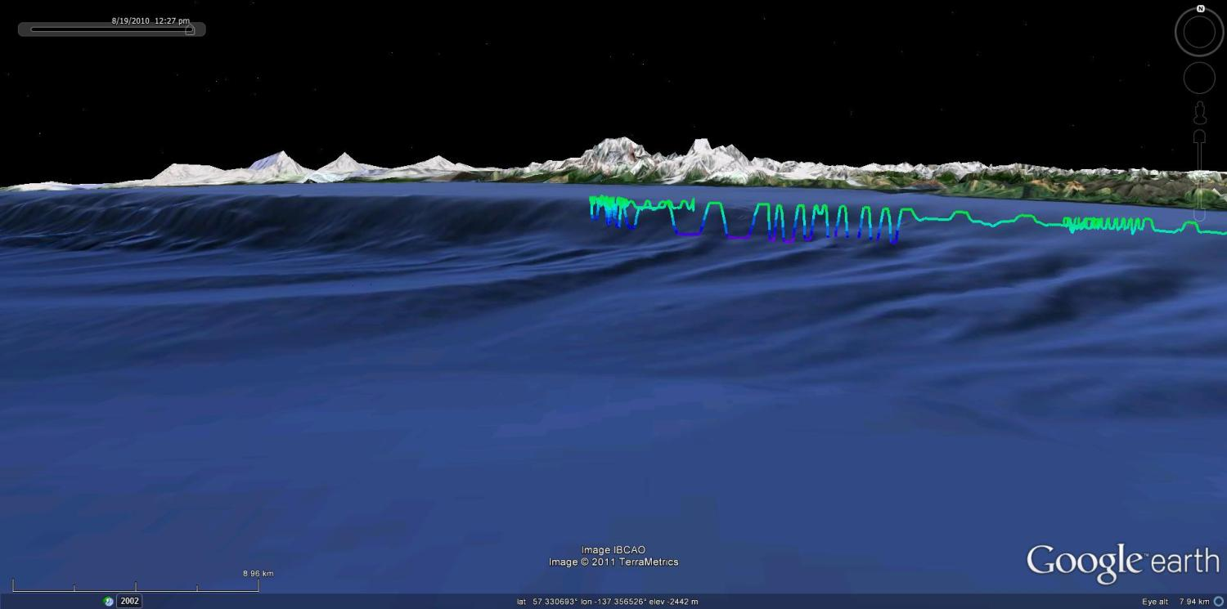
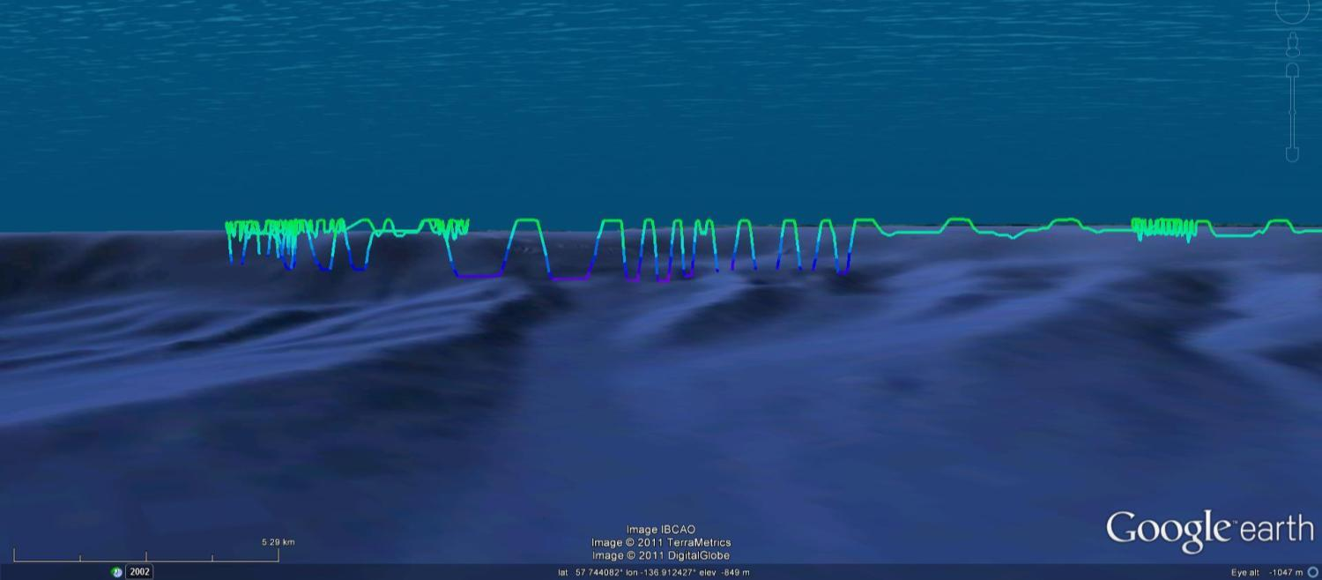

Slide 25
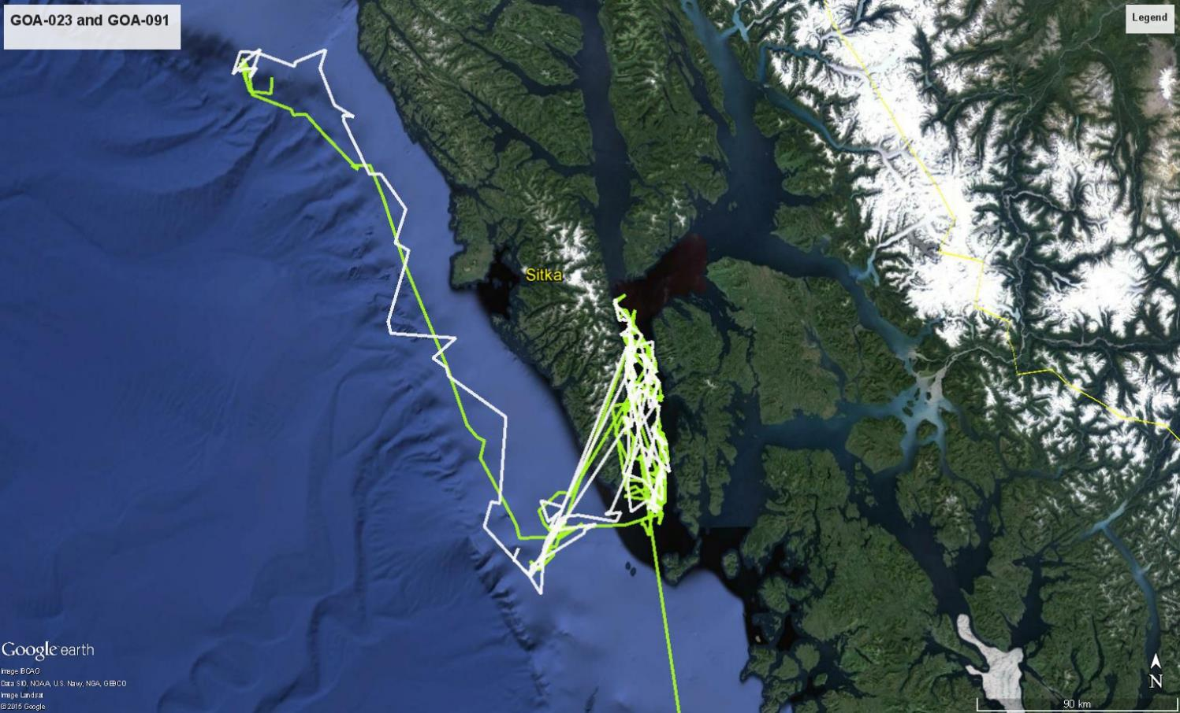
GOA-091 and GOA-023
2010
Notes:
They traveled in tandem but not close together for over two months documenting Site fidelity and association
There is a state regulated blackcod fishery Aug. 15 to Nov. 15.
It turns out that before 2008, there are no confirmed reports of sperm whales in Chatham Strait

Slide 26
Notes:
Spent all day in a little zodiac waiting for these whales to give us the chance to approach for tagging, but despite taking a tremendous amount of black cod off of a longlinger all day long, they just weren’t distracted enough. However, perhaps because of gorging themselves, shortly before sunset they started relaxing at the surface and allowed us to drive right up in a fishing vessel and get a couple tags on.

Slide 27
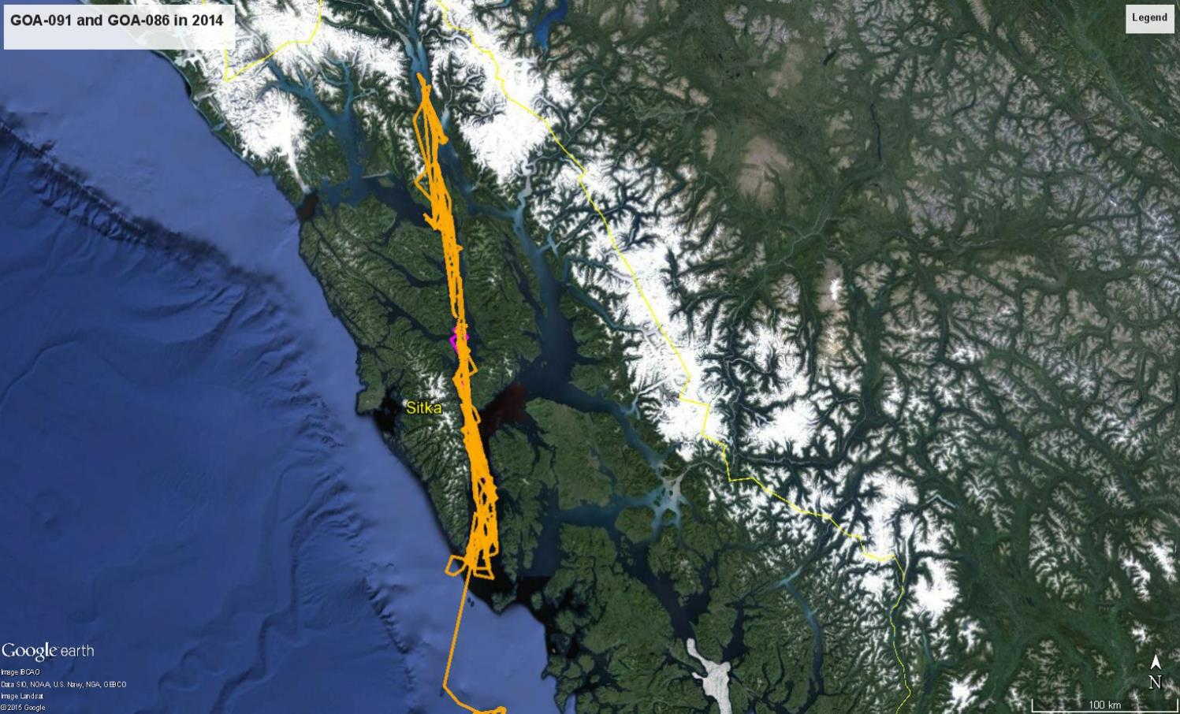
GOA-091 and GOA-086 and GOA-023
2014
Whales tagged 16Sep2014
― GOA-091 (duration 6 d)
― GOA-086 (duration 4 months)
GOA-023 Not tagged but observed with others until late October (30+ days)
Notes:
In 2014 two whales were tagged in Chatham Strait of three whales who were associating in the same area. GOA91’s tag stopped transmitting after 6 days but GOA-86 spent all fall and most of the winter in upper Lynn Canal.
Not just following longliner and depredating. Learning to use new habitat.
Swsat27 GOA-091 SWsat27_GOA-091 16-Sep-2014 18:04 to 22-Sep-2014 18:52
SWsat26 GOA-086 SWsat26_GOA-086 16-Sep-2014 17:14 to 27-Feb-2015 15:03 (164 days)

Slide 28
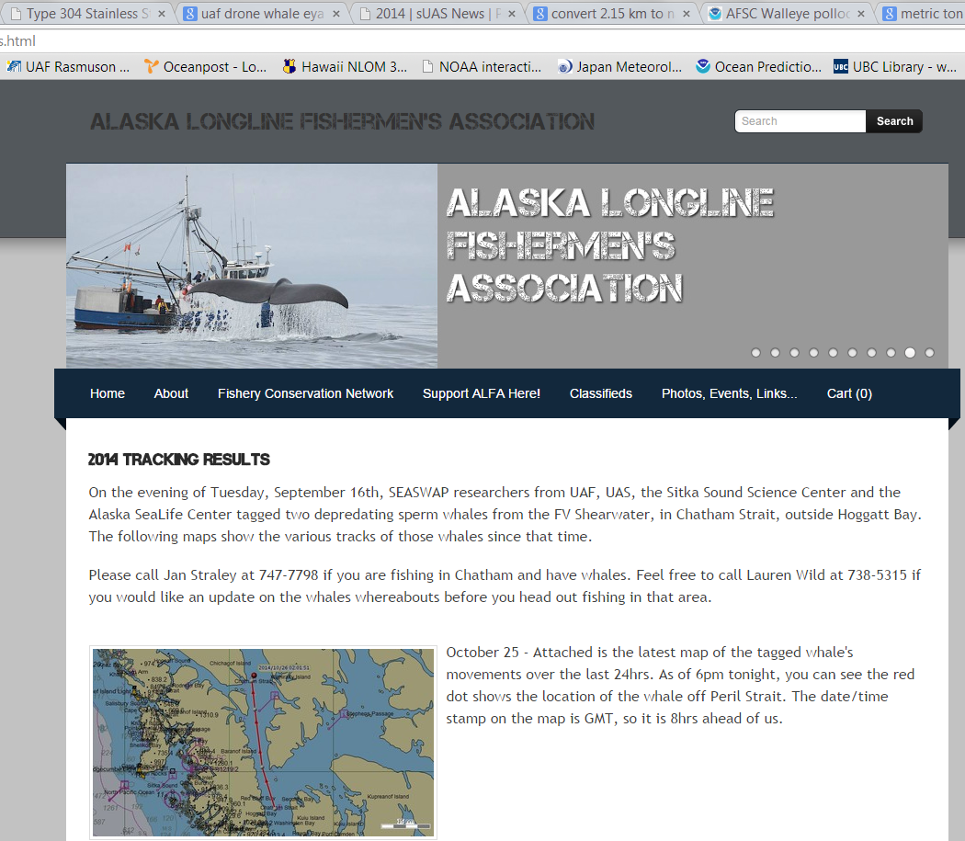

Slide 29
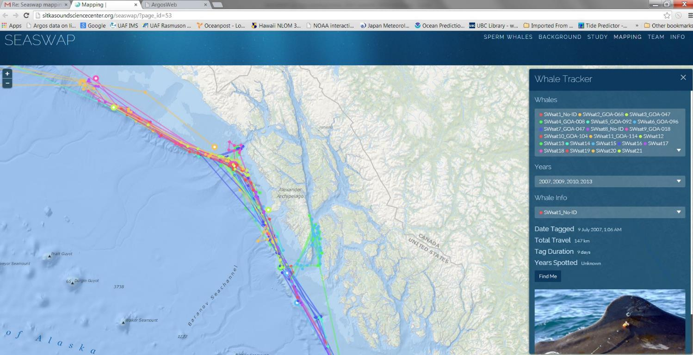
seaswap.info/whaletracker
Notes:
9 fishermen requested info and were informed of tagged whale’s whereabouts, and they all reported having used that info to successfully avoid sperm whale interactions.

Slide 30
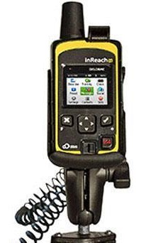
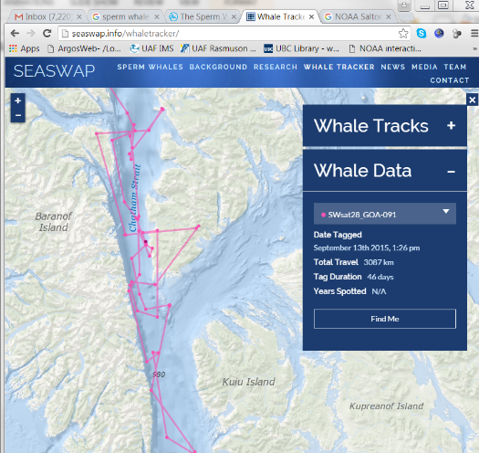
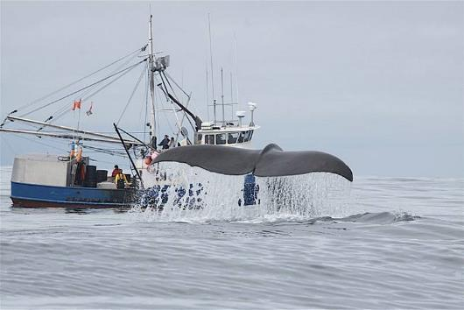
Reducing sperm whale – longline fisheries interactions: enabling fishermen to use avoidance through real-time updates from satellite tags and fishermen reports.
PIs: Tory O’Connell (SSSC), Jan Straley (UAS), and Russ Andrews (UAF & ASLC).
Funding: NOAA Saltonstall-Kennedy Grant Program

Slide 31
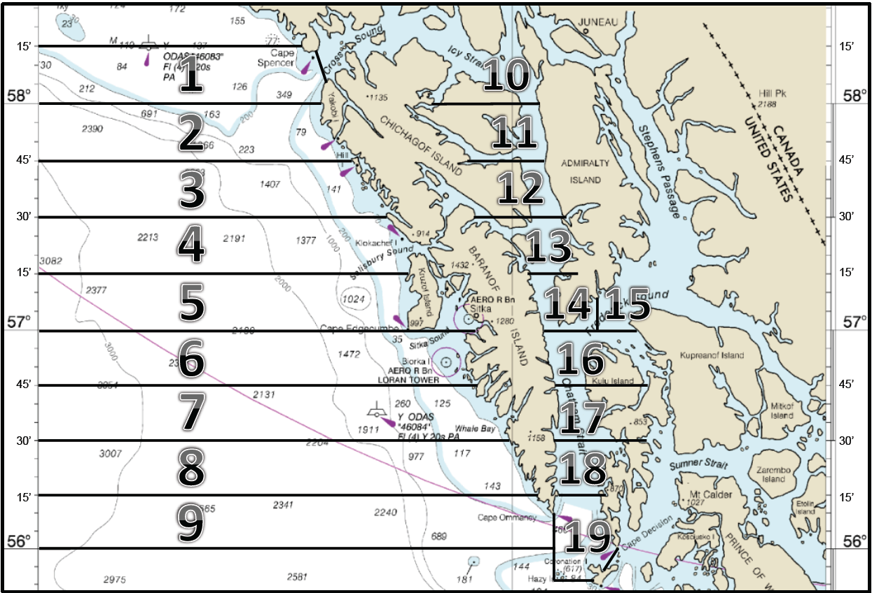
Notes:
Goal was to recruit at least 30% of the fleet to participate in the reporting network – successful!

Slide 32
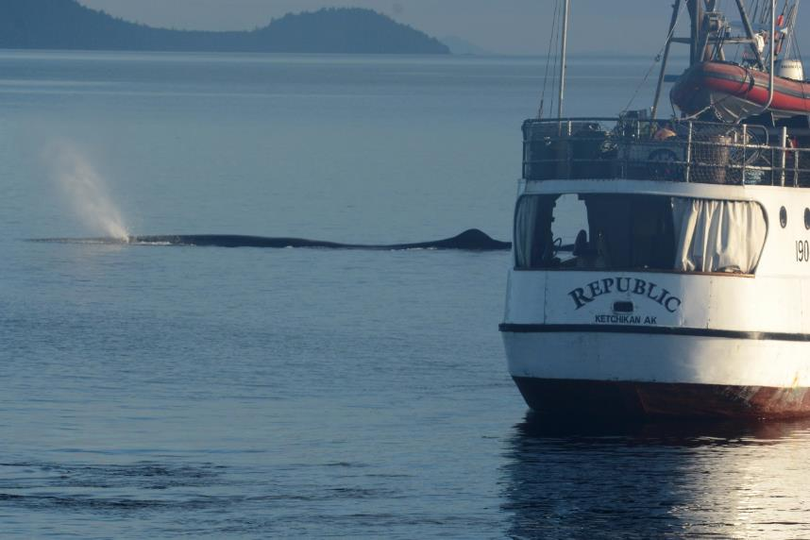
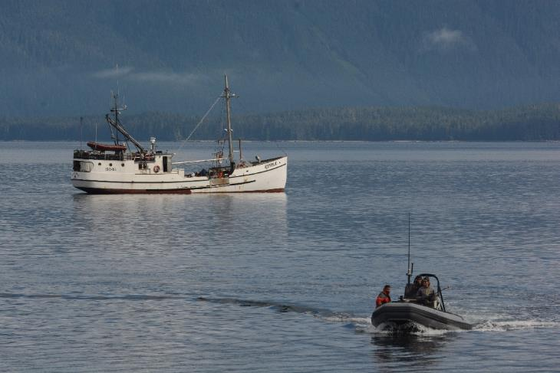
Notes:
GOA-091 AND GOA-023 were first whales – both tagged in previous years, hard to get close to.
Dewey Torgeson

Slide 34
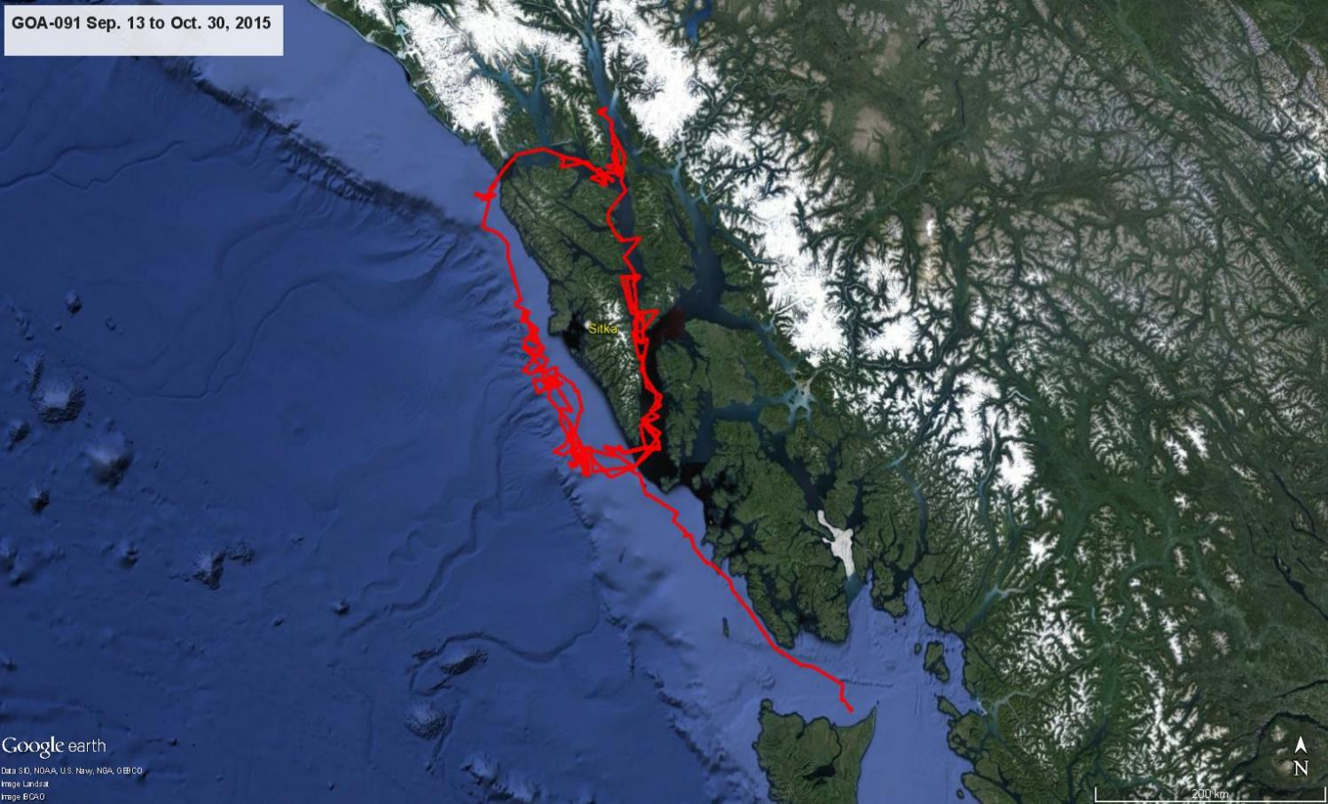
GOA-091 and GOA-023
2015
― GOA-091 in 2015
-GOA-091 in area
30+ days
GOA-023 not tagged but observed with GOA-091 for at least
14 days
Notes:
Although we had hoped to tag all the whales that were in Chatham, the 3 that spent the most time there appeared to mostly travel with the tagged whale.
We exceeded our goal of getting 30% of the fleet to participate. Now just need to do 2nd season and determine efficacy.
SWsat26 GOA-086 SWsat26_GOA-086 16-Sep-2014 17:14 to 27-Feb-2015 15:03 (164 days)
SWsat28 GOA-091 SWsat28_GOA-091 13-Sep-2015 13:26 to 30-Oct-2015 12:38 (47 days)

Slide 35
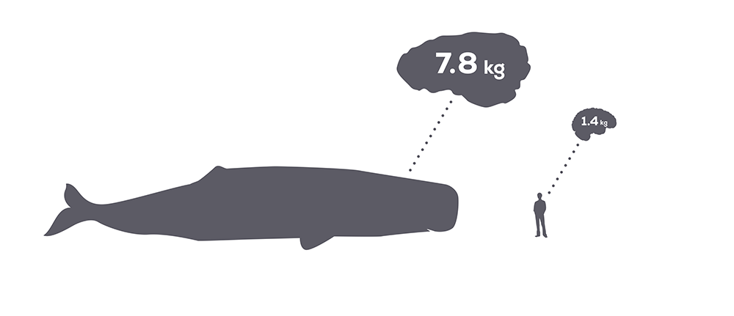
Sperm whale brain:
My puny brain:

Slide 36
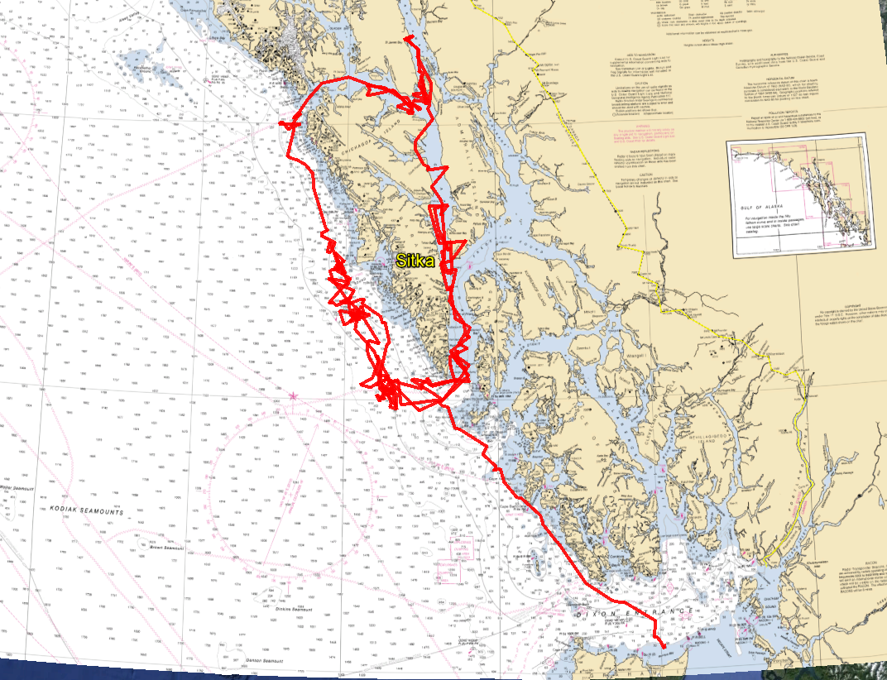

Slide 37
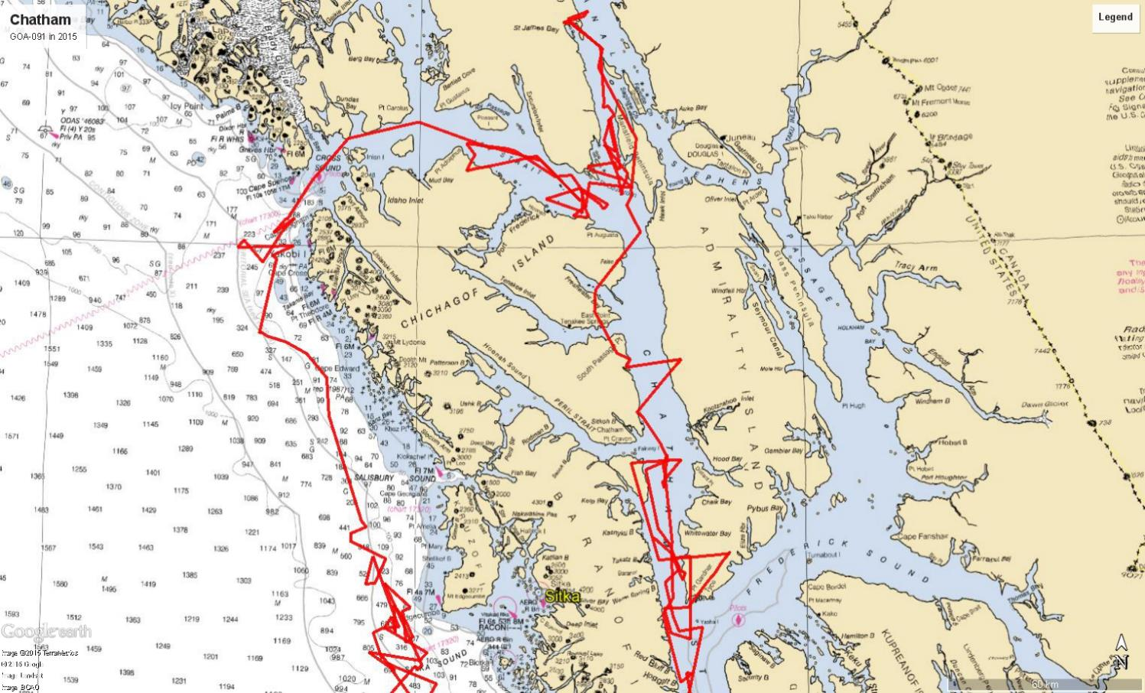

Slide 38
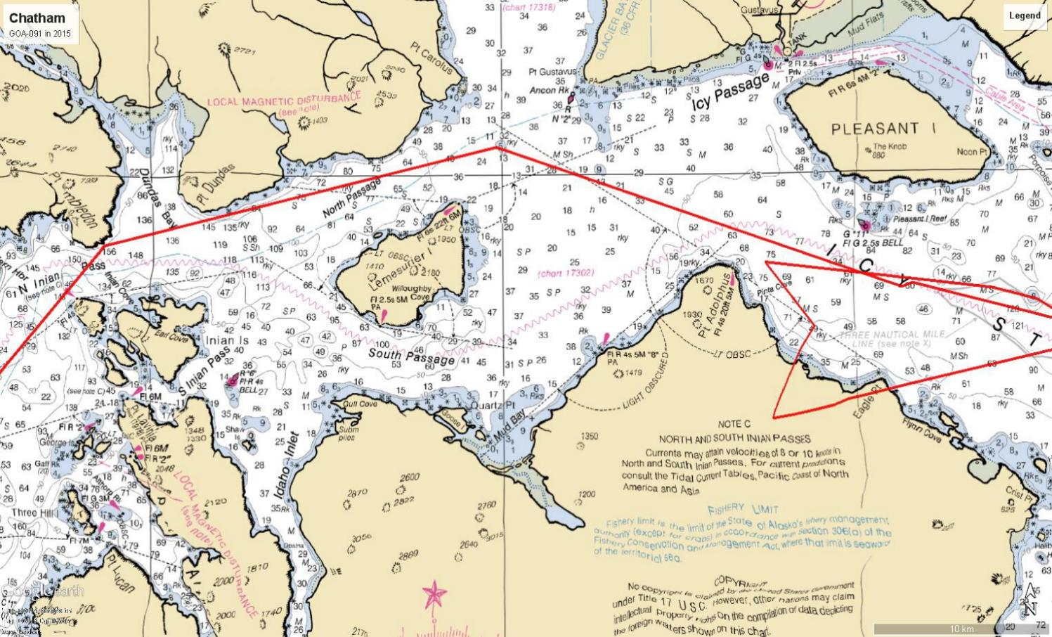

Slide 39
Acknowledgements:
Neve Baker, Lauren Bell, John Calambokidis, Jen Cedarleaf, Kendall Folkert, Madison Kosma, Kyle Kosma, Delphine Mathias, Sarah Mesnick, John Moran, Paul Norwood, Stephen Rhoads, Zachary Schakner, Greg Schorr, Fred Sharpe, J.J. Vollenweider, Nellie Warner & crews of F/V Magia, F/V Cobra, F/V Ocean Prowler, F/V Alaskan Leader, F/V Northwest Explorer, F/V Shearwater, M/V Surveyor and M/V Nepenthe
Funding:
NOAA grants (to AFSC, SSSC, UAS and ASLC)
North Pacific Research Board (to UAS, Scripps, ALFA)
NOAA Fisheries TSMRI Auke Bay Lab sablefish assessment program (UAS, ASLC)
E&P Sound and Marine Life Program JIP (SIO)
Office of Naval Research (improvements to tagging methods; ASLC)
Central Bering Sea Fishermen’s Association & Alaska Longline Fishermen’s Assoc.
Some of the organizations participating in SEASWAP:
Alaska Longline Fishermen’s Association
Petersburg Vessel Owner’s Association
University of Alaska Southeast
University of Alaska Fairbanks
Alaska SeaLife Center
Alaska Department of Fish and Game
NOAA Fisheries
International Pacific Halibut Commission
Cascadia Research Collective
Sitka Sound Science Center
North Pacific Fishery Management Council
Scripps Institution of Oceanography
North Pacific Research Board
Fishing Vessel Owner’s Association
National Geographic Society
Alaska Sea Grant
Marine Conservation Alliance

