Slide 1
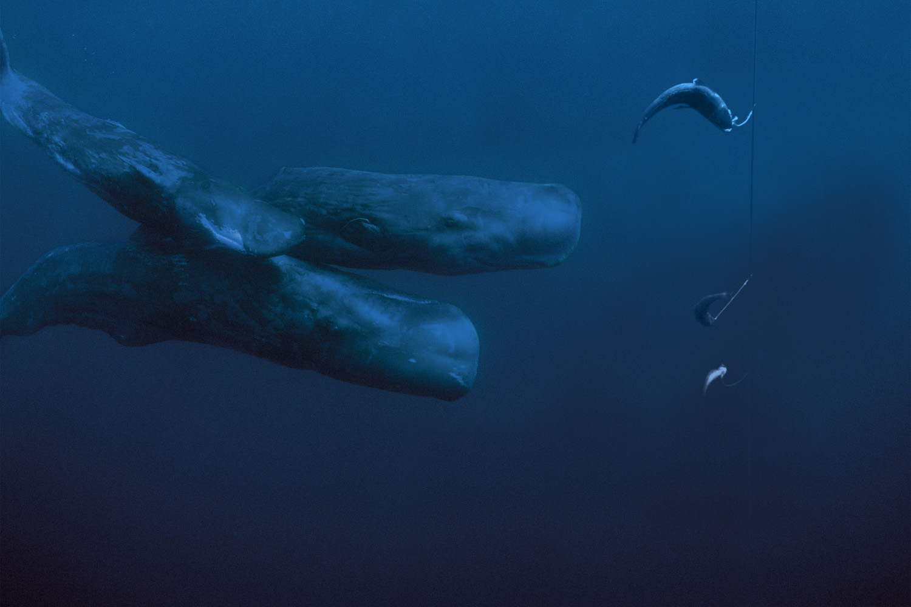






Hobart, 12/04/2018
The potential of fisheries interaction data to model the distribution of sperm whales in the Southern Ocean
Paul Tixier¹, Mary Anne Lea², Mark Hindell², Dirk Welsford³, Rhys Arangio⁴, John Arnould¹
¹School of Life and Environmental Sciences, Deakin University, Burwood, Australia
²Institute for Marine and Antarctic Studies, University of Tasmania, Hobart, Tasmania, Australia
³Australian Antarctic Division, Kingston, Tasmania, Australia
⁴Coalition of Legal Toothfish Operators (COLTO), Perth, Western Australia
Australian Research Council Research Linkage Project 2017-2020

Slide 2
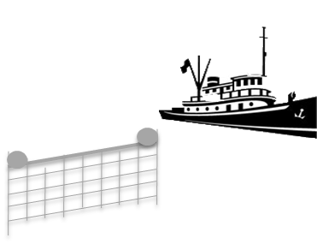
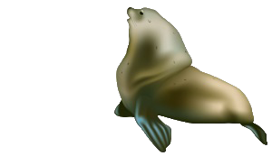
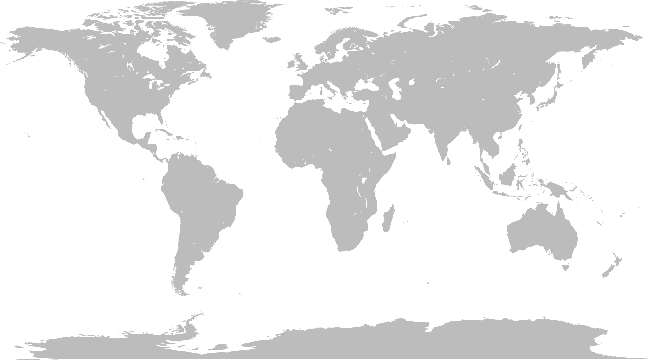
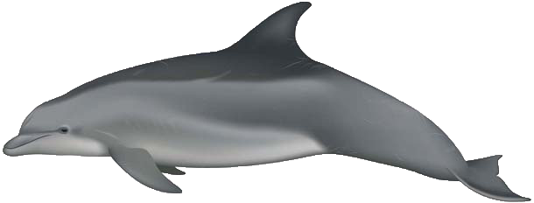
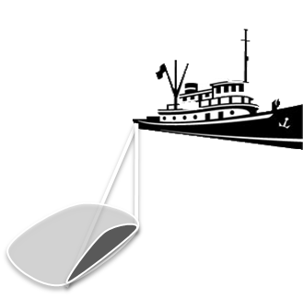
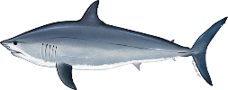
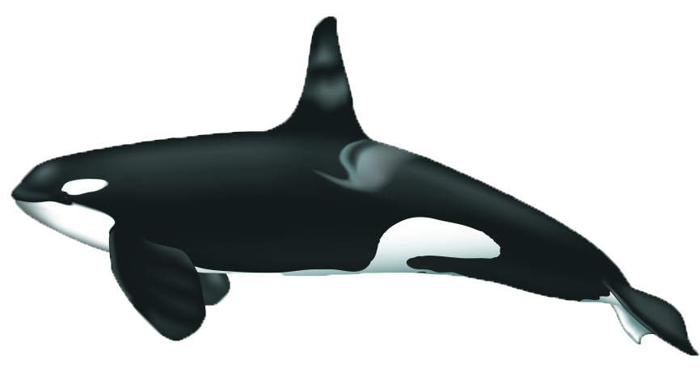
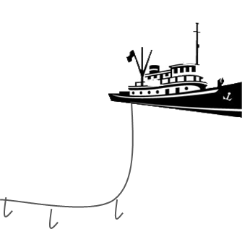
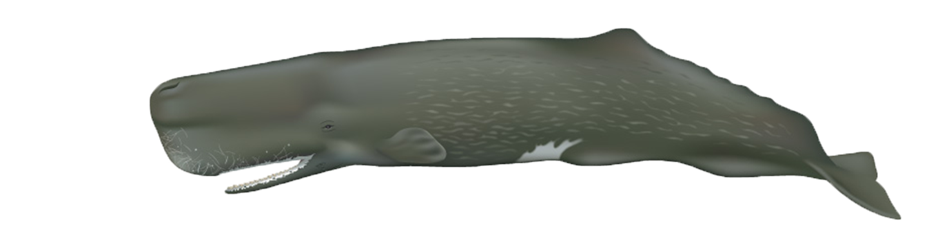
Marine predators – fisheries interactions
Depredation interactions: animals feed on fish caught on fishing gear

Slide 3
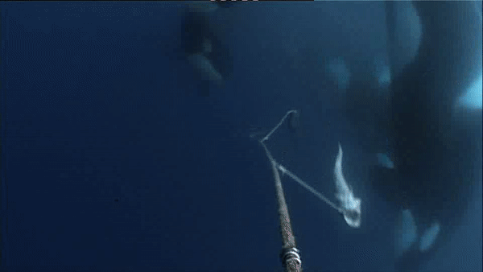
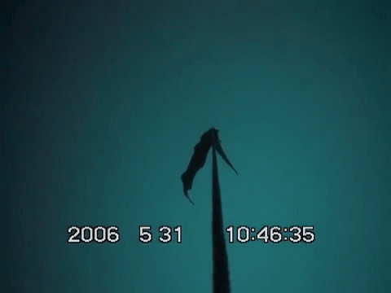
High latitudes
Demersal longline fishing most impacted
Orcinus orca
Physeter macrocephalus
Saint Thomas prod.
Seaswap
Consequences on:
Whale populations
Fish stocks
Fishing activity
Hamer et al. 2012, Gasco et al. 2015, Tixier et al. 2015, 2017

Slide 4
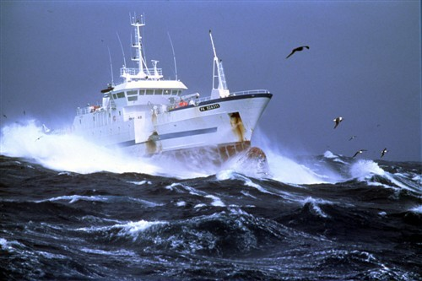
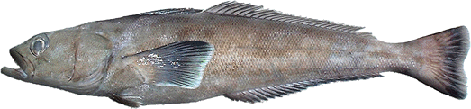
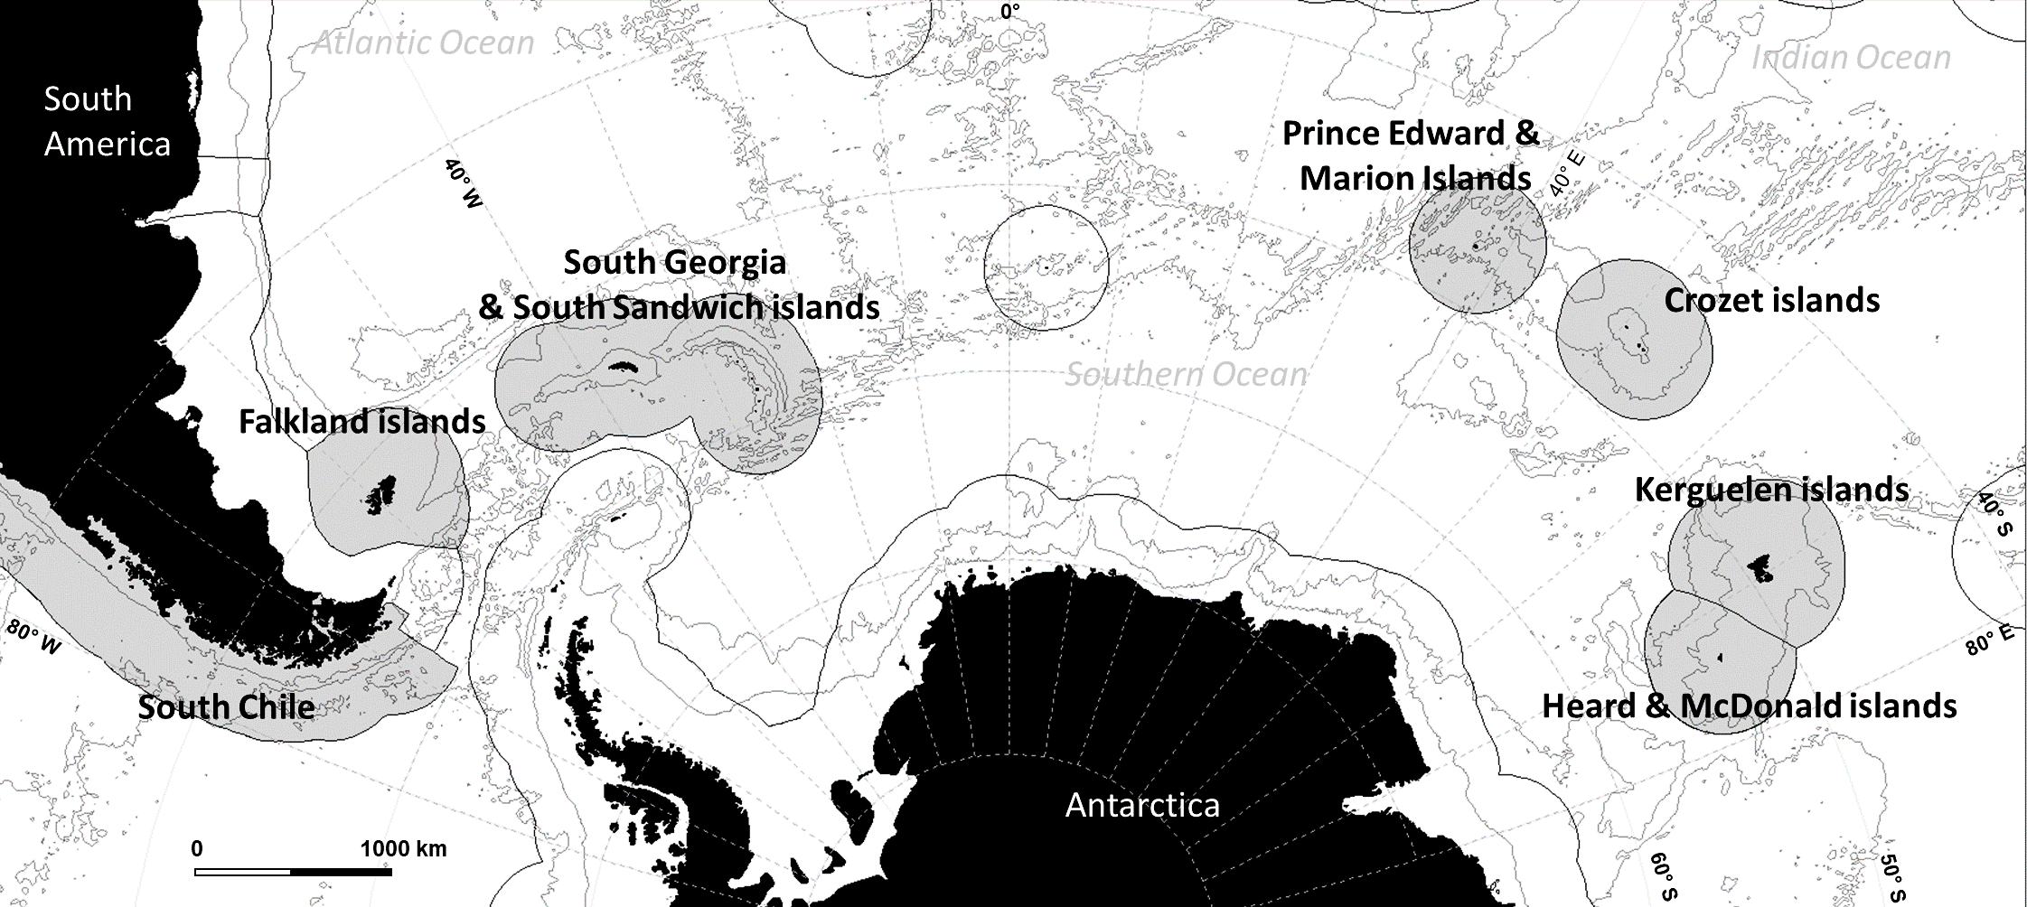
Southern Ocean
Commercial Patagonian toothfish fisheries
Orcinus orca
Physeter macrocephalus
Dissostichus elegenoides
Major fisheries

Slide 5
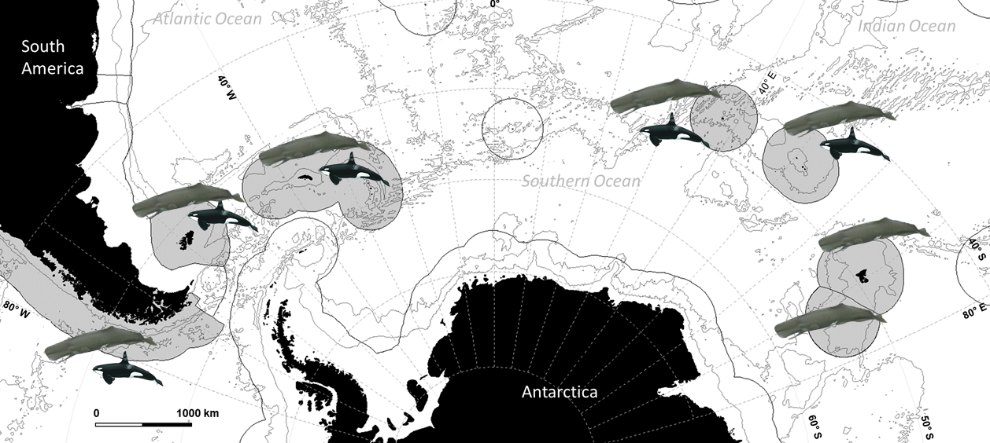
Southern Ocean
Commercial Patagonian toothfish fisheries
Orcinus orca
Physeter macrocephalus
Dissostichus elegenoides

Slide 6





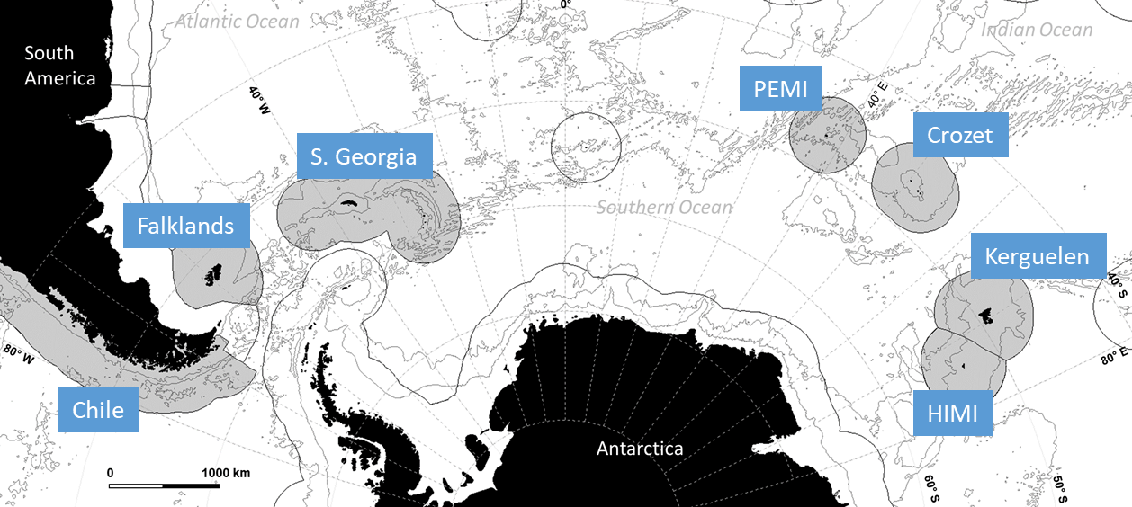
Research Project 2017-2020
Australian Research Council / Industry Partners (Austral Fisheries & Australian Longline) / Coalition of Legal Toothfish Operators
“Developing mitigation solutions to whale – fisheries interactions in the Southern Ocean”

Slide 7
Can we predict the occurrence of whale – vessel interactions?
Opportunistic
Active
Fishing operations
Whale distribution & ecology
Learning pathways
Overlap between whales and vessels
Specialisation towards depredation
Number of whales
History of fisheries
Observed interaction levels & patterns

Slide 8
Can we predict the occurrence of whale – vessel interactions?
Opportunistic
Fishing operations
Whale distribution & ecology
Overlap between whales and vessels
Observed interaction levels & patterns

Slide 9
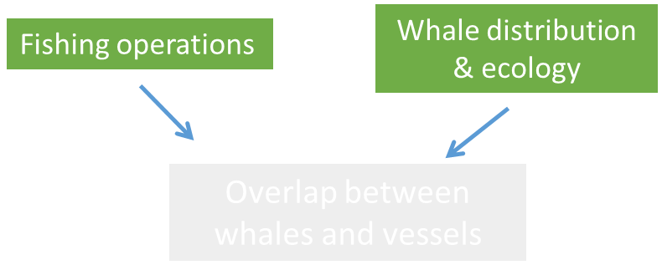
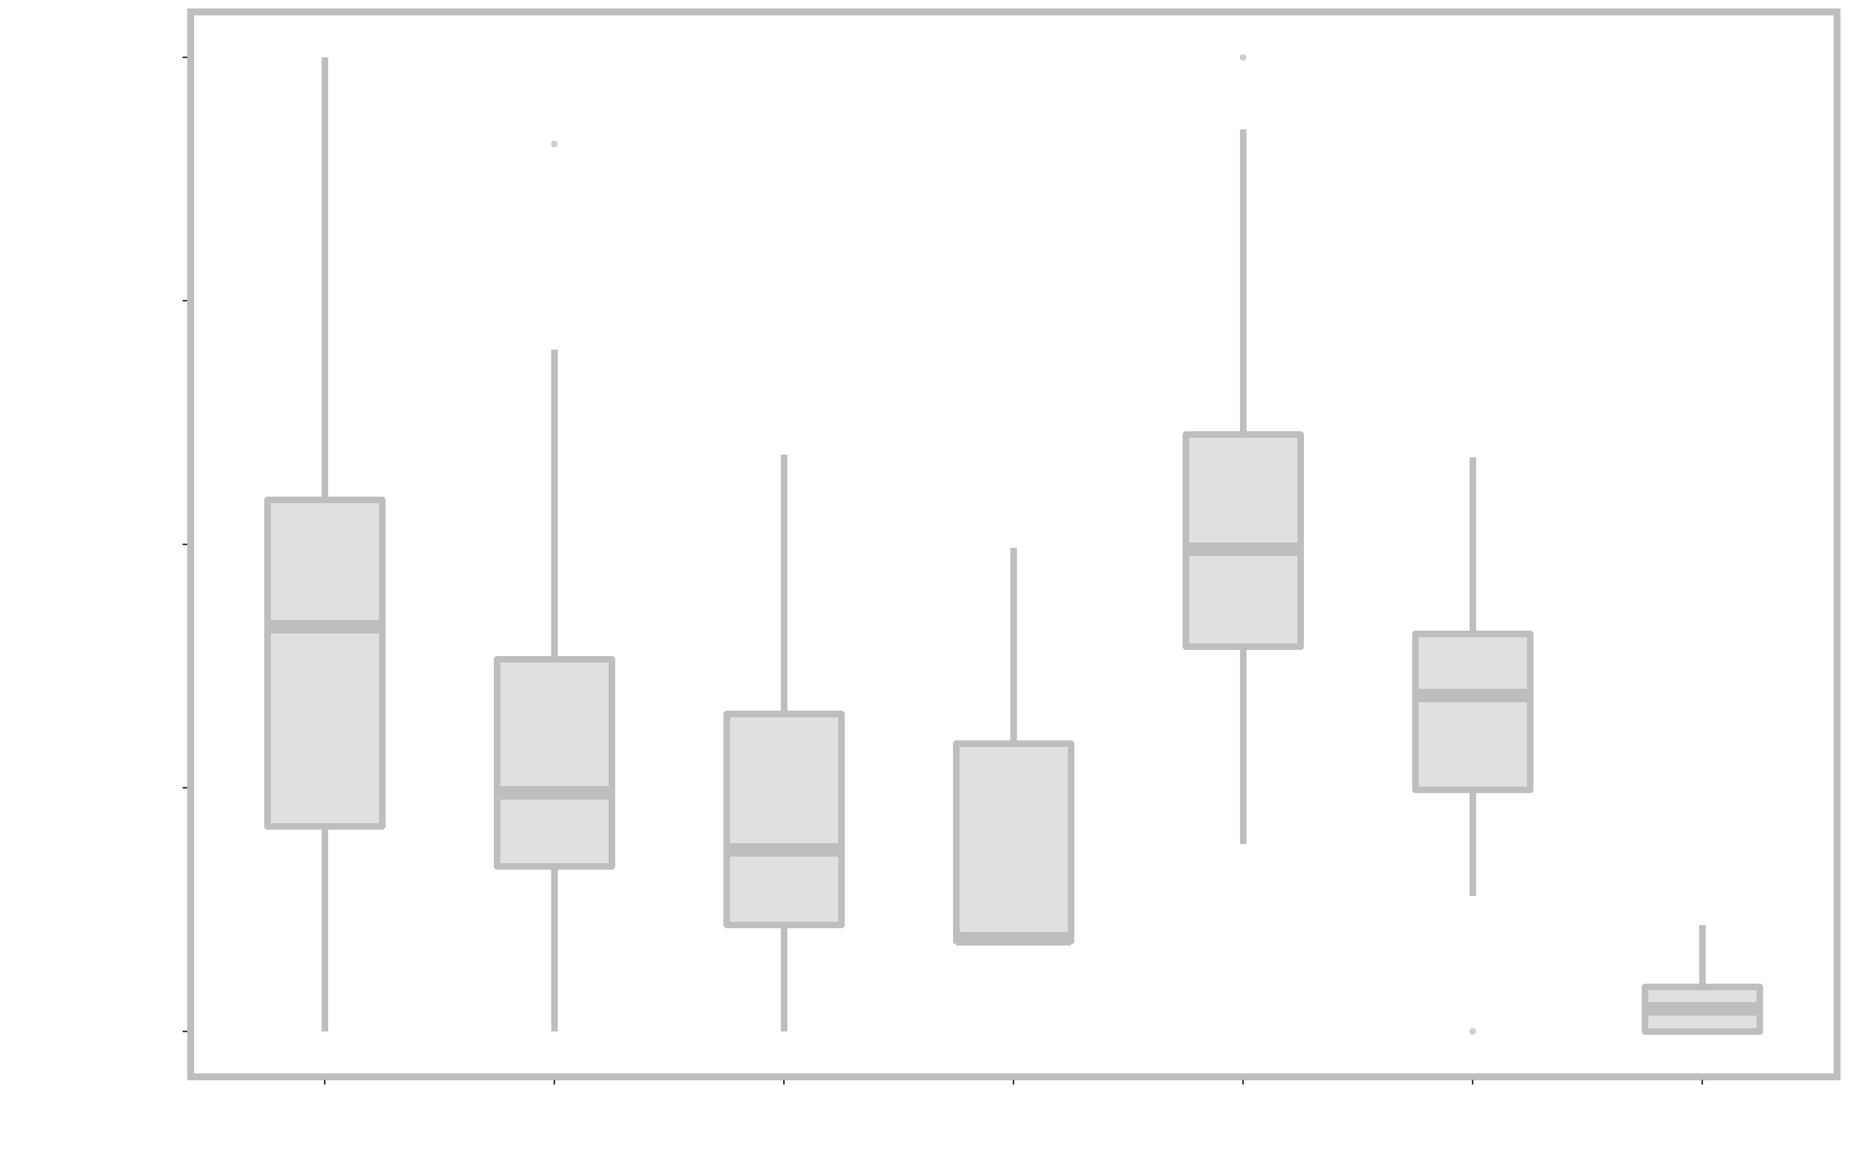
Can we predict the occurrence of whale – vessel interactions?
Large variations of sperm whale – vessels interaction levels
between fishing areas
Assumption
tested on sperm whales
Mean sperm whale – vessel interaction level
proportion of fishing operations
Adult males;
Present in the Southern Ocean for feeding purposes
Diet predominantly including cephalopods;
Heavily harvested during the whaling period
Clarke, 1980; Clarke and Roeleveld, 1998
Tixier, Burch, Olsson, Lea, Hindell, Welsford, Guinet, Arangio, Gasco, Duhamel, Arnould, to be submitted

Slide 10
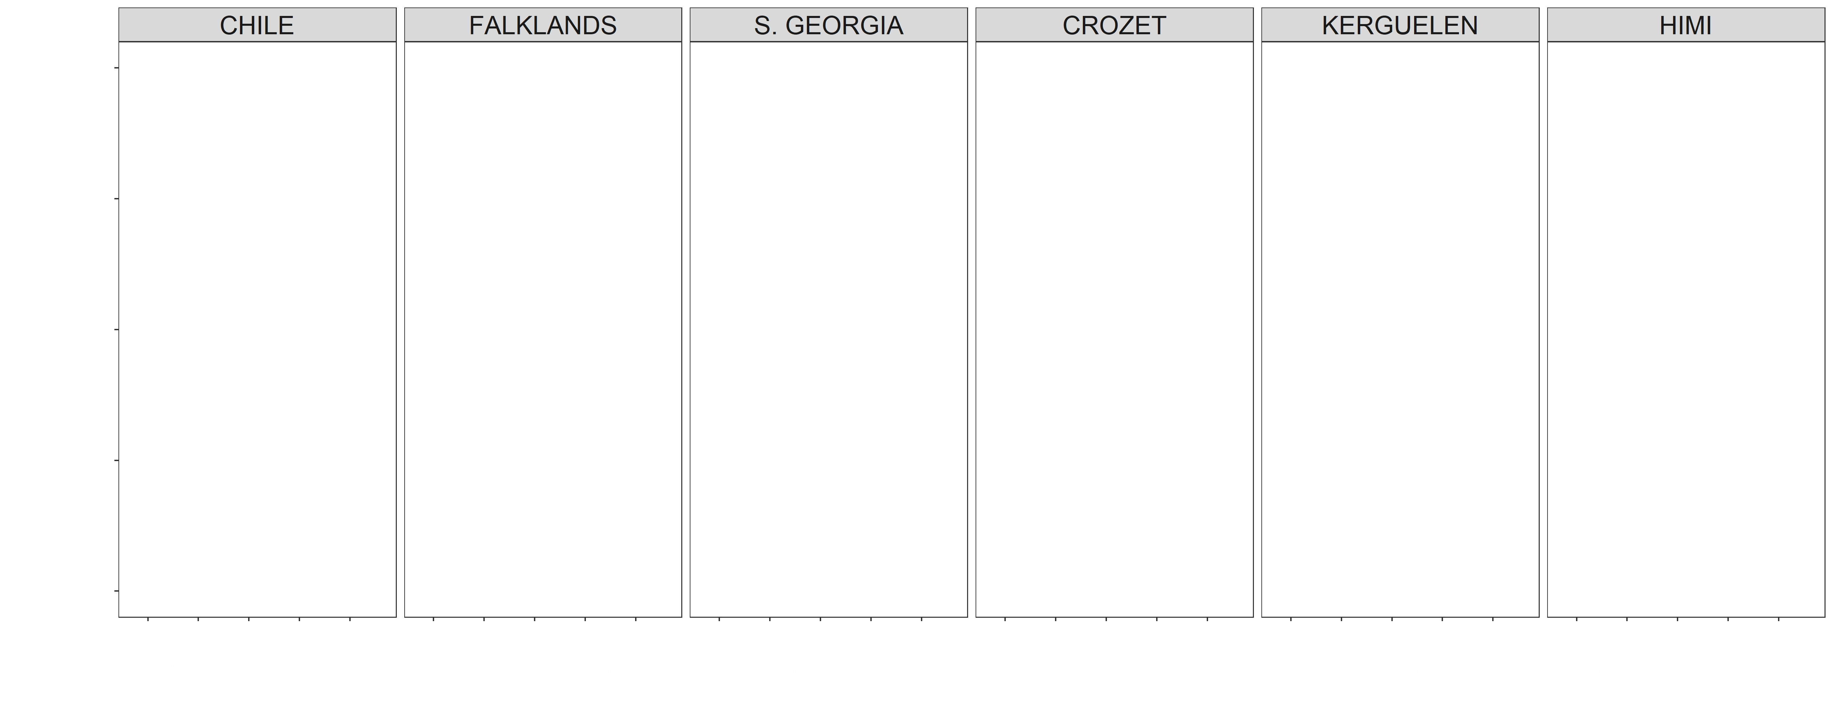
Data available
Long-term datasets of sperm whale – vessels interaction data from 6 fisheries
From 2003 to 2016
90,483 fishing operations monitored by fishery observers
30,761 records of sperm whale presence

Slide 11
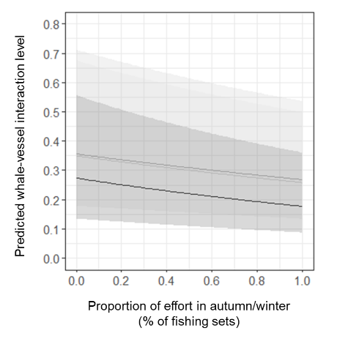
The role of fishing patterns
Test of fishing variables in
Generalized Linear Mixed Models
Fishing technique (Autoline, trotline, etc.)
Size of fishing areas;
Seasonal spread of fishing effort;
Mobility of vessels;
Density of vessels on fishing areas;
Seasonal spread of fishing effort
Explained a limited % of observed variations
Tixier, Burch, Olsson, Lea, Hindell, Welsford, Guinet, Arangio, Gasco, Duhamel, Arnould, to be submitted

Slide 12
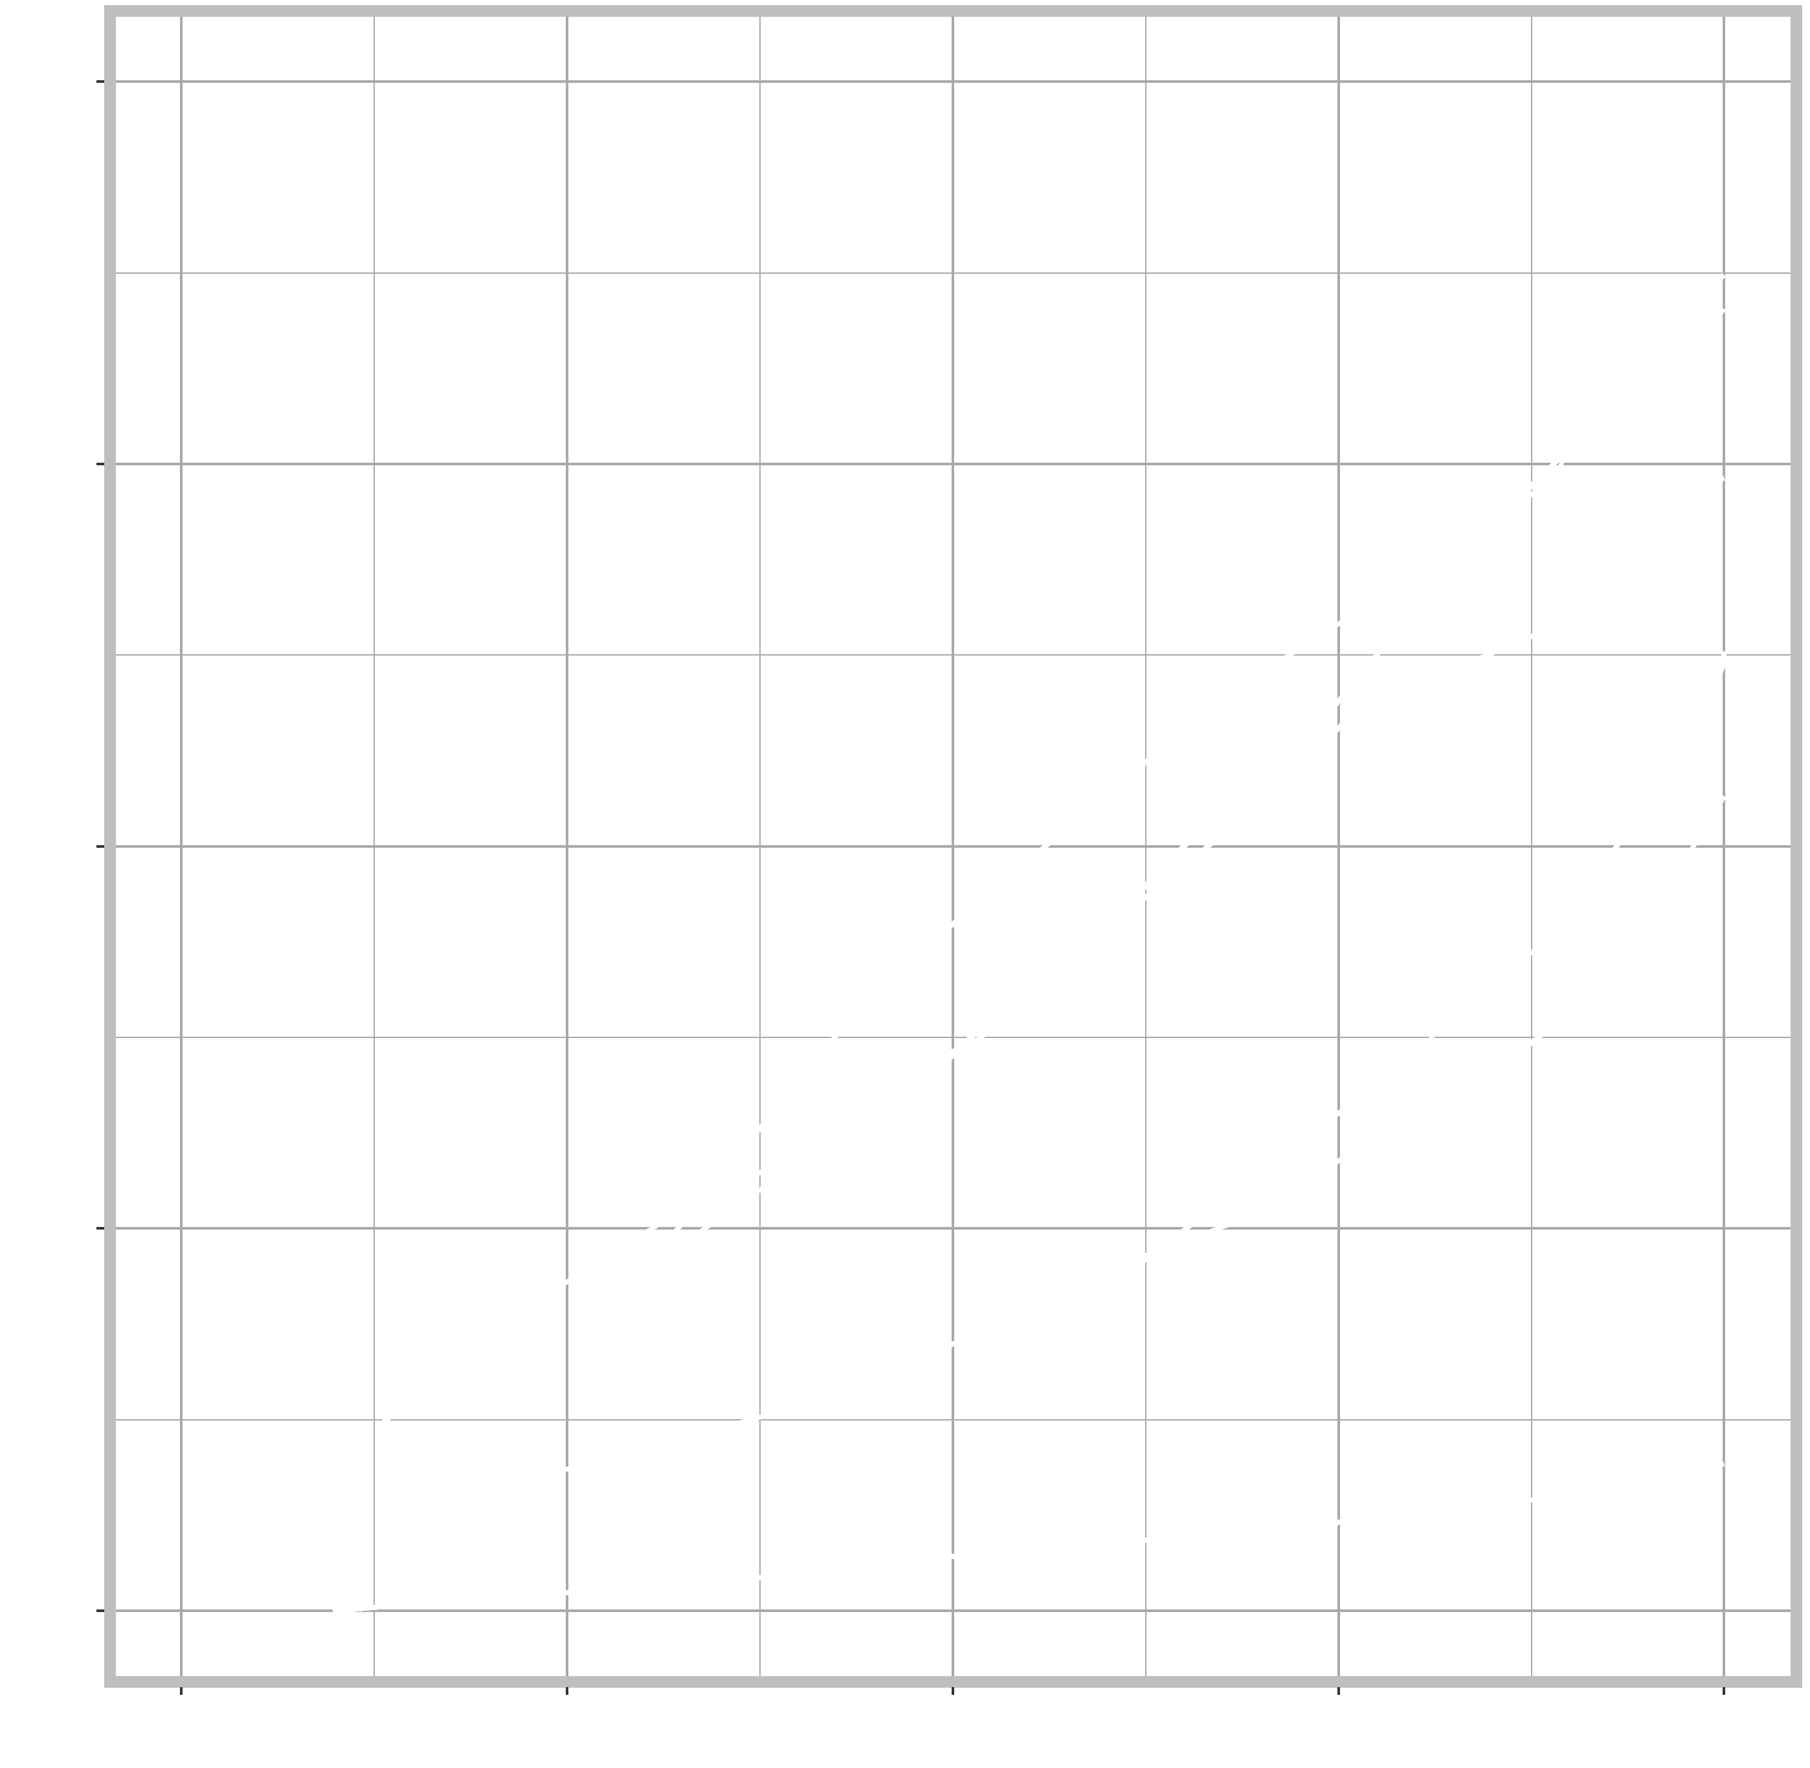
Influence of area-specific features
Time
Crozet
Whale natural distribution
Kerguelen
Chile
S. Georgia
Spatial spread of whale-vessel interactions
Cumulative proportion of the utilized fishing area
Overlap between whales and vessels
Falklands
HIMI
Observed interaction levels
Spatial spread of fishing operations
Cumulative proportion of the utilized fishing area
Tixier, Burch, Olsson, Lea, Hindell, Welsford, Guinet, Arangio, Gasco, Duhamel, Arnould, to be submitted

Slide 13
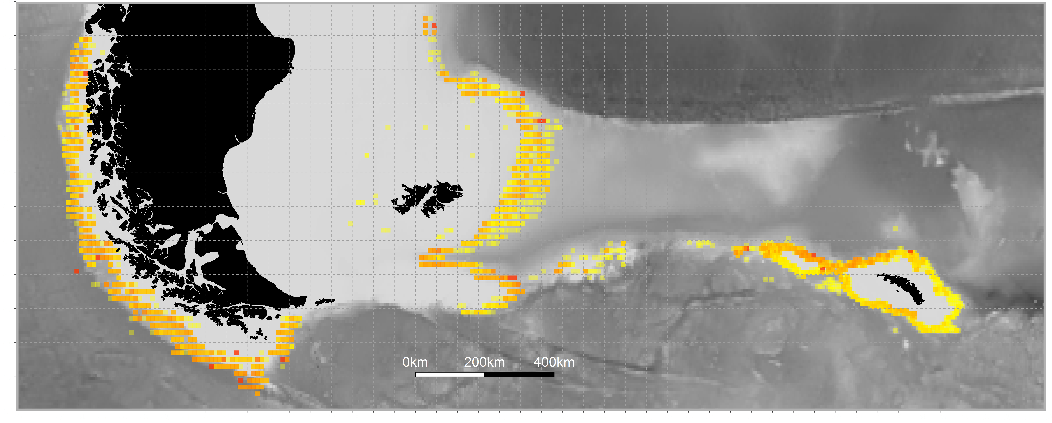
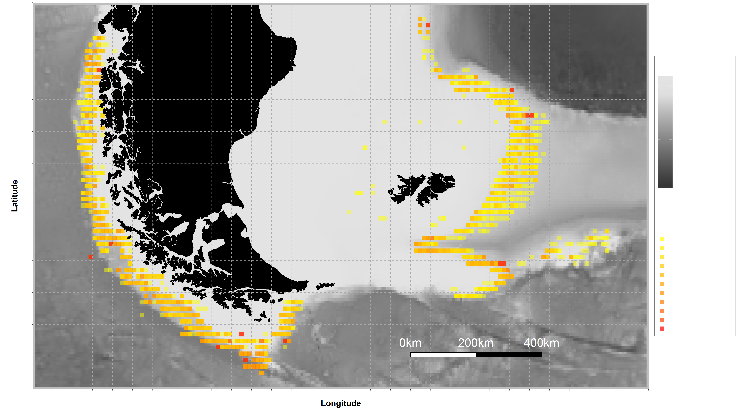
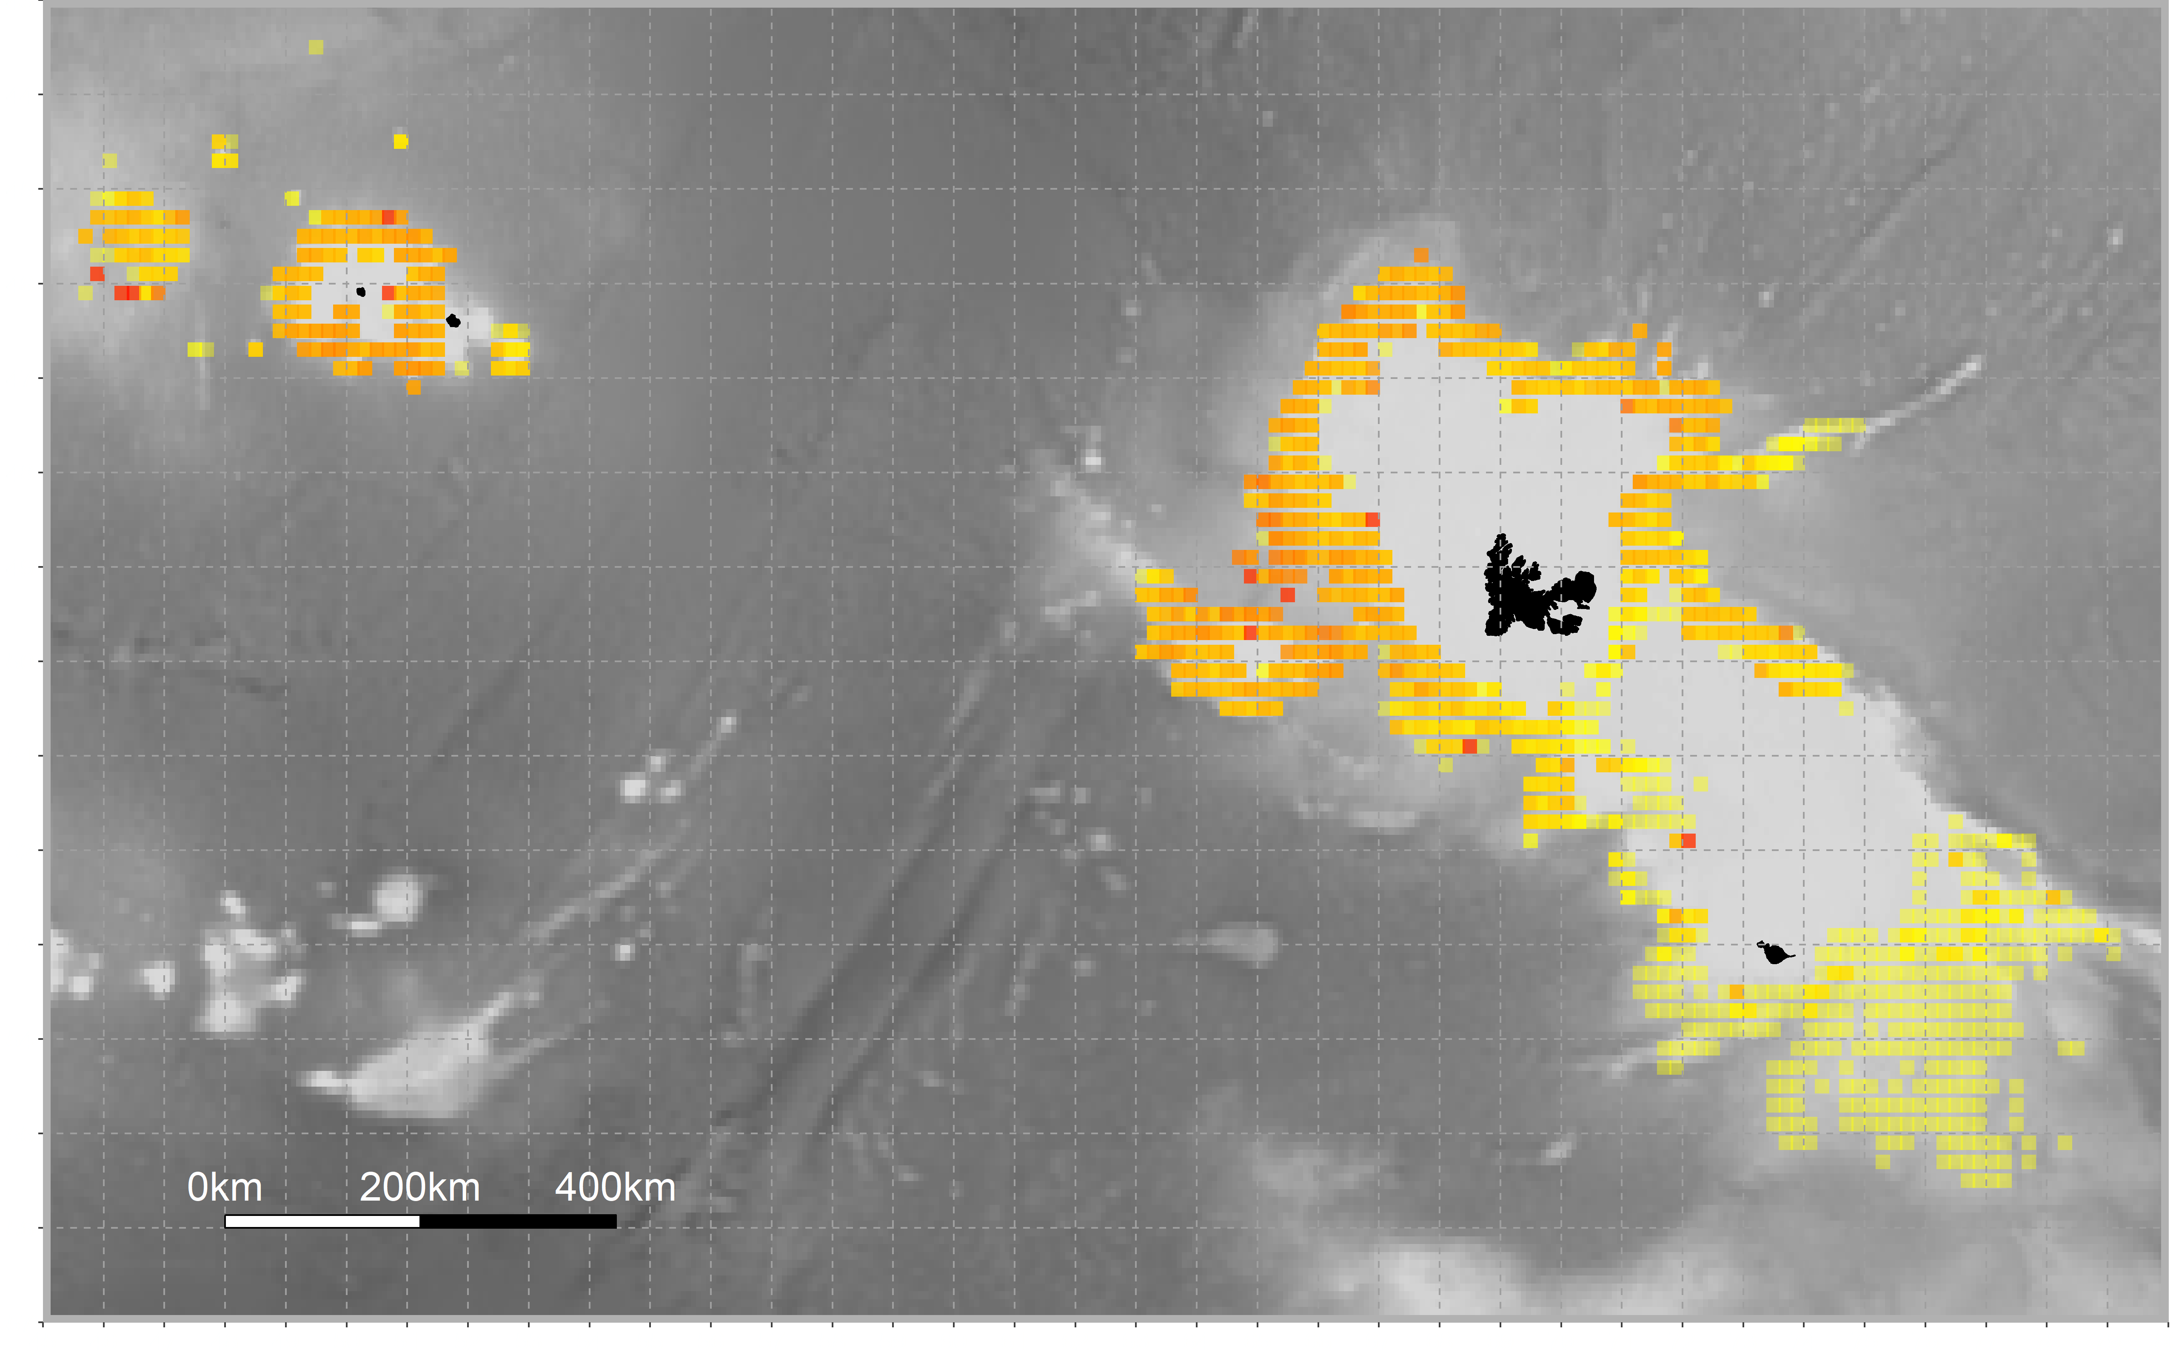
100
90
80
70
60
Sperm whale – vessel interaction level
(% of fishing operations)
50
40
30
20
10
0
Sperm whale – vessels interaction levels vary in space across and within fishing areas

Slide 14
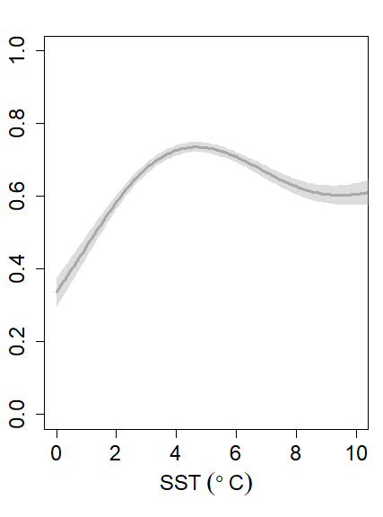
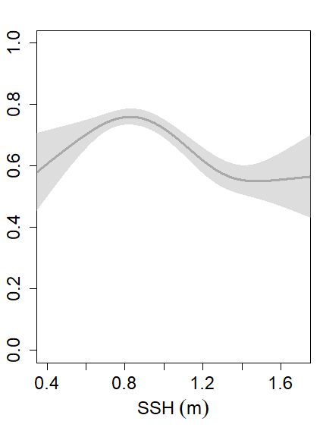
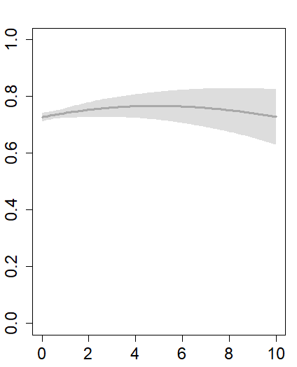
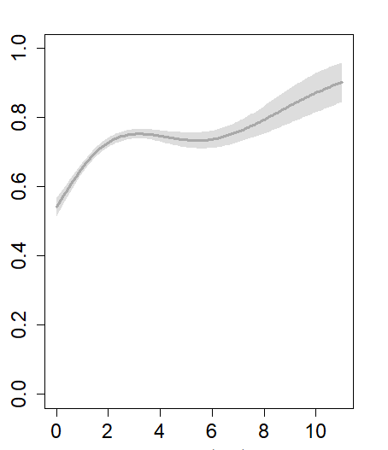
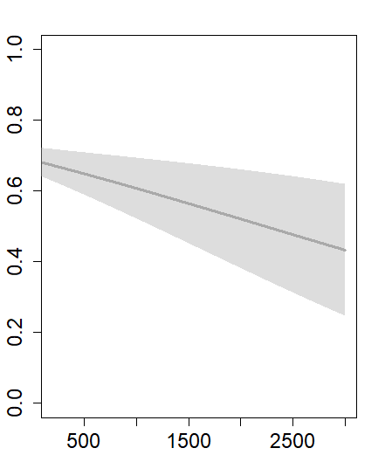
Habitat modelling on sperm whale interaction data
Use of Generalized Additive Models (GAMs) to test for the influence of environmental variables retrieved on a monthly basis
+++
++
NS
Response variable
Presence/absence of sperm whale interaction
SST (°C)
SSH (m)
CHLa (mg.m⁻³)
Probability of sperm whale interaction
with fishing vessels
+++
+
SST = Sea Surface Temperature
SSH = Sea Surface Height
CHLa = Chlorophyll-a conc.
Slope (°)
Depth (m)

Slide 15
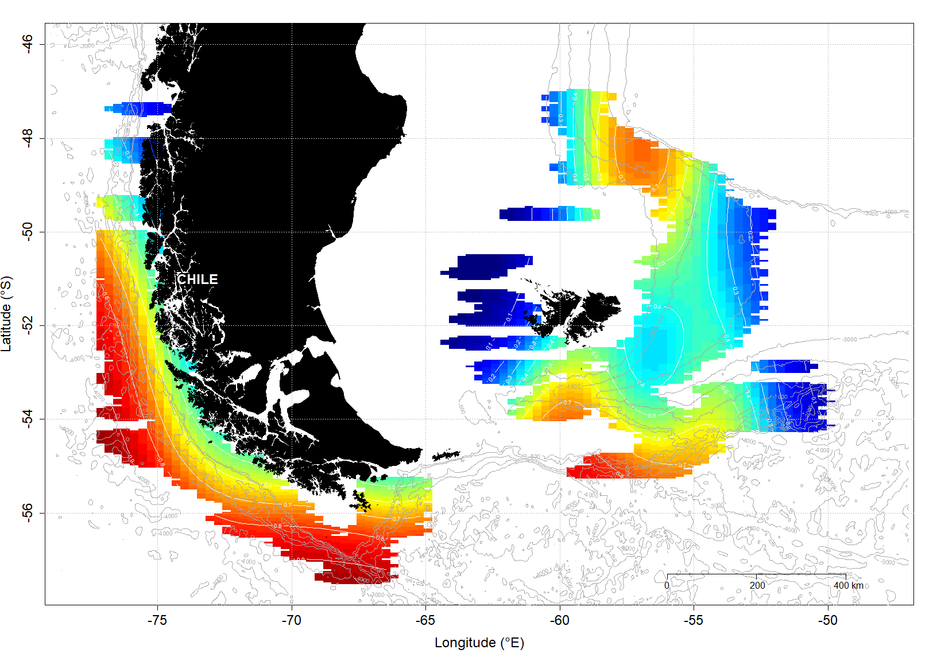
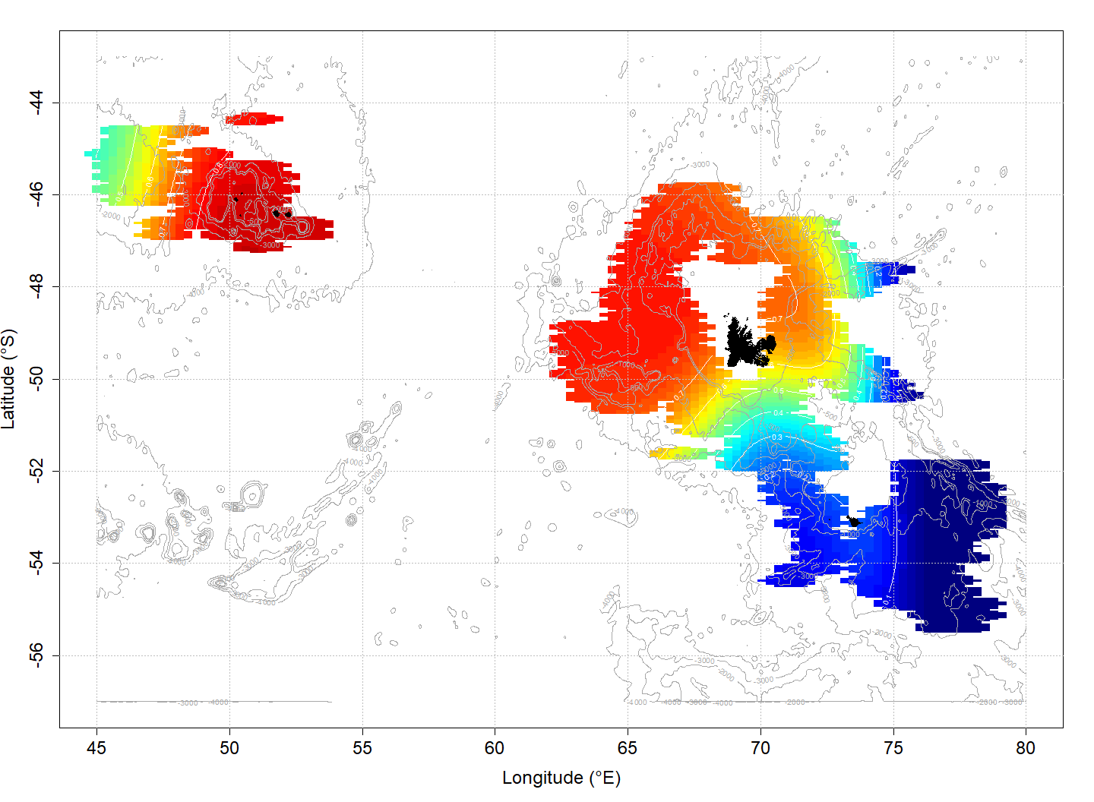
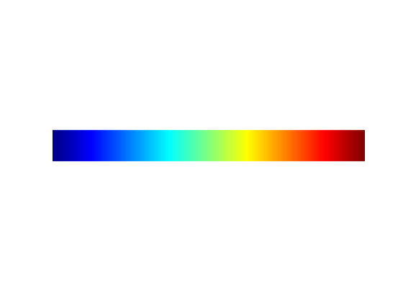
Habitat modelling on sperm whale interaction data
Probability of sperm whale interaction
1
0.5
0
Maps of predicted values of the occurrence of interaction with vessels

Slide 16
Conclusion
Whale distribution
Likely to be a key driver of the observed variations in whale-vessel interaction levels in the Southern Ocean
Overlap with fishing operations
Great potential of the data collected from fishing vessels
= currently the largest observation dataset for sperm whales
To predict the occurrence of interactions with fisheries
To map the distribution and identify areas of importance
Implications for the conservation of recovering populations
More complex models incorporating additional variables (distance to fronts, currents, eddies, prey density, etc.), and also the number of sperm whales per observation, currently being developed
Collaboration with L. Mannocci (Duke University, US), others?

Slide 17
Conclusion
Bias/effects to account for:
- Presence/absence data: True absence vs. pseudo-absence depending on fisheries
- Seasonal presence of adult male sperm whales
- Modification of sperm whale behaviour/distribution in response to fishing vessels (attraction)

Slide 18
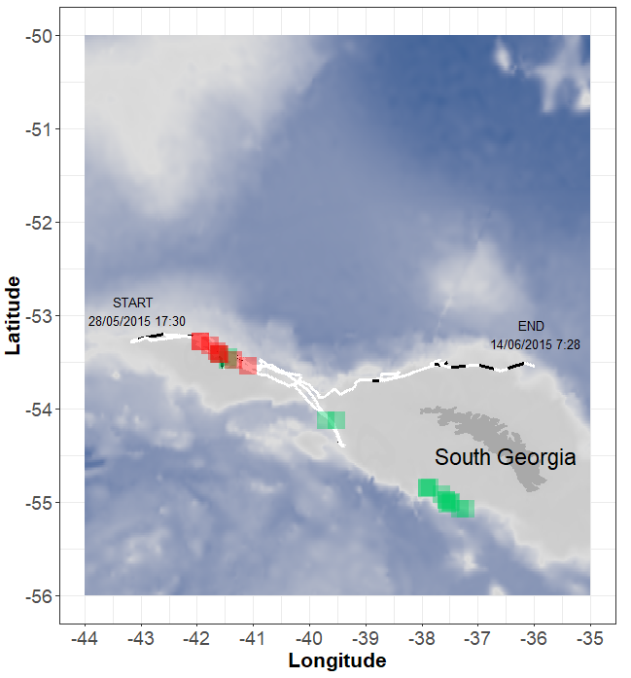
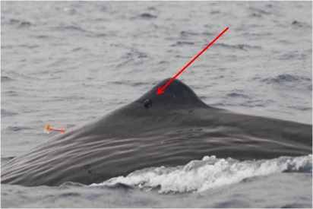
Conclusion
Bias/effects to account for:
- Presence/absence data: True absence vs. pseudo-absence depending on fisheries
- Seasonal presence of adult male sperm whales
- Modification of sperm whale behaviour/distribution in response to fishing vessels (attraction)
Fishing operations
Collaboration with J. Towers (DFO, Canada), M. Soffker (CEFAS, UK), R. Reisinger/G. Richard (CEBC, France)
No Interaction
Interaction
Using tracking data from a tagged individual that interacted with vessels:
Identification of decision-making points in response to vessels’ movements;
Distance to vessel at which whales redirect their movements

Slide 19



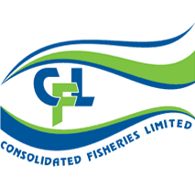





Acknowledgments
Financial support
- Australian Research Council: Industry Linkage Project
- Austral Fisheries Ltd. & Australian Longline Ltd.
Thanks to M. Exel, D. Carter, and M. McNeill
- COLTO, COLTO members
Collaborators
C. Guinet, P. Burch, K. Olsson, M. Soffker, J. Towers, N. Gasco, L. Mannocci, G. Richard, A. Janc, G. Duhamel
Access to data
T. Lamb (AAD), AFMA, G. Duhamel, C. Chazeau, P. Pruvost, A. Martin, N. Gasco (MNHN – PECHEKER database, Martin & Pruvost, 2007), Alex Blake, Janet Robertosn, Tim Cotter, AOBAC, IFOP, Renzo Ranieri, Alex Reid, the Government of South Georgia, DAFF, Rob Leslie, Chris Heineken
Skippers, crews and fishery observers

